Slide 1


8. Cybersecurity
D. Serikbayev East Kazakhstan State Technical University
ICT Spring 2018
Notes:
Welcome to this three-part series on cybersecurity! The first video discusses cybercrimes. The second video talks about general cybersecurity practices. The last video examines specific cyber threats and how to protect yourself against them.

Slide 2

Copyright Notice
This presentation is presented as is. It contains information pulled from various websites or sources across the web.
This presentation uses Creative Commons Attribution 4.0 International (CC BY 4.0)

Slide 3
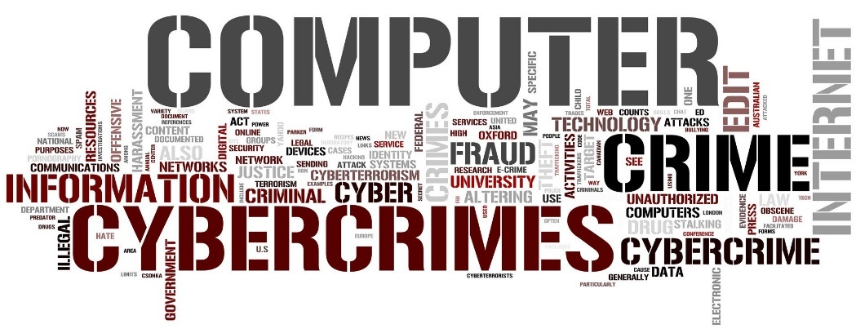
8.1: Cybercrime
8.1: Cybercrime
8.2: Cybersecurity
8.3: Common Threats
Notes:
Video 8.1 is an introduction to cybersecurity, with a focus on cybercrime and cybercriminals.

Slide 4
Learning Objectives
Know the definitions of cybercrime and cybersecurity
Describe cybercriminals
List four categories of computer crimes
Explain why you should care about cybercriminal
Describe the difference between Computer as a Tool and Computer as a Target
Notes:
Please take a moment to read the learning objectives for this video.

Slide 5

Terminology
Cyber: Relating to the culture of computers, information technology, and virtual reality
Cyberspace: The online world of computer networks
Notes:
Before we talk about cybercrime and security, let’s define these concepts.
First, cyber is a root word that relates to the culture of computers, information technology, and virtual reality.
Cyberspace is the online environment or world of computer networks. Cyberspace is synonymous with doing something or communicating online.

Slide 6
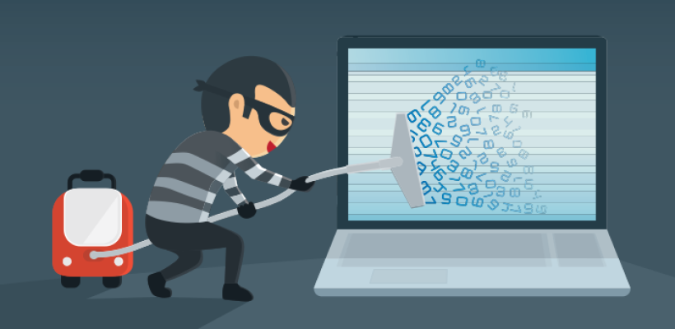
Terminology (2)
Cybercrime: Criminal activities carried out using computers or the internet
Notes:
Cybercrime is any criminal activity carried out using computers or the internet. Cybercrimes do not only happen online but also include crimes using a computer.

Slide 7
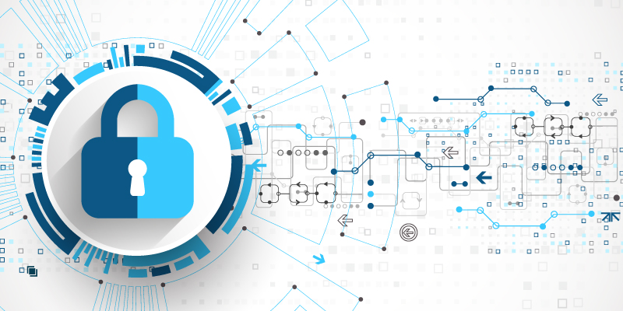
Terminology (3)
Cybersecurity, computer security, or IT security: Measures taken to protect a computer against unauthorized access
or attack
Notes:
Cybersecurity, computer security, or information technology security all refer to the same thing.
Cybersecurity is measures taken to protect a computer against unauthorized access or attack.
Just as you want to lock your apartment door against intruders, you want to protect your digital data.

Slide 8
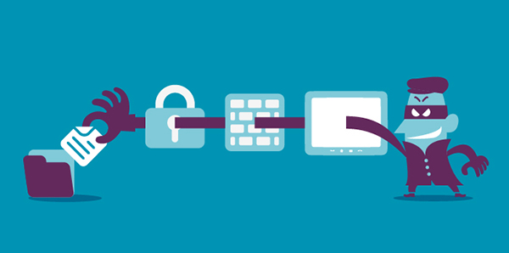
Do I need to worry about cybersecurity?
Hackers are getting more sophisticated… and more effective!
Hackers run successful
international enterprises
Hackers hack for a living
  That what they do, and they’re very good at it!
Notes:
A question you have to answer is to what degree you need to worry about cybersecurity.
If you do not take action, it is a matter of time before you become a victim of a cybercrime.
We hope these videos help you think through this question.
Today’s hackers are getting more sophisticated and growing more efficient at what they do.
Cybercriminals run successful international enterprises built on exploiting and stealing from others.
Hackers hack for a living. That is what they do, and they’re very good at it!

Slide 9
Cybercrime is not New
Computers have been hacked since their inception
The first spam email took place in 1978 when it was sent out over ARPANET
The first virus was installed on an Apple computer by a high school student 1981
Notes:
Cyber threats and security are not new.
Computers have been getting hacked since their inception.
The first spam email took place in 1978 when it was sent out over ARPANET.
A high school student unleashed the first computer virus in 1981.
As long as there is something to exploit, someone will try to do it. This reality is the world we live in.

Slide 10
Cybercriminals – No Rules!
Steady increase in cybercrime
Many nations refuse to investigate and prosecute
Hackers and governments can access your unprotected data
Ransomware is increasing – because it works!
Notes:
Cybercriminals only play by their own rules.
There is a steady increase in cybercrime because criminals are making money.
Many nations refuse to investigate and prosecute cybercriminals when they target people in other countries.
Hackers and governments want to access your data for various reasons.
Damaging viruses, such as ransomware, are increasing because cybercriminals are making money exploiting people.
These victims are willing to pay the criminals to release their data.

Slide 11
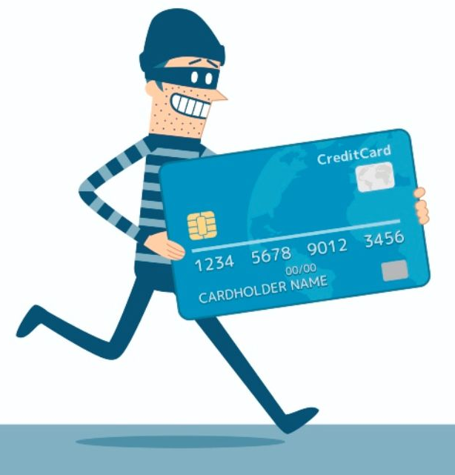
What do cybercriminals do?
Apply all sorts of techniques to steal personal or financial data
Work silently in the background
  They are stealthy
Use stolen data for their gain
Notes:
Cybercriminals use all sorts of techniques to steal personal or financial data.
They are stealthy, working silently in the background to gain the data they need.
They then use the stolen data or resources for their gain.
You may not even know that the cybercriminals are exploiting you.

Slide 12

Who are the cybercriminals?
Crackers and Hackers
  Computer-savvy programmer who create attack software
Script Kiddies
  Unsophisticated computer users who know how to execute programs created by the crackers
Criminals
  Create & sell bots to generate spam
  Sell credit card numbers, etc…
Notes:
Understanding cybercriminals help to identify the various threats.
These cybercriminals fall into three general categories, which are crackers, script kiddies, and criminals.
The crackers and hackers are computer-savvy programmers who create attack software.
Crackers find exploits or entryways in computer systems.
They then write software to exploit the vulnerability to gain control of the system.
This group also includes your high-level hacker who infiltrate sophisticated computer systems.
Crackers sell their software to other cybercriminals who are not programmers.
The next level of cybercriminals is the script kiddies who know how to use software created by the crackers that exploit unpatched software.
They are unable to write their own hacking software, so they purchase the hacking software or test it out for others.
The criminals are those who weaponize the attack software and use it to exploit users.
They might create ransomware or use the software vulnerabilities to get usernames and passwords or financial information.
They then sell this information online.

Slide 13

Cybercriminals
Cracker / Hacker:
Computer-savvy
programmer creates
attack software
Posts to
Hacker Bulletin Board
SQL Injection
Buffer overflow
Password Crackers
Password Dictionaries
Successful attacks!
Crazyman broke into …
CoolCat penetrated…
Script Kiddies:
Unsophisticated computer users who know how to
execute programs
Downloads
Reports
Posts to
Criminals:
Create & sell bots to generate spam;
Sell credit card numbers, etc…
Notes:
Understanding cybercriminals help to identify the various threats.
These cybercriminals fall into three general categories, which are crackers, script kiddies, and criminals.
The crackers and hackers are computer-savvy programmers who create attack software.
Crackers find exploits or entryways in computer systems.
They then write software to exploit the vulnerability to gain control of the system.
This group also includes your high-level hacker who infiltrate sophisticated computer systems.
Crackers sell their software to other cybercriminals who are not programmers.
The next level of cybercriminals is the script kiddies who know how to use software created by the crackers that exploit unpatched software.
They are unable to write their own hacking software, so they purchase the hacking software or test it out for others.
The criminals are those who weaponize the attack software and use it to exploit users.
They might create ransomware or use the software vulnerabilities to get usernames and passwords or financial information.
They then sell this information online.

Slide 14



What do cybercriminals want?
Make their living through cybercrimes
  Money
  Information
Notoriety
  Status, fame
Notes:
Many cybercriminals are professional criminals.
They make their living through cybercrimes, which is how they get their money.
They can directly steal money from a victim's bank account, extort money through ransomware, or they use a victim’s information for monetary gain.
Other cybercriminals, such as script kiddies, only want notoriety.
They want to be known and accepted by others.

Slide 15
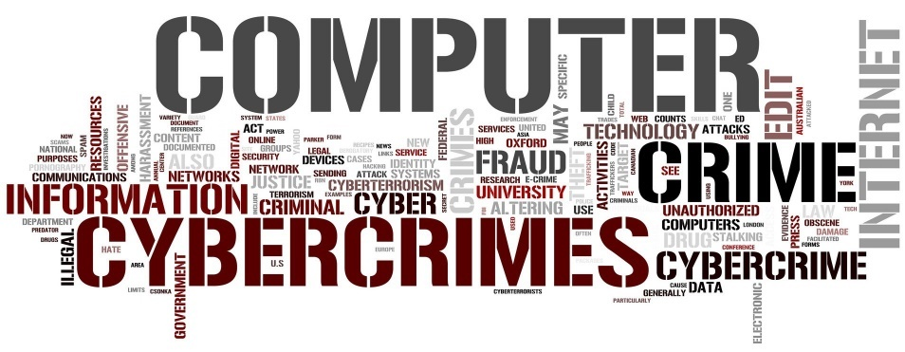
Categories of Computer Crimes
Computer as a Tool
Computer as the Target
Selling Illicit Goods
Offensive content or
Harassment
Notes:
Let’s move on to classifications of cybercrimes.
As we’ve discussed, Cybercrime refers to anything done with criminal intent using a computer.
Law agencies classify cybercrime based on how the criminal used the computer.
We will discuss four types. The first type is using a computer as a tool to commit a crime.

Slide 16
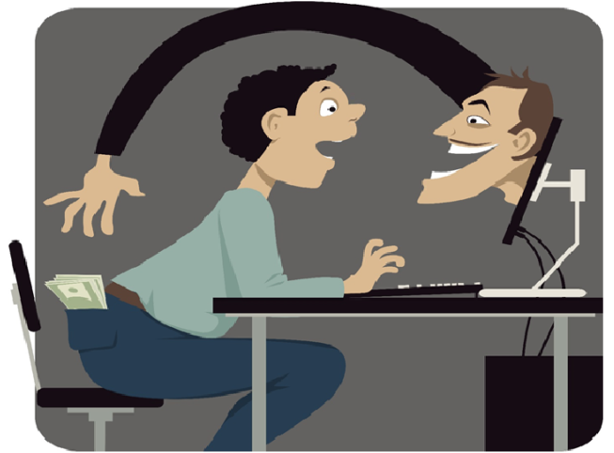
Computer as a Tool
Using a computer to target an individual
  Spam, phishing scams, cyber theft, fraud (deception), identity theft, etc.
These cyberthieves are scammers,
not technical experts
Notes:
When the individual is the primary target of cybercrime, the computer is the tool used to commit the crime.
These types of crimes are usually committed by scammers who are not technical experts.
Instead, they buy the hacking tools from the crackers.
These cybercriminals exploit human weaknesses to get the person to do something.
For example, a cyberthief creates an email to look like an official email from a bank to trick the person into giving up their login information.
Or, they trick someone into buying a fake product at the price of the real one.
These types of crimes and criminals are not new.
Scams have existed long before technology, but technology makes it easier and gives cybercriminals a larger audience.

Slide 17
Computer as a Target
Targeting a computer or system to commit a crime
  Viruses or malware
  Destruction or theft of information
  Unauthorized access of a computer or account
A select group of people with technical knowledge commit these crimes
Notes:
Another classification of cybercrime is when the target is a computer.
These crimes are committed by a selected group of criminals who have a high degree of technical experience.
These cybercriminals use malware, which is malicious software, to destroy or steal data.
These crimes also include the unauthorized access of a computer or account, such as hacking into someone’s email or bank account.

Slide 18
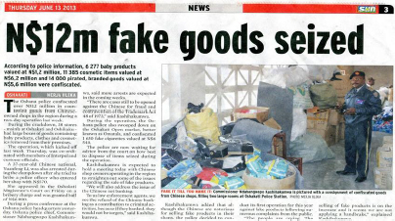
Selling Illicit Goods
Using a computer to sell illicit goods
  Drugs trafficking
  Counterfeit products
  Stolen items
  Weapons
Organized crime groups commit these crimes
Notes:
Another category of cybercrime is using a computer to sell illicit goods, usually by organized crime groups who use the dark web.
They sell illegal goods such as drugs, counterfeit products, stolen items, or weapons.

Slide 19
Offensive Content or harassment
The content of online information may be distasteful, obscene or offensive for a variety of reasons
  Hate speech
  Against a group based race, religion, ethnic origin, disability, etc.
Harassing someone through cyberspace
  Stalking, threats of violence, cyberbullying
Notes:
The final category that we will mention is offensive content and harassment.
These crimes use computers or electronic communication to spread hate speech against a target group based on race, religion, ethnic origin, disability, etc.
These cybercriminals usually write this information in online forums or on websites.
An individual or a group could harass someone through cyberspace, called cyberbullying.
Harassment includes stalking, making threats of violence, or sustained actions against a victim that is unwanted or hurtful.

Slide 20
Common Types of Cybercrime
Phishing: Using fake email messages to get personal information from internet users
Identity theft (misusing personal information)
Illegal pornography
Hacking: Shutting down or misusing websites or computer networks
Spreading hate and inciting terrorism;
Grooming: making sexual advances to minors.
Notes:
Some common types of cybercrimes are phishing, identity theft, illegal pornography, hacking, spreading hate, and grooming.
Phishing is using fake email messages to get personal information from internet users. Identity theft is pretending to be someone else, used especially for obtaining credit cards or loans.
Common types of online sex crimes are those against a minor, such as child pornography and grooming.

Slide 21
Cybercrime Legislation Worldwide
A worldwide fight against cybercrimes
138 countries have created laws to fight cybercriminals
However, 20% of countries do not have any legislation
Notes:
Cybercrime often happens across international borders because the internet does not have borders like physical countries do.
Anyone, anywhere can access .com, .cn, or .sa domain names. This reality turns fighting cybercrime into a worldwide issue.
So far, 138 countries have created laws to fight cybercriminals.
However, more work needs to be done because 20% of countries do not have such laws.

Slide 22
Cybercrime Summary
Cybercrime is any criminal activity carried out using computers or the internet
Cybersecurity is taking measures to protect a computer from unauthorized access
Cybercriminals exploit others for their personal gain
Cybercrime categories: Computer as a tool, as the target, selling illicit goods, offensive content and harassment
Computer as a tool: When an individual is a primary target
Computer as a target: When a computer is a target
Notes:
In summary,
cybercrime is any criminal activity carried out using computers or the internet.
The target of the criminals could be an individual or a computer.
Cybersecurity is taking measures to protect a computer from unauthorized access.
Cybercriminals do not use the same rules as we do, they are criminals who use any means necessary to get what they want. They exploit anyone they can and use stolen data for their gain.
The four cybercrime categories that we discussed are a computer as a tool, a computer as the target, using a computer to selling illicit goods, and offensive content and harassment.
Classifications of the computer as the tool are when the individual is the primary target of cybercrime, such as spam or phishing attempts.
Classifications of the computer as a target are when cybercriminals target a computer with viruses or unauthorized access.

Slide 23
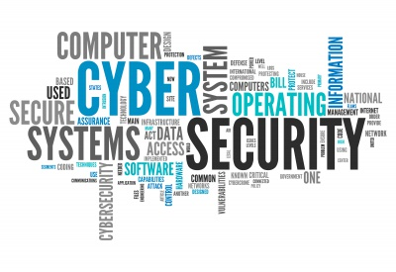
8.2: Cybersecurity
8.1: Cybercrime
8.2: Cybersecurity
8.3: Common Threats
Notes:
In the first video, we looked at cybercrime and cybercriminals. This video discusses how cybercriminals operate and how to protect against common types of attacks.

Slide 24
Learning Objectives
Define the goal of cybersecurity
Describe easy targets
Explain general guidelines of protection against cyber threats
Describe why pirated software is not safe
State why software updates are important
Describe the difference between a password and a passphrase
Notes:
Please take a moment to read the learning objectives for this video.

Slide 25
Cybersecurity Goal
Your goal is to make it as difficult as possible to dissuade a hacker from getting your data or from being a victim of cybercrime
Cybercriminals go after easy targets unless the victim has something of great value
Notes:
Your goal is to make it as difficult as possible to dissuade a hacker from getting your data or from being a victim of cybercrime.
Cybercriminals go after easy targets. If hackers see too much resistance, they will move on to softer targets unless the victim has something of great value.

Slide 26
Good Line of Defense
Can you prevent from being a victim of cybercrime?
  If a professional hacker or government surveillance wants your information, they will get it.
Make them work them for it! In doing so, they might give up and move on to an easier target
  Minimizes the chances of being a victim
Notes:
Can you prevent yourself from being a victim of cybercrime?
Unfortunately, hackers will ultimately find a weakness if they want to.
If you are a specific target because you have some information that a government-sponsored hacker wants, there is not much that you can do since they have vast amounts of resources.
A good line of defense is to make the cybercriminals work hard to get your data.
The harder they have to work, the more likely they will give up.
Additionally, good cybersecurity practices minimize the chances that you will be a victim.

Slide 27
Password Cracking Example
Hackers use “Brute-Force” Password Crackers
One group cracked 2700 “bad” passwords in 30 seconds
  The crack program ran for 48 hours more and did not crack the 250 remaining “good” passwords
Do the hackers keep trying to get the remaining 250 passwords? Or do they find easier targets?
Your goal: Be one of the 250
Notes:
Let’s look at weak passwords as an example.
Hackers do not play by the rules. They use brute-force to crack passwords.
A password cracker is a software application that tries all possible alphanumeric combinations until they find the password.
One group cracked 2700 bad or weak passwords in 30 seconds.
These were probably typical passwords such as qwerty or words in the dictionary.
The crack program ran for another 48 hours and did not crack the 250 remaining strong passwords.
Do the hackers keep trying to get the remaining 250 passwords? Or do they find easier targets?
Most hackers will give up since they can obtain many passwords in the time it would take to get the data from a secured account.
Your goal is to be in the group of 250 who withstood the initial hack attempt.

Slide 28
Are you a target?
Most victims are not specifically targeted
They are bystanders or part of a larger cybercrime operation
  A lot of information is out of your control
  Logins from a website you use is hacked and your password was leaked
Control what you can control
Notes:
Cybercriminals do not directly target most victims.
Instead, the victims are bystanders who are caught up in a larger cybercrime operation.
For example, you connect your laptop to an unsecured WiFi access point, and you get a virus that was propagating on the network.
Additionally, some things are out of your control.
For example, a website you use was hacked, and your login information is leaked online.
You plan for data leaks and control what you can control. In this situation, you could protect yourself by not reusing passwords.

Slide 29
Who are the easy targets?
Easy Targets
  Use weak passwords
  Reuse passwords
  Respond to spam
  Click links in emails
  Visit shady internet sites
  Run pirated software
Difficult Targets
  Security conscious
  Understand the dangers and risks
  Use encryption
  Use Two-Factor Authentication (2FA)
Notes:
Cybercriminals love easy targets!
People who are easy targets have a low awareness of cybersecurity.
They use weak passwords and use the same passwords on multiple sites.
They respond to spam solicitation or click links in emails.
They visit shady internet sites trying to find pirated software or pornography without knowing the risks.
Any of those items makes the person an easy victim.
Hard targets are security conscious, and they understand dangers and risks of cyberspace.
When possible, they use encryption to secure data
They use two-factor authentication to prevent others from accessing their accounts using leaked login information.

Slide 30
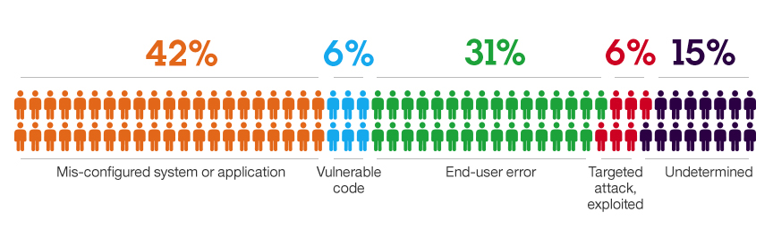
Why do Breaches Happen?
Vulnerabilities
Malware
Configuration Errors
“Weak” defaults
Easy passwords
Phishing Emails
“Bugs”
Input validation
Installing suspect applications
Clicking malicious links
Notes:
According to this graphic,
73% of the victims were easy targets (in the orange and green).
6% were victims based on someone else’s mistake (blue).
Another 6% were specifically targeted because they were high-value targets (red).
Your goal is to be in the first 6% and plan for leaked data based on someone else's mistakes.

Slide 31
General Protection Guidelines
Use official software (not pirated)
Do not visit shady websites
Update software regularly
Use a reputable antivirus program
Use strong passwords
Do not reuse passwords
Notes:
Before we talk about protection for specific threats, general protection guidelines apply to most types of threats.
First off, use official versions of the software. The majority of pirated software will contain malware.
Do not visit suspicious websites and search for illegal software because you might get infected with malware just by opening a webpage.
Perform automatic updates on your operating system and applications to patch known vulnerabilities.
Use a reputable antivirus program that prevents the occasional virus attempt, such as from a friend's flash drive.
Cybercriminals create fake antivirus software so their malware will not be detected.
Finally, use strong passwords and do not reuse the same passwords on different sites.

Slide 32
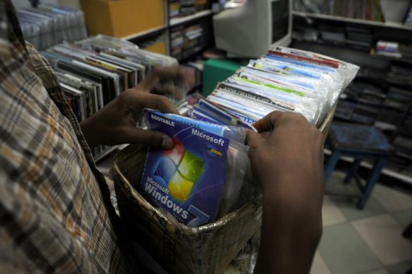
Pirated Software
Pirated software is software that has been copied or distributed for free against the wishes of the creator
Popular choices
  Windows 7/10
  Microsoft Office
  Kaspersky Lab
  Adobe products
Notes:
Pirated software is software that has been copied or distributed for free against the wishes of the creator. Popular choices are Windows 7/10, Microsoft Office, Kaspersky Lab, and Adobe products. They seem harmless, but they are dangerous.

Slide 33
Pirated Software (2): Created by Criminals
Crackers hack software for a living
  They do not do it for the goodwill of the community
  They are not Robin Hood
If they crack software, they do so to help their criminal enterprise
  They can control the computers of those who install it
Notes:
Pirated software comes from crackers who hack software for a living.
They do not do it for the goodwill of the community. They are not Robin Hood who takes from the rich to give to the poor.
If they crack software, they do so to help their criminal enterprise.
They do it at the expense of anyone who installs the software.
They can use the software to control or monitor the computers of those who use it.

Slide 34
Pirated Software (3): Risks
Pirated software contains backdoors
Cybercriminals use your computer in many ways
  Mine for Bitcoins or cryptocurrencies
  Send spam
  Launch cyber attacks
  Monitor communications for financial information
Notes:
Pirated software is inherently risky and contains backdoors so the cybercriminal can remotely use your computer without your knowledge.
The cracker will create the pirated software.
Cybercriminals obtain it from the hackers and then freely distribute it so they can have many computers at their disposal.
Cybercriminals then use your computer in many ways, such as mining for Bitcoins or cryptocurrencies, sending spam, launching cyber attacks, or monitoring your communications for financial information.

Slide 35
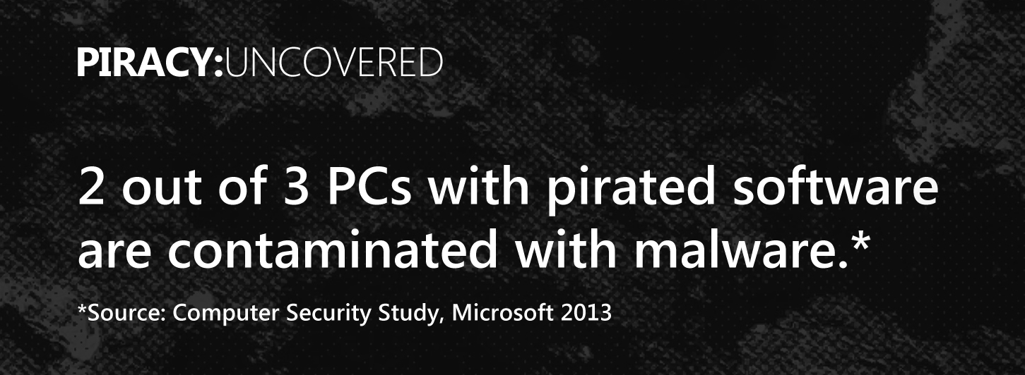
Pirated Software (4): Assumptions
All pirated software is compromised
All cracking software used to hack official versions contains malware
Notes:
There are exceptions, but you can assume that:
All pirated software is compromised and contains some form of malware.
All cracking software used to hack official versions contains malware.
The Privacy Uncovered project determined that 2 out of 3 PCs with pirated software are contaminated with malware.

Slide 36
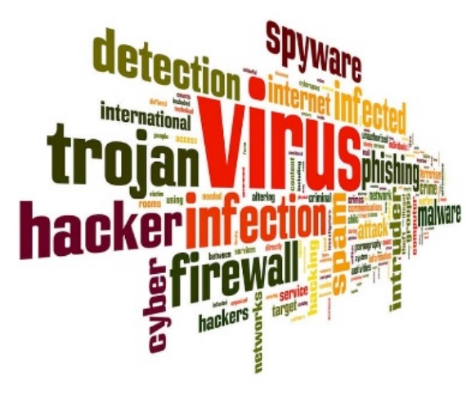
Pirated Software (5): Assumptions
Free download sites can be dangerous, even for free software, such as Adobe PDF
Could contain unofficial versions of
the software with malware
Notes:
Additionally, you can expect that any software downloaded from non-official sources or untrusted sites could contain malware.
Hackers upload their hacked versions with malware. Users who download the files cannot tell the authentic version from the fake.

Slide 37
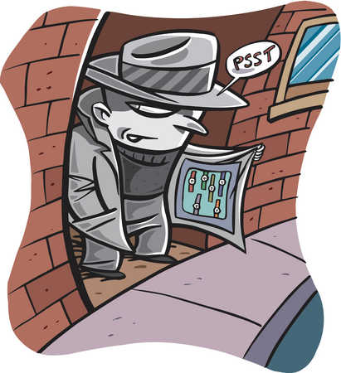
Pirated Software (6): Food for Thought
Would you install a free lock on your door from a mafia street vendor?
  What are the risks?
Similarly, why would you trust a hacker with your computer and data?
Notes:
Think about this scenario for a minute.
Would you install a free lock on your door that a stranger on the street gave you?
What are the risks?
For one, they have the key to your house.
Similarly, why would you trust a cybercriminal with your computer and data?

Slide 38

Pirated Software (7): Alternatives
Only download software from official sources
  microsoft.com; adobe.com; google.com; mozilla.org;
Do not use cracking software to unlock software
Use free alternatives
  GIMP - GNU Image Manipulation Program
  Linux
  FreeOffice
  Google Drive
Notes:
Protecting against pirated software is simple, but yet complicated in the developing world.
Only download software from official sources, such as microsoft.com or mozilla.org.
Stay away from cracking software to unlock legitimate software.
First off, you have to visit a suspicious site to get it, and secondly, the cracking software will contain malware.
The complicated part is that professional software is better, which is why it is expensive.
However, there are excellent free alternatives. Use GIMP instead of Adobe Photoshop and Google Drive or FreeOffice for office software.

Slide 39
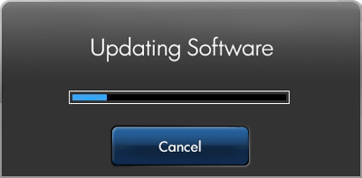
Software Updates: Are they important?
Crackers find new exploits all the time
  Write software to exploit these
Script kiddies and cybercriminals
purchase the hacker’s software
to use the exploits
Running up-to-date software patches these vulnerabilities
Notes:
Software updates are of paramount or extreme importance.
Crackers find new exploits all the time and write software to take advantage of them.
Script kiddies and cybercriminals purchase the hacker software to use the exploits for monetary gain.
Running up-to-date software patches these vulnerabilities and helps keeps hackers out.

Slide 40
Passwords
Bad passwords easily guessed by a computer program
  Qwerty; 123456; password; superman; p@ssword
Good passwords are long and have special characters and numbers.
  They do not make sense, such as:
  KN%6hGYgEqdVvAt7#W!cVk31
Notes:
Bad passwords are easy to guess by a computer program.
Good passwords are longer and use special characters and numbers.
It takes a lot of processing power to crack a secure password using brute force.
Strong passwords are long and contain a random mix of letters, numbers, and special characters.
You need a password safe to store strong passwords.

Slide 41
Passwords (2): Passphrase
Use a passphrase if you need to memorize your password
  Strong passwords require a password safe
Memorize a passphrase (can use special letters)
  Positive message: I want 2 smile more :)
  Random words: Yellow-green pancakes 4bfast
  Some phrase: Te@ is better with milk
  A memory: Remember Turkey 2017?
Notes:
An alternative to passwords is passphrases because they are long, secure, and easy to remember.
They could be a short positive message such as “I want to smile more :)”
or just some random words in your home, such as “Yellow-green pancakes 4bfast”.
Use a special character in place of the letters to make it even more secure!

Slide 42
Final point to ponder
Someone will always have your data
  You give them permission to read the emails and your documents by using the service
  Do you trust them?
Who do you trust more not to abuse your data?
  mail.ru/.kz
  Gmail.com
  yandex.ru/.kz
  any-email-address /.com/.ru/.cn/.eu/.abc

Slide 43
Cybersecurity Summary
Goal: Be a difficult target
Easy targets: People with a low awareness of cybersecurity; don’t take measures to protect themselves online
Protection guidelines: Use official software that automatically updates, do not visit shady websites, and choose strong passwords
Pirated software: Are tools of hackers
Software updates: Fix recent exploits in software
Password: UecX6JxZJ^cJ$;
Passphrase: I like d33p blue!
Notes:
To summarize:
the goal of cybersecurity is to make it as difficult as possible to dissuade a hacker from getting your data.
Cybercriminals typically go after easy targets, who are people not aware of cybersecurity.
They use weak passwords and use the same passwords on multiple sites.
They respond to spam solicitation or click links in emails and visit shady internet sites.
To protect yourself online, use only official versions of software and do not visit underground websites.
Regularly update your software and use a reputable antivirus program.
Use strong passwords and do not reuse the same passwords on different sites.
Pirated software often comes with malware, which turns the infected computer into a hacker’s tool.
If you use pirated software, cybercriminals are using you for their own gain.
Software updates are critical because they prevent new ways for hackers to access your computer by fixing recent exploits in software.
A password is a string of text that makes no sense.
A passphrase contains several words that you can easily memorize. Passphrases are usually longer and stronger than passwords.

Slide 44
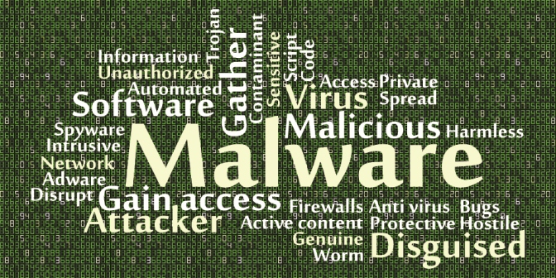
8.3: Common Threats
8.1: Cybercrime
8.2: Cybersecurity
8.3: Common Threats
Notes:
This video discusses common cyber threats and how to protect against them.

Slide 45
Learning Objectives
Describe the common cyber threats
Understand how malware works
List the ways that malware infects computers
Describe how to protect against data leaks
Explain the dangers links in unsolicited email
Describe security risks when using public WiFi
Notes:
Please take a moment to read the learning objectives for this video.

Slide 46
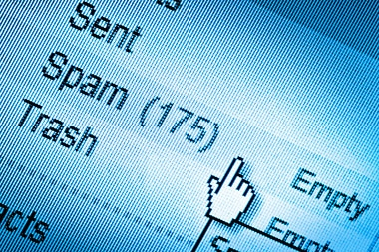
Common Cyber Threats
Malware
Data Leaks
Unsolicited Email
Open WiFi Networks
Notes:
There is a long list of possible cyber threats, but the common types that could affect you are malware, data leaks, unsolicited email, and open WiFi networks

Slide 47
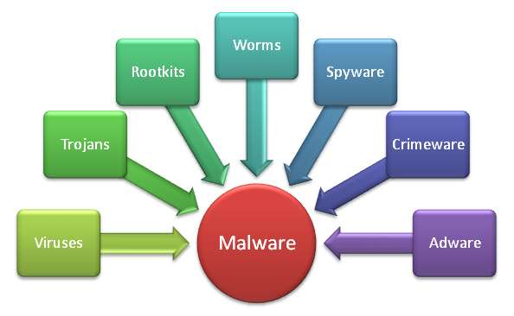
Malware
The word "malware" comes from
the term "MALicious softWARE."
Malware is any software
that infects and damages
a computer system without
the owner's knowledge or permission
Notes:
Malware is a general term to describe any software that infects and damages a computer system without the owner's knowledge or permission. It comes from the words malicious software.

Slide 48
Malware (2): How Malware Operates
The malicious code attaches itself to a program, file, or disk
When the program executes, the virus activates and replicates itself
The virus works in background, often without knowledge of the user
Notes:
Most malware works the same way.
The malicious code finds its way into the computer and then attaches itself to a program, file, or disk.
When the program executes, or the flash drive is inserted, the virus activates and replicates itself.
The malicious code works in the background, often without the knowledge of the user.

Slide 49
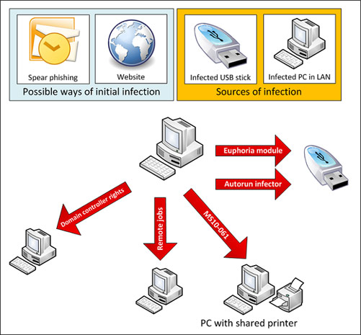
Malware (3): Infection Methods
Untrusted websites
  Clicking a link in email
  Downloading a file
  Malicious JavaScript
Email attachments
Pirated software
Flash drives
Another computer on the network
Notes:
Malware infects computers through various methods, but common ways are through untrusted websites, email attachments, pirated software, flash drives, or infected computers on a network.
When a user visits a web page run by cybercriminals with malicious code, the web browser executes the malicious JavaScript code to install a keylogger, spyware, or even ransomware.
A user might not intentionally visit the website, but clicks on a link in an email.
Another method of infection is downloading a file from an untrusted source instead of from the vendor’s site.

Slide 50
Malware (4): What They Do
Worms self-replicate but do not cause harm
Viruses can cause the computer crashes, loss of data,
Trojan horses steal data and provide a backdoor for the cybercriminal
Spyware collects data from the infected machine
Keyloggers record all of a user’s keystrokes
Fake antivirus software allows malware to remain undetected
  This is true for pirated/hacked antivirus software
Notes:
There are many subclassifications of malware, but some common types are worms, viruses, trojan horses, spyware, keyloggers, and fake antivirus software.
Worms are designed to self-replicate from computer to computer, but they typically do not cause harm to the host computer.
Viruses are also self-replicating, but they are designed to cause harm or do damage by destroying or changing files on the computer.
Trojan horses are software that looks safe, such as a computer game, but trojans are harmful.
Users are tricked into installing them.
Trojans delete files, steal data, or open a backdoor so the cybercriminal can take full advantage of the computer.
Spyware monitors your computer and sends collected information to the cybercriminal.
Keyloggers are spyware that records everything a user types on the keyboard.
The cybercriminals are looking for login information to websites or email.
A final type of malware is fake or pirated antivirus software that allows malware to remain undetected.

Slide 51
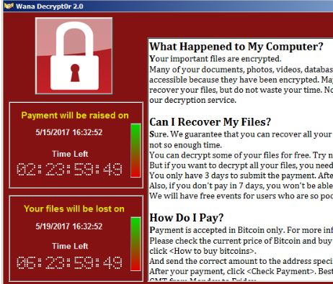
Malware (5): Ransomware
Encrypts your entire computer
Only way to get access to your files is to pay the cybercriminal
Notes:
Ransomware is a special kind of malware designed to extort money from the user.
Once the ransomware activates, it encrypts the victim’s entire hard drive.
Only the cybercriminal can give you the key to unlock your files, but you have to pay them first.
The cost of restoring your files might cost between 200 to 2000 US dollars.
There were several worldwide attacks using ransomware in 2017 that took advantage of unpatched software in Windows XP.
One particular attack infected over 300,000 computers in just four days.
Many victims paid the extortion fee to restore their files.

Slide 52

Malware (6): Infected Computers
Antivirus software can clean some malware, but not all
Might require the user to reinstall the operating system
User’s data may or may not be salvaged
Notes:
Should malware make it past the antivirus protection software and infect your computer, you do not have a lot of options.
It is likely that much of the damage has been done, especially if you permitted the virus to run, such as using an infected software cracker.
Antivirus software can clean some malware, but not all of it.
A virus will have infected core operating system files and permanently changed them.
The most stubborn kind of malware requires a user to reinstall the operating system.
Furthermore, just like with ransomware, a virus might encrypt or even destroy a user’s data.

Slide 53

Malware (7): Protect Against
Use a reputable antivirus program
Keep your computer up to date
Do not visit untrusted websites
  Do not click unknown links in an email
  Do not download files from unknown sources
Do not use pirated software
  Most pirated software contains malware
Notes:
There are good ways to protect against malware.
First, use a reputable antivirus program. Hopefully, this will stop any attempts at infection.
However, this should be a last resort and not something you rely on to protect you.
Whatever you do, do not install a pirated version of an antivirus program.
Next, keep your operating system and applications updated.
Third, stay away from untrusted websites by not clicking on unknown links in an email.
Any file you download should come from the vendor, not from an unknown site.
Finally, do not use pirated software.
Most copies of pirated software will contain malware, even if the antivirus software will not detect it.

Slide 54
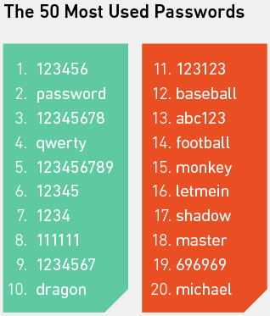
Data Leaks
Release of secure information to an untrusted environment
Cybercriminals frequently post hacked usernames and passwords from websites
  One online hacker’s database has 1.4 billion usernames and passwords
Notes:
The next common cyber threat that we discuss is data leaks.
Data leaks are the release of secure information to an untrusted environment.
Cybercriminals frequently post hacked usernames and passwords from websites.
For example, one online hacker’s database contains 1.4 billion usernames and passwords.

Slide 55
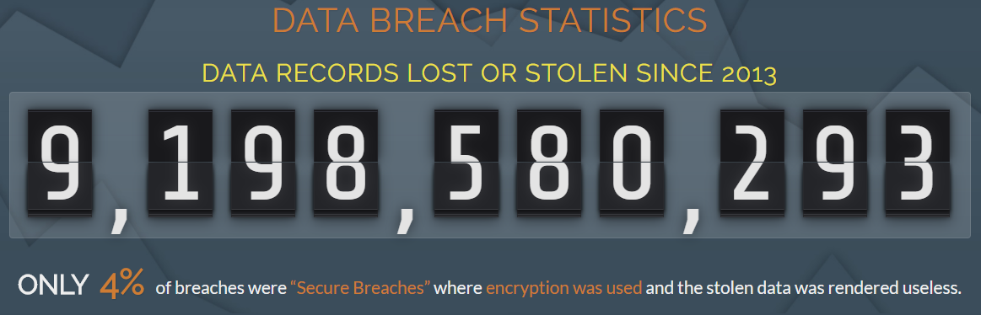
Data Leaks (2): Data from Websites
Notes:
Since 2013, over 9 billion records were lost or stolen. Only 4% of those data were encrypted. Any data you post online is at risk of being leaked.

Slide 56
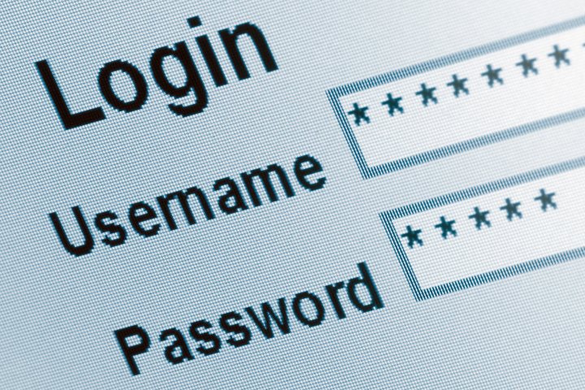
Data Leaks (3)
You cannot prevent data leaks
Instead, plan for your username, password, and other sensitive data to be leaked online
Notes:
You cannot prevent data leaks. They are a fact of life in cyberspace. Instead, plan for your username, password, and other sensitive data to be leaked online.

Slide 57
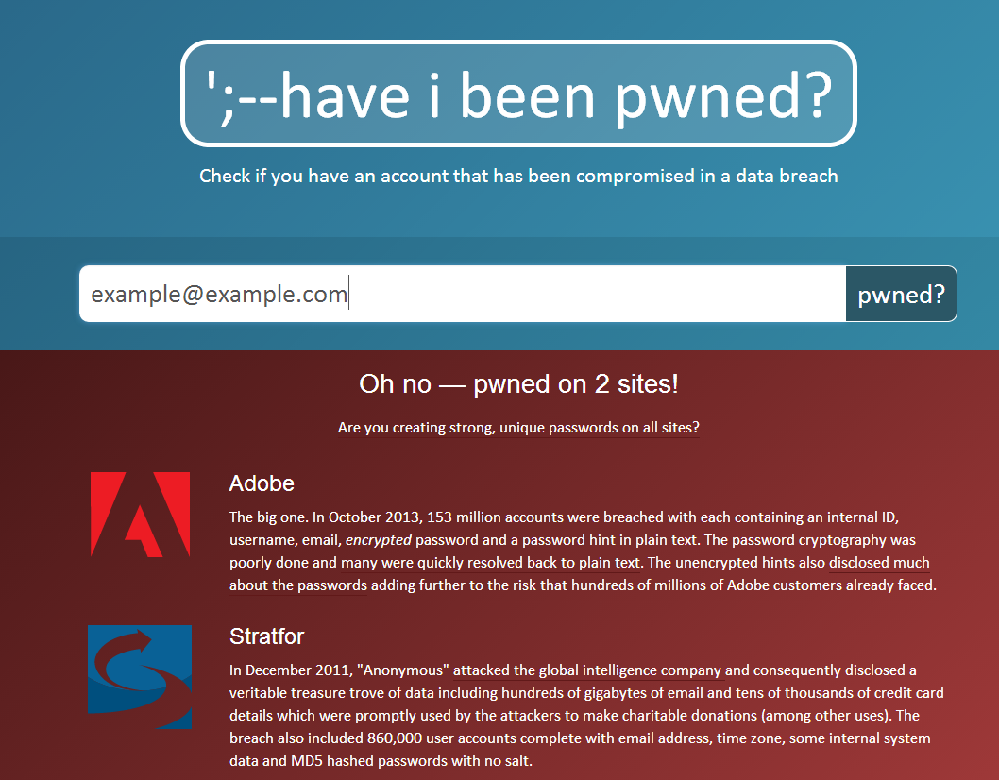
Data Leaks (4)
Cybercriminal plan on users using the same username and password for multiple accounts
Notes:
Cybercriminals plan on users using the same username and password for multiple accounts. Cybercriminals try the same combination on different websites trying to gain access to a user's sensitive or financial data.

Slide 58
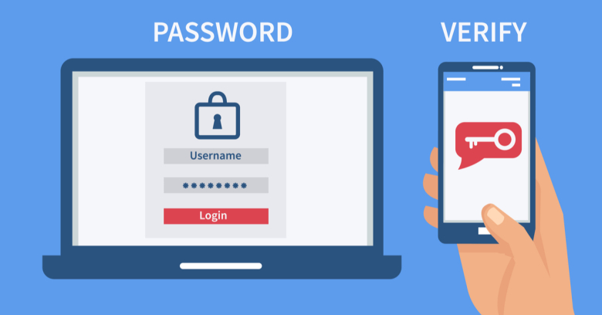
Data Leaks (5): How to Plan
Use a unique username and password combination for each account
Use a password manager
  LastPass
  1Password
  KeePass
Use two-factor authentication
Notes:
The best way to plan for data leaks is to use a unique username and password combination for each account.
This way, the hacker will only have access to one account, therefore lessening the damage they can do.
Maintaining unique passwords is not easy. Password managers help to log you into the sites automatically.
Another step is to use two-factor authentication, such as Google Authenticator.
Accounts that use two-factor authentication require two passwords.
The first is the password you choose.
The second requires the user’s phone to authenticate the login.
Even if your username and password are compromised, others are unable to log in without the second authentication code.

Slide 59
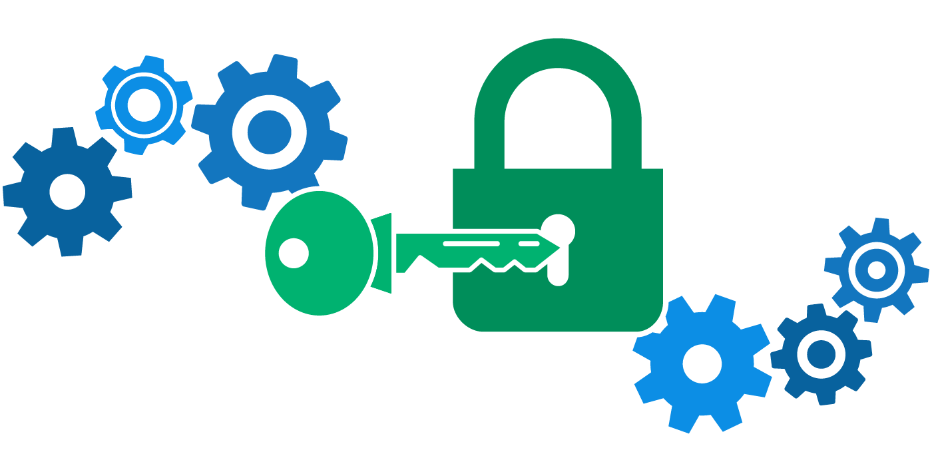
Data Leaks (6): Encryption
Encrypt sensitive data
  Secure Folder (Samsung)
  BitLocker (Windows 7/10 Pro )
  VeraCrypt (Windows)
  7zip encrypts compressed files (Any)
    The easiest to use
    You will learn how to use 7zip in a lab
Notes:
For a final step, know what sensitive data you have online, on your laptop, or phone that could be leaked.
What if your emails were leaked online?
What if your laptop or phone were stolen?
How secure is the data?
There are some tools you can use to encrypt sensitive data.
For example, Samsung uses an application called Secure Folder to keep sensitive files.
Windows 7/10 can encrypt the entire hard drive using BitLocker or VeraCrypt.
If you need to encrypt only a few files, you can use 7zip.

Slide 60
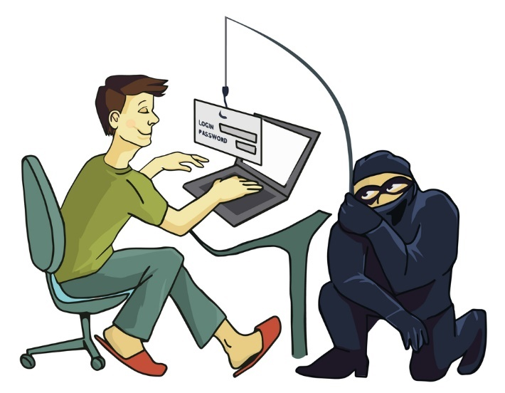
Unsolicited Email
Unsolicited email is a favorite way for cybercriminal to get access to a computer or an account
  Phishing: Tricking the user to
  giving account information
  Click Here: The link takes a
  user to a malicious website
Notes:
Unsolicited email is a favorite way for cybercriminals to gain access to a computer or an account. There are several different ways they do it.
One way is through phishing, which is tricking the user into giving up their account information.
The cybercriminals create an email to reset a password that looks like it comes from a legitimate source, such as from Google or Facebook.
If the user isn’t paying attention, they go to the fake website and give the login information to the hacker.
Another way is through hyperlinks that read “click here”, but hide the real URL.
The cybercriminal hopes the user will click on the link.
Once they do, the user’s computer could get infected.

Slide 61

Unsolicited Email (2)
  Infected attachments: A doc, pdf, or another file that contain malicious software
  Self-replicating: Once you are infected, the malware uses your account to send the infected email to everyone in your address book
Notes:
Unsolicited email is a favorite way for cybercriminals to gain access to a computer or an account. There are several different ways they do it.
One way is through phishing, which is tricking the user into giving up their account information.
The cybercriminals create an email to reset a password that looks like it comes from a legitimate source, such as from Google or Facebook.
If the user isn’t paying attention, they go to the fake website and give the login information to the hacker.
Another way is through hyperlinks that read “click here”, but hide the real URL.
The cybercriminal hopes the user will click on the link.
Once they do, the user’s computer could get infected.
They also send infected file attachments in emails, such as DOC or PDF files.
These emails are self-replicating and look like they come from your known contacts.
Once you are infected, the malware uses your account to send the infected email to everyone in your address book.
Your friends think the file is safe because it came from you.

Slide 62
Unsolicited Email (2): Click Here
If you click a malicious link or fall for a phishing scam, it might be too late…
  Drive-by downloads: Malicious software can install just by visiting a website (virus, ransomware, keylogger)
  Ransomware: 93% of all phishing emails are now ransomware
Notes:
Links with "Click Here" text are dangerous because people click on them to see the URL.
However, the webpage downloads the malicious code before the page displays.
By the time you see that the website is suspicious, it might be too late.
This behavior is called drive-by downloading.
The malicious software can then install other software even if you quickly close the web page.
Common drive-by download malware types are viruses, keyloggers, and ransomware.
Experts estimate that 93% of all phishing emails are now ransomware!

Slide 63
Unsolicited Email (3): Protection
In addition to the malware protection guidelines:
  Know how to identify fake email or spam
  Never click a link in an email, not even from a friend, unless you know it is safe
  Never click a password reset link. Instead, go to the website directly
  Mouse over a link to verify the URL
Notes:
Your best protection against malware in email is to know how to identify a fake email or spam.
Never click a link in an email, not even from a friend, unless you know it is safe.
You can mouseover a link to verify the URL. If the domain name is just some random letters, do not trust it.
Never click a password reset link from an email. Instead, go to the website directly and see if you actually need to reset your password.

Slide 64

Open WiFi Access Points
Any data transmitted through an unsecured WiFi connection can be easily collected
  Intercepting login credentials
  Only use SSL/HTTPS when logging into your sites
Understand the risks and use with care
  Virus threat from infected users
Better to use mobile data through your phone
Notes:
Another area to be knowledgeable about is Open WiFi Access Points.
The purpose of discussing this topic is to understand the risks of public WiFi.
Any data transmitted through an unsecured WiFi connection can be easily collected.
Cybercriminals are looking for login credentials used without encryption.
In 2017, an Austrian man lost over 100,000 US dollars in bitcoin by viewing his account over a public wireless network.
If you do use open WiFi access points, only use HTTPS when logging into your website.
Because viruses propagate over networks, you also run the risk of infection if your computer is not up to date.
The safer option is to use your mobile data and create your own hotspot.

Slide 65
Common Threats Summary
Common cyber threats
  malware, data leaks, unsolicited email, and public WiFi
Malware is malicious software that runs the background
  From: untrusted websites, email attachments, pirated software, infected flash drives, or infected computers on a network
Data leaks publish private data online
Harmful websites automatically install malware when visited
Public WiFi expose unencrypted data, such as passwords
Notes:
In summary,
some common cyber threats are malware, data leaks, unsolicited email, and open WiFi access points.
Malware is malicious software that runs in the background without the user’s knowledge, and often self-replicates to other computers.
Malware infects computers through untrusted websites, email attachments, pirated software, flash drives, or infected computers on a network.
Malware is very difficult to remove from an infected computer. Data leaks are another threat that is out of the user’s control.
One level of protection from data leaks is to use unique passwords for every website.
Unsolicited emails are dangerous because of embedded hyperlinks that lead to harmful websites.
If a user clicks a link, the website will infect the computer before the user can see the webpage.
Once the user can view the site, it is too late. The computer is already infected by a method called drive-by downloading.
Public WiFi networks have security risks since others on the network can view any unencrypted data.

