Slide 1
Analysis

Slide 2
?
Archaeological material
Archaeological data

Slide 3
Documentation of excavation
Hand made documentation (maps, plans, stratigraphy profiles, cross-sections, field diaries)
Digital documentation (total station, field computer, field database)

Slide 5
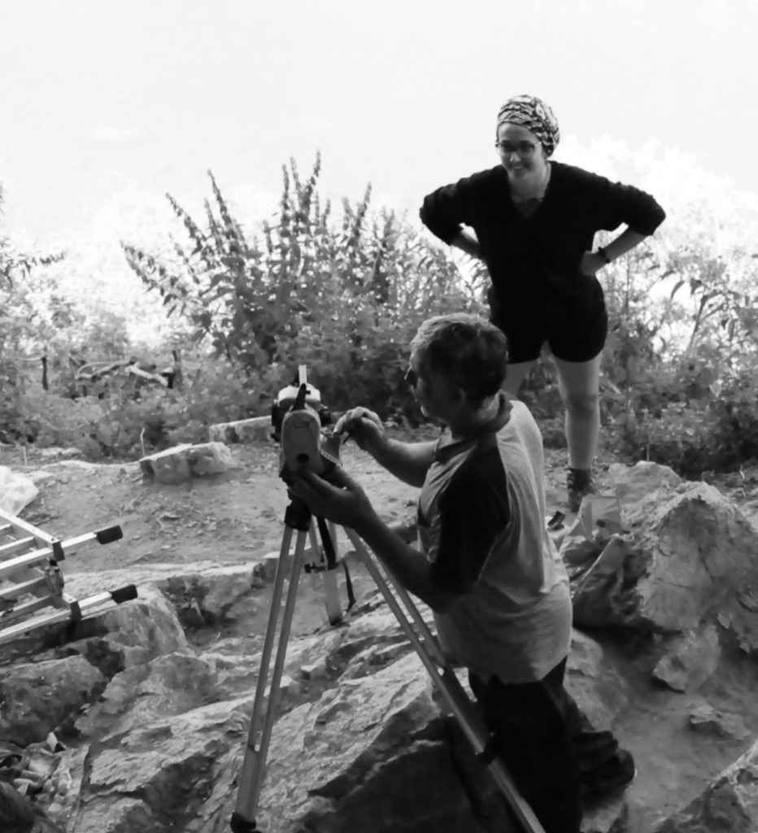

Slide 6
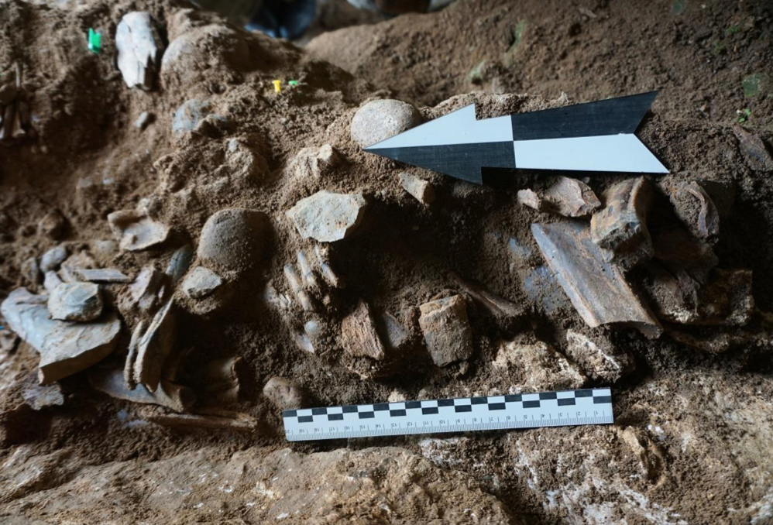
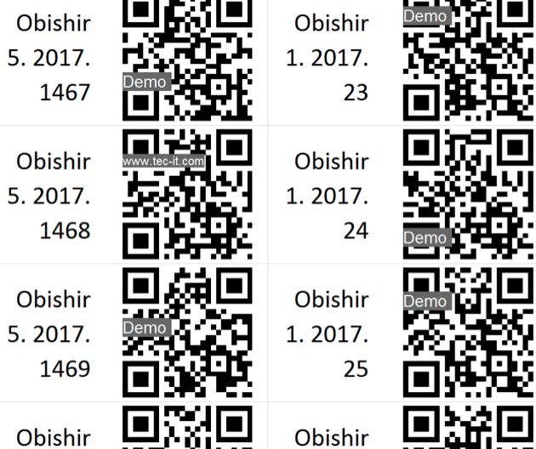
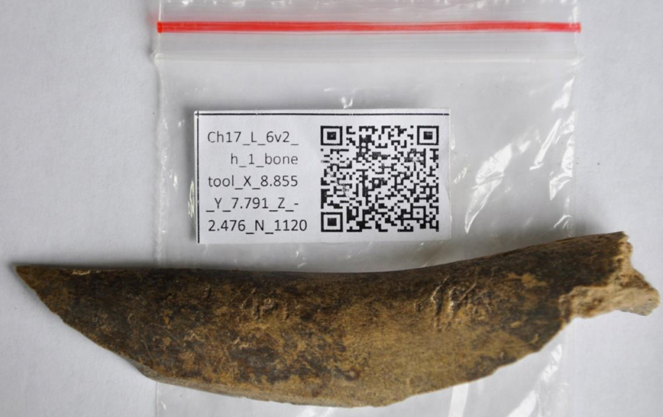

Slide 7
Dealing with material
Preliminary processing (packing, marking, conservation)
Cleaning (by water, fine brush, special lab treatment)
Some artifacts better do not clean (pots with organic remains inside, lipid analysis)
Labelling and coding (handle or machine inventory)
Conservation (for fragile artefacts)
Sorting for analysis (lithic analysis, refitting or reconstruction of fragments)
Packing and storing

Slide 8
Marking

Slide 10
Conservation

Slide 11
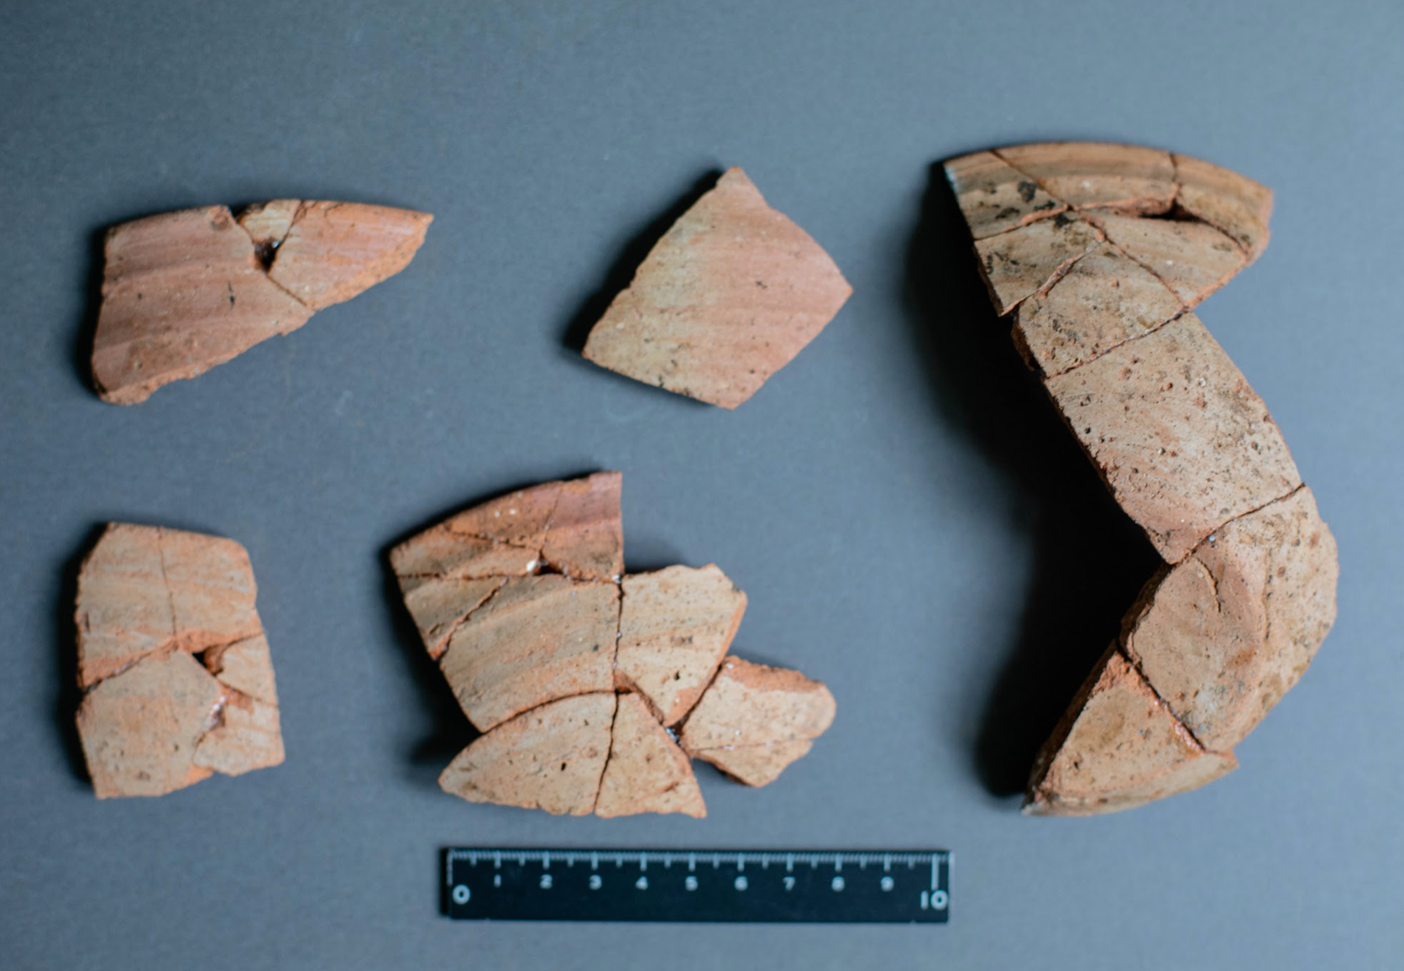
Refitting and restoration

Slide 12
Data
Analysis of database
Analysis of context
Analysis of artefacts

Slide 13
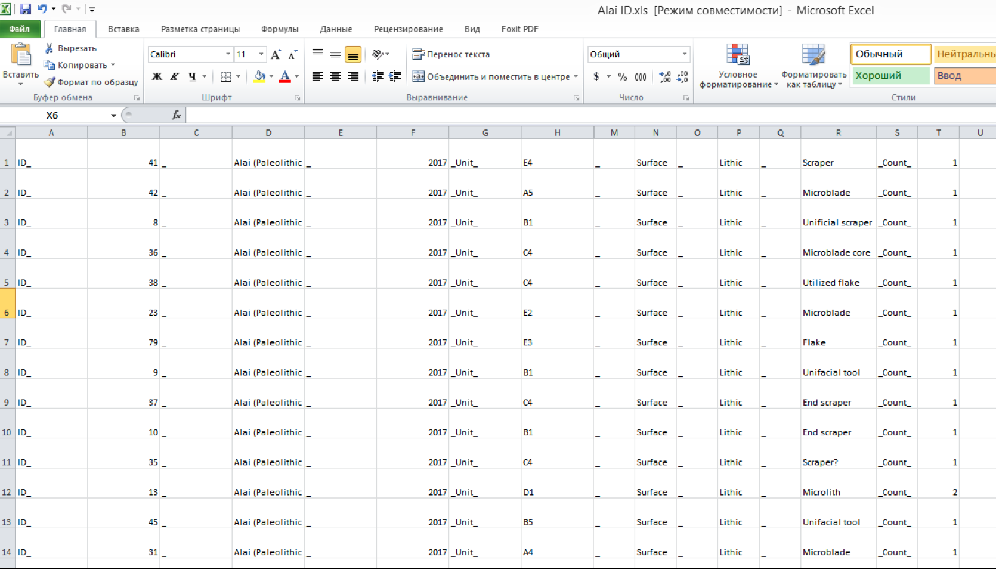
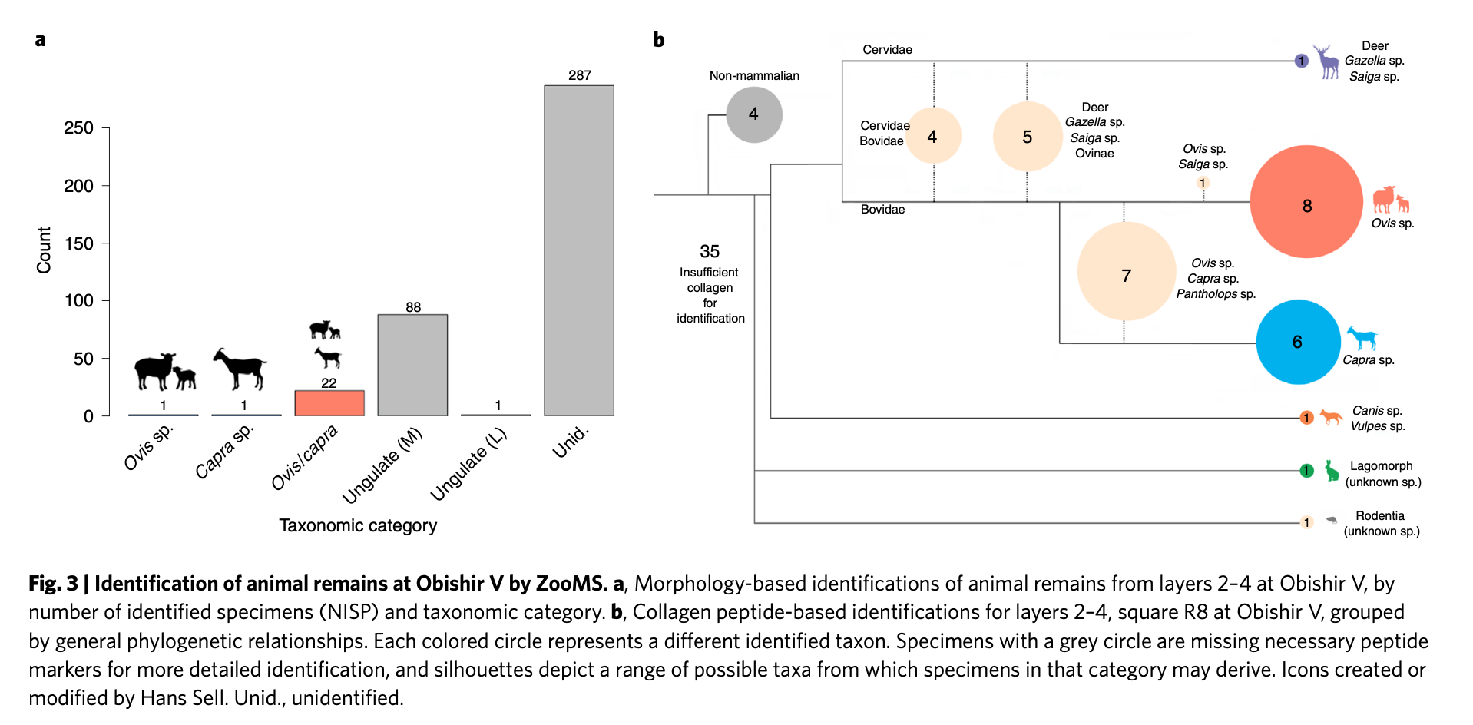

Slide 14
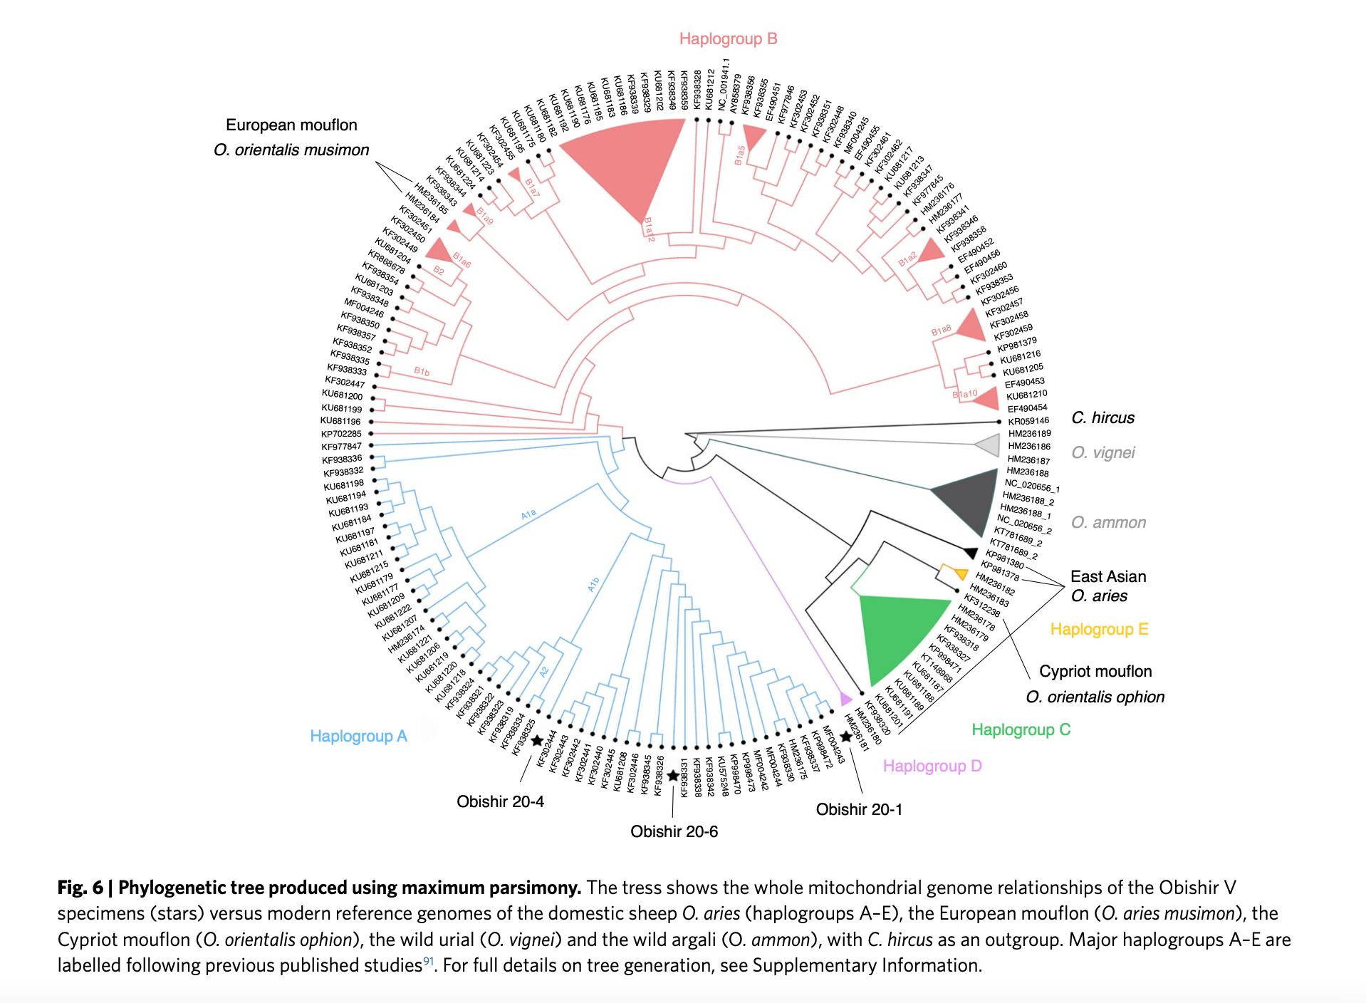

Slide 15
3D-modelling
Photogrammetry
3D-scanning
3D-tomography

Slide 16
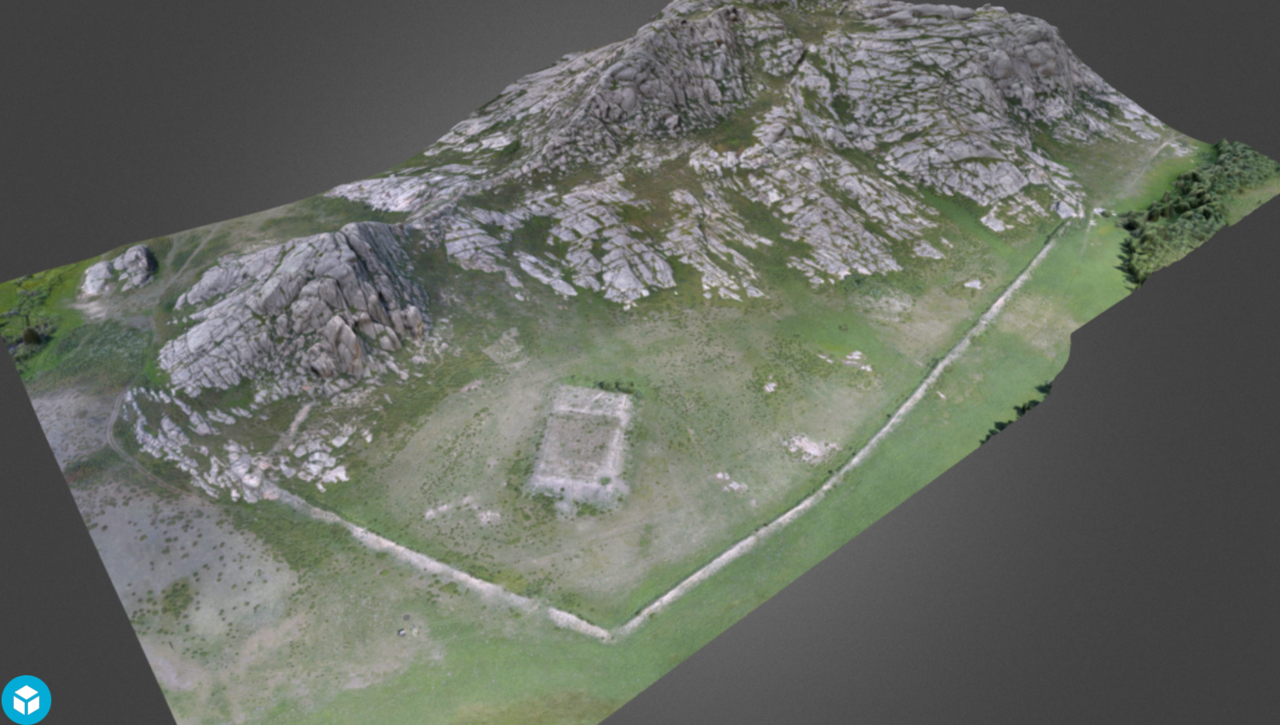
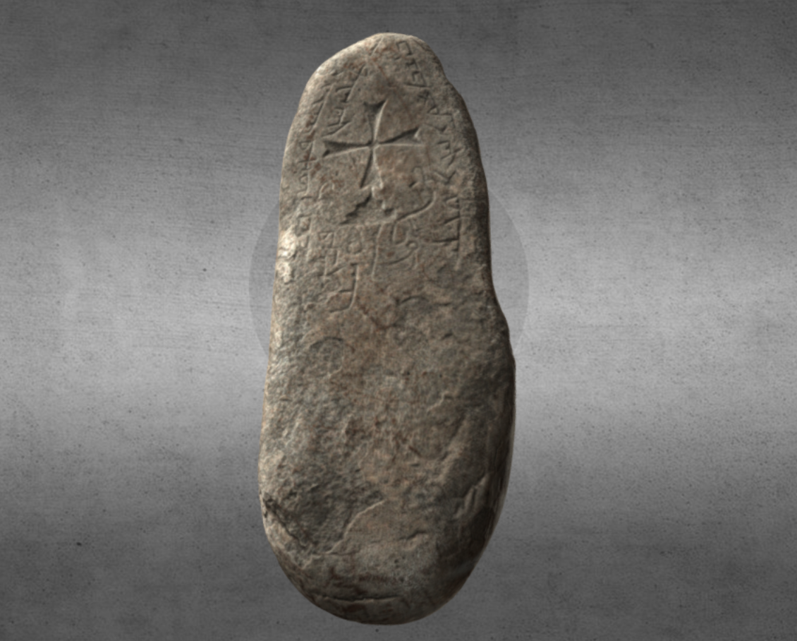
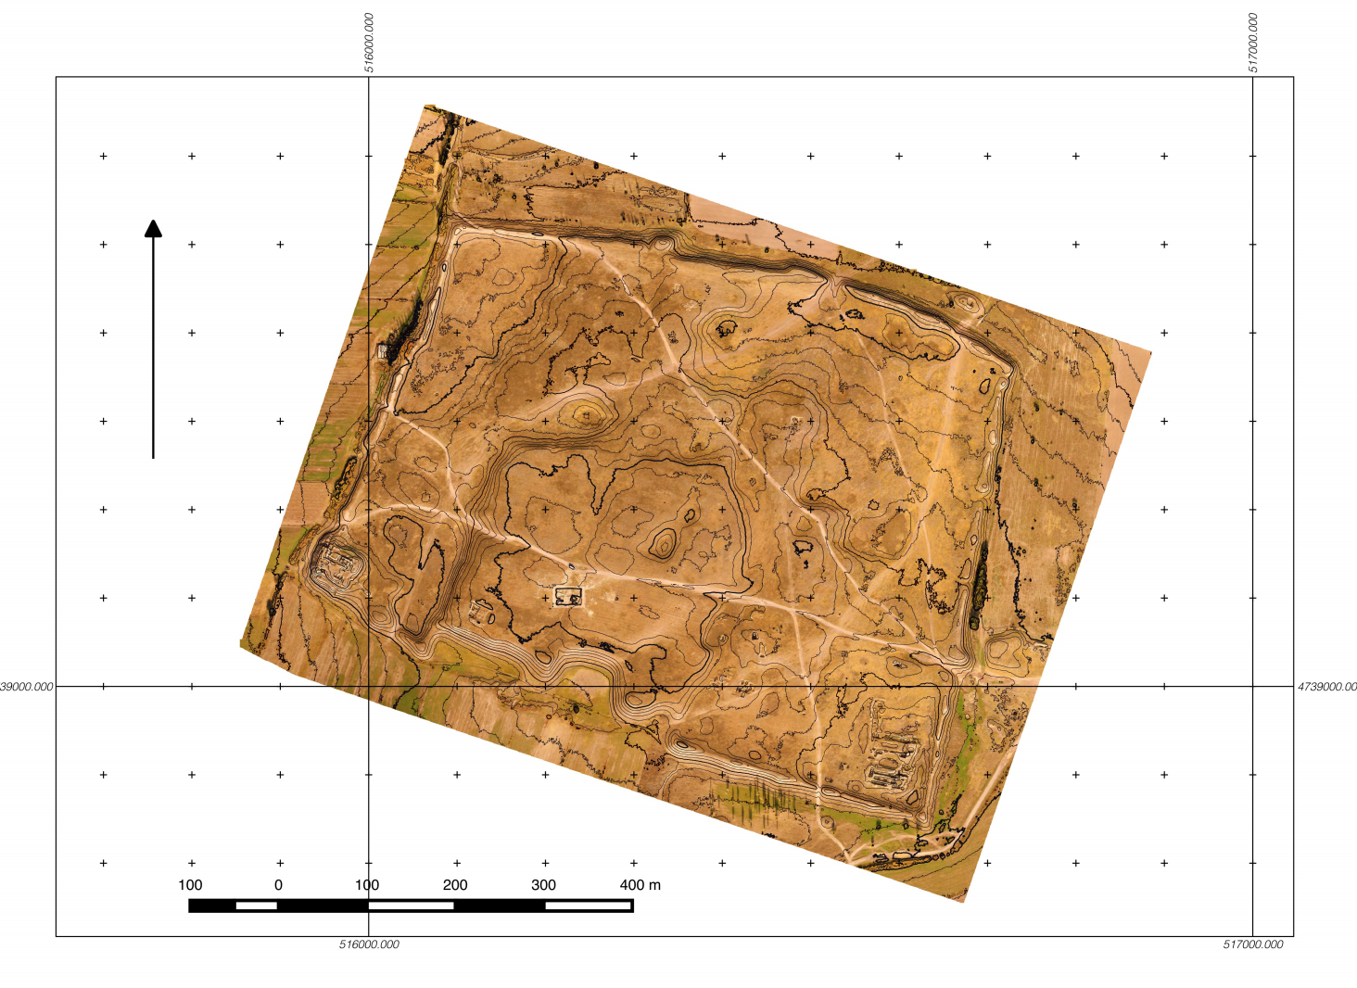

Slide 17
Sampling
C14 samples (any organic material, better coal)
OSL samples (soil and rocks with particles of quartz and feld spar)
Soil samples (for palynology, soil analysis)
ZooMS (identification of genus and specie of animal)
DNA (human and animals)
Wood analysis (to reveal the tree specie)

Slide 18
Why we need to do sampling?
Dating/Chronological affiliation
Reconstruction (climate, cultural attributes)

Slide 19
C14
Avoid any contamination (air, any organic material, paper, etc.)
Avoid destruction / Fragility (fix in foil)
Know amount of sample (from 1 ml up to 5 g)
Take series of samples (There is safety in numbers)
Limitations up 45 kya

Slide 20
OSL and TL
Avoid any light
Three ways: tubes, monoliths and at night
Limitations 100-120 kya (quarts), 400-500 kya (feldspar)

Slide 21
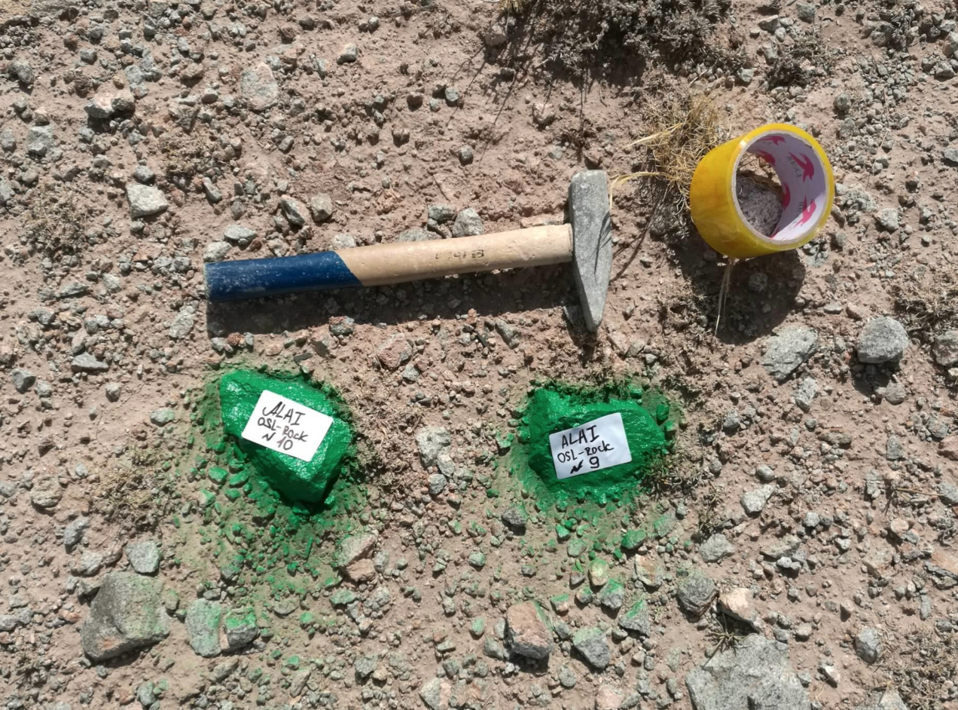
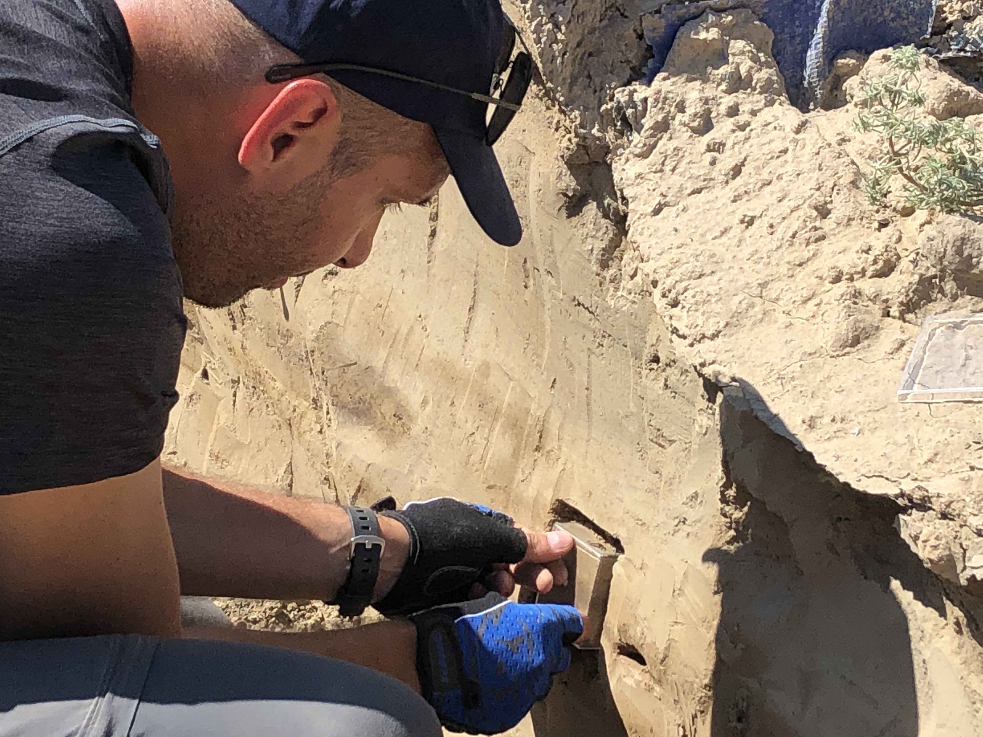
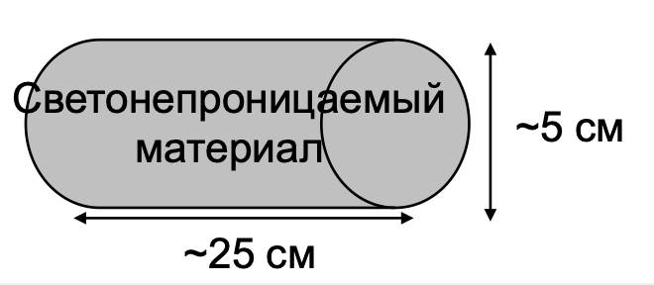

Slide 22
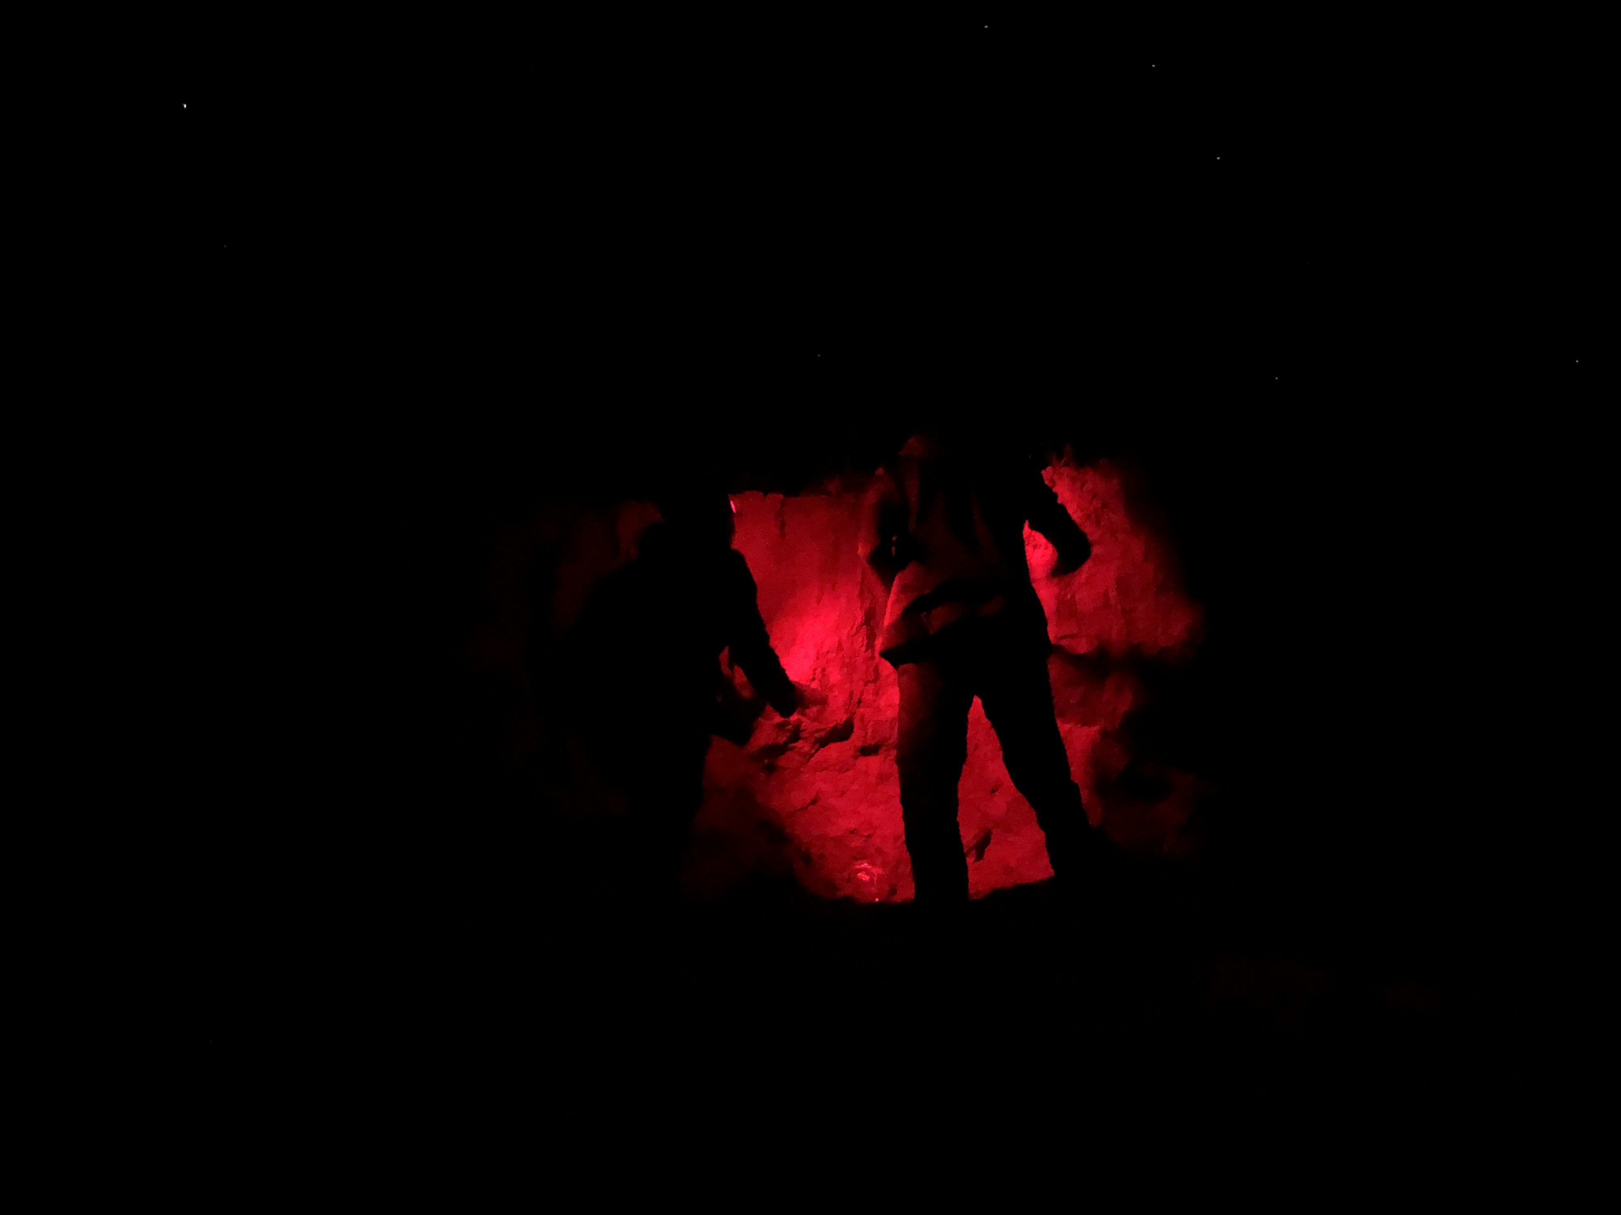
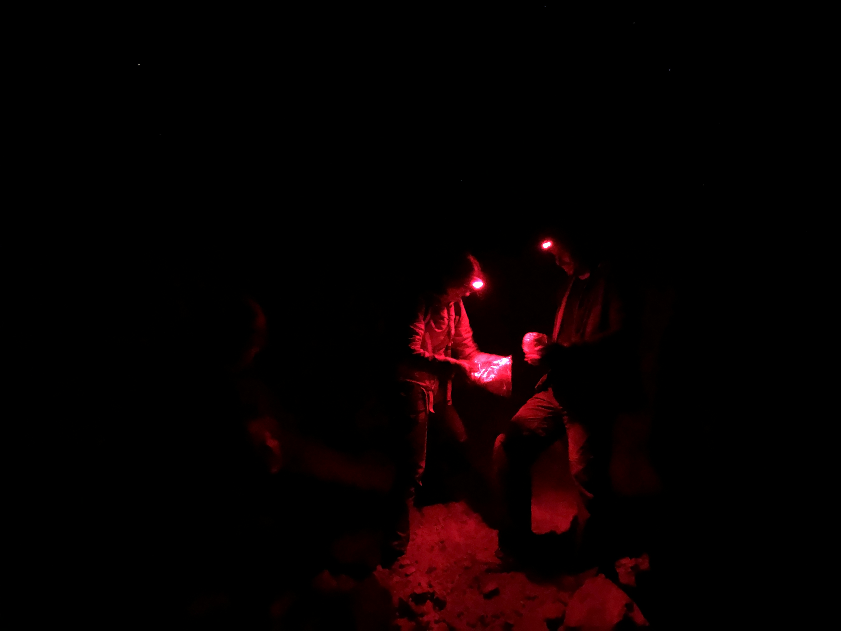

Slide 24
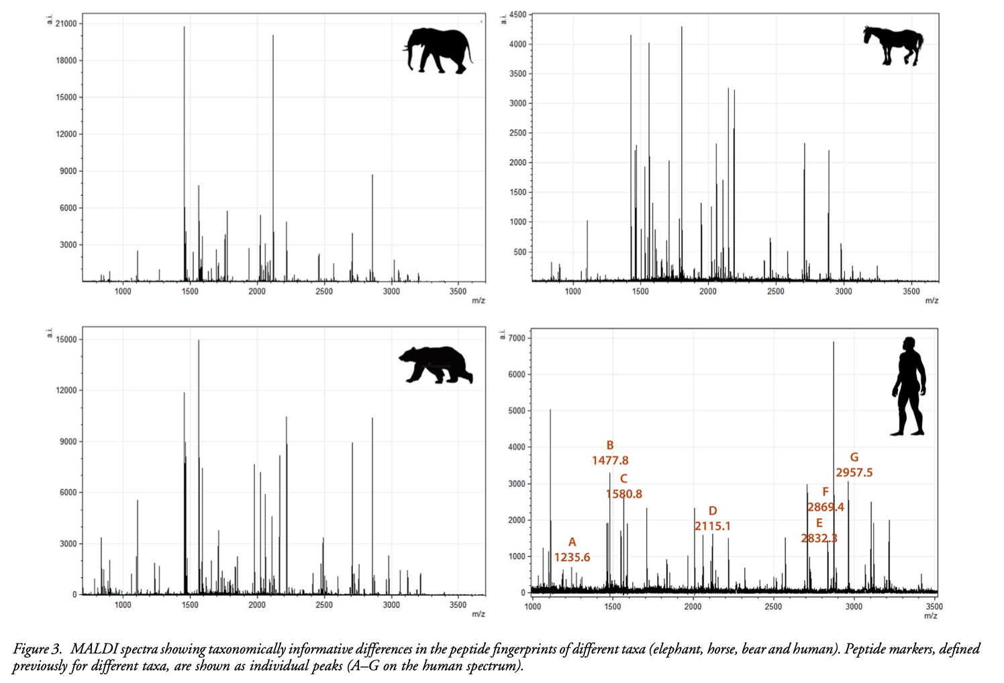
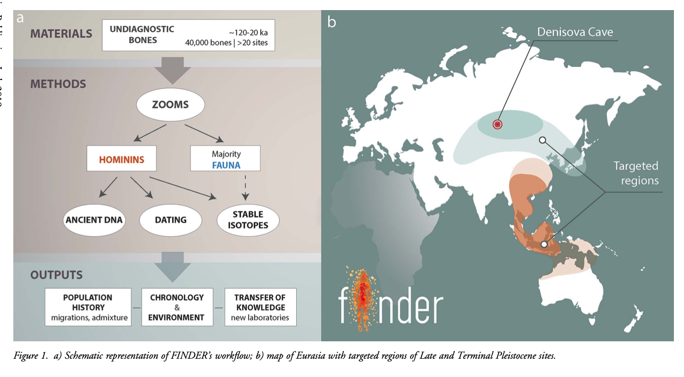
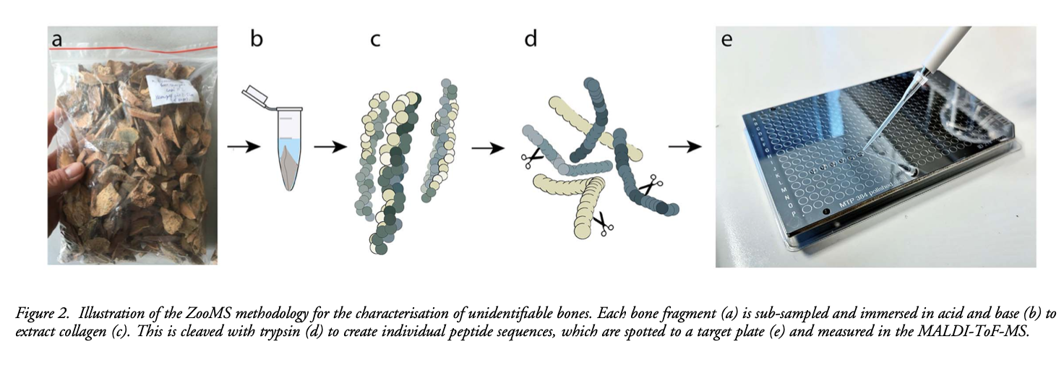
ZooMS collagen fingerprinting

Slide 25
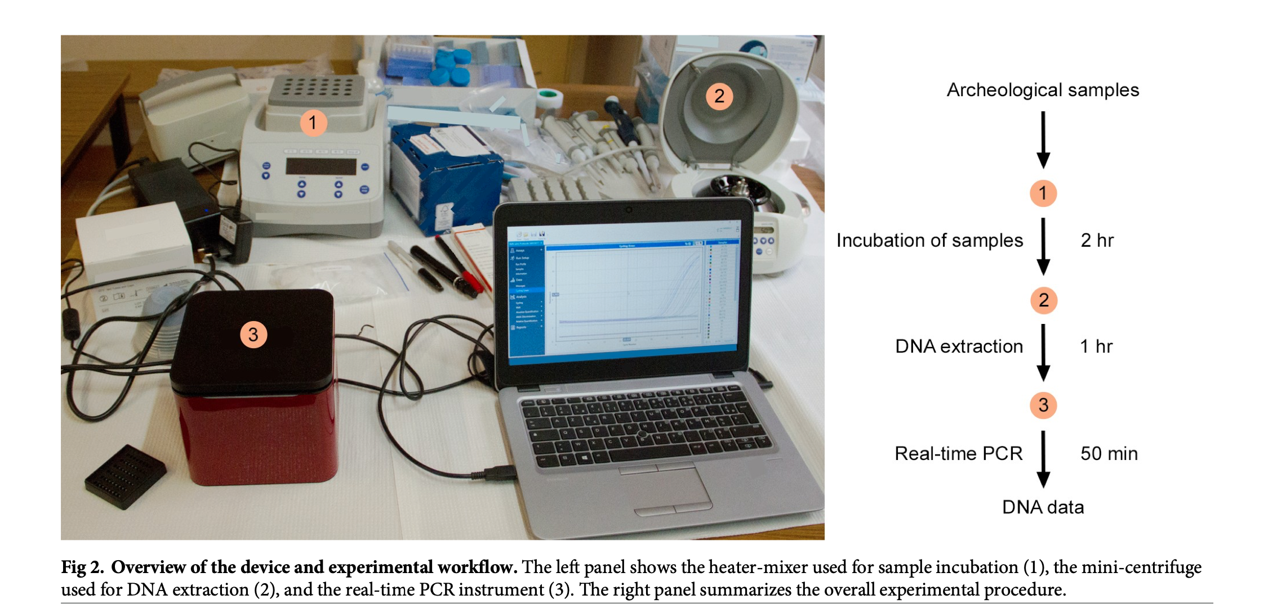
Ancient DNA
Bone, teeth
Soil
Coprolites

