Slide 1
Survey
In archaeology

Slide 2
Lesson objective
Understand the steps of locating and extracting archaeological evidence

Slide 3
Survey
Is the process of locating the archaeological resources in a given area of land
Research in archaeology is essential
Allowed only archaeologists who have a special permission

Slide 4
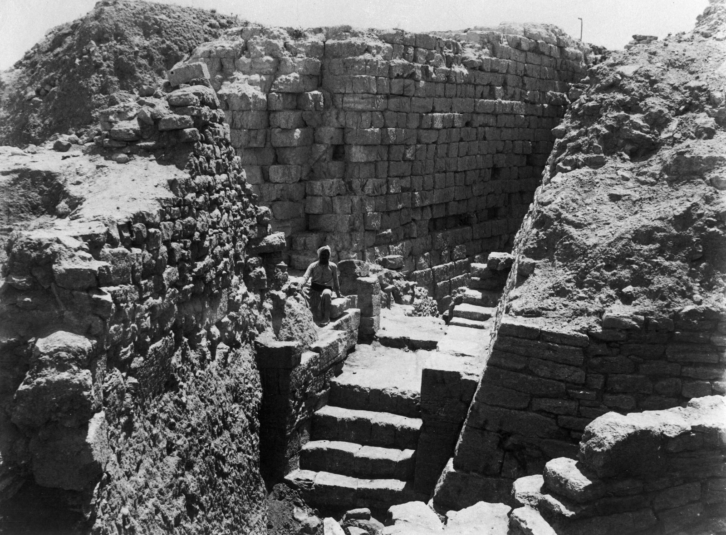
Troy of Heinrich Schliemann

Slide 5
Remote sensing
Anything (usually technological device) that helps you learn what is on/in the ground without your having to be there or dig there
Map is remote sensing device
Aerial photos, satellite images, and pictures generated by various geophysical prospecting techniques such as magnetometers, electrical resistivity detectors, ground penetrating radars, other kinds of radar, sonar, and all those spy devices developed by friendly military scientists

Slide 6
Satellite imagery

Slide 7
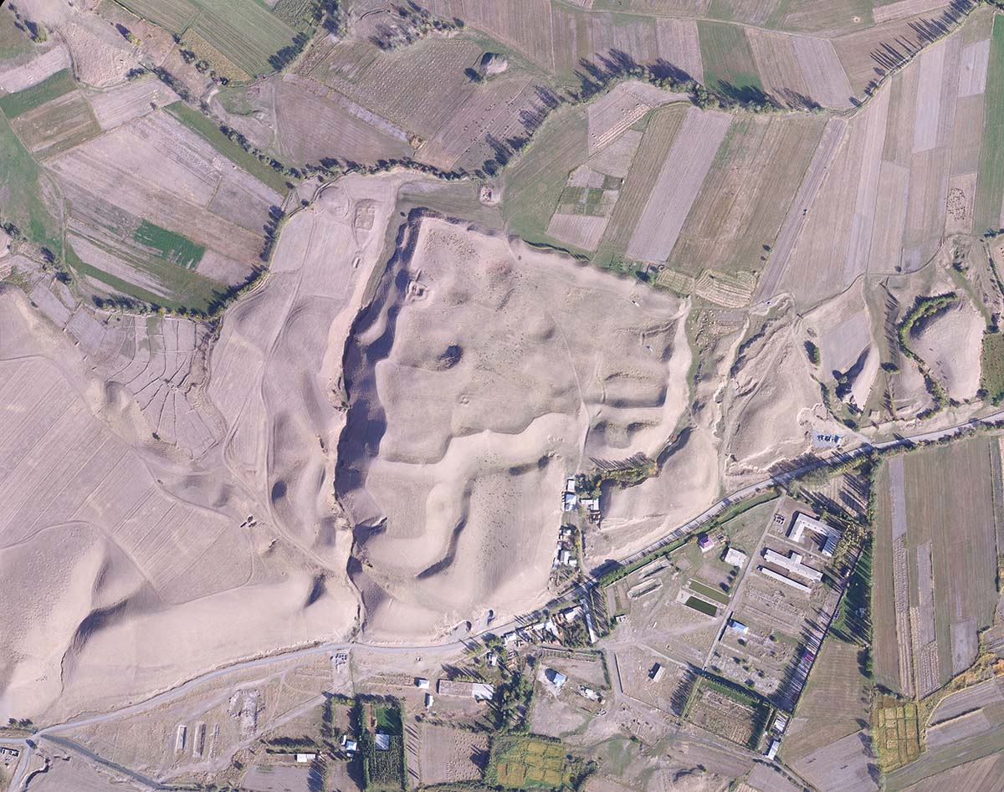
Aerial photography

Slide 8
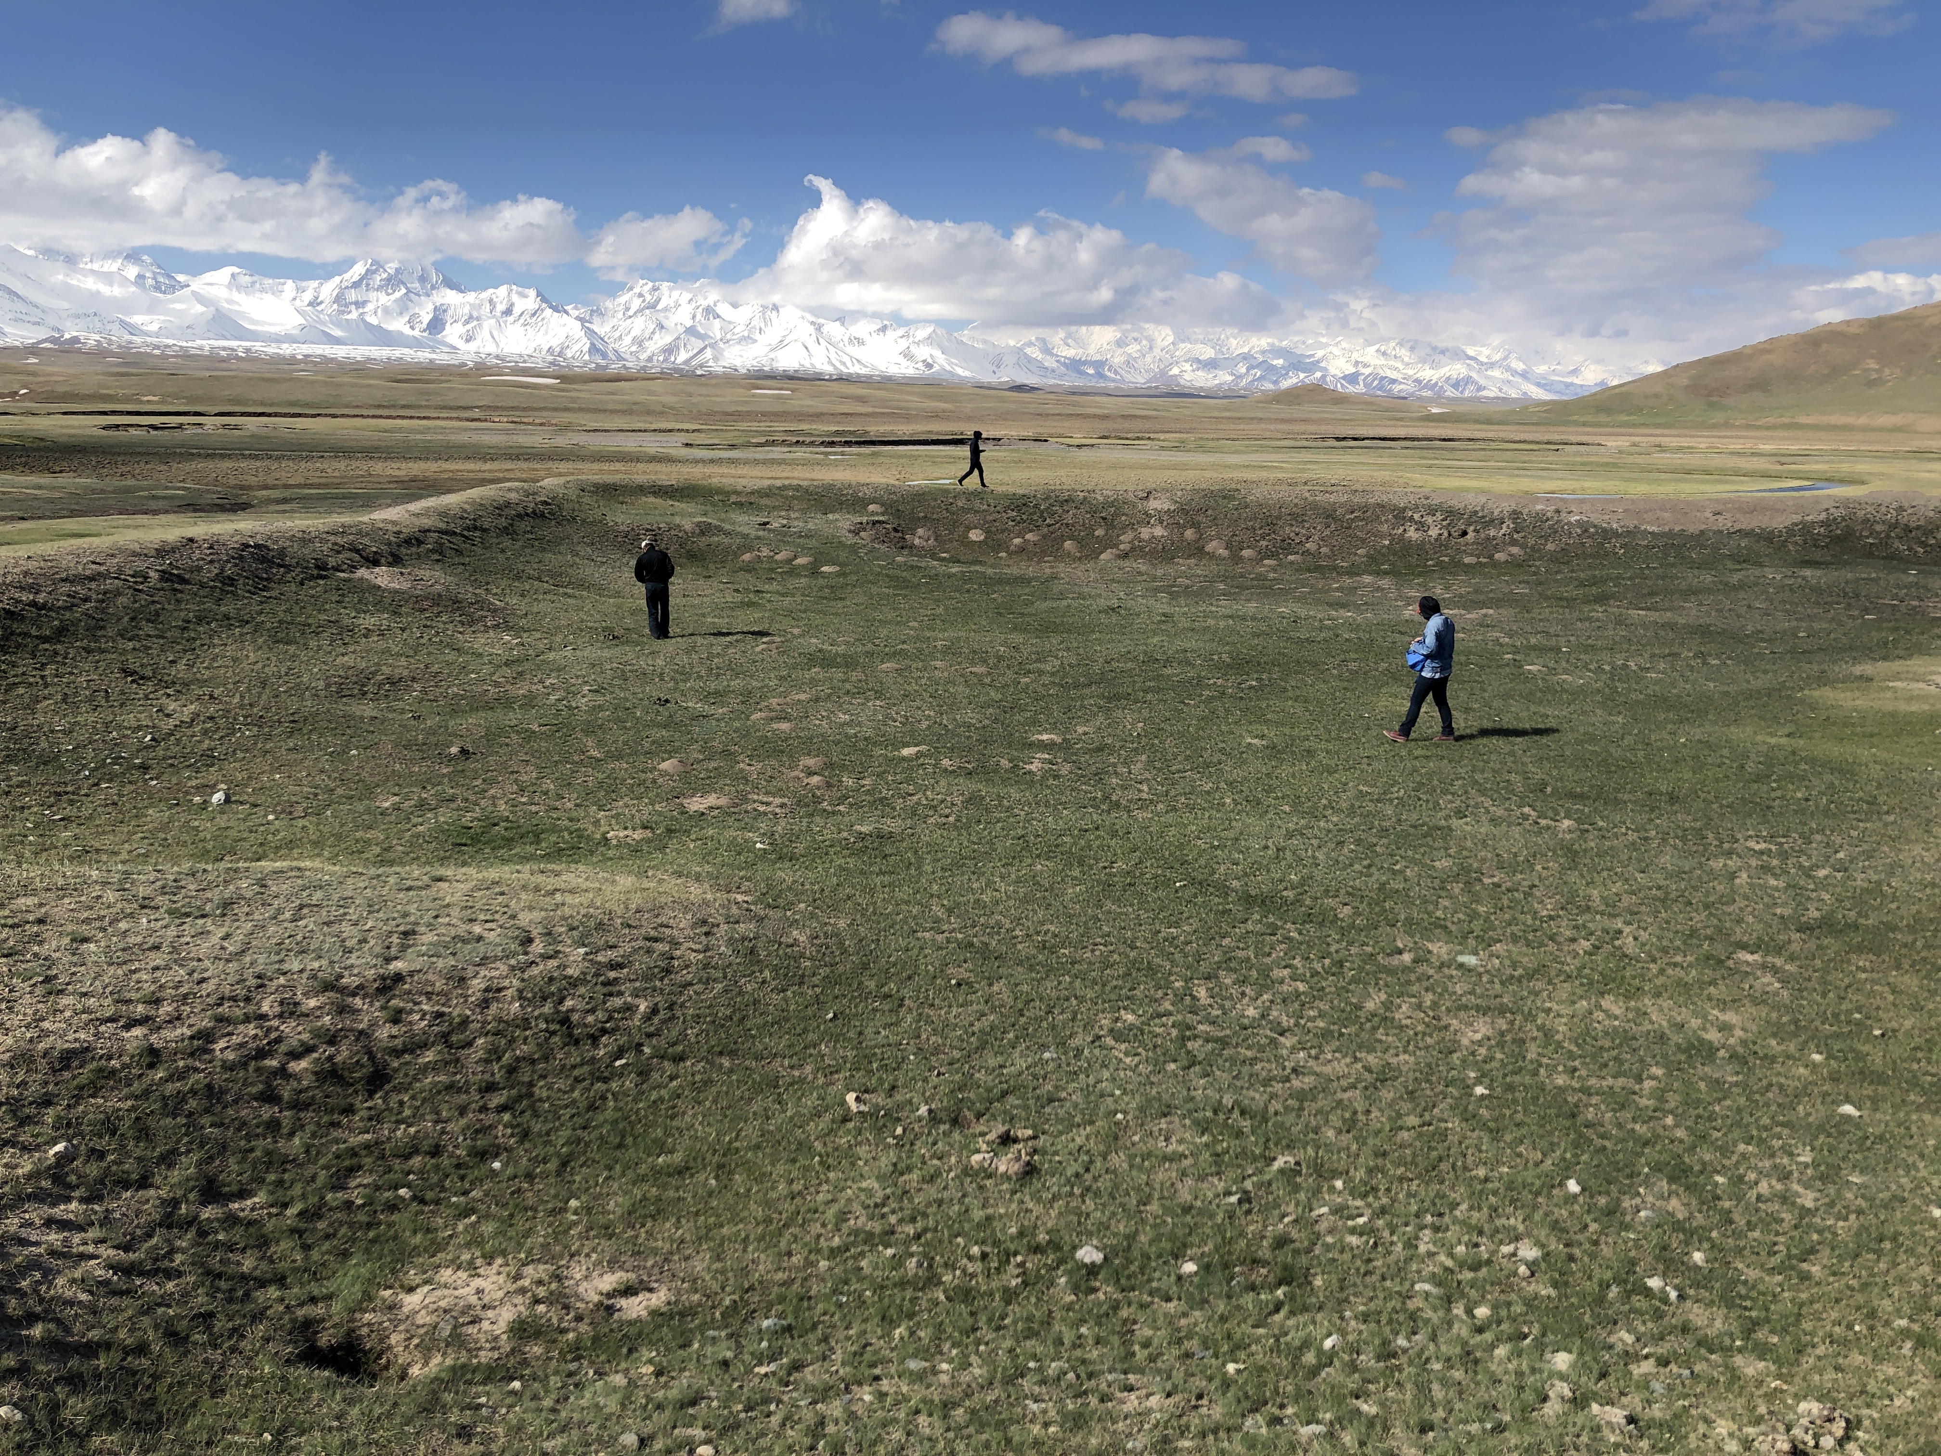
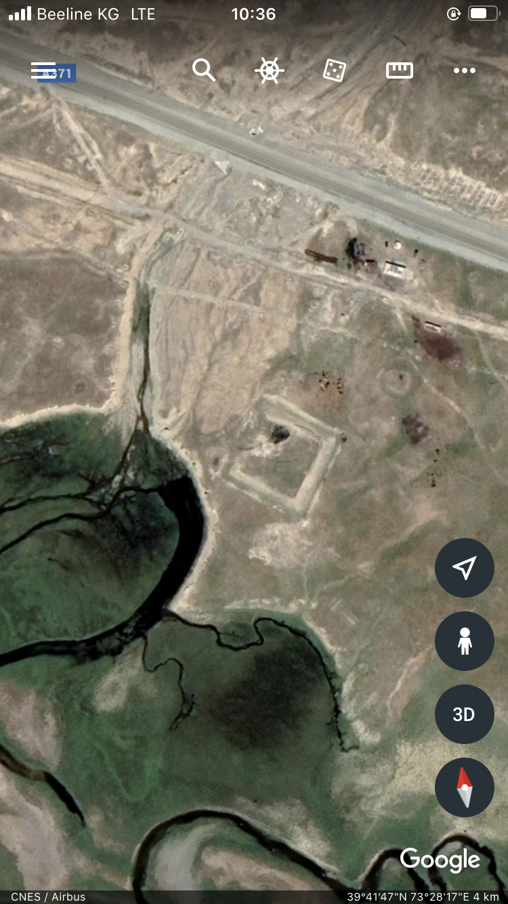
combination of satellite imagery and field survey

Slide 9
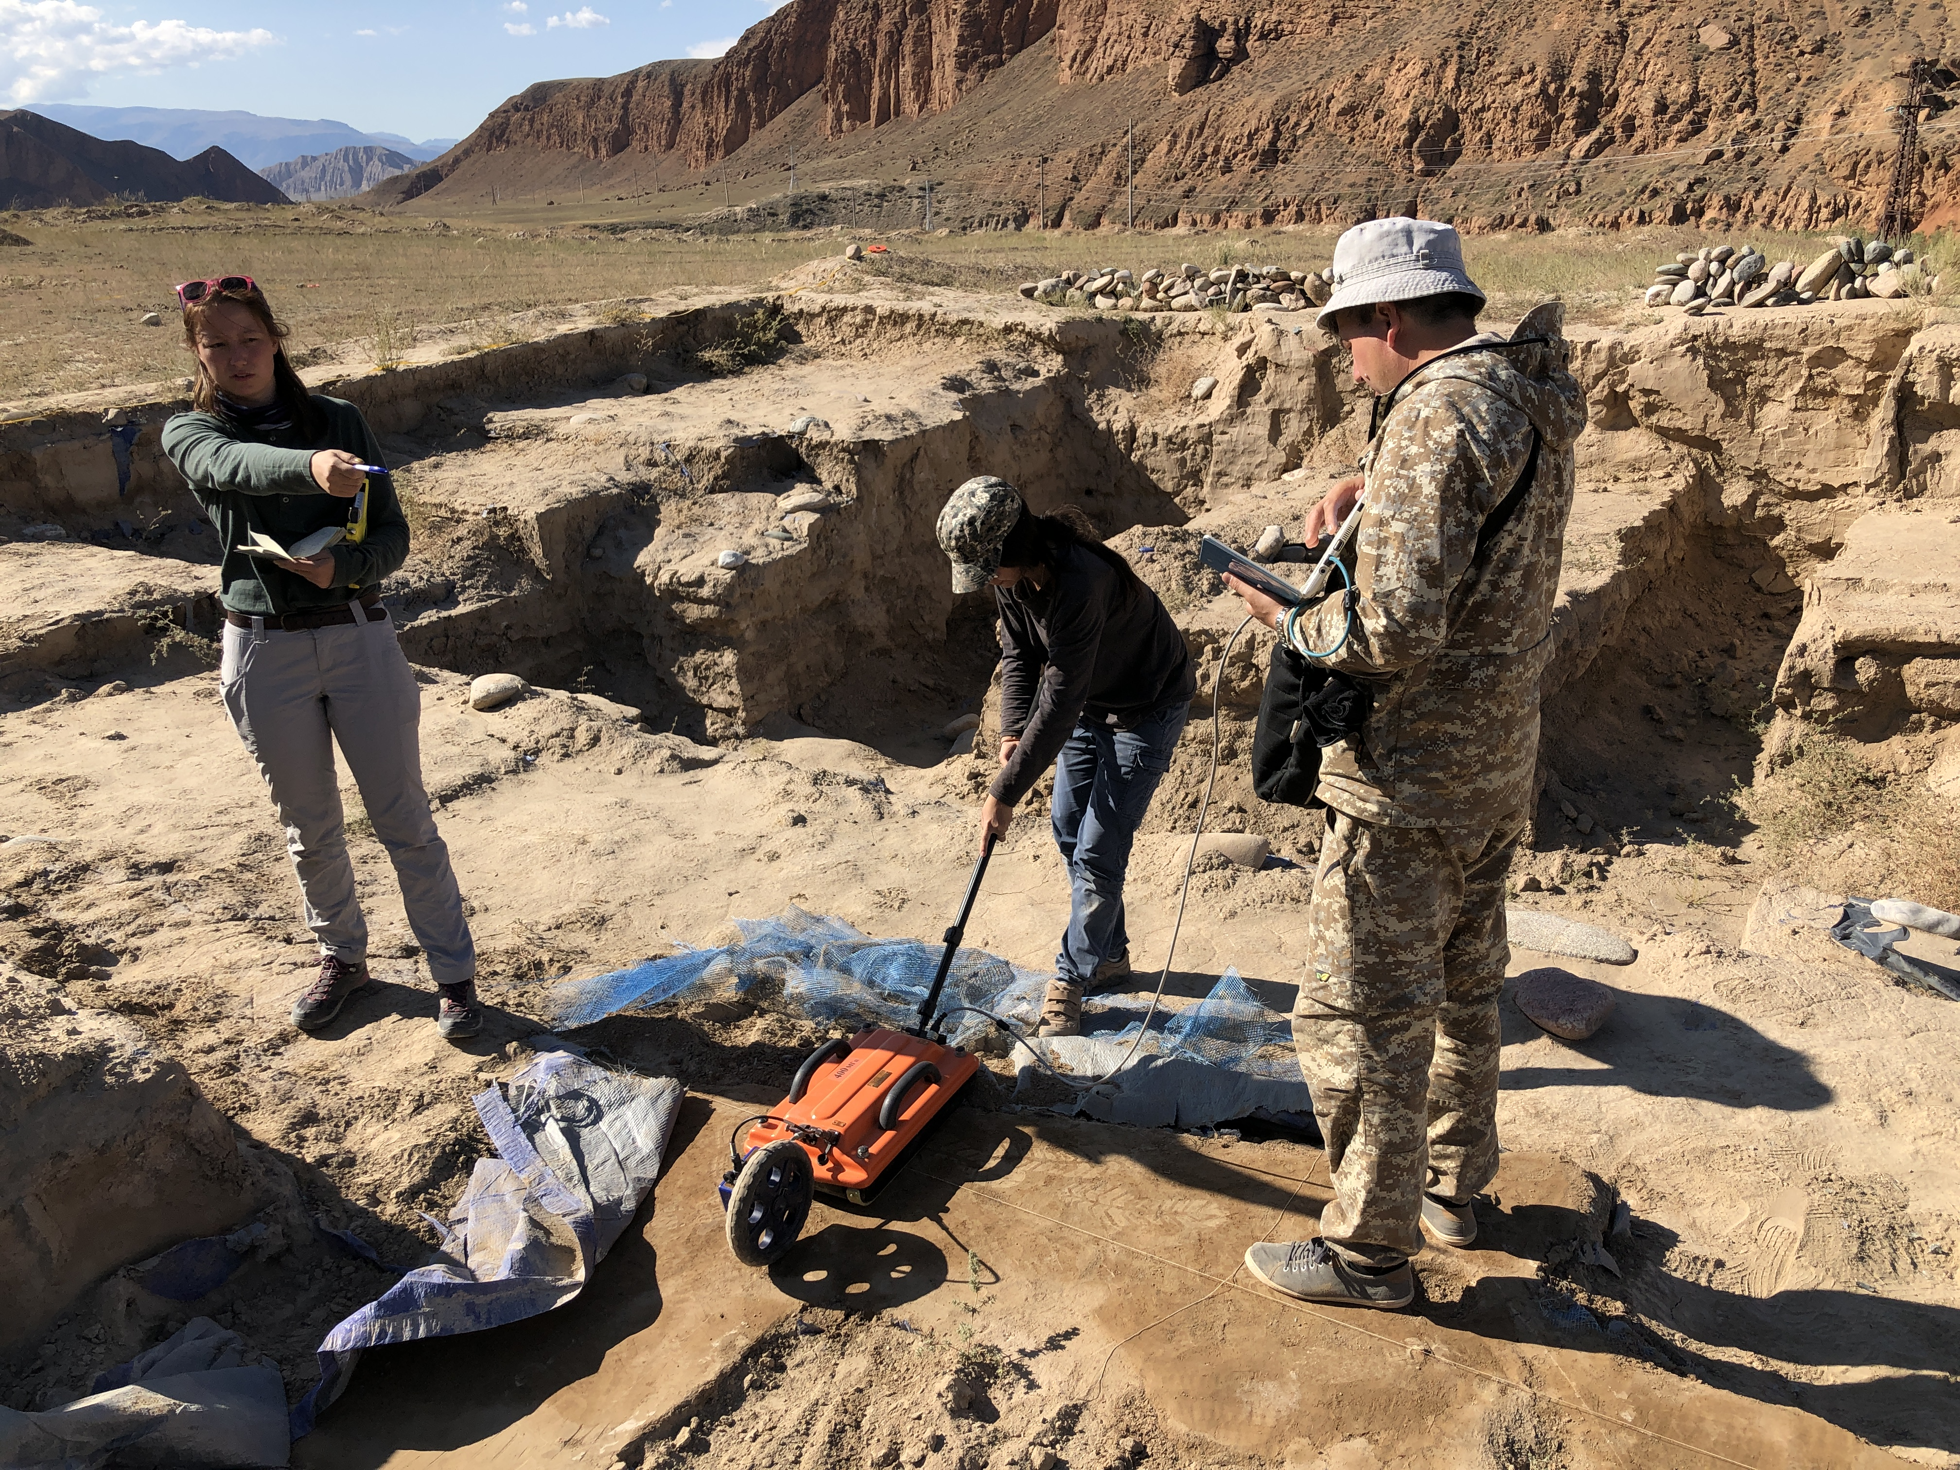
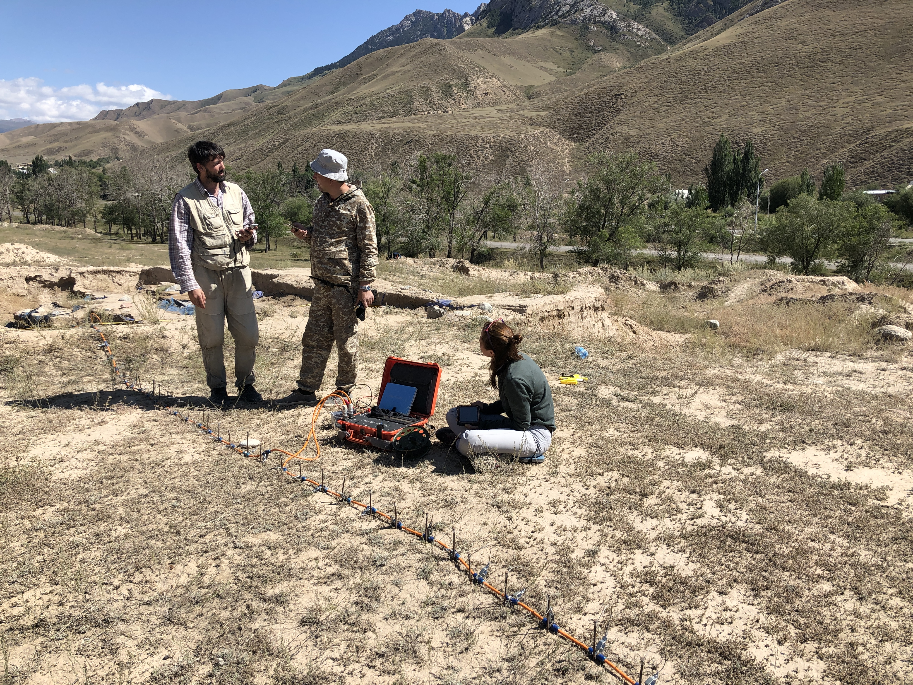
Remote sensing

Slide 10
How is most archaeological survey conducted?
There is no substitute of being there and walking around.
Especially important is covering open and disturbed ground, where shallower remains have been churned up by plows, other heavy road building equipment, burrowing animals and so on.
Seasonality is important for survey. Why?

Slide 11
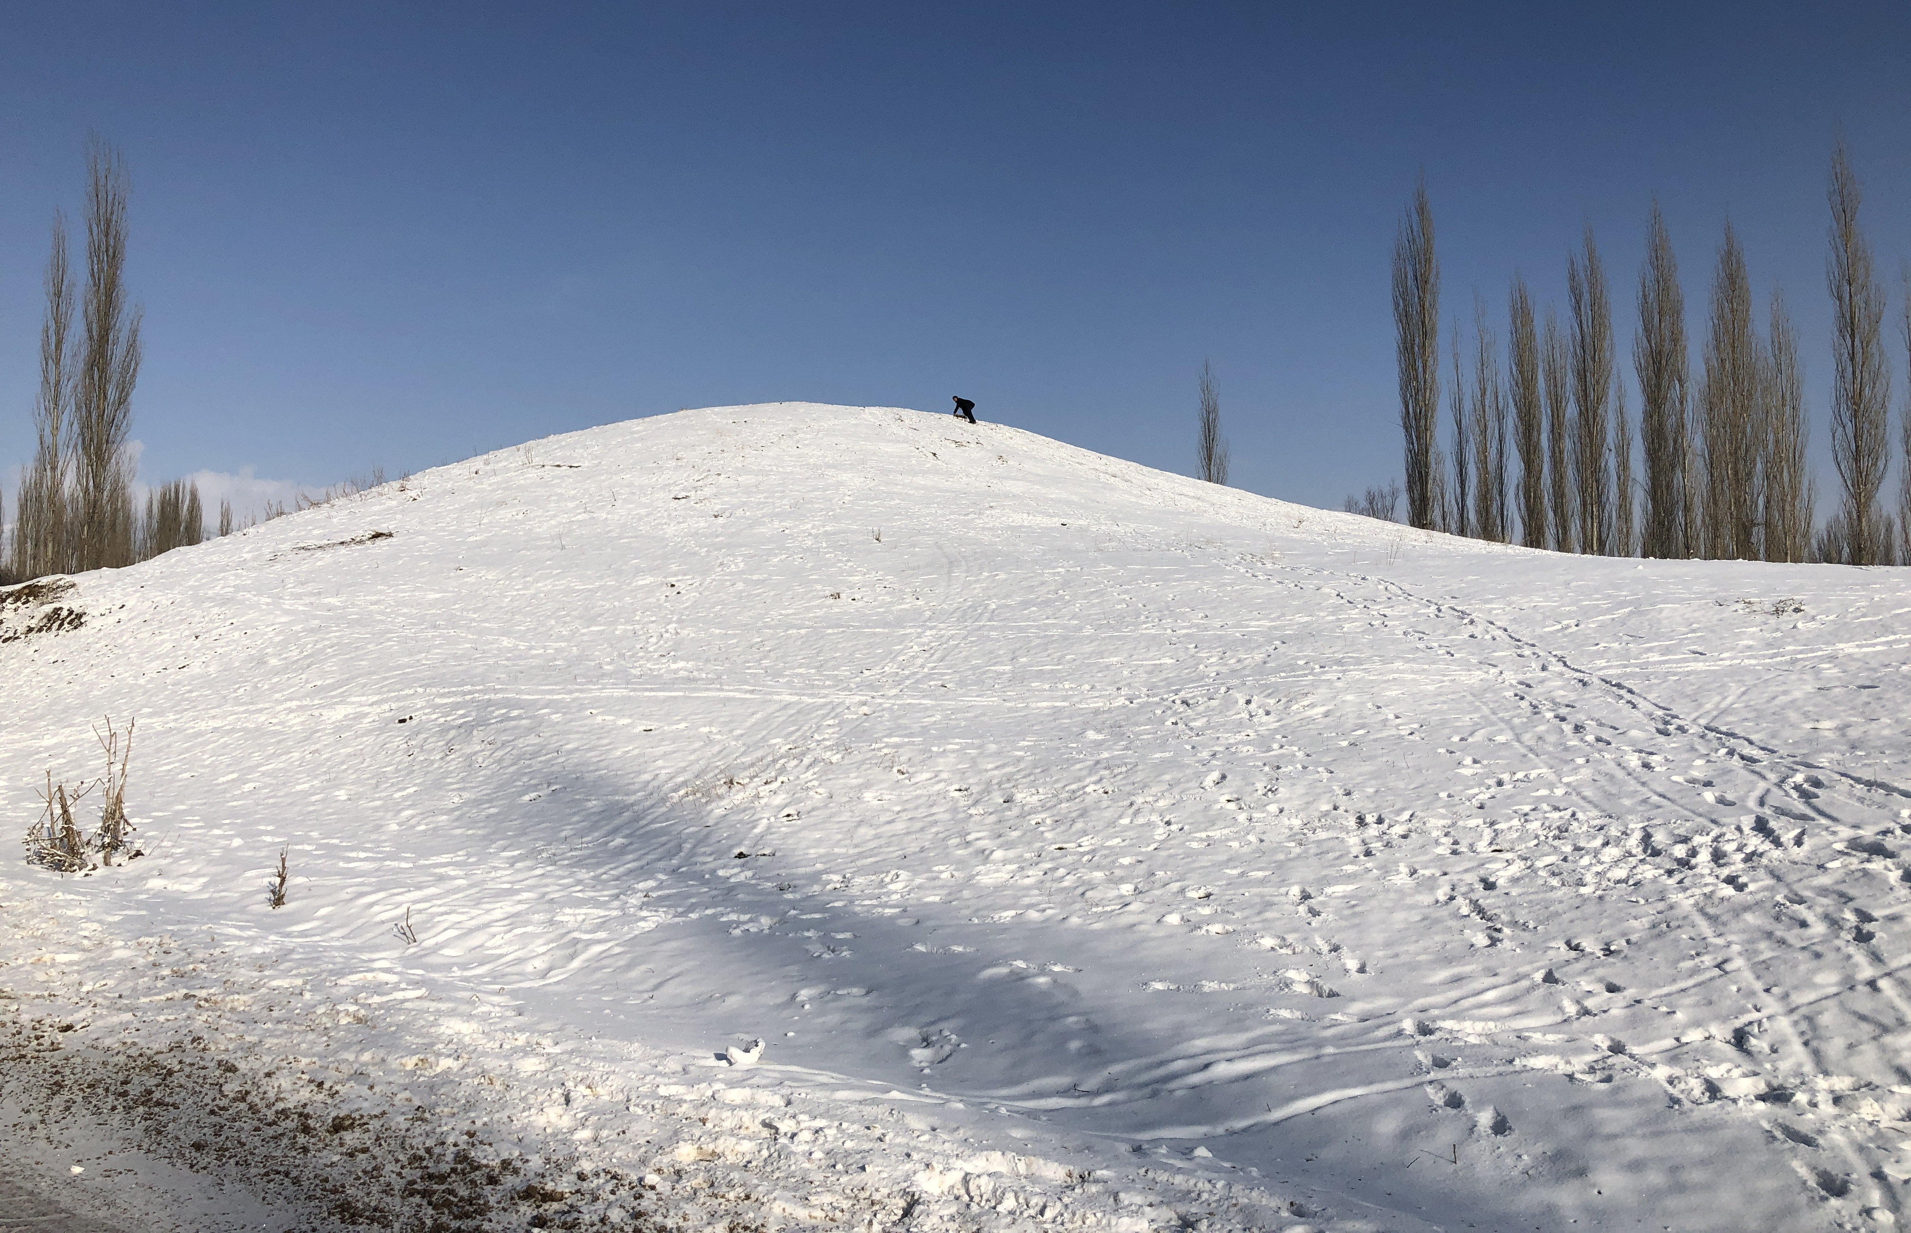
Kuluk-Dobo castle

Slide 12
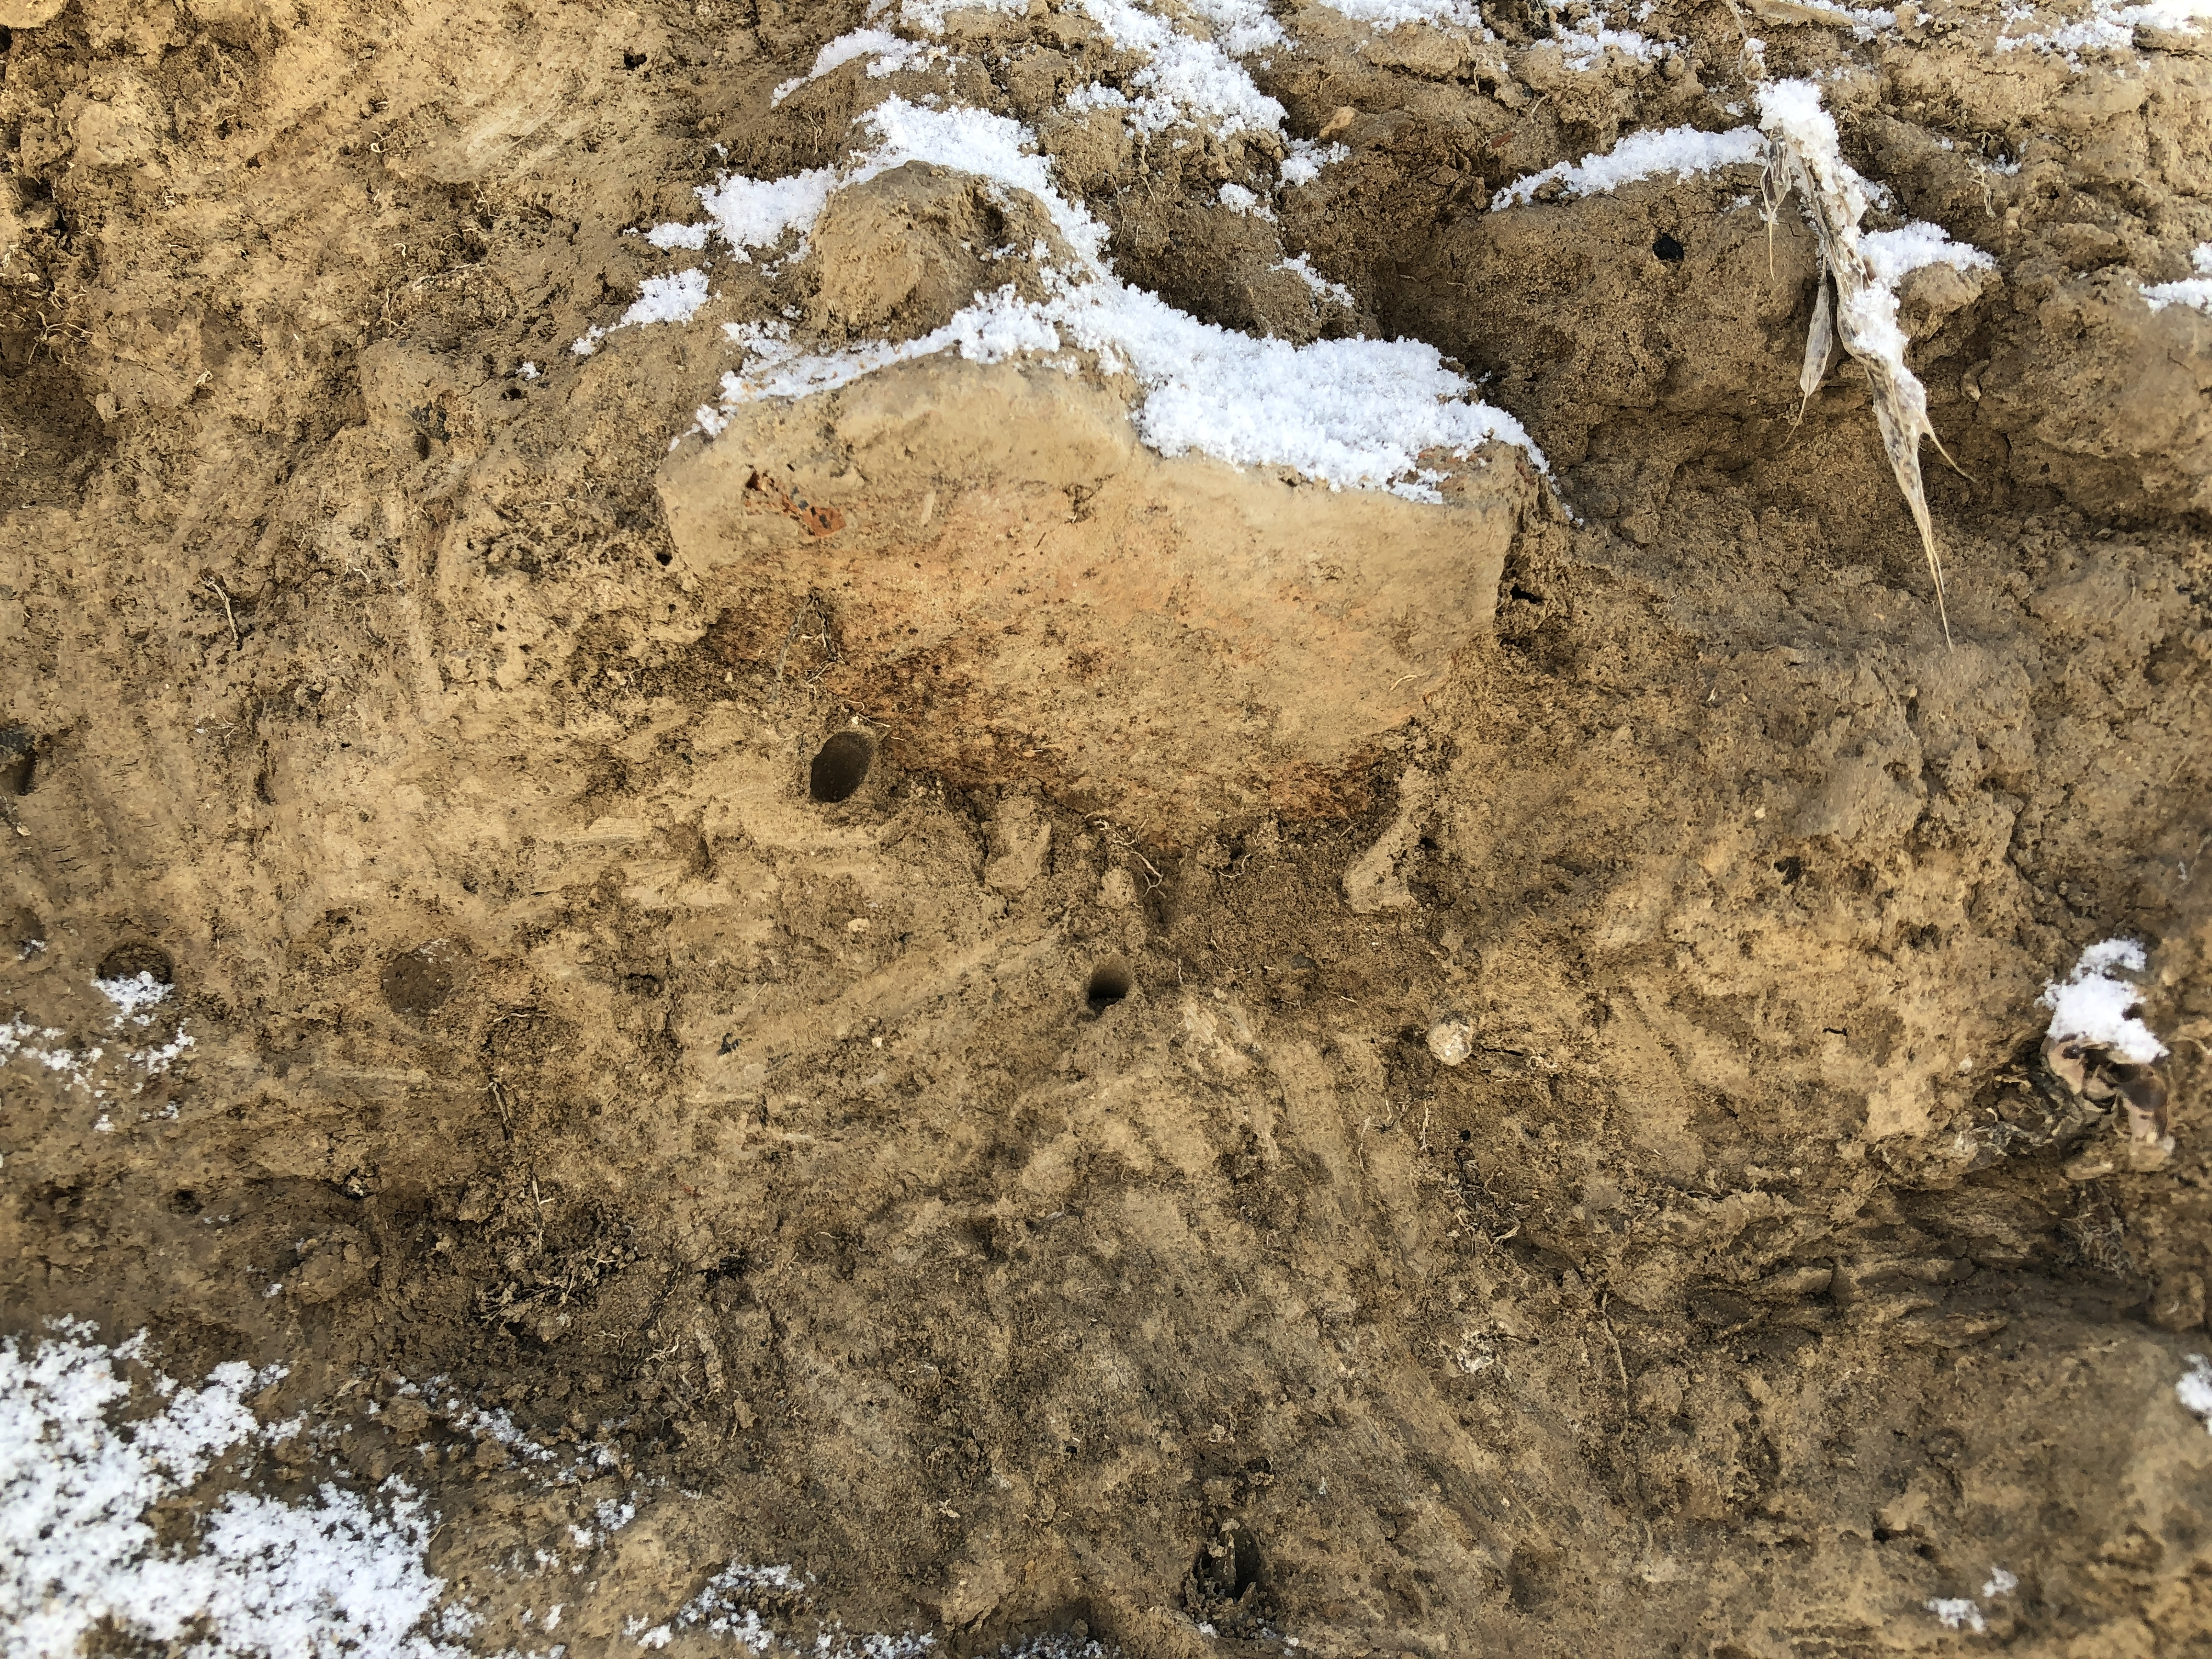
Fragment of the burnt brick

Slide 13
Does survey include any digging?
Subsurface sampling is enormously important
The shovel test is usually 50 cm or 1 m square

Slide 14
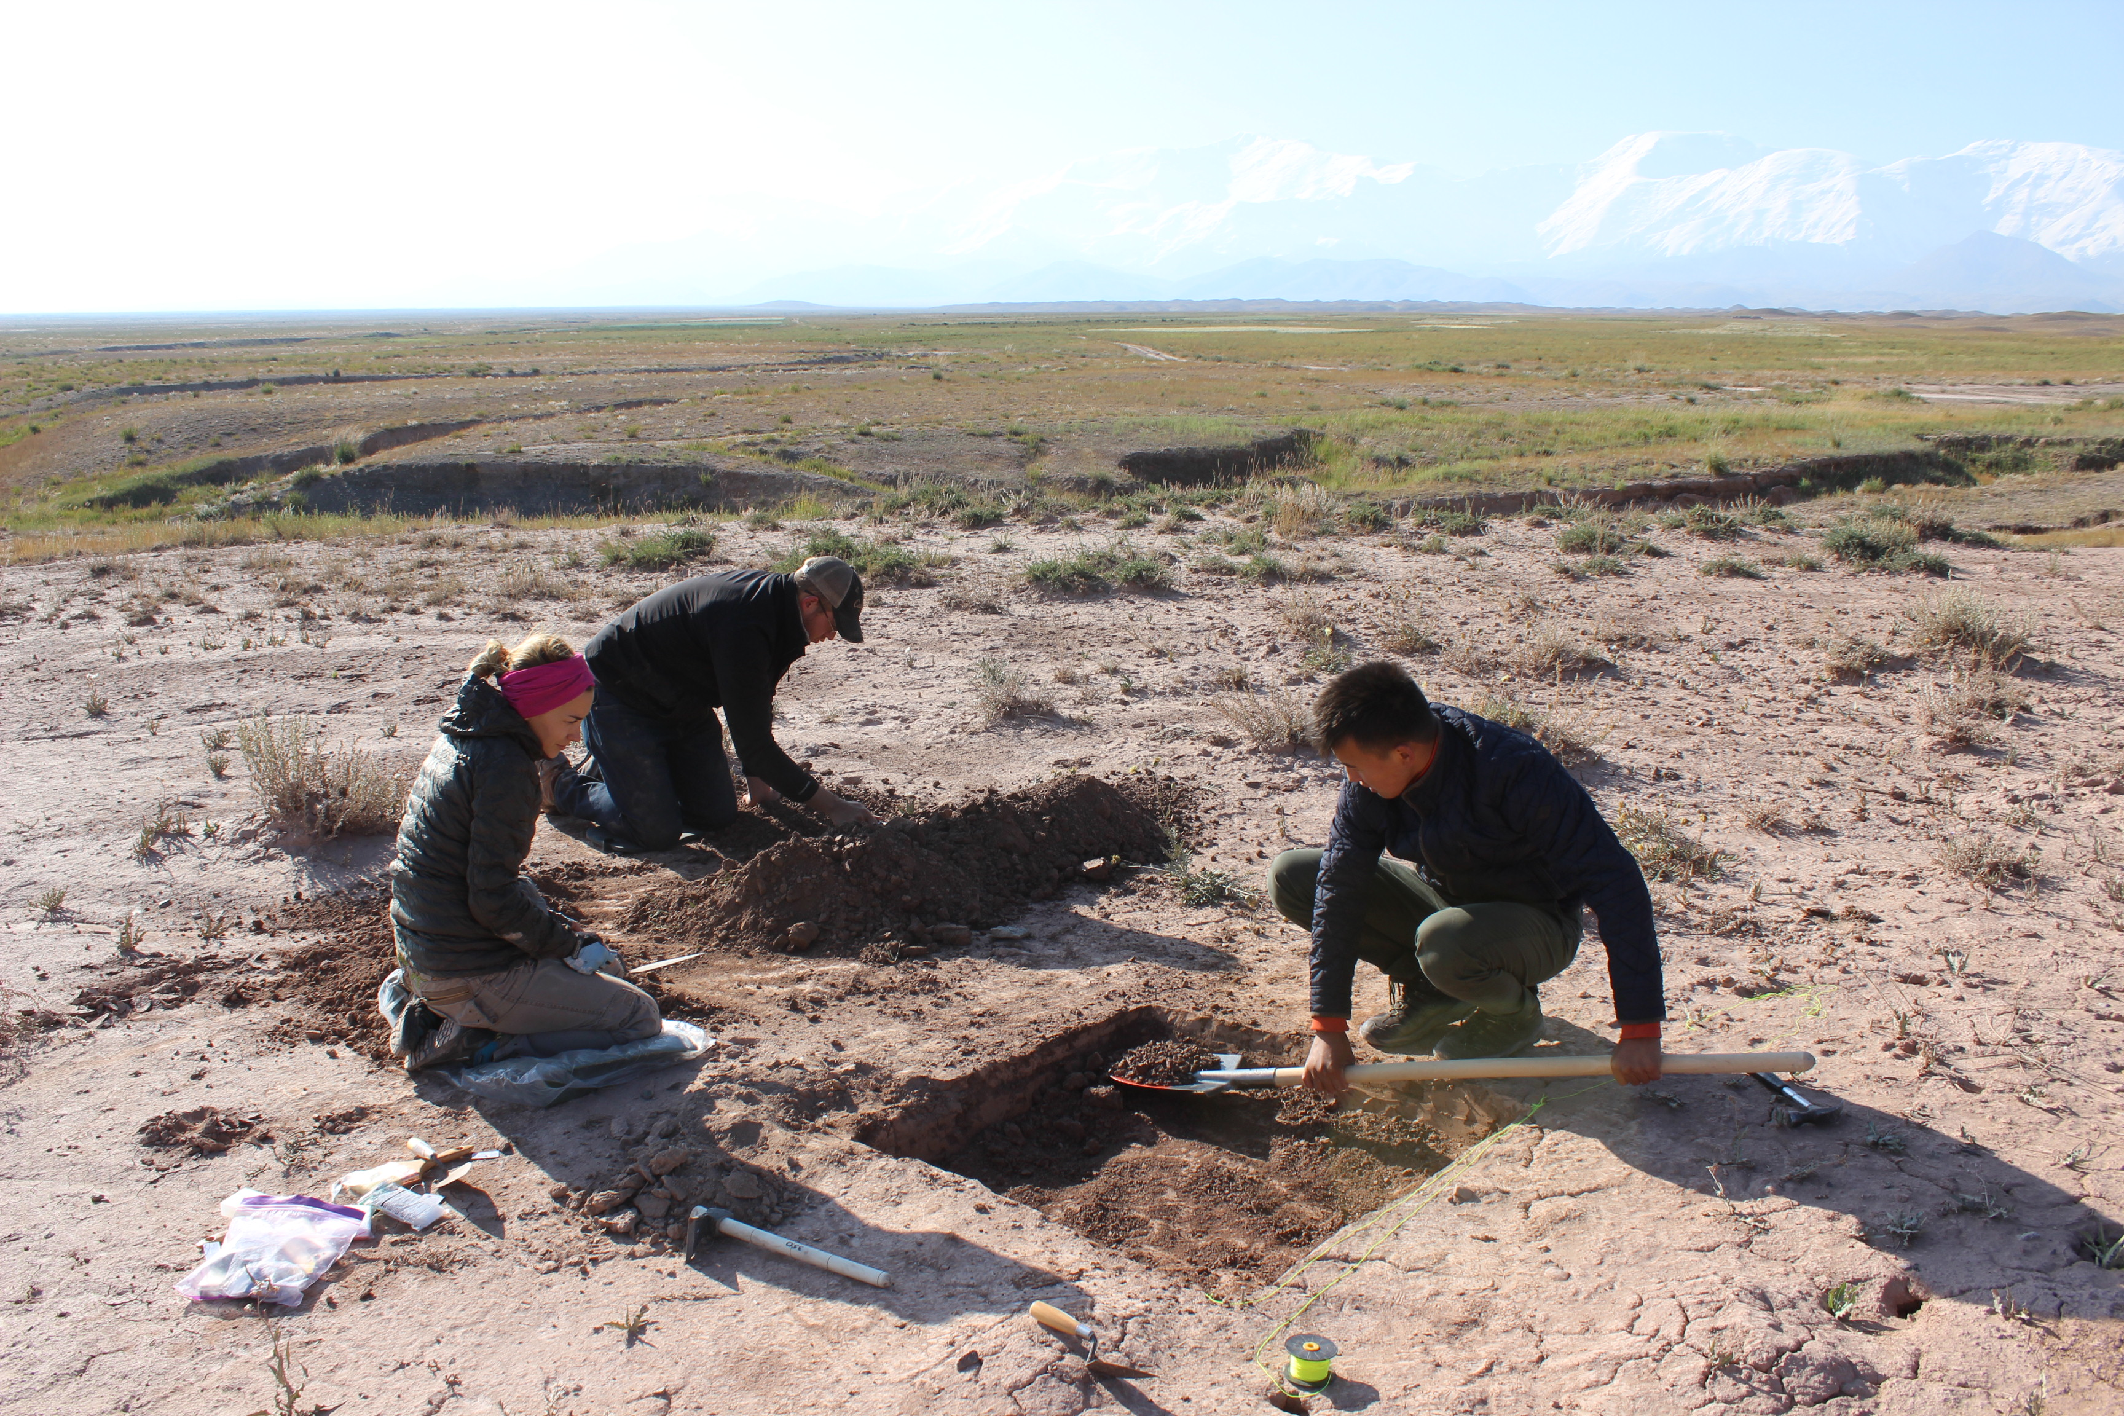
Testing

Slide 15
What other technological devices must modern archaeologists use?
Global Positioning System (GPS) unit, which reads signals bouncing off several satellites to give exact location in latitude/longitude or other coordinates
Geographic Information System (GIS), which are simply computerized ways of making maps of different features that can be overlain to show relationships of natural and cultural features through time

Slide 16
OsmAnd Maps
https://osmand.net/

