Slide 1
Economics of Climate Change
15 September 2022

Slide 2
Goal
To introduce goals of the economics of climate change

Slide 3
What kind of a problem is climate change?
Who must solve it?
Which academic discipline or professional field is most useful?
What the ideal solution or result look like?

Slide 4
Content
How economics can help to solve climate change problem
Assessing the benefits and costs of climate change mitigation
Dealing with Uncertainty
The Choice of Instrument for Climate Change Policy
International Policy Initiatives and Coordination

Slide 5
“SUPER WICKED PROBLEM”

Slide 6
Wickedness of Climate Change Problem
Spatial Dimension of Climate Change: Global Cause vs. Global Effect
Largest emitters vs the most vulnerable
Most politically and economically vulnerable countries vs Developing countries
Fossil fuel based economic growth
Multiple stakeholders vs Few leaders
Long-term vs. short-term
Notes:
In tragic contrast, the most highly industrialized nations that have emitted the vast majority of greenhouse gases over the past one hundred years—including the United States, Russia, and much of Western Europe—are located almost exclusively in the higher latitudes in the northern hemisphere. These are, somewhat perversely, the areas that are likely to suffer the least in the short term and economic interests in these areas may even believe that they will enjoy some shortterm benefits.
Such nations are not only the most responsible for the current problems, but they are also invariably some of the most politically and economically powerful nations on the globe. They are consequently not readily susceptible to less powerful nations’ efforts to compel them to reduce their emissions. Because of their relative wealth, they are also more easily able to adopt adaptation measures and consequently suffer fewer immediate hardships.

Slide 7
Assessing the benefits and costs of climate change mitigation
Market damages -> Production function approach (e.g. wheat production)
Non-market damages. -> direct vs indirect utility (e.g. biodiversity)
Notes:
SUPER WICKED PROBLEMS AND CLIMATE
CHANGE: RESTRAINING THE PRESENT
TO LIBERATE THE FUTURE
Richard J. Lazarus†
In addition to agriculture, this approach has been applied in other industries, including forestry, energy services, water utilities, and coastal flooding from sea level rise

Slide 8
Cost Assessment
“bottom-up” models (for example, Barretto and Kypreos 2004)
“top down,” economy-wide models (see, for example, Jorgenson and Wilcoxen 1996; Conrad 2002) -> computable general equilibrium models
Notes:
Substitution
These models tend to concentrate on one sector or a small group of sectors and offer less information on abilities to substitute from energy in general or on how changes in the prices of energy-intensive goods affect intermediate and final demands for those goods.
In recent years, attempts have been made to reduce the gap between the two types of models. Bottom-up models have gained scope, and top-down models have incorporated greater detail (see, for example, McFarland, Reilly and Herzog 2004.)
Some models focus on R&D-based technological change, incorporating connections between policy interventions, incentives to research and development, and advances in knowledge (see, for example, Goulder and Schneider 1999; Nordhaus 2002; Buonanno, Carraro and Galeotti 2003; Popp, 2004). Others emphasize learning-by-doing-based technological change, where production costs fall with cumulative output in keeping with the idea that cumulative output is associated with learning (for example, Manne and Richels 2004).

Slide 9
Integrated Assessment
to relate costs to mitigation benefits (avoided damages) has spawned the development of integrated assessment models (IAM).
https://www.youtube.com/watch?v=o9tnpwSovJA
Notes:
Many of the integrated assessment models are optimization models that solve for the emissions time-path that maximizes net benefits, in some cases under constraints on temperature or concentration (see, for example, Nordhaus 1994).

Slide 10
Dealing with Uncertainty
The science is not uncertain: the mechanisms through which the accumulation of greenhouse gases in the atmosphere warm the earth are simple and well understood.
We still do not understand fully the implications for social and economic activity ( Heal and Kristrom 2002)

Slide 11
Dealing with Uncertainty
The uncertainties about both the costs and the benefits from reduced climate change are vast.
In meta-analysis examining 28 studies’ estimated benefits from reduced climate change (Tol 2005), the benefit estimates ranged from –$10 (e.g., a net benefit) to $350 per ton of carbon, with a mode of $1.50 per ton.
On the cost side, a separate study found marginal costs of between $10 and $212 per ton of carbon for a 10 percent reduction in 2010 (Weyant and Hill 1999).

Slide 12
The Choice of Instrument for Climate Change Policy
WHAT: emissions taxes, abatement subsidies, emissions quotas, tradable emissions allowances, and performance standards
HOW: directly (as with an emissions trading program) or instead to pollution-related goods or services (as with a fuel tax or technology subsidy)
Notes:
Policymakers can consider a range of potential instruments for promoting reductions in emissions of greenhouse gases.

Slide 13
Instrument for Climate Change Policy
Carbon tax
Quantities (Tradable Allowances)
Fiscal Impacts and Instrument Choice
Notes:
number of studies show that using such revenues to finance reductions in pre-existing distortionary taxes on income, sales, or payroll can achieve given environmental targets at lower cost—perhaps substantially lower— than other policies (see, for example, Goulder et al. 1999; Parry, Williams and Goulder 1999; Parry and Oates 2000). Therefore, carbon taxes and auctioned permit programs that employ their revenues this way will lower the excess burden from prior taxes, giving them a significant cost advantage. Correspondingly, subsidies to emissions reductions or to new, “clean” technologies will have a cost disadvantage associated with the need to raise distortionary taxes to finance these policies.

Slide 15
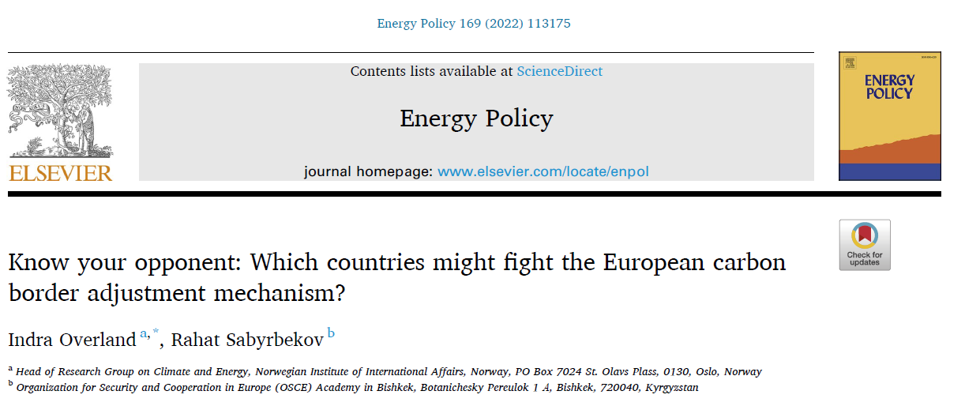
The European Union (EU) plans to activate a carbon border adjustment mechanism (CBAM) in January 2023. This is meant to secure fair competition for European energy-intensive industries, incentivize countries both inside and outside the EU to cut emissions, and hinder carbon leakage from the EU.
The analysis indicates that the following countries are most likely to mount opposition to CBAM: Iran, Ukraine, the USA, the United Arab Emirates, Egypt, China, India, Kazakhstan, Russia, and Belarus.

Slide 16
International Policy Initiatives and Coordination
Notes:
number of studies show that using such revenues to finance reductions in pre-existing distortionary taxes on income, sales, or payroll can achieve given environmental targets at lower cost—perhaps substantially lower— than other policies (see, for example, Goulder et al. 1999; Parry, Williams and Goulder 1999; Parry and Oates 2000). Therefore, carbon taxes and auctioned permit programs that employ their revenues this way will lower the excess burden from prior taxes, giving them a significant cost advantage. Correspondingly, subsidies to emissions reductions or to new, “clean” technologies will have a cost disadvantage associated with the need to raise distortionary taxes to finance these policies.

Slide 17
The goals of the Paris Agreement
Ambitious and hopeful
The largest number of participants
Legally binding

Slide 18
Conclusion
Climate change economics has produced new methods for evaluating environmental benefits, for determining costs in the presence of various market distortions or imperfections
Clearly, many theoretical and empirical questions remain unanswered.
From 2003 until 2030, the world is poised to invest an estimated $16 trillion in energy infrastructure, with annual carbon dioxide emissions estimated to rise by 60 percent.

Slide 19
Questions
What do you think economists should do better in order to solve climate crisis?
In which field do you see the largest potential?

Slide 20
Thank you! Questions?

