Slide 1
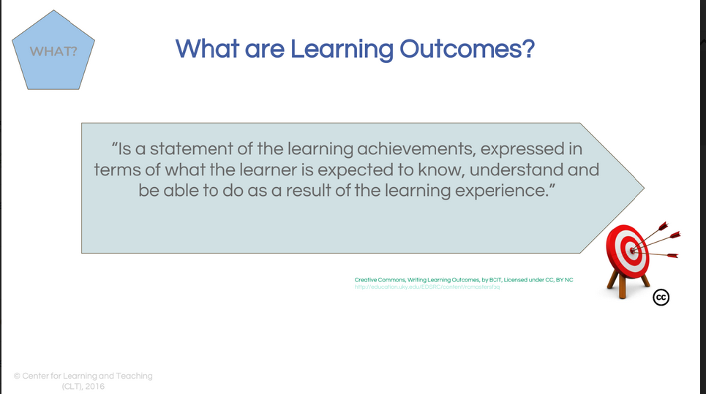
Learning outcomes
Notes:
define the type and depth of learning students are expected to achieve
provide an objective benchmark for formative and summative assessment
clearly communicate expectations to learners
guide and organise teacher and learner behaviours
Learning outcomes begin with an action verb and describe something observable or measurable. Use only one action verb per outcome. Vague verbs such as ‘know’ or ‘understand’ are not easily measurable. Substitute with ‘identify’, ‘define’, ‘describe’ or ‘demonstrate’.
Avoid vague verbs such as ‘know’, ‘appreciate’ and ‘understand’. (Phrases like ‘Demonstrate understanding of...’ are just as vague as ‘Understand’!)
 Check that the verbs used reflect the level of learning required.
Ensure that outcomes are observable and measurable.
Write the outcomes in terms of what the learner does, not what the teacher does.
Check that the outcomes reflect knowledge, skills or attitudes (or a combination of these).
 Include outcomes that are woven into the entire course (such as ‘Work effectively in teams’).
Check that there are the appropriate number of outcomes (ideally no more than three per major topic).

Slide 2
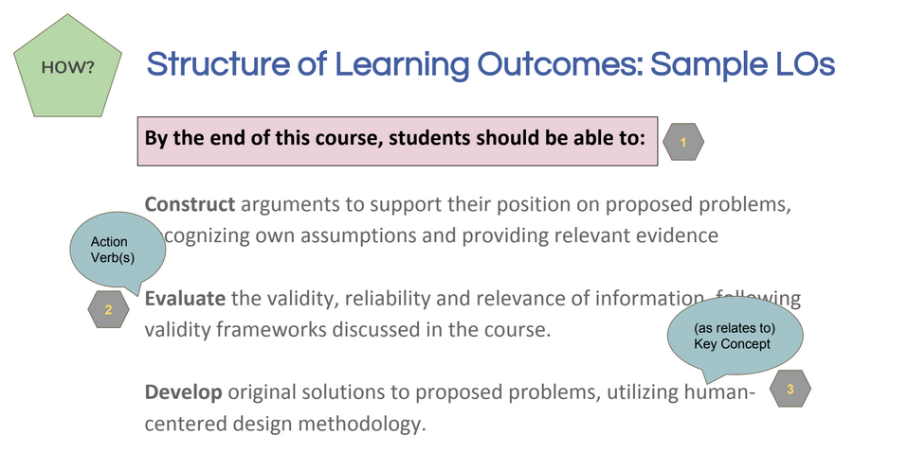

Slide 3
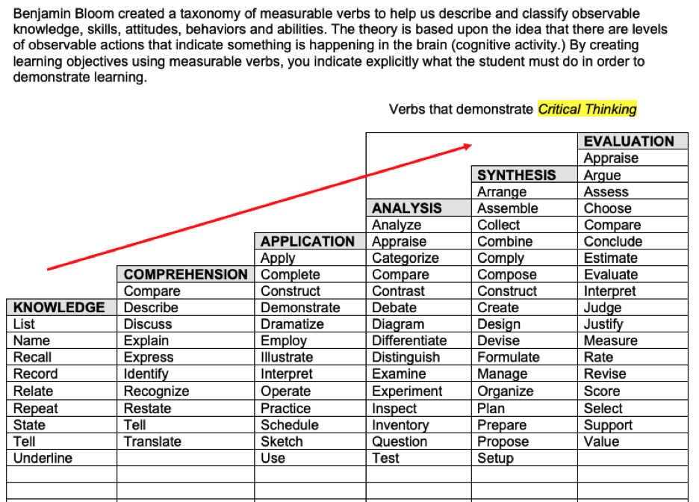

Slide 4
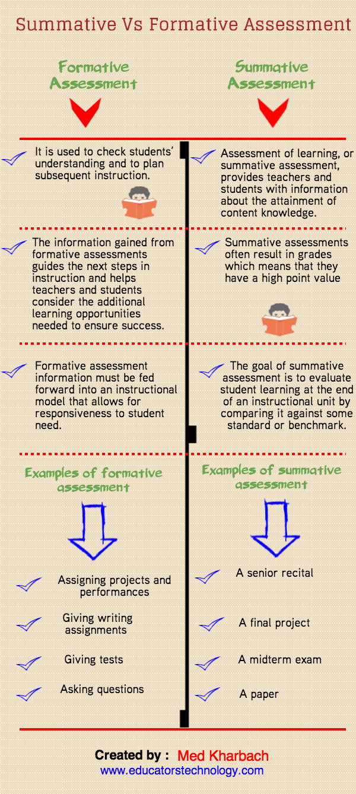

Slide 5
Assessment
Purpose:
Create an assessment plan for your course.
Task:
With the learning outcomes of your course in mind, define your assessment plan, completing the following:
What must be assessed?
I would like to assess in these ways (e.g., through an exam or an assignment):
I would rather not assess in these ways:
I will exploit technology for formative and summative assessment by (e.g., by using a discussion forum to provide formative feedback or by setting up a multiple-choice exam):
The work done during the course will contribute to formative and summative assessment in these ways:
Formative feedback will be offered by teachers and peers in these ways and using these technologies:
Peer assessment
Notes:
Individual break out rooms 10”
Groups of three after 10 minutes

