Slide 1
Things in the Context and Time

Slide 2
Main concepts
Artefacts
Features
Structures
Eco/Biofacts
Sites

Slide 3
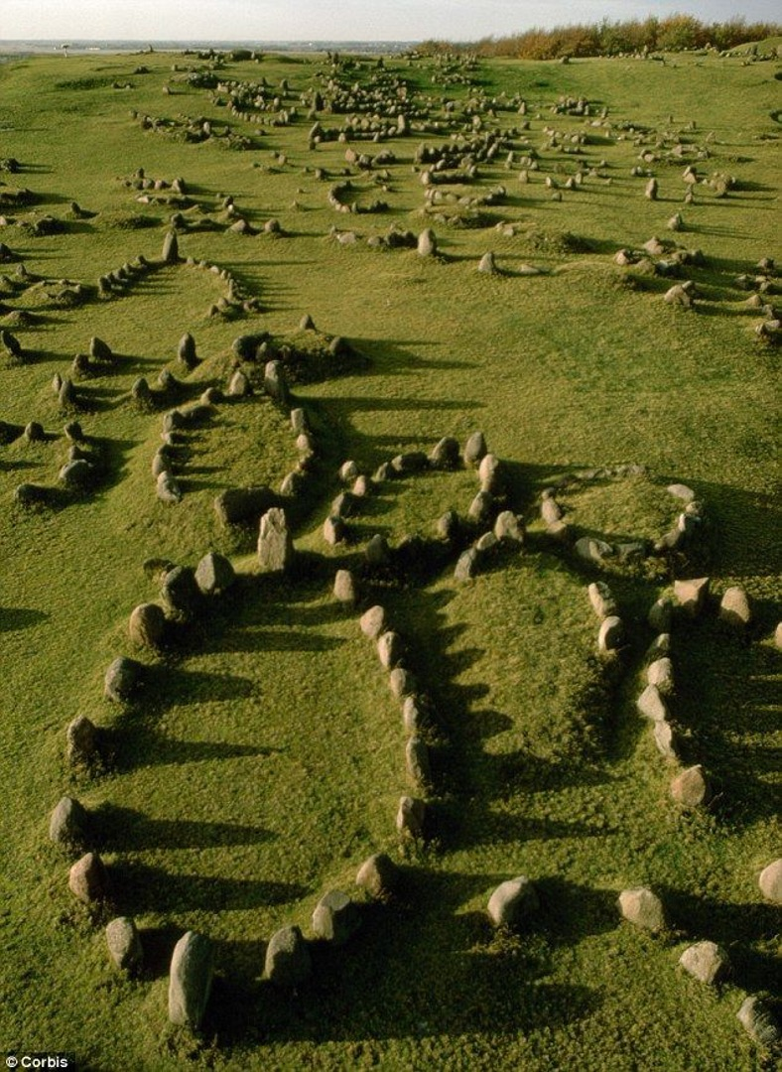
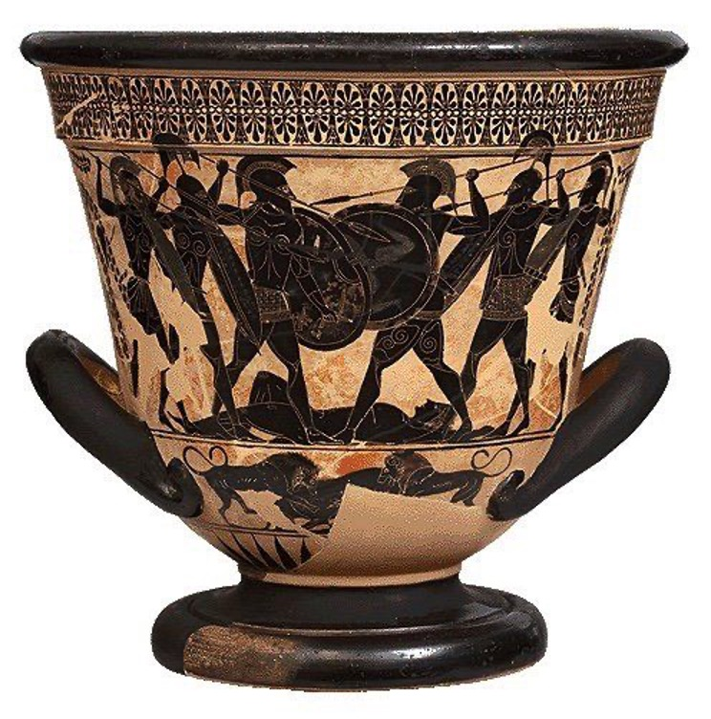
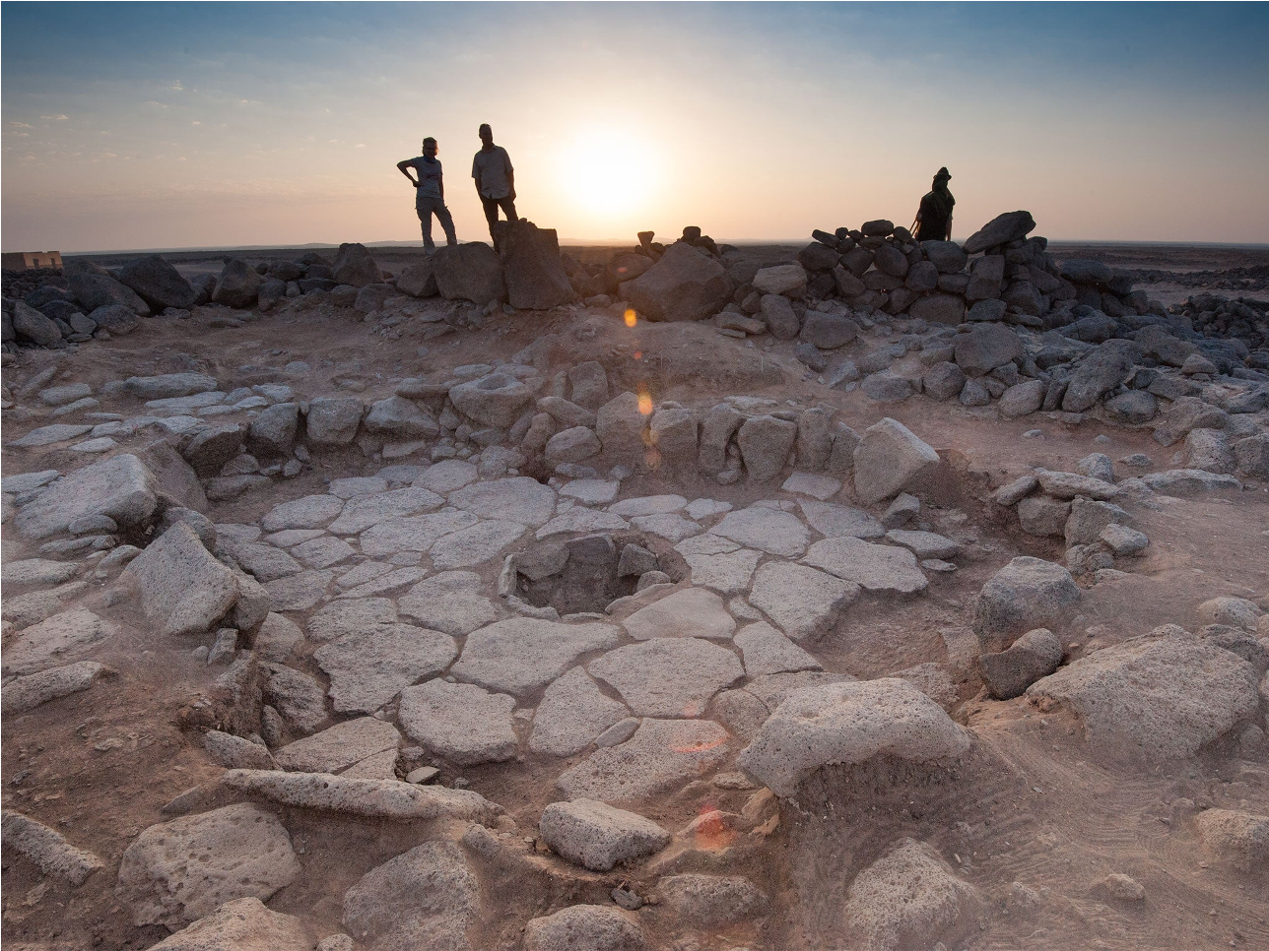
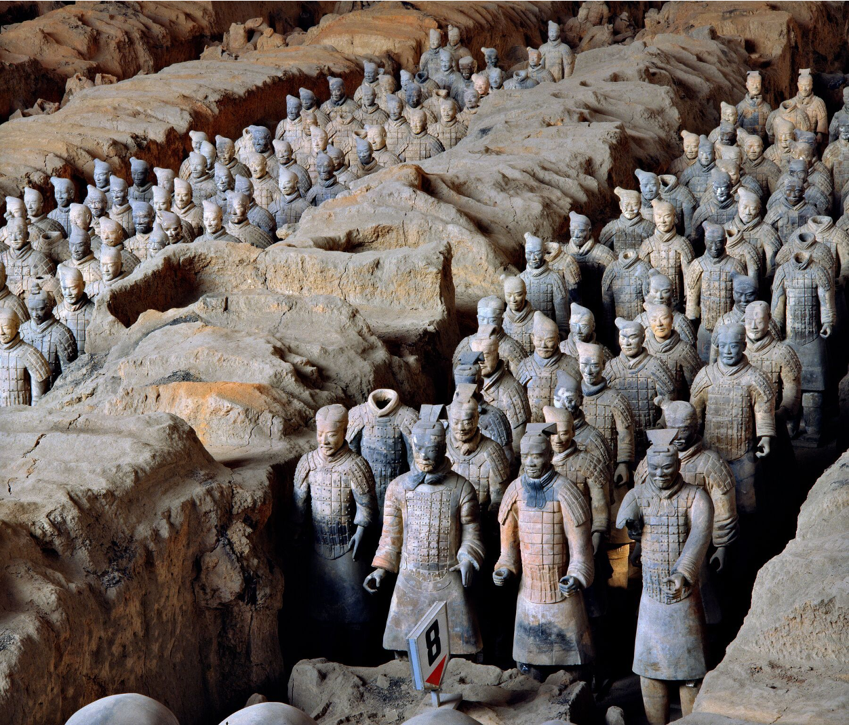
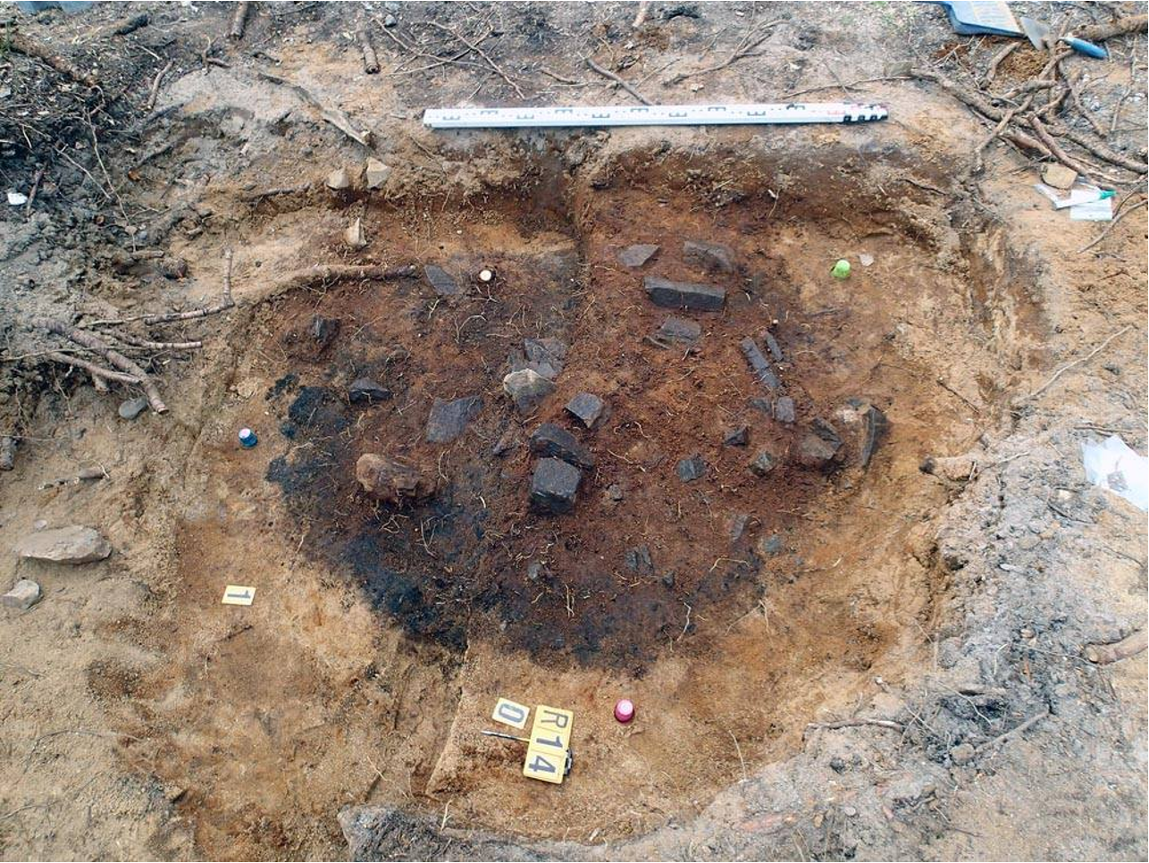
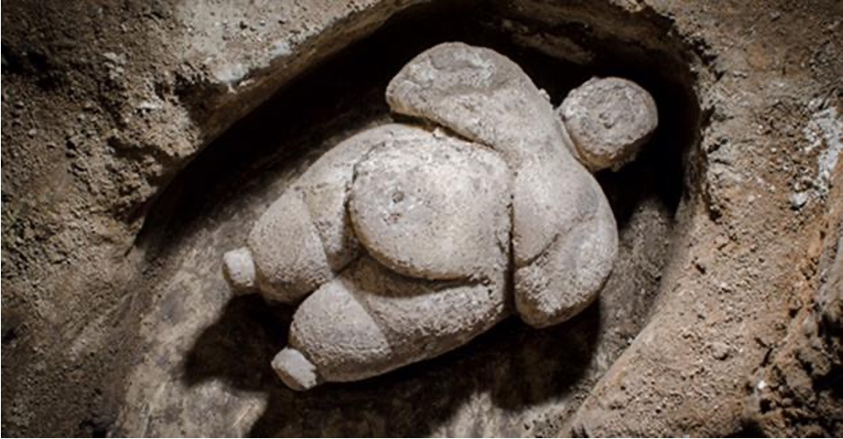

Slide 4
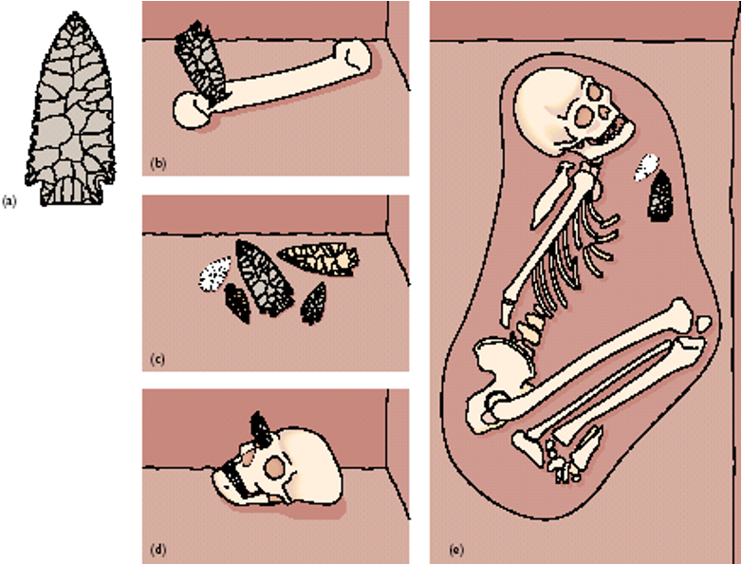
Context
Context of find/s is essential!
Context = Matrix+Provinience+Association
Primary context = in situ
Secondary context

Slide 8
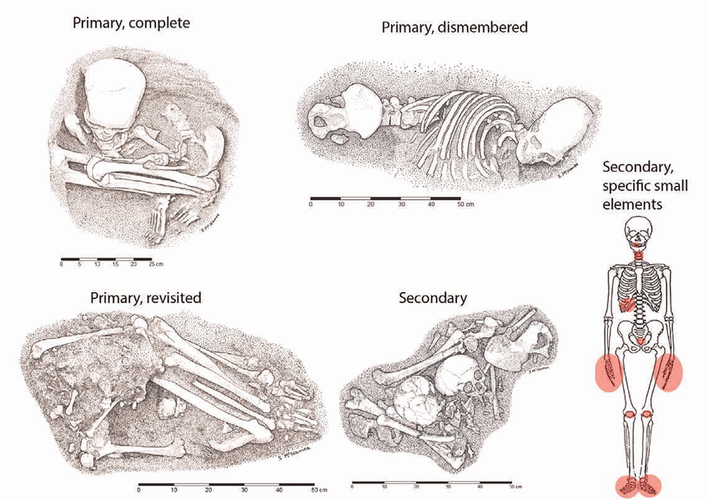

Slide 9
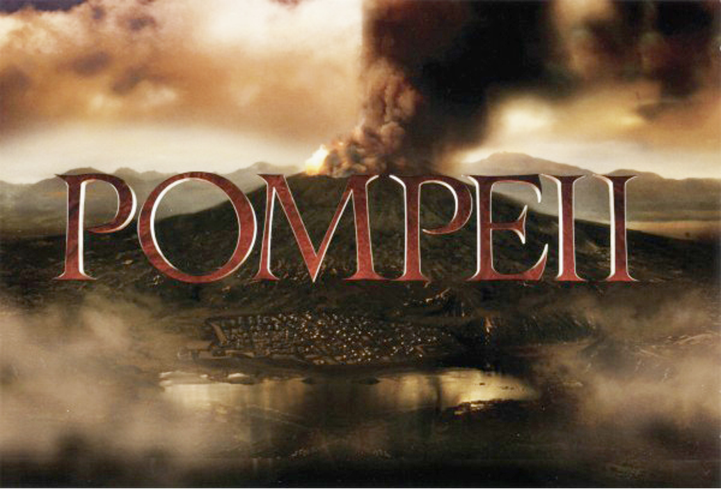
?

Slide 10
Site formation
Taphonomy
Cultural formation processes (human impact)
Natural formation processes (non-human impact)

Slide 11
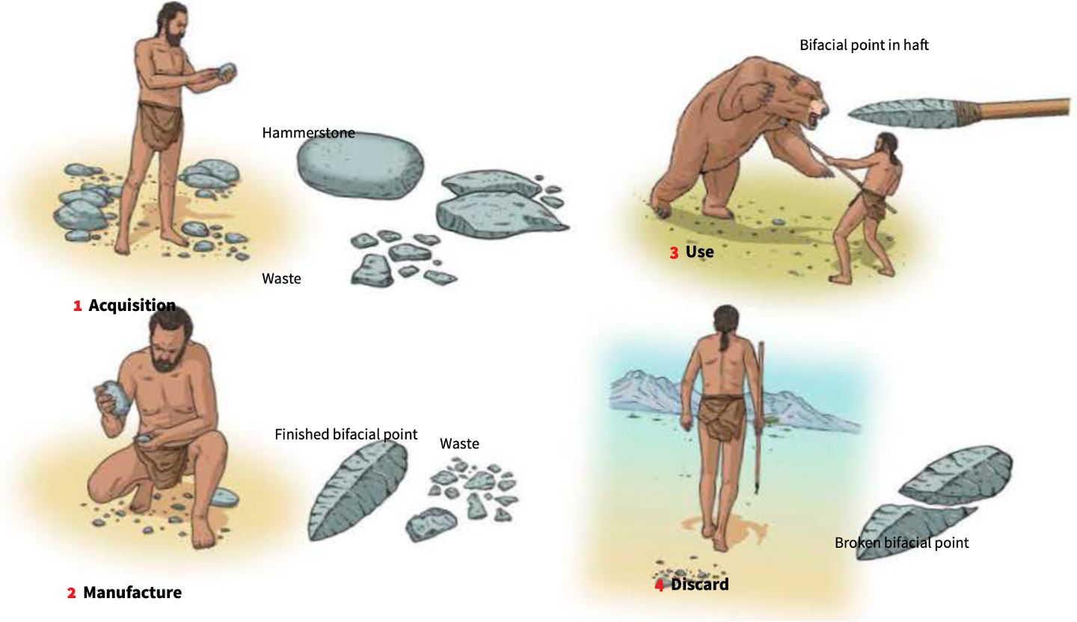

Slide 12
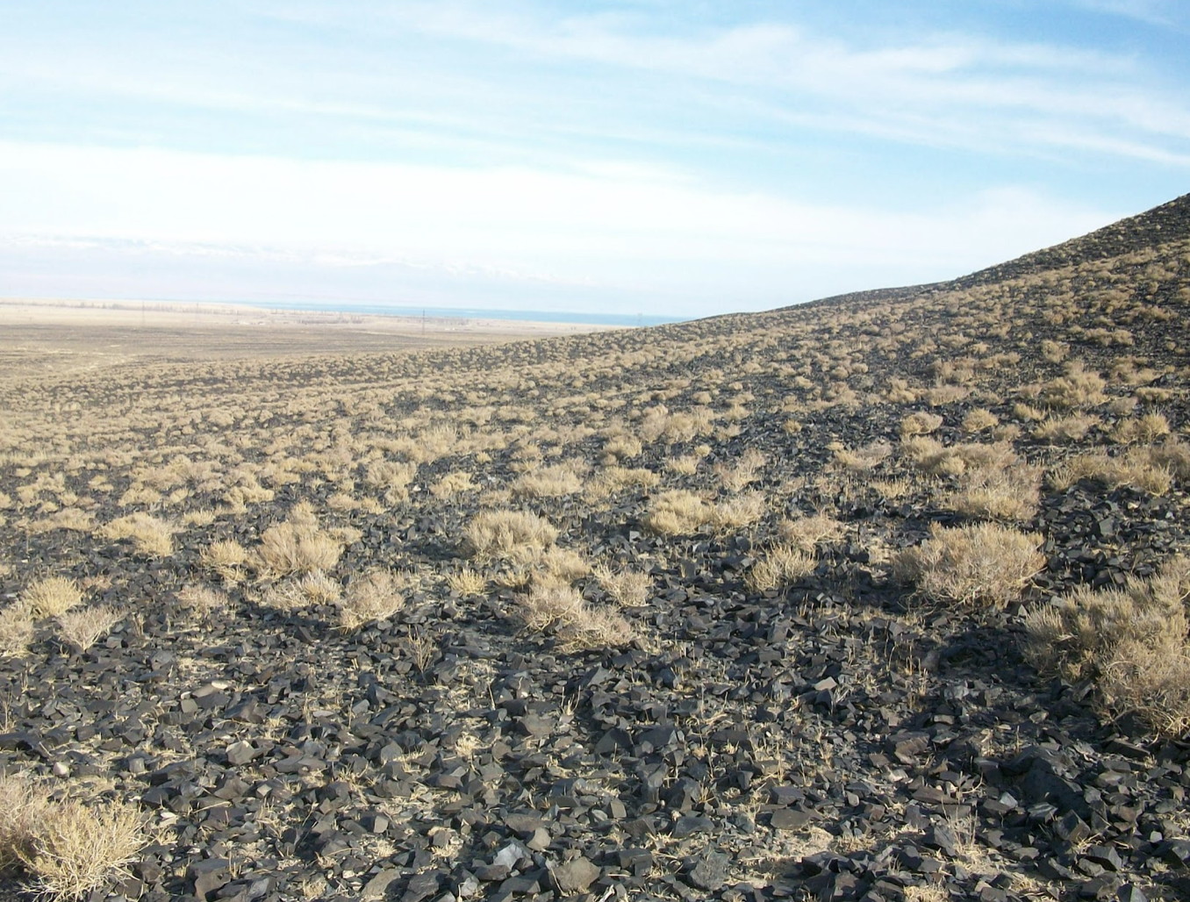
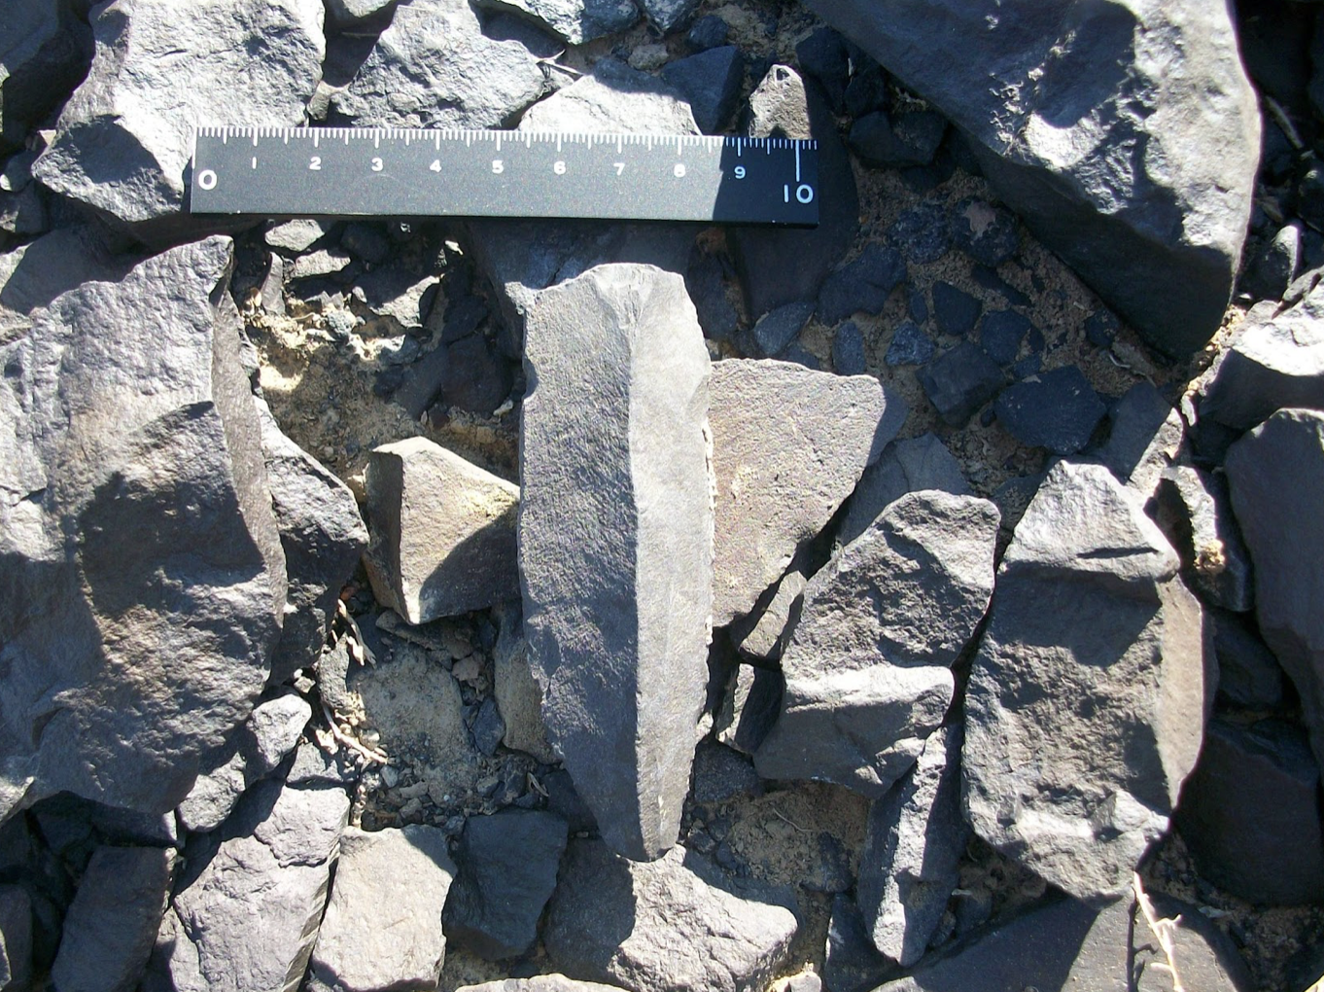

Slide 13
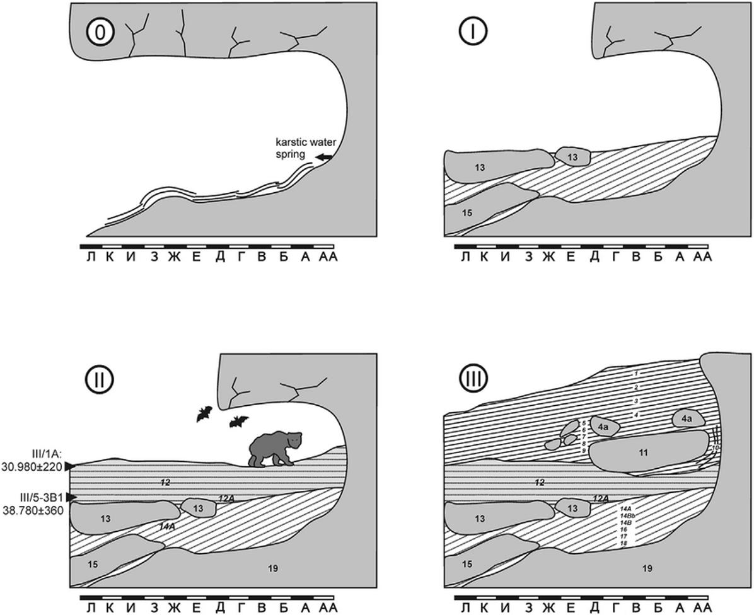

Slide 14
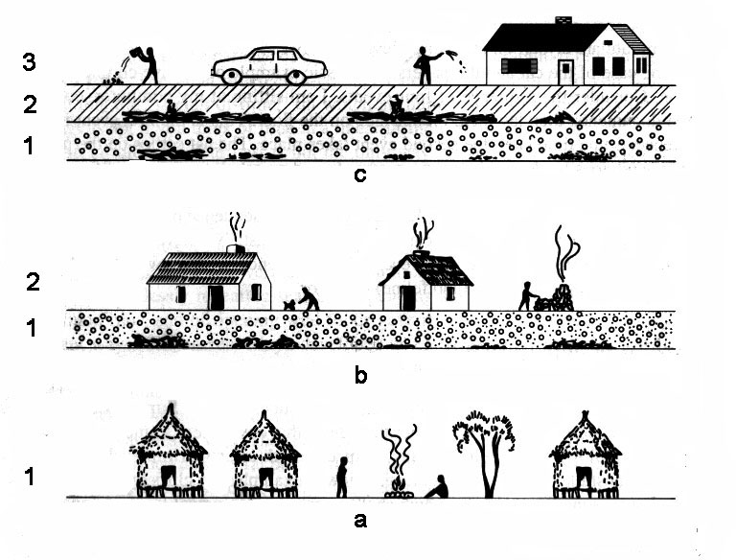

Slide 18
Stratigraphy
Law of superposition
Law of original horizontality
Law of cross-cutting relationship
Law of lateral continuity

Slide 21
Harris matrix
tool that archaeologists use to keep track of stratigraphy and stratigraphic units.
By using the laws of stratigraphy, archaeologists create these logic diagrams to record the top-down sequence of stratigraphic deposits and help make sense of the information they contain.

Slide 22
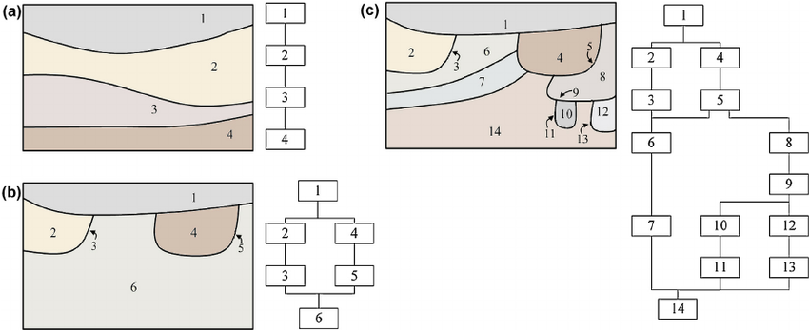

Slide 23
Typical terms
Cut (ditch cut)
Overlay (fill)
Above
Below
Butts or abut (An example would be a clay floor laid up to the vertical face of an already existing wall)
Contemporary: a context may be different but formed in the sequence at the same time (an example of this would be a body in a coffin was already in the coffin when the two where fixed in the sequence)
Same as:

Slide 24
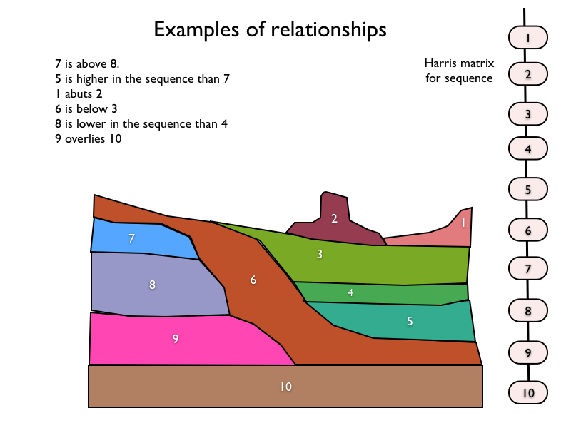

Slide 25
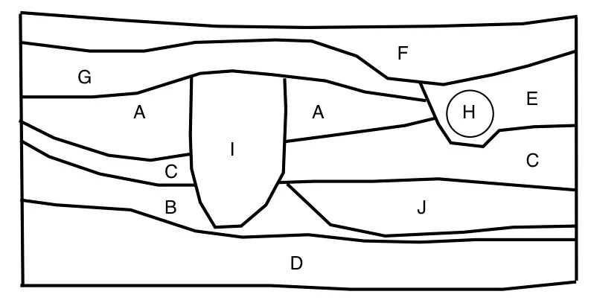
Please place the order of layers using Harris matrix method

