Slide 1
Brief Summary of Covered Materials

Slide 2
Short Run Goods and Financial Markets: The IS-LM Model

Slide 3
Financial Markets and the LM Relation
The Goods Market and the IS Relation

Slide 4
Putting the IS and the LM Relations Together

Slide 5
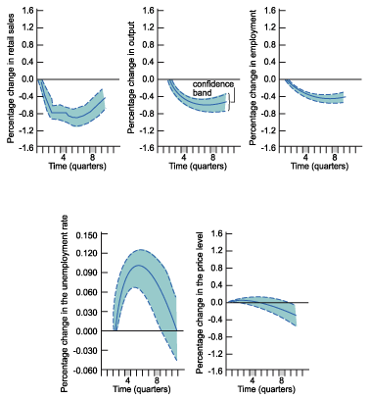
How does the IS-LM Model Fit the Facts?
The two dotted lines and the tinted space between them gives us a confidence band, a band within which the true value of the effect lies with 60% probability.

Slide 6
Medium Run: The AS-AD Model

Slide 7
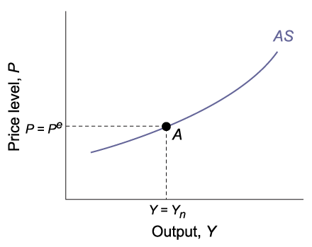
Aggregate Supply Relation
↓Y→↑u→ ↓ W → ↓ P
(-, +)

Slide 8
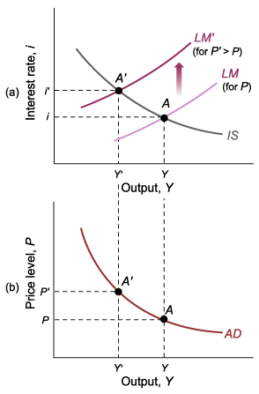
Aggregate Demand Relation
AD Relation

Slide 9
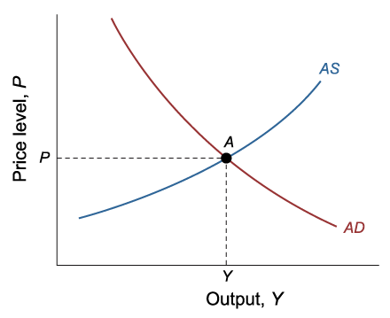
The AS-AD Model

Slide 10
Long Run: The Solow Model

Slide 11
The Solow growth Model

Slide 12
GDP growth rate dynamics

