Slide 1
Zoroastrian death rites

Slide 2
Origin
Monotheistic and dualistic religion (Ahura Mazda and His adversary Angra Mainyu)
In Persia
Founded by prophet Zaratustra between 1,700 and 1,500 BC
Migrated to India (Parsees) and beyond
Through texts of Avesta (liturgical) and Gatas (hymns)
Based on two ritual elements: water and fire, with daily plant and animal offerings made to the fire

Slide 3
Belief to afterlife
Idea of a spirit, believed in the ancient tradition to travel to an underground kingdom, aided by mortuary blood sacrifices
Daily rituals took place for thirty days and then less often until after some thirty years the soul was reckoned to be part of the ancestral fellowship of the dead
Dead were commemorated on the last night of each year when souls were said to return to their old homes

Slide 4
Videvdat (Vendidad)
The nineteenth book of the Avesta, entitled Videvdat (Vendidad) or the “Law Against Devas (Demons)”
Death being in opposition to life meant that dead bodies were treated as polluting and polluted
The highly ritualized nature of body disposal was essential for the individual to advance towards paradise.

Slide 5
‘put your trust in life, for at the last death must overtake you and dog and bird will rend your corpse and your bones will be tumbled on the earth. For three days and nights the soul sits beside the pillow of the body’
Bridge of destiny and meeting with women who is a symbol of the good deeds
Getting the Endless Light and eating ‘butter of early spring’ or meeting an ugly woman and eating the vilest food

Slide 6
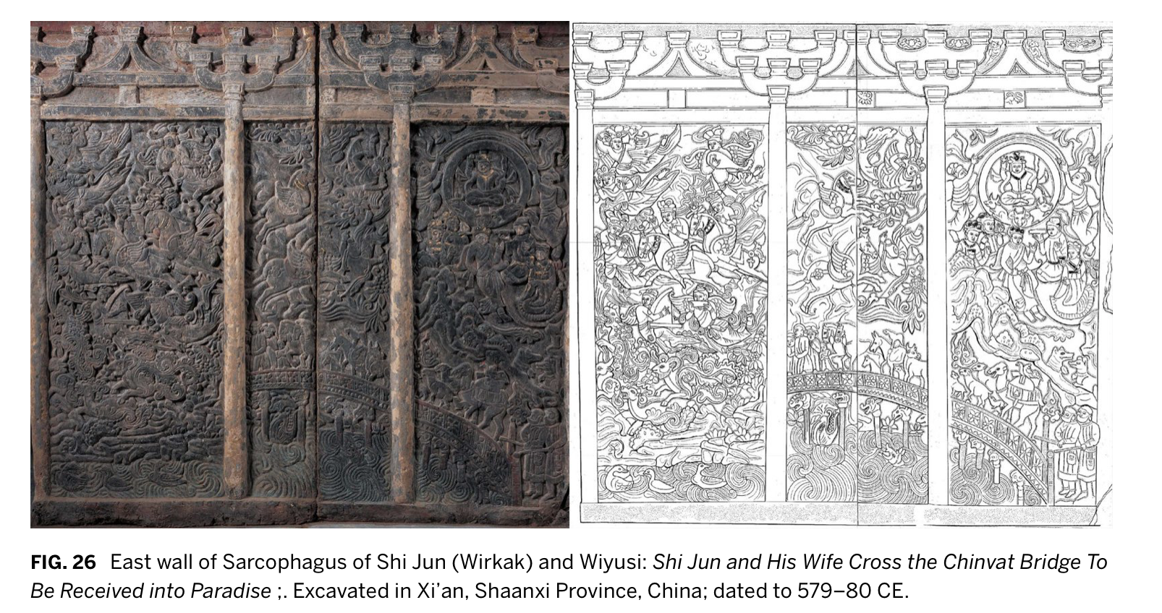

Slide 7
Towers of silence
“O Maker of the material world, thou Holy One! Whither shall we bring, where shall we lay the bodies of the dead, O Ahura Mazda?” – Ahura Mazda answered: “On the highest summits (on the top of a mountain), where they know there are always corpse-eating dogs and birds”
Dakhme (originally meant the grave)
Nauses and Ossuaries

Slide 8
Tower of Silence in Yazd

Slide 10
