Slide 1
Cost-benefit analysis for climate change
23 September 2022

Slide 2
Content
Cost Benefit Analysis basics
CBA relation to climate change
Social Discount Rate, Carbon Price.
DICE model updates
Concluding message

Slide 3
Cost-Benefit Analysis Principles
Utility Maximization
Total Economic Value Framework

Slide 4
Cost-Benefit Analysis Principles
Benefits > Costs
Economic and Social Feasibility. Calculate the economic value of the investment or intervention and decide whether it is worth undertaking it from the society’s point of view, i.e. whether scarce resources should be invested.
Decision rule NPV>0.

Slide 5
Climate Change as a Global Public Good
The two key attributes of a public good are
the cost of extending the output to an additional person is zero (“nonrivalry”)
it is impossible to exclude individuals from enjoying it (“nonexcludability”).

Slide 6
International Cooperation
Governance is a central issue in dealing with global externalities because effective management requires the concerted action of major countries.
It is only by designing, implementing, and enforcing cooperative multinational policies that nations can ensure effective climate-change policies.

Slide 7
Do you think humans can succeed in establishing effective international climate agreement?

Slide 8
Social Cost of Carbon
The social cost of carbon, then, refers to the monetary cost of emitting a single ton of carbon dioxide into the atmosphere, given that these emissions will further contribute to global warming.

Slide 9
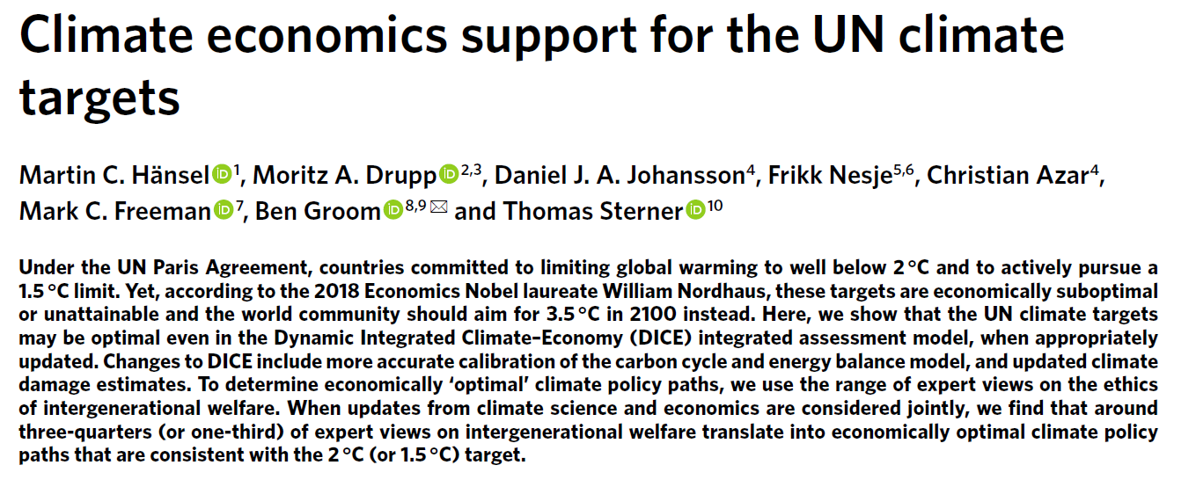

Slide 10
1. Discount Rate
The social discount rate (SDR) is a rate applied to benefits and costs that are expected to occur in the future in order to convert them into a present value. This conversion is done to ascertain what those benefits and costs are worth today.
When calculating the social cost of carbon, applying a higher discount rate causes the cost to decrease, and vice versa.
Specifically, intergenerational welfare in DICE
is the discounted sum of utilities at each point in time where utility is discounted at the pure rate of time preference δ and marginal utility diminishes by η% with each 1% increase in consumption.

Slide 11
2. Damage Function
In what they refer to as their ‘preferred model’, damages are substantially higher than in the original DICE model, reaching 6.7% of global gross domestic product (GDP) for a 3 °C temperature increase, as compared to 2.1% in the standard DICE.

Slide 12
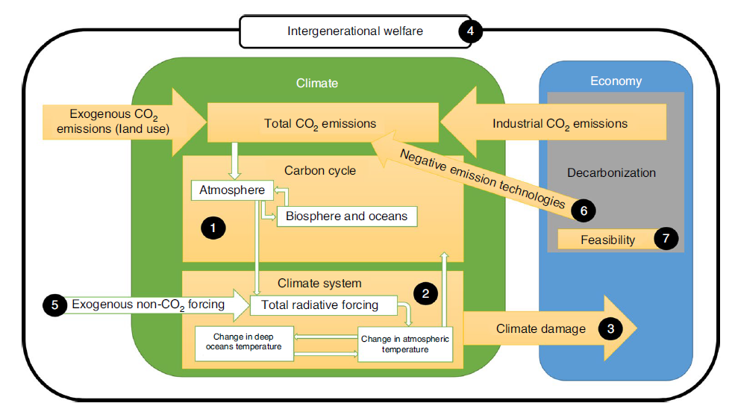
Updates to the DICE model (Nature 2020)

Slide 13
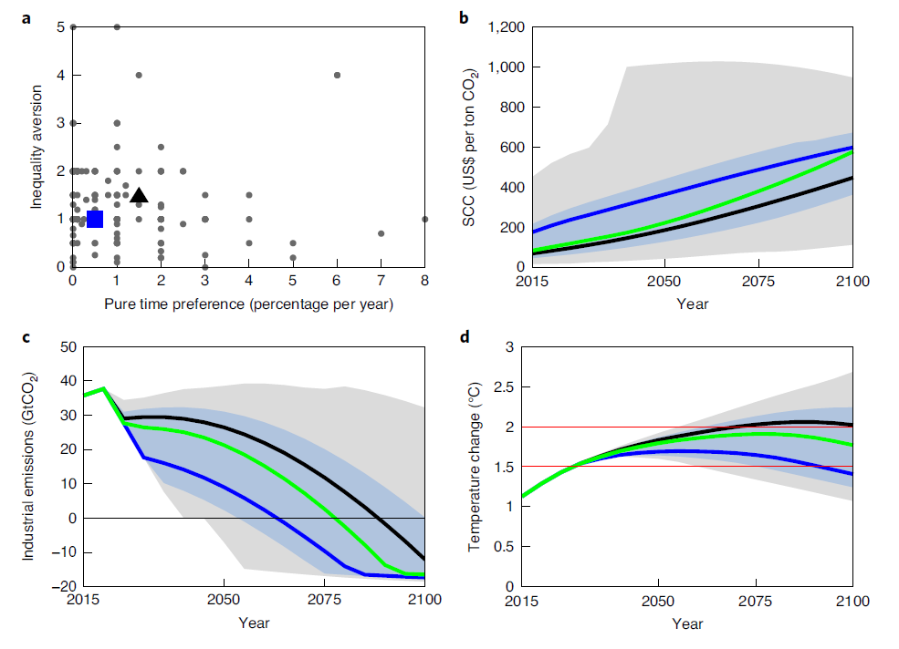
Climate policy pathways in the updated DICE model
Notes:
Graph showing each expert’s value judgements on discounting parameters (rate of pure
time preference; inequality aversion; n = 173). The black triangle (1.5%; 1.45) indicates the choice of discount parameters by Nordhaus34 and the blue
square (0.5%; 1) the median expert view on intergenerational welfare. b–d, Graphs showing the 95th (grey-shaded area) and 66th (blue-shaded area)
percentile ranges in terms of intergenerational fairness for three climate policy measures: the SCC (b, in US$ per ton), industrial emissions (c, in GtCO2)
and global mean temperature increases from 1850 to 1900 levels (d, in °C). These ranges do not correspond to confidence intervals relating to uncertainty
about forecasts, rather they capture how the disagreement about discounting parameters affects the optimal paths when incorporated into our updated
DICE model. Panels b–d also compare climate policy pathways implied by Nordhaus’ discounting in this updated DICE (black line) to those resulting from
the median expert view (blue line) and the median expert path (green line). While Nordhaus’ discounting implies an optimal carbon price of US$82 in
2020, in our updated DICE the median expert path (or view) translates into a value of US$101 (or US$208) in 2020.

Slide 14
Conclusion
Even if the UN Paris Agreement is attainable, intergenerationally fair and economically optimal in our updated version of DICE, it is also necessary to consider the political feasibility of meeting these stringent climate targets.
CO2 price
Speed of decarbonization

Slide 15
Price of Carbon
While the median expert path implies a carbon price of around US$100 in 2020 and zero emissions in 2080, the median expert view results in an optimal CO2 price of just above US$200 per ton in 2020 and complete global decarbonization by 2065.
This contrasts with a carbon price of around US$80 that results from the discounting parameters of Nordhaus in our updated model and a carbon price of around US$40 in Nordhaus’ original DICE calibration.

Slide 16
Cost Benefit Analysis of Climate Change Conclusion
CBA Framework is widely used by economists
DICE-based models inform global climate policies
Critical questions: generational fairness (social discount rate), uncertainties (damage functions), carbon price and international cooperation.

Slide 17
Useful resources
Cost-effectiveness Analysis https://dimewiki.worldbank.org/Cost-effectiveness_Analysis

Slide 18
Thank you! Questions?

