Slide 1
International Climate Policy

Slide 2
Content
Brief history of global climate agreements
Paris Agreement (NDC)
Progress and perspectives of global cooperative efforts

Slide 3
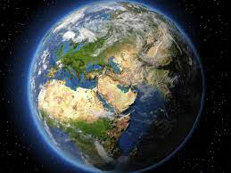
Brief history of global climate agreements
Since the 1990s, humanity has been striving to come to a single global agreement on climate change
Big agreements are signed, but it's too early to draw conclusions about success or failure
Source: sites.google.com

Slide 4
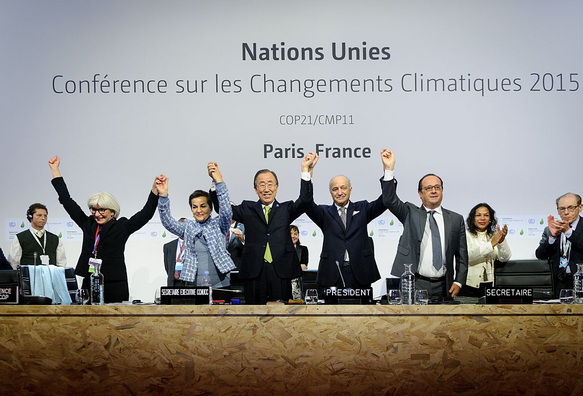
Important Climate Treaties
1987
Montreal Protocol
1992
United Nations Framework Convention on Climate Change (UNFCCC)
2015
Kyoto Protocol, 2005Paris Agreement
Source: Anadolu Agency, Getty Images
Notes:
While not designed to tackle climate change, the Montreal Protocol has been a historic environmental agreement that has become a model for future diplomacy on the issue. Every country in the world eventually ratified a treaty that requires them to stop producing substances that deplete the ozone layer, such as chlorofluorocarbons (CFCs). The protocol succeeded in eliminating nearly 99 percent of these ozone-depleting substances. In 2016, the parties agreed through the Kigali Amendment to also cut production of hydrofluorocarbons (HFCs), powerful greenhouse gases that contribute to climate change.
United Nations Framework Convention on Climate Change (UNFCCC), 1992, ratified by 197 countries including the United States, Landmark Consent [PDF] was the first global treaty to explicitly address climate change. It established an annual forum known as the Conference of the Parties or COP for international discussions aimed at stabilizing the concentration of greenhouse gases in the atmosphere. These meetings produced the Kyoto Protocol and the Paris Agreement.
Kyoto Protocol, 2005. The Kyoto Protocol , adopted in 1997 and entered into force in 2005, was the first legally binding climate treaty. This is required for developed countries to reduce emissions by an average of 5 percent below 1990 levels, and a system has been set up to monitor countries' progress. But the treaty does not oblige developing countries, including large carbon emissions from China and India, to take action. The United States signed the agreement in 1998 but never ratified it, and then withdrew its signature.

Slide 5
Paris Agreement
The Paris Agreement is a legally binding international treaty on climate change. It was adopted by 196 Parties at the 21st session of the Conference of the Parties to the United Nations Framework Convention on Climate Change (UNFCCC COP-21) on December 12, 2015 in Paris.
The goal of the Paris Agreement is to keep the global average temperature rise below 2C above pre-industrial levels, while efforts are made to limit temperature rise to 1.5 degrees Celsius.

Slide 6
Paris Agreement (2)
It is the first-ever legally binding instrument that brings countries together to achieve a common goal of climate change mitigation and adaptation.
Financial Support
Ambition Cycle
Notes:
The Paris Agreement is guided by three goals, which are laid out in Article 2 of the Agreement. The temperature goal aims to hold the increase in the global average temperature to well below 2°C above pre-industrial levels and to pursue efforts to limit this increase to 1.5°C. The adaptation goal aims to increase the ability to adapt to the adverse impacts of climate change and to foster climate resil-ience and low greenhouse gas emissions develop-ment. Finally, the ‘finance flows’ goal aims to make finance flows consistent with a pathway towards low greenhouse gas emissions and climate-resilient de-velopment.
The pursuit of the three goals of the Paris Agreement shows overlaps and synergies, as schematically depicted in Figure 3. As an example, an investment in reforestation, which improves flood resilience and sequesters carbon from the atmosphere, may contribute to all three goals.
It should be noted that the ‘finance flows’ goal is broader than the concept of ‘financial support’ addressed in Article 9 of the Paris Agreement (cf. chapter 2.3.4 below). While Article 9 addresses financial support to developing countries, this ‘finance flows’ goal (also commonly referred to as 2.1.c) aims at also addressing finance flows within countries, e.g. the distribution of subsidies or private investments.
The ‘finance flows’ goal also needs to be distinguished from the ‘100 billion dollar goal’, a commit-ment by developed country Parties, first made at the COP in Copenhagen in 2009, to mobilise climate finance amounting to USD 100 billion per year by 2020, from public and private sources. The ‘100 billion dollar goal’ was reiterated in the decision on the Paris Agreement (UNFCCC 2015a), and it was decided that it shall apply from 2020 to 2025 and a new global goal shall be set from a floor of USD 100 billion per year, which is to apply thereafter.
Besides the three overarching goals of the Paris Agreement, the 'ambition cycle' constitutes another important overarching feature. The ambition cycle is not explicitly stated or defined in the Paris Agreement; it refers to the overall architecture and functioning of the Paris Agreement that results from the interplay of the different individual and collective obligations it contains. Each Party is re-quired to undertake ambitious efforts to strengthen the global response to climate change. The spe-cific efforts are determined by each Party, hence referred to as 'Nationally Determined Contributions' (NDCs). Many Parties already provided Intended Nationally Determined Contributions ahead of the Paris conference and maintained these as their NDCs under the Paris Agreement. Others provided their NDCs in the course of the ratification process of the agreement. All Parties are required to com-municate a new NDC or update their existing NDC by the end of 2020.

Slide 7
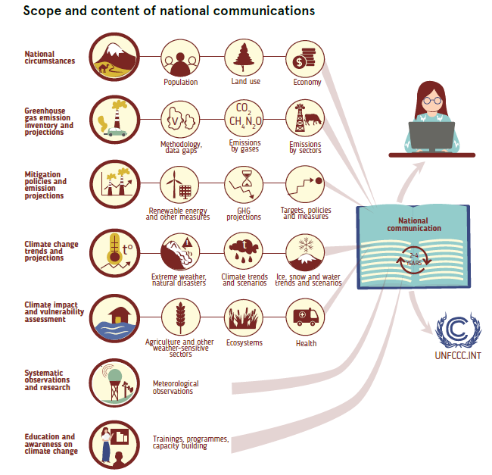
Source: Climate Change in CA Illustrated, 2020
Notes:
Исто 0- иллюстрации

Slide 8
Mechanism of the Paris Agreement
A five-year cycle for countries to build up ambitious targets to combat climate change.
Country Climate Change Plans - Nationally Determined Contributions (NDCs)
The Paris Agreement also calls on countries to develop and submit to the UN Climate Secretariat Long-Term Development Strategies with Low Greenhouse Gas Emissions by 2020.
Notes:
Paris Agreement, 2015. The most significant global climate agreement to date, the Paris agreement requires all countries to establish commitments to reduce emissions. Governments set targets, known as nationally defined contributions, with the goal of preventing global average temperatures from rising 2 ° C (3.6 ° F) above pre-industrial levels, and are making efforts to keep it below 1.5 ° C (2, 7 ° F). It also aims to achieve global net-zero emissions, where the amount of greenhouse gases emitted is equal to the amount removed from the atmosphere in the second half of the century. (This is also known as climate neutral or carbon neutral.)
Every five years, countries are required to assess their progress towards implementing the agreement, through a process known as a global inventory; first scheduled for 2023 Countries set their own targets and there are no enforcement mechanisms to ensure they meet them. In their NDCs, countries report on planned measures to reduce greenhouse gas emissions in order to achieve the goals of the Paris Agreement. This tool also contains information on the intended actions for sustainable development in order to adapt to a changing climate. The strategies contain details of long-term planning for NDCs. Unlike the development of the latter, the preparation of Strategies is not an obligation of the Parties. However, they integrate the NDCs into the context of national long-term planning and development priorities.

Slide 9
Financial Support
Paris Agreement provides for the provision of financial and technological assistance, as well as assistance in capacity building.
Paris Agreement emphasizes developed countries must take the lead in mobilizing funds to support more vulnerable nations
Paris Agreement aims to fully realize the development and transfer of technologies to improve resilience to climate change and reduce greenhouse gas emissions.
Notes:
2. In doing so, other countries are also encouraged to provide appropriate financial assistance. Climate finance is needed to mitigate the effects of climate change as large investments are required to significantly reduce emissions. Climate finance is also important in the context of adaptation, as adapting to a changing climate requires significant financial resources. Developed countries intend to continue their existing collective goal to mobilize USD 100 billion per year by 2020 and extend this until 2025.
3. The Agreement establishes a Technology Framework to provide comprehensive guidance to the Technology Mechanism. The development and transfer of technologies is carried out through the strategic affairs and implementation units of the mechanism.

Slide 10
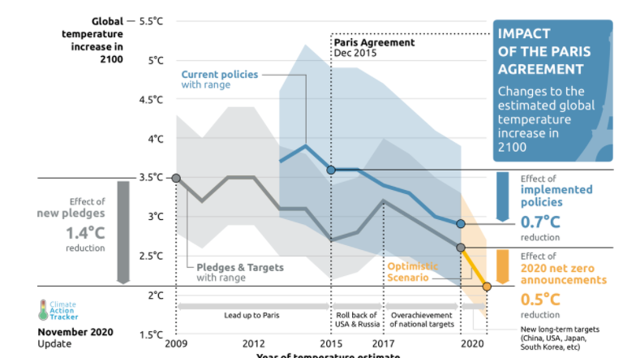
Progress Monitoring
Countries will report on climate change action and progress towards climate change mitigation starting in 2024

Slide 11
Source: Expertise France

Slide 12
Carbon price is the basis of climate policy

Slide 13
How successful is the global community?
Source: Climate Action Tracker

Slide 14
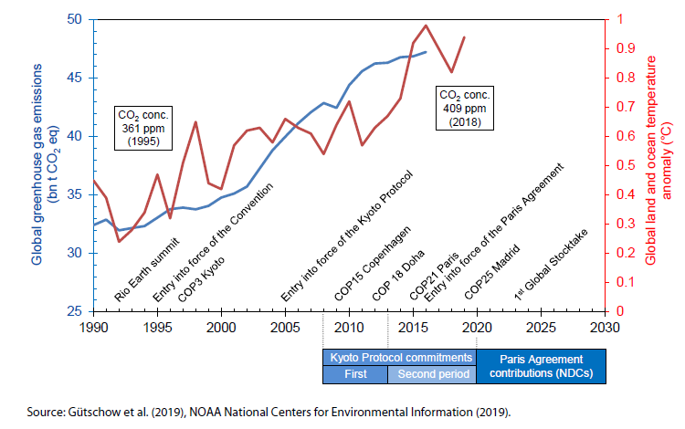
Climate Treaties in time

Slide 17
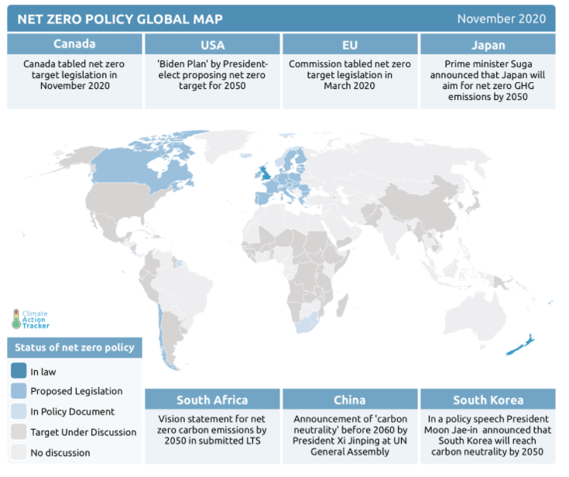

Slide 18
Summary
Since the 1990s, humanity has tried to create a global climate agreement, all of them have failed to reduce greenhouse gases
High hopes for the 2015 Paris Agreement
Wealthy countries have started to implement zero-carbon climate policies, thanks to institutions and technology development
Poor countries have also started developing NDCs

Slide 19
Thank you for your attention!

Slide 20
