Slide 1
ECO606: Vector Autoregressive Models

Slide 2
Vector Autoregressive Models
What are VARs?
Multi-variate linear time-series models
Endogenous variables are functions of lagged endogenous variables.
Very simple alternative to international models

Slide 3
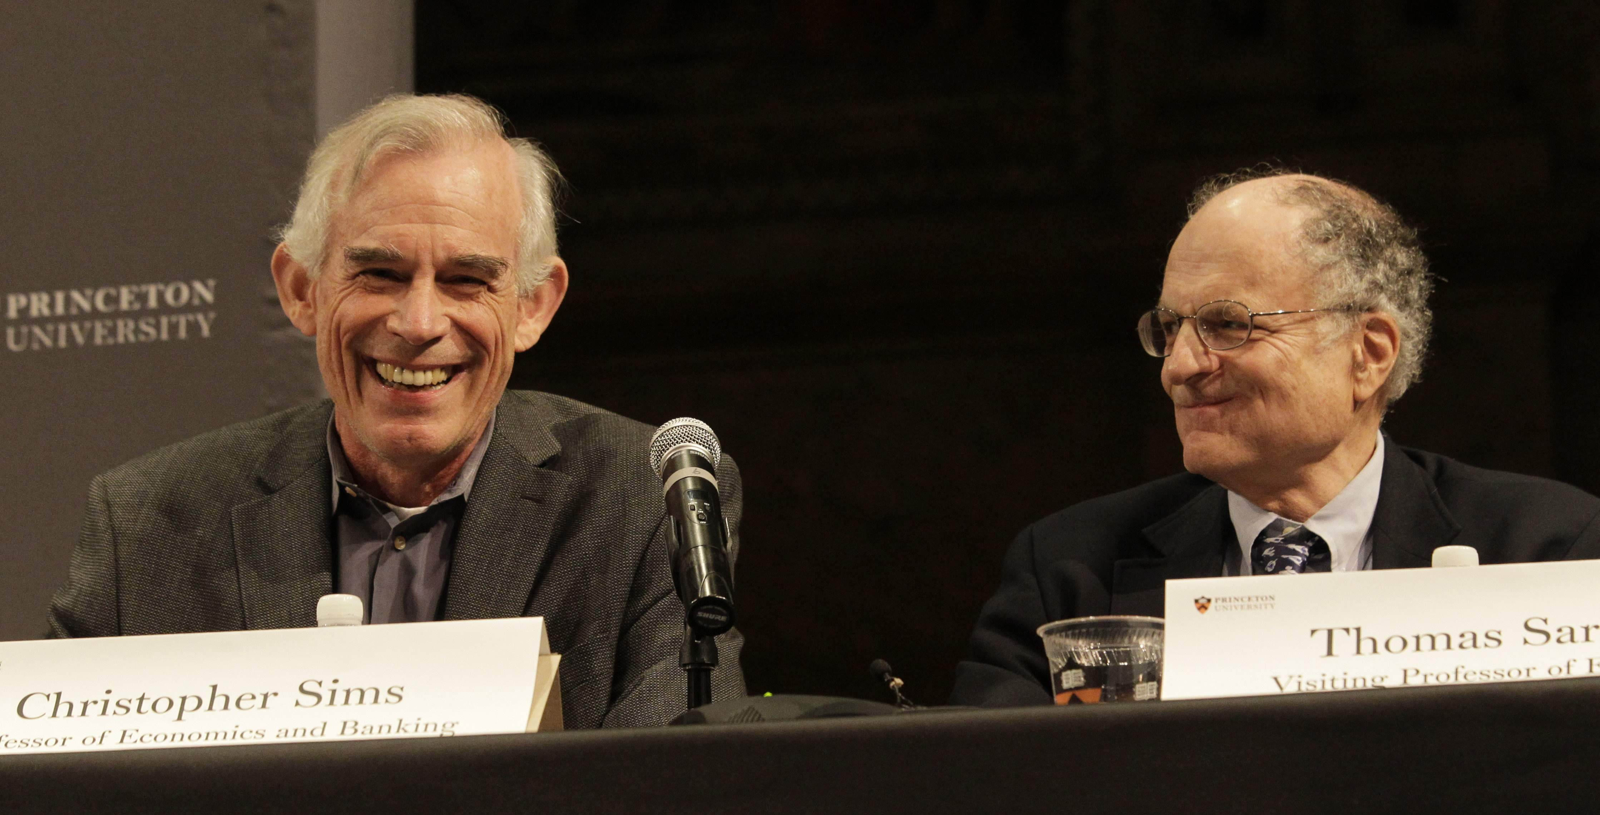
Vector Autoregressive Models
Sargent & Sims: Cause & effect in Macroeconomy –> NOBEL. -> Restrictions & models of 1980s.
-> Very strong assumptions about dynamic relationships between variables and inconsistent with the idea of, “I make choices today based on my utility tomorrow”. (Sim’s critique)
-> If expectations are involved then, no variable can be exogenous.

Slide 4
Vector Autoregressive Models
What are VARs used for?
According to a well-known paper by Stock & Watson (2001, JEP) macro-econometricians (would like to) do four things:
1. Describe and summarize macroeconomic time series
2. Make forecasts
3. Recover the true structure of the macroeconomy from the data
4. Advise macroeconomic policymakers
Vector autoregressive models are a statistical tool to address these tasks.

Slide 5
Vector Autoregressive Models
What can we do with vector autoregressive models?
3 variables: real GDP growth (∆y), inflation (π) and the policy rate (i)
A VAR can help us answering the following questions
What is the dynamic behavior of these variables? How do these variables interact?
What is the profile of GDP conditional on a specific future path for the policy rate?
What is the effect of a monetary policy shock on GDP and inflation?
What has been the contribution of monetary policy shocks to the behavior of GDP over time?

Slide 6
Vector Autoregressive Models
“Monetary policy tries to control inflation, and as a result interest rates tend to be high when inflation is high. But we think that raising interest rates lowers inflation. The main contribution of this work is to provide a way to untangle the relationship between interest rates and inflation, so we can see what the effect of interest-rate policy changes are on the price level and inflation, and separate that from the reverse causality that makes central banks react to inflation by changing interest rates.” - Christopher Sims, in an interview on Oct 10, 2011

Slide 7
Vector Autoregressive Models
Vector autoregression (VAR) models are useful to summarize the information contained in the data.
VAR models are also useful to conduct certain types of economic experiments, among which policy experiments are most popular.
*Reduced-form VAR models do not have economic interpretations.
*To give an economic interpretation to a reduced-form VAR, we need to use economic theory. Compared with a macro models based on micro-foundations, only a minimalist set of restrictions are employed -> switch to structural VAR.

Slide 8
Vector Autoregressive Models
VARs come in three varieties:
Reduced form
Recursive form
Structural form

Slide 9
Vector Autoregressive Models
Consider a bivariate system ($y_{t,}x_{t})$. Assume that, y is GDP and x is unemployment and the relationship between them, will give us the “Phillips curve”.
The first order VAR for this bivariate system is (see image).
VAR(1)
So each variable depends on the first lag of itself and the other variable.
The error terms in these regressions are the “surprise” movements in the variables after taking its past values into account.

Slide 10
Vector Autoregressive Models
One can express the VAR(1) in matrix form. This is called, reduced form VAR.
Or as a system of equations.
The error terms, “unobservable zero mean white noise processes” meaning, serially uncorrelated and independent of each other.

Slide 11
Vector Autoregressive Models
Reduced-form VARs do not tell us anything about the structure of the economy (identification problem!)
What is the nature of the shock?
Is it a shock to aggregate demand that induces policy to move the interest rate? Or is it a monetary policy shock?
This is the very nature of the identification problem

Slide 12
Vector Autoregressive Models
Using the lag operator we can show the MA(∞) representation for the VAR(1) is:
The coefficient in the MA representation measures the impulse response:

Slide 13
Vector Autoregressive Models
Reduced Form and Structural Form
Why is it called structural VAR?
The equations of a structural VAR define the true structure of the economy.
One of the main assumptions of standard VARs is stationarity of the data.
A common assumption in many time series techniques is that the data are stationary. A stationary process has the property that the mean, variance and autocorrelation structure do not change over time.
Stationarity can be defined in precise mathematical terms, but for our purpose we mean a flat looking series, without trend, constant variance over time, a constant autocorrelation structure over time and no periodic fluctuations.

Slide 14
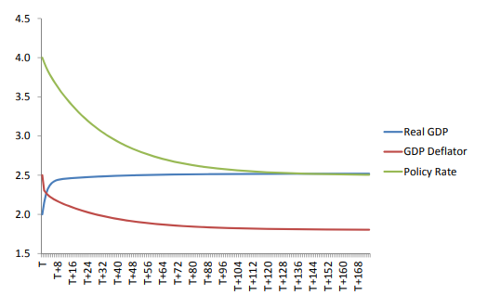
Vector Autoregressive Models
Why stationarity of data is important?
In absence of shocks, each variable will converge to its unconditional mean!!!!

Slide 15
Vector Autoregressive Models
What’s the other word for periodic fluctuations?
Can you think of any examples?

Slide 16
VAR ESTIMATION
UK quarterly data from 1985.I to 2013.III
VAR(1) with a constant

Slide 17
VAR ESTIMATION
UK quarterly data from 1985.I to 2013.III
VAR(1) with a constant

Slide 18
Advise macroeconomic policymakers
(A good) identification allows us to address “advice macroeconomic policymakers”. This is normally done by means of Impulse responses, Forecast error variance decompositions, and Historical decompositions.
1. What is the response of current and future values of each of the variables to a one-unit increase in the current value of one of the structural errors, assuming that this error returns to zero in subsequent periods and that all other errors are equal to zero?
2. Provide information about the relative importance of each structural shock in affecting the variables in the VAR
3. What portion of the deviation of X from its unconditional mean is due to the structural shock ?

Slide 19
….summary
The reduced form VAR are used to summarize the co-movements of the time series. In the example of, GDP, inflation and policy rate.
We use it also to forecast variables and ass the performance against some benchmark models.
Structural VARs are used to estimate the effect of a policy-induced surprise move in policy rate on future rates of inflation and unemployment.

Slide 20
Vector Autoregressive Models
Granger-causality; is concerned with whether lagged x helps explain y, and vice versa. We can test each null hypothesis (below) using the F test. The null hypothesis is rejected when the p-value is less than 0.05
Granger Causality ̸= Causality.
Granger causality is about in-sample fitting. It tells nothing about out-of-sample forecasting

Slide 21
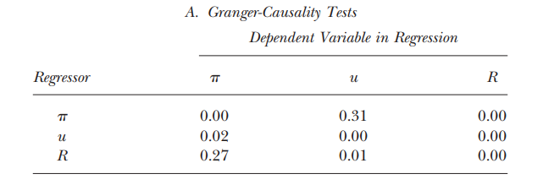
Vector Autoregressive Models
If the unemployment rate does not help predict inflation, then the coefficients on the lags of unemployment will all be zero in the reduced-form inflation equation. See table below. It shows the p-values associated with the F-statistics for testing whether the relevant sets of coefficients are zero.

Slide 22
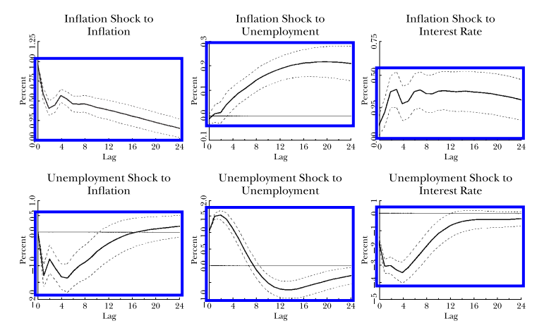
Vector Autoregressive Models

Slide 23
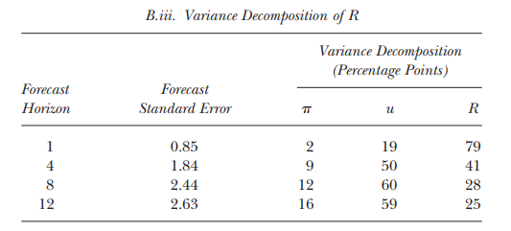
Vector Autoregressive Models

Slide 24
How well do VARs perform?
The VAR summary statistics are useful in assessing theoretical macroeconomic models.
State of the art VAR forecasting systems usually have more than 3 variables and allow for time varying parameters to capture important drifts in coefficients (Sims, 1993). BUT, adding more variables creates complications because the # of VAR parameters increases as the square of number of variables. Ex: four-lag VAR has 333 unknown coefficients -> Macro-data cannot provide reliable estimates of these coefficients without more restrictions. One way to overcome this is to do Bayesian Estimation.

Slide 25
How well do VARs perform?
Three important criticisms of structural VAR modeling:
What makes up the VAR shock? (omitted variable bias)
Policy rules change over time and form stat.tests reveal widespread instability in low-dimensional VARs. (Stock, Watson; 1996)
The timing conventions in VARs don’t necessarily reflect real-time data availability.

