Slide 1
Fiscal Policy. Taxes and Taxation.
Almazova Aigerim

Slide 2
Content
Fiscal policy
Types of fiscal policy
Government revenue and expenditure
Tax and taxation in KR
Tax revenue
Income Tax
VAT
Sales Tax
Excise Tax

Slide 3
Fiscal policy
What is Fiscal policy?
In economics and political science, fiscal policy is used by the government revenue collection (mainly taxes) and expenditure (spending) to influence the economy.
According to Keynesian economics, when the government changes the levels of taxation and government spending, it influences aggregate demand and the level of economic activity. Fiscal policy can be used to stabilize the economy over the course of the business cycle.

Slide 4
Fiscal policy
Types of fiscal policy:
Expansionary fiscal policy
Contractionary fiscal policy

Slide 5
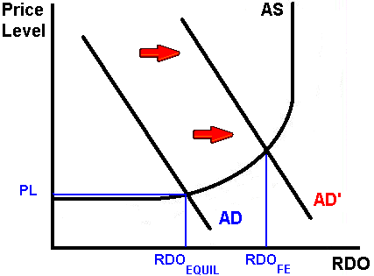
Fiscal policy
Expansionary fiscal policy

Slide 6
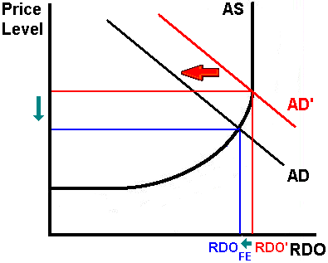
Fiscal policy
Contractionary fiscal policy

Slide 7
Government expenditure in Kyrgyz Republic
( thousand soms)
year | 2007 | 2008 | 2009 | 2010 | 2011
Total expenditures | 35 859 351,0 | 45 031 663,6 | 58 557 709,3 | 68 781 197,9 | 91 544 096,4
General public services | 4 221 707,3 | 6 754 463,4 | 8 333 414,7 | 8 191 395,6 | 10 130 625,3
Defense | 1 551 362,3 | 1 774 836,6 | 2 382 703,0 | 2 846 533,5 | 3 168 999,5
Public order and safety | 2 787 161,0 | 534 378,0 | 4 008 338,7 | 5 629 254,0 | 6 551 300,8
Economic issues, not elsewhere classified | 1 067 367,5 | 2 243 305,7 | 8 008 077,3 | 10 801 740,6 | 15 553 305,8
Environmental protection | 108 187,2 | 399 664,6 | 581 798,4 | 567 835,4 | 561 997,8
Housing and communal services | 1 710 629,4 | 2 303 054,1 | 2 441 795,9 | 2 504 236,0 | 2 893 312,9
healthcare | 3 664 862,5 | 4 376 160,1 | 5 809 784,8 | 6 413 264,0 | 9 084 196,1
culture and religion | 995 574,9 | 1 130 555,3 | 1 382 469,4 | 1 560 123,3 | 2 234 489,7
education | 8 012 760,8 | 9 616 593,2 | 11 498 445,9 | 11 993 832,4 | 18 239 033,8
social protection | 3 780 592,5 | 4 659 247,7 | 5 587 468,6 | 11 075 226,2 | 14 182 532,2
Expenditure on acquisition of nonfinancial assets | 6 387 203,6 | 8 087 694,7 | 8 523 412,6 | 7 197 756,9 | 8 944 302,5

Slide 9
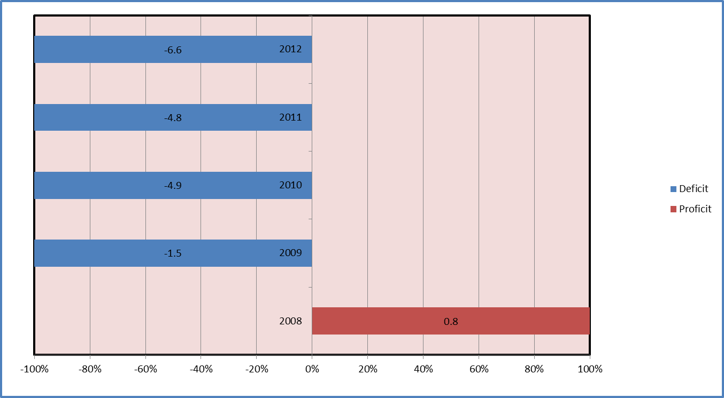
This chart represents the Deficit (Proficit) of Kyrgyz Republic for years 2008-2012. The estimation is in percentages to the GDP.

Slide 10
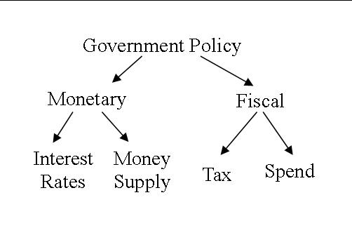
Fiscal policy

Slide 11
Tax and Taxation
Tax (from the Latin taxo; "rate") is a financial charge or other levy imposed upon a taxpayer (an individual or legal entity) by a state or the functional equivalent of a state such that failure to pay, or evasion of or resistance to collection, is punishable by law. Taxes are also imposed by many administrative divisions. Taxes consist of direct or indirect taxes and may be paid in money or as its labour equivalent.

Slide 12
Type of Taxes
An indirect tax (such as sales tax, a specific tax, value added tax (VAT), or goods and services tax (GST)) is a tax collected by an intermediary (such as a retail store) from the person who bears the ultimate economic burden of the tax (such as the consumer). The intermediary later files a tax return and forwards the tax proceeds to government with the retur

Slide 13
Type of Taxes
A direct tax is generally a tax paid directly to the government by the person on whom it is imposed.
In a general sense, a direct tax is one imposed upon an individual person (juristic or natural) or property (i.e. real and personal property, livestock, crops, wages, etc.) as distinct from a tax imposed upon a transaction. In this sense, indirect taxes such as a sales tax or a value added tax (VAT) are imposed only if and when a taxable transaction occurs.

Slide 14
Taxation in KR
Taxation in the Kyrgyz Republic is regulated by the Constitution of the Kyrgyz Republic, the Tax Code of the Kyrgyz Republic, (42) specific laws, regulations, and instructions. The authorized agency responsible for the supervision of timely payment of taxes is the State Committee on Taxes and Duties of the Kyrgyz Republic.
The Tax Law of the Kyrgyz Republic has been effective since June 26, 1996.

Slide 15
Taxes in KR
National taxes are:
Profit tax
Income tax
Value added tax
Excise tax
Sales tax

Slide 16
Taxes in KR
Local taxes and duties are:
Land tax
Health resort tax
Advertisement tax
Hotel tax
Retail sail tax and tax on paid services to individuals
Property tax
Automobile owner tax

Slide 20
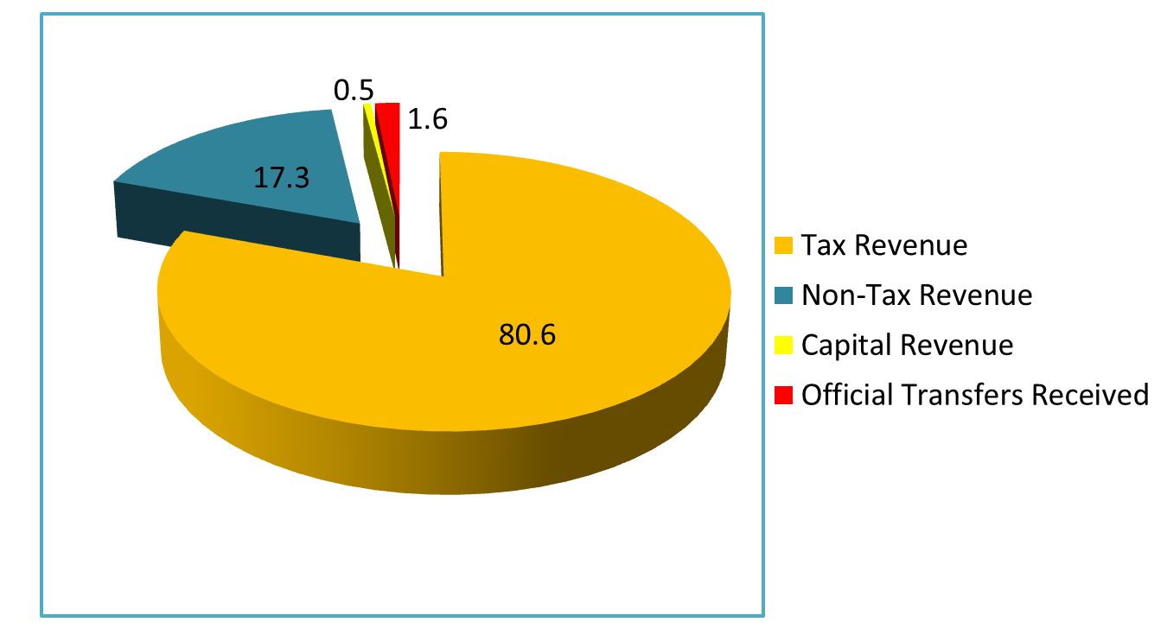
2005

Slide 21
Income of State budget
( Thousand soms)
 | 2008 | 2009 | 2010 | 2011 | 2012
Official Transfers Received | 1399763,1 | 10201145,8 | 7022062,1 | 8752288,2 | 5608258,6
Non-Tax income | 8179699,3 | 9058446,6 | 11000234,4 | 15654627,8 | 17252409,8
Income of property and interests | 2756505,6 | 3289991,7 | 4894648,4 | 8141767,6 | 9032710,0
Income from sales and Services | 4765423,7 | 5282704,0 | 5293671,8 | 6503909,3 | 7217118,9
Administrative Payment | 841775,9 | 807150,7 | 662938,6 | 1023773,2 | 1128106,3
Revenue from Services | 3923647,8 | 4475553,3 | 4630733,2 | 5480136,1 | 6089012,6
Fines, Compensations, and Sanctions | 231843,8 | 317422,6 | 243581,9 | 335940,2 | 294748,2
Voluntary Transfers, except Grants | 135889,9 | 54059,3 | 4495,4 | 8902,9 | 338716,0
Other non-tax income | 290036,3 | 114269,0 | 563836,9 | 664107,8 | 369116,7
Income from sales of non-financial assets | 1116816,8 | 312072,8 | 628191,7 | 456105,6 | 236047,4

Slide 22
Income Tax
Payers of income tax are individuals, residents and non-residents of the Kyrgyz Republic, having income. Business participants that represent a source of income to other persons must calculate, withhold and transfer to the budget income tax on the following:
Pay to employees working under a labor agreement/contract or hired within the business activity framework
Pensions, with the exception of pensions paid in the system of state social protection
Interest
Income derived by a non-resident individual from a source located within the Kyrgyz Republic
Income and other one-time payments to resident individuals at their primary place of work (study, service)
The Object of taxation is the difference between the gross annual income of an individual and deductions provided by tax legislation of the Kyrgyz Republic.
The rate of the income tax is 10%.

Slide 24
Value Added Tax
Also known as Goods and Services Tax (G.S.T), Single Business Tax, or Turnover Tax.
A value-added tax (VAT) is a form of consumption tax. From the perspective of the buyer, it is a tax on the purchase price. From that of the seller, it is a tax only on the value added to a product, material, or service, from an accounting point of view, by this stage of its manufacture or distribution. The manufacturer remits to the government the difference between these two amounts, and retains the rest for themselves to offset the taxes they had previously paid on the inputs.

Slide 25
Value Added Tax
In Kyrgyz Republic value added tax is charged at point of 12 percent. Comparing to other countries, we can see that VAT is charged 17, 5% in United Kingdom, 27% in Hungary, 17% in China, 25% in Denmark, Norway and Sweden, no federal VAT in the USA (sales tax) and, finally, 5% in Japan and Taiwan

Slide 26
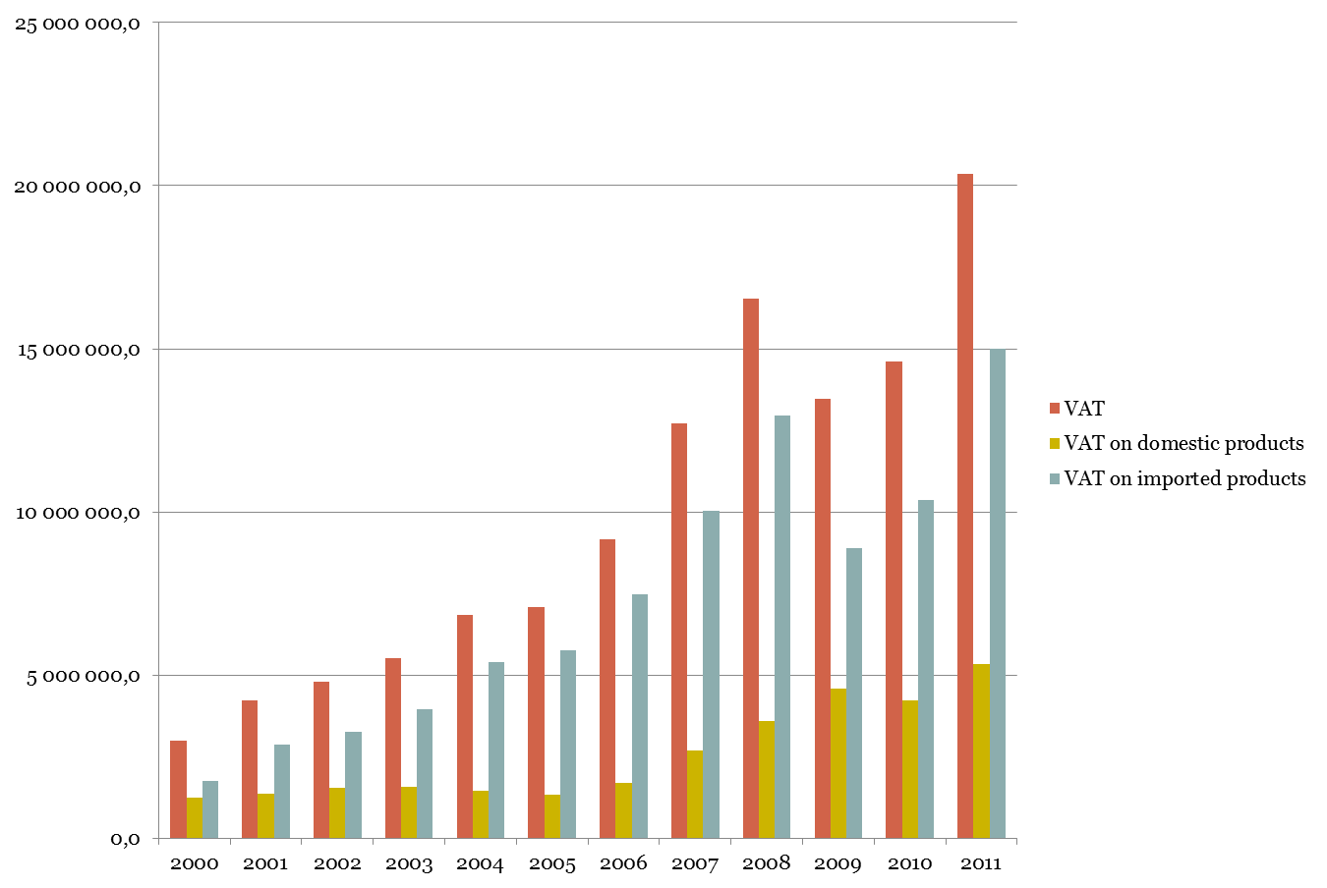
Value Added Tax

Slide 28
Sales Tax
A sales tax is a tax paid to a governing body for the sales of certain goods and services.
In Kyrgyz republic sales tax is charged from 1 to 5 percents, depending on type.
The sales tax rate from 1 January 2010 was set as follows:
a)at a rate of 1.0 per cent - for trading activities and the industrial processing of agricultural products;
b) at a rate of 2.0 per cent - for commercial activities;
c)at a rate of 3.0 per cent - for activities not specified in subparagraph "a" of this paragraph.
For activities in the field of cellular communication rate is set at 5.0 per cent

Slide 30
Excise Tax
An excise is an inland tax on the sale, or production for sale, of specific goods. Excises are distinguished from customs duties, which are taxes on importation.
An excise is considered an indirect tax, meaning that the producer or seller who pays the tax to the government is expected to try to recover the tax by raising the price paid by the buyer. Excises are typically imposed in addition to another indirect tax such as a sales tax or value added tax.

Slide 31
Excise Tax
ethanol
beer
alcoholic beverages
mixture of alcoholic and non-alcoholic beverages
tobacco products
Oil and petroleum products

Slide 32
Excise Tax
Typical examples of excise duties are:
Ethil alcohol (70 som/l)
Vodka (40 som/l)
Alcoholic beverages (40 som/l), wine (10 som/l), cognac (27 som/l), champagne (22 som/l), beer (5 som/l)
Tobacco and cigarettes (297 som/1000 units, 195 som/1000, 91 som/1000, 32 som/1000, 13 som/1000 units)
Jewel from gold, platinum, or silver (5%)
Fur clothing (5%)
Leather clothing (5%)
Firearms (20%)
Oil products: benzine (3000 som/ton), diesel fuel (800 som/ton)
Coffee and cacao (10%)
Carpets (10%)

Slide 34
Excise tax
2009 | 1668560 | 5%
2010 | 1689335 | 4%
2011 | 2187005 | 4%
2012 | 2826730 | 4%

Slide 38
Optimal tax
Optimal tax theory or the theory of optimal taxation is the study of designing and implementing a tax that reduces inefficiency and distortion in the market under given economic constraints. Generally, this criterion consists of individuals' utility and the optimization problem involves minimizing the distortions caused by taxation.

Slide 39
Recommendation
According Elima Karalaeva is an Assistant Professor of the Public Administration Program :
It is important to develop a strategic plan of comprehensive local tax reform with explicit goals
Kyrgyz Republic (KR) should continue to simplify the tax system and improvement of horizontal and vertical equity by reducing or eliminating tax holidays, exemptions, preferences and other tax asymmetries.
Kyrgyz Republic should modernize tax administration, which requires the simplification of tax procedures, the reduction of compliance costs, and the increasing of spending in training, equipment and taxpayer services.
Minister of Finance and National Bank should discourage the barter and other non-monetary payment methods and discontinue using the tax offsets.
The tax reform should be accompanied by reforms in supplementary sectors including bankruptcy laws, international accounting standards, and contracts.

Slide 40
References:
Расходы Государственного Бюджета”, stat.kg
Доходы Государственного Бюджета”, stat.kg
Государственная налоговая служба Кыргызской Республики
Minfin.kg
sti.gov.kg
LOCAL TAX REFORM IN THE KYRGYZ REPUBLIC by Elima Karalaeva

Slide 41
Thank You

