Slide 1
Solow Growth Model
AUCA
Rahat Sabyrbekov
2019

Slide 2
https://www.youtube.com/watch?v=4-2nqd6-ZXg

Slide 3
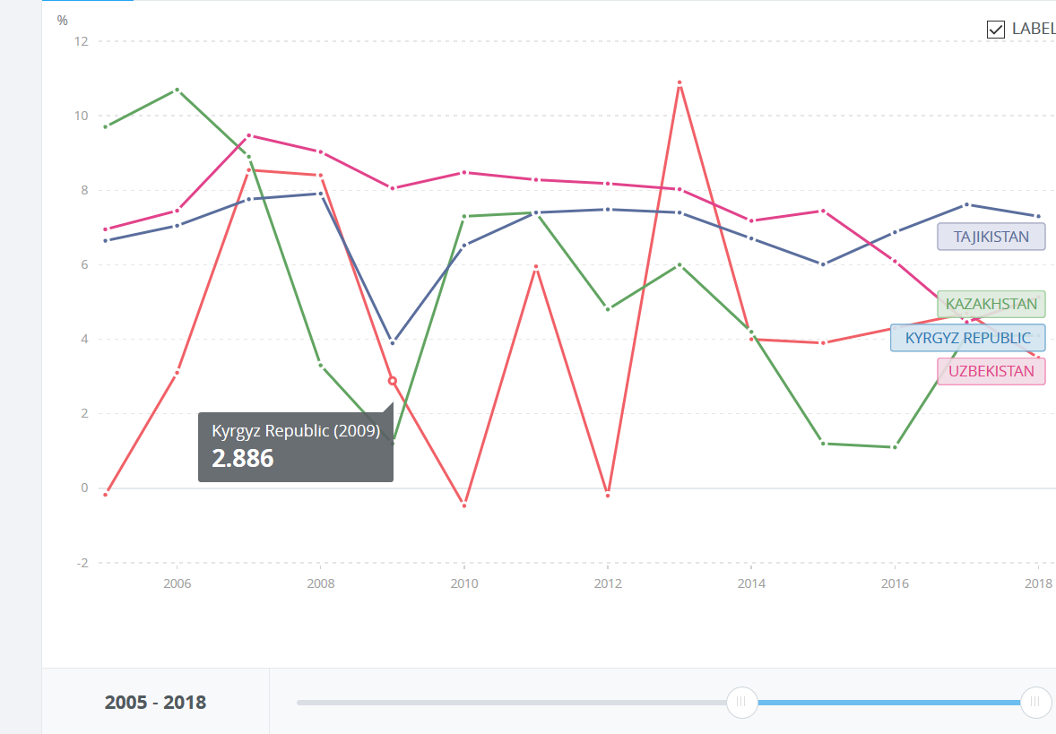

Slide 4
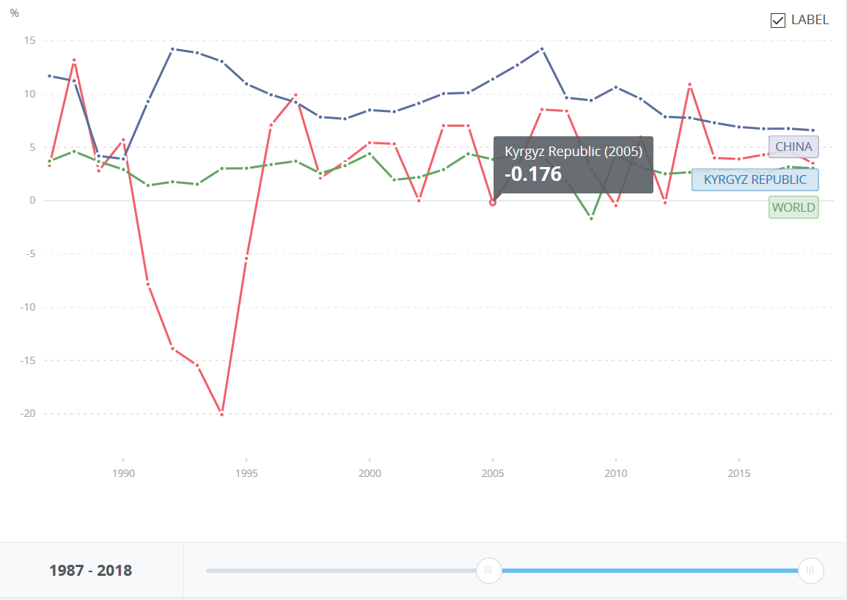

Slide 5
Solow Model
Developed by Robert Solow and T. Swan in 1950s
Two primary inputs K & L
Diminishing returns of each factor
The flexible production function Y= F(K, L) involving capital-labor substitution

Slide 6
Steady state equilibrium
Break-even investment = capital depreciation
k* - equilibrium point
If k>k* - expenses to maintain the current capital are too large -> decreasing
Notes:
First, existing capital is depreciating; this capital must be replaced to keep the capital stock from falling. This is the δk term in (1.18). Second, the quantity of effective labor is growing. Thus doing enough investment to keep the capital stock (K) constant is not enough to keep the capital stock per unit of effective labor (k) constant. Instead, since the quantity of effective labor is growing at rate n + g, the capital stock must grow at rate n + g to hold k steady

Slide 7
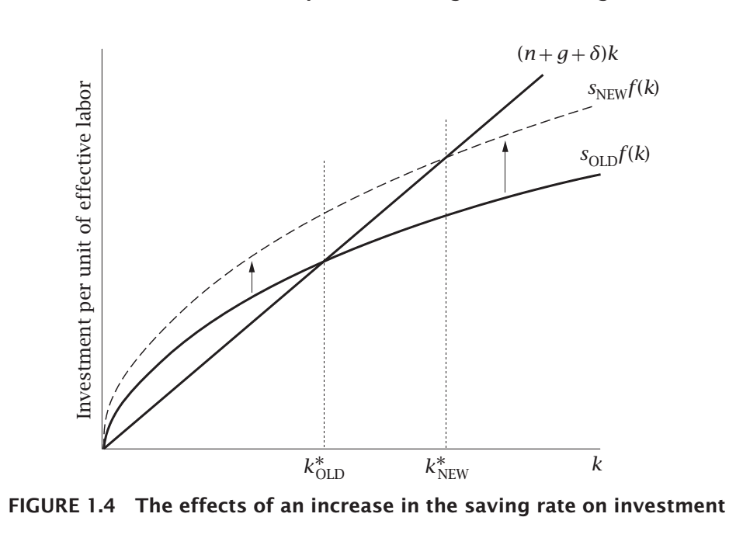
Impact of change in saving rate
Saving is part of the investment curve
Shift factor of the curve
k* is larger
Note: returns rate did not change
On the balanced growth path, the growth rate of output per worker is determined solely by the rate of technological progress
Notes:
In sum, a change in the saving rate has a level effect but not a growth effect: it changes the economy’s balanced growth path, and thus the level of output per worker at any point in time, but it does not affect the growth rate of output per worker on the balanced growth path.

Slide 8
Three functions of the Solow mode

Slide 9
The Solow model identifies two possible sources of variation—
differences in capital per worker (K/L)
differences in the effectiveness of labor (A).
BUT only growth in the effectiveness of labor can lead to permanent growth in output per worker
Limitations: no precise definition of the effectiveness of worker
Notes:
More fundamentally, the model does not identify what the “effectiveness of labor” is; it is just a catchall for factors other than labor and capital that affect output. Thus saying that differences in income are due to differences in the effectiveness of labor is no different than saying that they are not due to differences in capital per worker. To proceed, we must take a stand concerning what we mean by the effectiveness of labor and what causes it to vary. One natural possibility is that the effectiveness of labor corresponds to abstract knowledge. To understand worldwide growth, it would then be necessary to analyze the determinants of the stock of knowledge over time. To understand cross-country differences in real incomes, one would have to explain why firms in some countries have access to more knowledge than firms in other countries, and why that greater knowledge is not rapidly transmitted to poorer countries.

Slide 10
Other issues
Convergence
Capital returns
Saving & Investment
Cross-country rates
Environment
Absent in the model
Notes:
The first is that markets provide valuable signals concerning how the good should be used The second implication of the existence of property rights for an environmental good is that we can use the good’s price to obtain evidence about its importance in production. But the fact remains that most economists who have studied environmental issues seriously, even ones whose initial positions were sympathetic to environmental concerns, have concluded that the likely impact of environmental problems on growth is at most moderate.

Slide 11
CAPITAL IS BACK: WEALTH-INCOME RATIOS IN RICH COUNTRIES 1700–2010 Thomas Piketty and Gabriel Zucman
Notes:
This mechanism sheds light on the rise in the wealth-income ratios of Europe and Japan, two economies where population and productivity growth has slowed markedly: capital is back because low growth is back. It also helps understand why wealth-income ratios are lower in the United States, where population growth— but not saving—is larger than in Europe.

Slide 12
Wealth is always very concentrated and implies the inequality of wealth, and potentially the inequality of inherited wealth, is likely to play a bigger role for the overall structure of inequality in the twenty-first century than it did in the postwar period.
Gap between the growth rate and the return on capital while growth slows down and return on capital is steady.

Slide 13
Why were wealth-income ratios so high in the eighteenth and nineteenth centuries, and why do they seem to be approaching these levels again in the twenty-first century? – steady state (?)
Strikingly, today’s wealth-income ratios in the United Kingdom and France seem relatively close to their eighteenth-century levels, in spite of considerable changes in the nature of wealth.

Slide 14
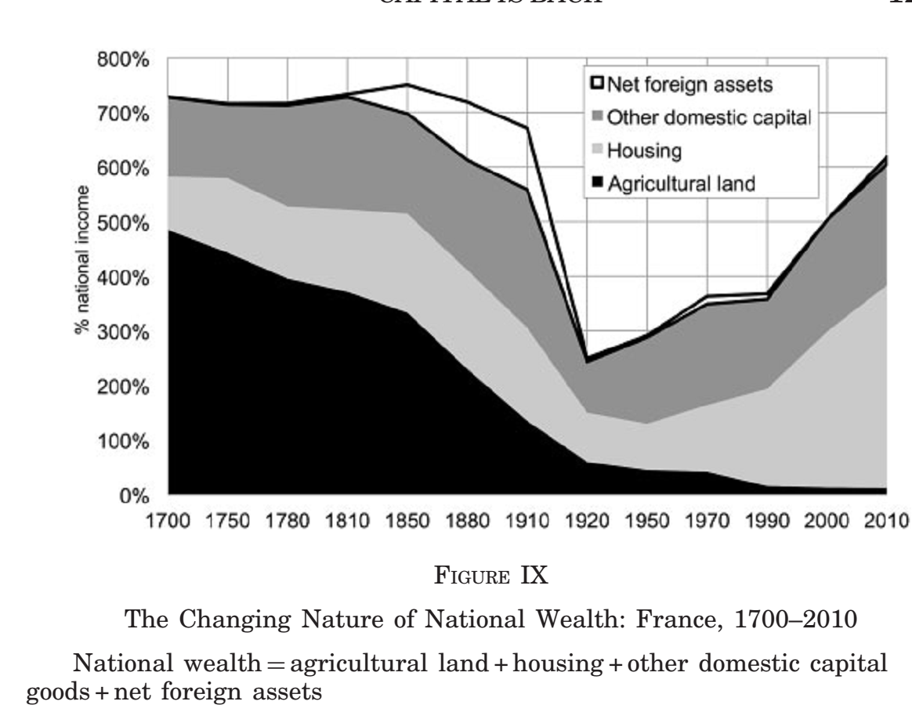

Slide 15
A note on Piketty and diminishing returns capital Matthew Rognlie
Reviews the argument of Piketty on capital expansion
Uses net elasticity of substitution between capital and labor
Questions use of housing as 100% increase in long-term increase in capital/income ratio
If housing removed then high elasticity assumption does not hold
Intellectual property = tech-intensive capital is not captured.
Notes:
This note articulates the opposite view: most evidence suggests diminishing returnspowerful enough that further capital accumulation will cause a decline in net capital in-come, rather than an expansion. If, followingPiketty(2014)’s model of savings, a de-cline ingcauses an expansion in the long-term capital stock, both the net capital shareof income andr
Net E – includes depreciation

Slide 16
Thank you! Questions?

