Slide 1
Introduction to Game Theory, Behavioral and Experimental Economics
Ulan Kasymov
Resource Economics Group,
Humboldt-Universität zu Berlin
18 September, 2018

Slide 2
Aim and Structure
Aim: General Introduction to Game Theory, Experiments concepts in Social Sciences and Economics, as to achieve a common basis of understanding within the group and facilitate future reading of the groups or individuals
Structure:
Basic Definitions
Experiments in Social and in Natural Sciences
Lab vs Field Experiments
Role of Context
Prisoner‟s Dilemma and Bargaining game
Nash Equilibrium and Pareto efficiency
What you can get out of this?

Slide 3
“You can discover more about a person in an hour of play than in a year of conversation”
Plato

Slide 4
Introduction: Basic Definitions I
A game is a structured activity, usually undertaken for enjoyment and sometimes used as an educational tool. In the context of Experimental Economics is the methodological tool used to get insights into economic questions.
An experiment (Latin: ex- periri, "to try out") is a method of investigating causal relationships among variables, or to test a hypothesis.
An experiment is a cornerstone of the empirical approach to acquiring data about the world and is used in both natural sciences and social sciences. An experiment can be used to help solve practical problems and to support or negate theoretical assumptions.
Games ≠ Experiments.

Slide 5
Introduction: Basic Definitions II
Game theory captures behavior of subjects (=players) in strategic situations (=games), where individual's success in making choices depends on the choices of others. OPPOSITE to RPGs.
Experimental economics is the application of experimental methods to study economic questions.
Behavioural economics study the effects of social, cognitive, and emotional factors on the economic decisions of individuals and institutions and the consequences for market prices, returns, and the resource allocation.

Slide 6
Introduction: Basic Definitions III
Social dilemmas that such games explore are typically situations in which the collective interest clashes with the individual.

Slide 7
Experiments: Social & Natural Sciences
Experiments in Natural Sciences:
There is a “truth” and we try to find it
This “truth” is naturally defined and exists independently from
humanity
Discovering the “truth” allows you to formulate stable natural “laws” (e.g law of gravitation) and create models to predict certain behaviour
Results can be replicated (verified) infinitely with perfect accuracy under the same conditions

Slide 8
Experiments: Social & Natural Sciences
Experiments in social sciences:
There are multiple truths
Such “truths” are constructed by human societies and without
Discovering (some) “truths”, only allows you to identify some “trends” or “patterns” of behaviour
Results may differ even if the conditions are (almost) the same

Slide 9
Experiments in social sciences:
- are based on behavioural approaches of decision making and experimental techniques, aiming to address common biases of economic valuation.
- examine how incentives and institutions affect decisions and outcomes.
- study typical problems of group externalities or social dilemmas associated with CPR and public good issues with direct applications to resource and environmental issues.
Application: Lab or Field

Slide 10
Experiments in Economics
– Test theory, most commonly against predictions of game theoretic models (homo oeconomicus, „rational“ agents)
– Compare (market) institutions and their efficiency, e.g. different auction types (first bid vs. second bid)
– Study the role of contextual factors, framings, institutions, etc. For example:
Communication
Availability of information
Sanctions
Framing, reward
Distribution/fairness
Subject pool

Slide 11
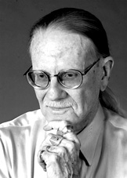
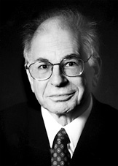
Experimental Econonomics vs. Behavioral Econonomics
Vernon L. Smith
Economist
Strategic Interaction/Game Theory
Testing (neo-classical) economic theory using experimental methods
2002 Sveriges Riksbank Prize in Economic Sciences in Memory of Alfred Nobel
Daniel Kahneman
Psychologist
Decision-making under uncertainty (Allais paradox; loss aversion)
Developing a new descriptive theory
2002 Sveriges Riksbank Prize in Economic Sciences in Memory of Alfred Nobel
“for having integrated insights from psychological research into economic science, especially concerning human judgment and decision-making under uncertainty
“for having established laboratory experiments as a tool in empirical economic analysis, especially in the study of alternative market mechanisms”

Slide 12
Types of experiment (Harrison and List 2004)
Conventional lab exp: students, abstract game
Artefactual field exp: like lab, but non-standard subjects
Framed field exp: same as artefact., but uses framing/field context in task, commodity, information
Natural field exp: tasks are undertaken in natural environment, subjects do not know they participate in an exp
+ external validity (comprehension)
- control/internal validity

Slide 13
Lab Vs. Field Experiments
Debate: if and how much they differ.
NO: positive correlation between pro-social behaviour inside and outside a lab environment (Benz and Meier 2008)
YES: different stakes, preference heterogeneity, homogeneity of lab participants etc make by definition the results of lab experiments limited in relevance for predicting and/or explaining field behaviour (Andersen et al, 2007; Harrison and List 2004)
…

Slide 14
Lab Experiments
Laboratory Experiments are useful methodological tools to examine certain theories or attributes (Ostrom 2007, 2006) but when cooperative behaviour is involved, laboratory experiments are extremely limited in scope and fail to address social norms that often influence and explain individual motives (Wichardt, 2007)

Slide 15
Lab Experiments
...with other words
Field experiments much broader in scope, well reflects reality (involving high complexity)
Lab experiments allow the study of a certain variable in a controlled environment

Slide 16
Lab Experiments

Slide 17
Lab Experiments

Slide 19
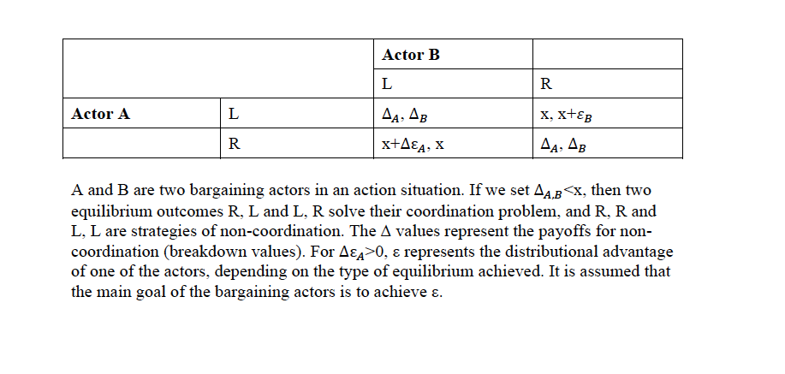
Bargaining game

Slide 20
Bargaining game
Each player has a discount factor di (0<di> 1)
In cases where offers are rejected, the pie decreases for each player differently, according to her or his discount factor. The stronger a player is, the higher their share will be. Bargaining game theory predicts that
In the first round, player 1 offers (1−d2)/(1−did2) for himself and 1− (1−d2)/(1−did2) for player 2.
Player 2 will immediately accept this offer.

Slide 21
Bargaining game
Other Games
Dictator Game
Ultimanum Game
Public Goods Game
Tit for Tat
…

Slide 22
Relevance
Environment: Climate change and the benefits of “free ride”
Economics: “Free” market and cartels • Politics: The “arms race”
In many cases the Equilibrium is that the involved actors will always defect (in slightly differentiated versions of the Prisoner‟s dilemma situations).

Slide 23
The Nash Equilibrium
Nash equilibrium is a solution concept of a game, in which each player is assumed to know the equilibrium strategies of the other players, and no player has anything to gain by changing only his or her own strategy unilaterally.
If each player has chosen a strategy and no player can benefit by changing his or her strategy while the other players keep theirs unchanged, then the current set of strategy choices and the corresponding payoffs constitute a Nash equilibrium.

Slide 25
Example Irrigation game

Slide 26
Example Irrigation game
Social Dilemmas on CPR
Individual Vs Group maximisation / optimum (+ ecosystem dynamics)
Decision Making
Effects of Rules
Effects of Sanctions
Effects of Communication

Slide 27
To do:
Check the „Other Games“. Try them with friends and colleagues. Discuss the results and your own findings
Watch the move “A Beautiful Mind”

Slide 28
Thank you!

