Slide 1
Economic Policy Analysis Lecture I

Slide 2
Introduction Lecture
The word "policy" is not a tightly defined concept but a highly flexible one, used in different ways on different occasions. Policy is everywhere. It controls what we buy, where, what we eat, how much we pay, transportation, the environment, sports…everything. Its application and effect demonstrate what makes policy so important. Policy is about the people. Policy outlines our socially accepted norms and practices to assure some form of predictability in the allocation of scarce resources so we can all contribute towards a social outcome.
Notes:
Use the background points to post details that are not common knowledge, or that the audience will need to understand the context of the speech.
-Do not read these main points from the PowerPoint, instead elaborate on these points during the speech.

Slide 3
Introduction Lecture
A football league sets out rules and regulations regarding return to play procedures for athletes following a concussion.
A school sets a dress code
A government increases the tax on sugary drinks
A parent establishes what is acceptable behavior at the dinner table
Policy: a course or principle of action adopted or proposed by a government, party, business, or individual.
Notes:
Use the background points to post details that are not common knowledge, or that the audience will need to understand the context of the speech.
-Do not read these main points from the PowerPoint, instead elaborate on these points during the speech.

Slide 4
Introduction Lecture
Although a policy is like a decision, it is not just, independent decision. A policy is a set of coherent decisions with a common long-term purpose(s). When decisions are one-off, incoherent or opportunistic, complaints are made that a government or minister "does not have a policy". Government policies are often supported by special legislation.
The terms "policy", "plan", "programme" and "project" are progressively more specific in time and place. Policies are usually national policies (not district or provincial) and are not normally limited in time: one does not usually speak in terms of "2-year policies" as one does of "2-year programmes" or "5-year plans".
Notes:
Use the background points to post details that are not common knowledge, or that the audience will need to understand the context of the speech.
-Do not read these main points from the PowerPoint, instead elaborate on these points during the speech.

Slide 5
Introduction Lecture
The point is that policy is not always straight forward and classification is often misleading.
Example;
Reactive and Proactive Policies (Cigarettes vs. Obesity)
Vertical and Horizontal (Government vs. 3P)
Current and Future (Importance of future policies esp. that come with technological advancements)
Public Policy vs. Social Policy (Social policy is part of public policy but public policy is more than that, it is economic policy, industrial policy, and also social policy, etc.)
Notes:
Use the background points to post details that are not common knowledge, or that the audience will need to understand the context of the speech.
-Do not read these main points from the PowerPoint, instead elaborate on these points during the speech.

Slide 6
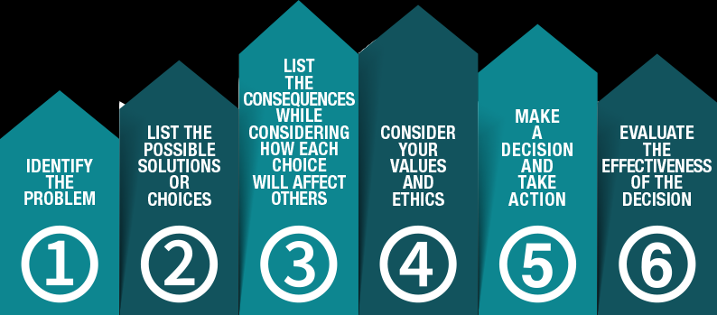
The Policy Cycle
Distracted Driving example:
Studies released, support the assertion that texting and driving is wildly dangerous. Public concern is raised around the issue and public policy is identified as a possible solution.
Politicians and bureaucrats determine what policy options are available, most successful and most cost effective.
The legislative body votes and passes distracted driving legislation.
The enforcement agency (cops) enforce the policy
The public reflects on the policy, enforcement and implementation. If there is an attitude for continued change (too harsh, not strong enough, etc.) this forms the basis for Agenda Setting and the cycle starts again.
A popular policy analysis is the SWOT analysis – Strengths, Weaknesses, Opportunities and Threats.

Slide 7
Introduction Lecture
For any policy, you should ask yourself 4 Questions:
1. Why should government intervene?
2. How should policies be designed?
3. What are the effects of economic policies?
4. Why are public authorities acting the way they do?
Notes:
Use the background points to post details that are not common knowledge, or that the audience will need to understand the context of the speech.
-Do not read these main points from the PowerPoint, instead elaborate on these points during the speech.

Slide 8
Introduction Lecture
Economic policies constantly affect our everyday life: Through price interventions: taxes (sales tax on what we buy, income tax on what we earn, property taxes on our houses,etc.), transfers (Pensions, EITC, Food Stamps, UI, Disability, etc.), public provision of public goods (schools & education, Homeland Security, etc.),...
Through regulation: on what we eat and consume (FDA and other environmental regulation), on the way we drive (DMV regulations, etc.), on the labor market (minimum wage, labor laws, etc.), on how we educate our children (minimum education laws, etc.)...
https://www.bbc.com/news/world-us-canada-46739180
Notes:
Use the background points to post details that are not common knowledge, or that the audience will need to understand the context of the speech.
-Do not read these main points from the PowerPoint, instead elaborate on these points during the speech.

Slide 9
Why should government intervene?
Notes:
Dedicate this entire slide to the thesis statement. It is the reason the speech is being given. Use this time to reveal the three main points of the speech (slides 4,5,6) as an overview for the direction of the speech:
-[type main point #1 here]
-[type main point #2 here]
-[type main point #3 here]
Be sure to transition to the first main point and the next slide.

Slide 10
Why government intervention?
Fundamental theorems of welfare economics:
Competitive markets are Pareto-efficient
Any efficient allocation can be reached by a competitive equilibrium.
Markets need secure property rights: police/justice to ensure that private contracts are enforceable
(Secure property rights favor development of credit markets (cf. Acemoglu-Johnson)
2. Government might restrict/prevent the existence of markets on moral/ethical grounds
Notes:
The title of main point #1 should be clear and concise. Each piece of evidence should be summarized for clarity and cited correctly. Do not simply read the pieces of evidence, but elaborate where needed.
[type notes for elaboration here]
Be sure to transition to main point #2 and the next slide.

Slide 11
Why government intervention?
Organ donation
Increase in organ donation activity due to better regulation.
High physician to population ratio in KG but low transplantation capacity. In KG, only living relative donors are accepted for a kidney transplant. More in KZ, refer here: https://astanatimes.com/2016/05/number-of-organ-transplant-operations-grows-in-kazakhstan/ and http://ectrx.org/forms/ectrxcontentshow.php?doi_id=10.6002/ect.tdtd2015.L5&year=2015&volume=13&issue=3&supplement=3&makale_no=0&spage_number=4&content_type=PDF
What are the possible policy implications for the development of organ donation and transplantation?
Example; U.S. 30 days extra paid leave for federal government employees and tax incentives such as in Utah that, covers up to $10,000 of unreimbursed costs such as travel, lodging and medical expenses.
Notes:
The title of main point #2 should be clear and concise. Each piece of evidence should be summarized for clarity and cited correctly. Do not simply read the pieces of evidence, but elaborate where needed.
[type notes for elaboration here]
Be sure to transition to main point #3 and the next slide.

Slide 12
Why government intervention?
Marijuana is one of America's top-selling agricultural products. According to the Colorado Department of Revenue, combined four-year sales of marijuana for that state since it legalized cannabis in 2014 has now topped $4.5 billion.
"... mainstream pundits like Fox News' Glenn Beck and CNN's Jack Cafferty have publicly questioned the billions spent each year fighting the endless war against drugs," per the San Francisco Chronicle in 2009.
If marijuana was legalized and regulated, an estimated $8 billion would be saved annually in government spending on enforcement, including for the FBI and U.S.-Mexico border security.
There are no significant fiscal reasons against U.S. legalization of marijuana.
Notes:
The title of main point #3 should be clear and concise. Each piece of evidence should be summarized for clarity and cited correctly. Do not simply read the pieces of evidence, but elaborate where needed.
[type notes for elaboration here]
Be sure to transition to the counterargument and the next slide.

Slide 13
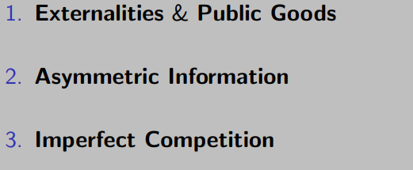
Why government intervention?
Private market provides a Pareto efficient outcome under three conditions: no externalities, perfect information and perfect competition.
When these conditions do not hold ⇒ Market failure
Notes:
The title of main point #1 should be clear and concise. Each piece of evidence should be summarized for clarity and cited correctly. Do not simply read the pieces of evidence, but elaborate where needed.
[type notes for elaboration here]
Be sure to transition to main point #2 and the next slide.

Slide 14
Why government should intervene?
Markets do not provide optimally public goods or externality producing goods.
Can you provide examples of externality? -Negative vs. positive externality
Can you provide examples of public goods? -The classical definition of a public good is one that is non‐excludable and non‐rivalrous.
Notes:
The counterargument should be the most common argument against the topic. The goal for this slide is to address the counterargument in such a way as to actually strengthen the original topic. Be sure to address each piece of evidence against the topic. As you address each piece of evidence elaborate on the text found on the slide. Remember to transition to the final slide, the action step.

Slide 15
Why government should intervene?
When some agents have more information than others, markets fail.
-> Adverse selection in health insurance
Healthy people drop out of private market → Mandated coverage could make everyone better off
(Adverse selection can be defined as strategic behavior by the more informed partner in a contract against the interest of the less informed partner(s). In the health insurance field, this manifests itself through healthy people choosing managed care and less healthy people choosing more generous plans)
When markets are not competitive, there is role for government regulation.
-> natural monopolies such as electricity and telephones
-> the United States vs Microsoft case (read more here: https://www.wired.com/story/us-vs-microsoft-supreme-court-case-data/ )
Notes:
The counterargument should be the most common argument against the topic. The goal for this slide is to address the counterargument in such a way as to actually strengthen the original topic. Be sure to address each piece of evidence against the topic. As you address each piece of evidence elaborate on the text found on the slide. Remember to transition to the final slide, the action step.

Slide 16
Why government intervention?
Recent addition to the list of potential failures that motivate government intervention: people are not fully rational.
The foundation for behavioral economics (cf. Kahneman and Tversky 1979): https://www.theguardian.com/world/2017/oct/09/what-is-behavioural-economics-richard-thaler-nobel-prize
Eating sugary food, drinking alcohol and smoking cigarettes are legal activities. But politicians still use the law to discourage them. They raise their price, prohibit or limit their advertisement, restrict where they can be sold and consumed, and sometimes ban them outright. These politicians thereby violate John Stuart Mill’s famous principle that people should be free to do whatever they like, provided they harm no one but themselves.
Government paternalism switched from public morality to public health. The usual targets are alcohol, tobacco, ‘ junk food’ and sugary drinks, with e-cigarettes and gambling products sometimes thrown into the mix.
Notes:
The title of main point #1 should be clear and concise. Each piece of evidence should be summarized for clarity and cited correctly. Do not simply read the pieces of evidence, but elaborate where needed.
[type notes for elaboration here]
Be sure to transition to main point #2 and the next slide.

Slide 17
Why government intervention?
In many situations, individuals may not or do not seem to act in their best interests [e.g., many individuals are not able to save for retirement]
Two Polar Views on such situations:
1) Paternalism [Libertarian Chicago View] Individual failures do not exist and govt wants to impose its own preferences against individuals’ will
2) Individual Failures [Behavioral Economics View] Individual Failures exist: Self-control problems, Cognitive Limitations
Key way to distinguish those 2 views: Under Paternalism, individuals should be opposed to govt interventions. If individuals understand they have failures, they will tend to support government interventions.
Read more: http://harvardpolitics.com/united-states/a-new-kind-of-paternalism/
And https://iea.org.uk/publications/killjoys-a-critique-of-paternalism/
Notes:
The title of main point #1 should be clear and concise. Each piece of evidence should be summarized for clarity and cited correctly. Do not simply read the pieces of evidence, but elaborate where needed.
[type notes for elaboration here]
Be sure to transition to main point #2 and the next slide.

Slide 18
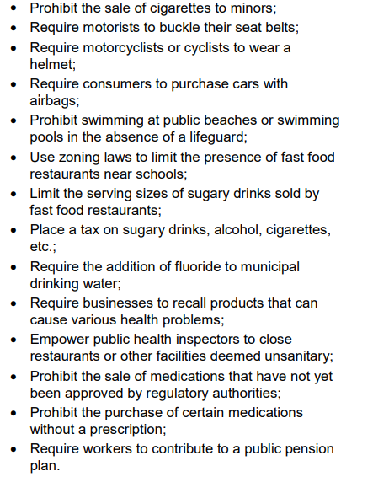
Why government intervention?
Why might we be attracted to policies or interventions that are called paternalistic in public health?
1. BECAUSE THEY CAN HELP REDUCE THE BURDEN
OF NONCOMMUNICABLE DISEASES AND INJURIES.
(ex; public health increasingly became interested in policies and
interventions aimed at changing people's lifestyles in ways that would protect or promote their health such as, eat healthier, exercise etc.)
2. BECAUSE THEY CAN BE MORE EFFECTIVE OR
EFFICIENT.
(ex; pass a law requiring the labelling of trans fat content in foods so as to reduce the incidence of heart attacks and heart disease in the population)
3. BECAUSE THEY CAN BE MORE EQUITABLE
(ex; certain policies that are called paternalistic, such as a ban on cigarette sales, may seem fairer, because they have the
potential to improve the health of the population in general, while helping reduce inequalities in health)
Notes:
The title of main point #1 should be clear and concise. Each piece of evidence should be summarized for clarity and cited correctly. Do not simply read the pieces of evidence, but elaborate where needed.
[type notes for elaboration here]
Be sure to transition to main point #2 and the next slide.

Slide 19
How should government intervene?
Setting social objectives; modern public economics & EPA is based on the individualistic view because it respects individual freedoms and places individuals first.
Defining a Social Welfare Function is a normative choice!
(Normative decision theory, which gives advice on how to make the best decisions given a set of uncertain beliefs and a set of values)
More complex than it sounds, in reality.
Notes:
The title of main point #1 should be clear and concise. Each piece of evidence should be summarized for clarity and cited correctly. Do not simply read the pieces of evidence, but elaborate where needed.
[type notes for elaboration here]
Be sure to transition to main point #2 and the next slide.

Slide 20
How should government intervene?
Pareto criterion; pure efficiency criterion, no redistributive concerns.
Utilitarian Social Welfare Function; each individual has the same weight and redistribution may occur because of differences in marginal utilities.
Rawlsian Social Welfare Function; maximize well-being of the worst-off person in society.
More complex than it sounds, in reality.
Notes:
The title of main point #1 should be clear and concise. Each piece of evidence should be summarized for clarity and cited correctly. Do not simply read the pieces of evidence, but elaborate where needed.
[type notes for elaboration here]
Be sure to transition to main point #2 and the next slide.

Slide 21
How should government intervene?
What tool should government use and how to set the level of use of that tool?
Example of tools: Government wants to increase education level of low-income individuals:
1. Increase direct provision of education in low income districts
2. Give vouchers to low-income families
3. Increase incentives through tax breaks/credits
4. Mandate longer schooling days/ change in class sizes /changes in organization of curriculum, etc.
To be able to answer the question of what tool to use, one needs to ask, “What are the effects of these different economic policies?”
Once a SWF is chosen, government intervention is optimal when it maximizes social welfare.
Notes:
The title of main point #1 should be clear and concise. Each piece of evidence should be summarized for clarity and cited correctly. Do not simply read the pieces of evidence, but elaborate where needed.
[type notes for elaboration here]
Be sure to transition to main point #2 and the next slide.

Slide 22
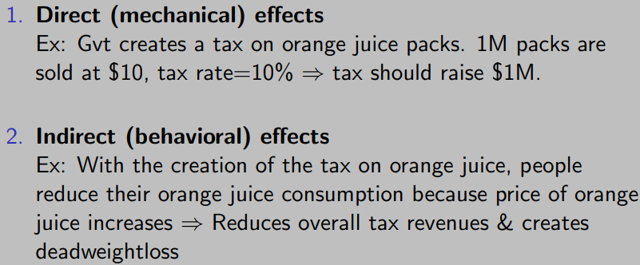
What are the effects of government intervention?
A deadweight loss is a cost to society created by market inefficiency. Mainly used in economics, deadweight loss can be applied to any deficiency caused by an inefficient allocation of resources.

Slide 23
The Spectrum of Economic Policies
Industrial Policies (IO in general)
Macro Policies (Monetary policies, Deficit & Debt level, Fiscal stimulus, etc.)
Financial market regulation
Taxation
Social Insurance: Social Security, Health Care, Unemployment
Insurance, Disability Insurance...
Education policies
Environmental policies
Notes:
Use the background points to post details that are not common knowledge, or that the audience will need to understand the context of the speech.
-Do not read these main points from the PowerPoint, instead elaborate on these points during the speech.

