Slide 1
Copyright and Electronic Resources
Courtesy to Safia Rafikova
Former Director of the Library

Slide 2
What is Copyright
Copyright is exclusive rights (economic and moral rights) given to owners of original, creative works like
- literary works (novels and song lyrics, multimedia works, training manuals, computer programs, etc.),
- dramatic works (film scenarios, dance, etc.),
- artistic works (paintings, drawings, diagrams, maps, , photographs , etc.),
- films, musical works and sound recordings, communication works (radio and television broadcasts and internet webcasts).
If you will write the book, essay or take the photograph, you will be copyright owner.
http://www.iponz.govt.nz/cms/copyright/what-is-copyright
Notes:
‹#›

Slide 3
Economic and Moral Rights
Authors have economic rights (имущественные права):
- Making copies (reproduce, scan, record, download and store)
- Issuing copies to the public (publish or distribute, perform, radio and television broadcasting, internet webcasting)
- Adapting the work (translating the work from one language to another).
Authors have moral rights (неимущественные права):
- Authors have moral rights as to be identified as the author of the work
- Note: an Author can sell economic rights, however, moral rights will always remain with the original author
http://www.slideshare.net/crmwilson/copyright-in-online-resources-users

Slide 4
When does copyright expire?
50 years after the death of the author under the Kyrgyz Republic Law
70 years after the death of the author under the United States Law

Slide 5
What is Public Domain?
The public domain is generally defined as consisting of works that are either ineligible for copyright protection or with expired copyrights
No permission whatsoever is needed to copy or use public domain works.
Public domain works and information represent some of the most critical information that faculty members and students rely upon.
Public domain works can serve as the foundation for new creative works and can be quoted extensively
Public domain works can also be copied and distributed to classes or digitized and placed on course Web pages without permission or paying royalties.
http://copyright.universityofcalifornia.edu/publicdomain.html
Notes:
‹#›

Slide 6
What types of works make up the public domain?
Ideas and facts
Works with expired copyrights
Works governed by early copyright statutes that failed to meet the requirements for copyright protection, i.e., notice, registration, and renewal requirements
U.S. government works (projects written by non-government authors with federal funding may be copyright protected
Scientific principles, theorems, mathematical formulae, laws of nature
Scientific and other research methodologies, statistical techniques and educational processes
Laws, regulations, judicial opinions, government documents and legislative reports
Words, names, numbers, symbols, signs, rules of grammar and diction, and punctuation
http://copyright.universityofcalifornia.edu/publicdomain.html

Slide 7
Exceptions and Limitations to Copyright
Fair Use is an important right to use copyrighted works at the University.
Fair Use is a limitation and exception to the exclusive right granted by copyright law to the author of a creative work.
Section 107 of the U.S. Copyright Law permits Fair Use copying for certain purposes. Fair Use can allow you to quote, scan, copy, share and make many other common uses of protected works for research and private study, scholarship, and teaching.
http://www.copyright.gov/title17/92chap1.html#107/

Slide 8
Fair Use in the Kyrgyz Republic Legislation Exceptions and Limitations Law of the Kyrgyz Republic On Copyright and Neighboring Rights = Закон Кыргызской Республики «Об авторском праве и смежных правах» http://patent.kg/
Article 18. Reproduction of Works for Personal Purposes without the Author's Consent and Payment of Author’s Remuneration = Воспроизведение произведений в личных целях без согласия автора и без выплаты авторского вознаграждения
1. The reproduction of a lawfully disclosed work for exclusively personal purposes shall be authorized without need for author’s consent or payment of remuneration except in the cases provided for in Article 26 of this Law.
2. The provisions of the first paragraph of this Article shall not apply in relation to:
- Reproduction of architectural works in the form of comparable buildings and structures;
- Reproduction of databases or substantial parts thereof;
- Reproduction of computer programs with the exception of cases provided for in Article 25 of this Law;
- Reproduction of books (in full) and musical scores.

Slide 9
Fair Use in the Kyrgyz Republic Legislation Exceptions and Limitations
Article 19. Use of a Work without Consent of the Author and Payment of Author’s Remuneration = Использование произведения без согласия автора и без выплаты авторского вознаграждения
1. The following shall be authorized without the author's consent and without payment of author’s remuneration but with obligatory indication of the author's name whose work is used and the source of the borrowing:
1) The quotation from lawfully disclosed works in the original and translation for scientific, research, polemic, critic and information purposes to the extent justified by the purpose of such quotation, including reproduction of excerpts from newspaper and magazine articles in the form of press reviews;
2) The use of lawfully disclosed works and excerpts therefrom as illustrations in publications, radio and TV broadcasts and educational audio and video recordings to the extent justified by the intended purpose;
3) The reproduction in newspapers, the broadcasting or communication to general public by cable of legitimately published articles in newspapers or magazines on current economic, politics, social and religious topics or of broadcast works of the same nature in cases where such reproduction, broadcast or communication by cable have not been expressly prohibited by the author,
4) The reproduction in newspapers, the broadcasting or communication to the public by cable of political speeches, addresses, lectures and other works of the same nature given in public to the extent justified by an informational purpose. In such cases the author shall retain the right to publication of such works in collections,
5) The reproduction or communication of the current events to the public in reviews by means of photography, broadcasting or public cable communication of works that are seen or heard in the course of such events to the extent justified by the informational purpose. In such cases the author shall retain the right to publication of such works in collections;
6) The reproduction of lawfully published works without gainful intent by using the Braille system or other special means for the blind, except for works specifically created for such means of reproduction.
2. Export of copy of a work by natural person without consent of the author or other owners of copyright and without payment of remuneration shall be allowed only for personal purposes, with the exception of the works, export of which damages the national interest of the republic, the list of which is determined in the established order.

Slide 10
Fair Use of Copyrighted Material
Guidelines
Give the full reference (author, title, etc.)
Acknowledge the source
Give link + “last accessed on dd/mm/yy”
High risk factors include:
Commercial use
Making available on the Internet
Content of high commercial value
If a rights holder complains, stop immediately. Otherwise you have no defense if sued.
Teresa Hackett. Accessing digital resources: it’s mostly about licence. Istanbul, 2009

Slide 11
What is a Licence?
Formal authority (permission) to do something that would otherwise be unlawful
Legally binding agreement between two or more parties
Mostly regulated by contract law
Contract law takes precedence over copyright law i.e. licence terms override copyright law provisions
Teresa Hackett. Accessing digital resources: it’s mostly about licence. Istanbul, 2009

Slide 12
http://creativecommons.org/
set up in 2002
a US non-profit corporation
by professor Lawrence Lessig
the CC licenses are based on US copyright law
more than 250 million CC licensed objects available on the internet (more than 85 million pictures on flickr.com alone
Who Uses CC?
Flickr Wikipedia Google Al Jazeera Nine Inch Nails OpenCourseWare
Public Library of Science Whitehouse.gov

Slide 13
The Creative Commons Licences
Notes:
‹#›

Slide 14
6 Core Licences
Attribution - NonCommercial – NoDeriveratives
Attribution - NonCommercial – ShareAlike
Attribution – NonCommercial
Attribution – NoDeriveratives
Attribution – ShareAlike
Attribution
Notes:
‹#›

Slide 15
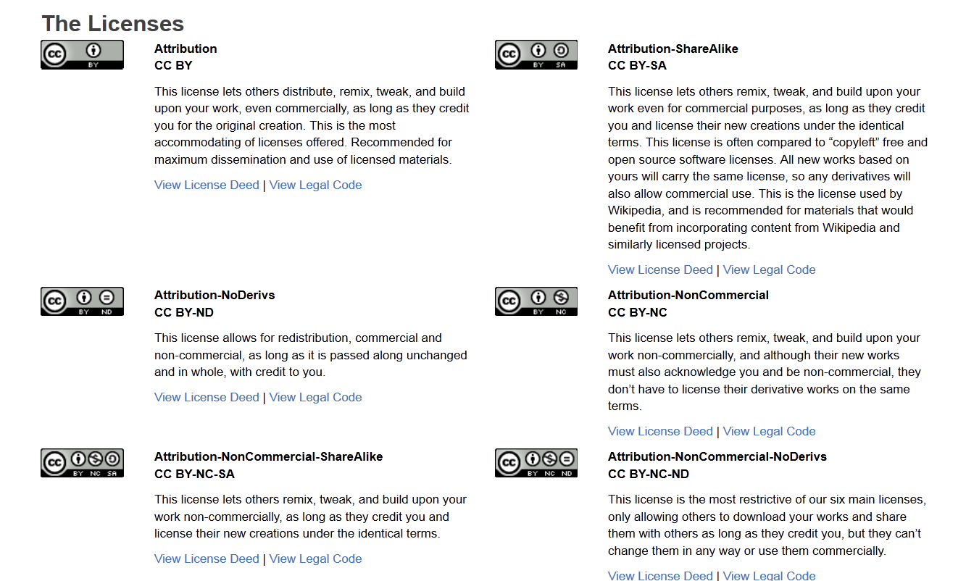
Licences

Slide 16
Licences
Enable to change copyright terms from "All Rights Reserved" to "Some Rights Reserved.“
Enable to Share, Remix, Reuse — Legally
Dr. Maja Bigataj Jancic. Creative Commons Licenses Explained. –Istanbul, 2009

Slide 17
Licences – Rights
All CC licenses allow
- to share - to copy, distribute, display, and perform the work (for non-commercial purposes)
- to transfer the work into another format
Under the condition that the user gives proper attribution to the original author and provides a link to the licenses
Dr. Maja Bigataj Jancic. Creative Commons Licenses Explained. –Istanbul, 2009

Slide 18
Conclusion
Always follow copyright when using licensed electronic resources available through the Library and copyrighted material freely available on the web (always assume material on the web is copyrighted)
Fair Use is an important right to use copyrighted works at the University
Anyone can use a work for any purposes without restriction under copyright law if the work is in public domain
Creative Commons licences apply to works that are protected by copyright
Always give correct information about a source (full reference)

Slide 19
References
Copyright information & resources: https://www.lib.umn.edu/copyright/limitations
Copyright Law of the United States of America: http://www.copyright.gov/title17/92chap1.html#107
Copyright: Essential Reading: http://www.ipo.gov.uk/c-essential.pdf
Creative Commons: http://creativecommons.org/
Law of the Kyrgyz Republic On Copyright and Neighboring Rights = Закон Кыргызской Республики «Об авторском праве и смежных правах»: http://patent.kg/index.php/ru/legislation/67-laws/kodeksy-i-zakony-kyrgyzskoj-respubliki/759-zakon-kyrgyzskoj-respubliki-ob-avtorskom-prave-i-smezhnykh-pravakh.html
Public Domain: http://copyright.universityofcalifornia.edu/publicdomain.html
What is Fair Use? http://copyright.columbia.edu/copyright/fair-use/what-is-fair-use/
Wilson, Rowan. Copyright in Online Resources: http://www.slideshare.net/crmwilson/copyright-in-online-resources-users
Правовая экспертиза лицензий Creative Commons на соответствие законодательству Кыргызстана — Отчет (рус. и англ. варианты): http://www.gipi.kg/archives/907
Notes:
‹#›

