Slide 1
Introduction: The State of Macroeconomics
Rahat Sabyrbekov
AUCA
Fall 2019

Slide 2
Content
Lee E. Ohanian, “The Economic Crisis from a Neoclassical Perspective,” Journal of Economic Perspectives 24 (Fall 2010), 45–66 http://skchugh.com/images/Ohanian_2010JEP_GreatRecessionNeoclassicalPerspective.pdf
Ricardo J. Caballero, “Macroeconomics after the Crisis: Time to Deal with the Pretense-of-Knowledge Syndrome,” Journal of Economic Perspectives 24 (Fall 2010), 85–102. https://pubs.aeaweb.org/doi/pdfplus/10.1257/jep.24.4.85

Slide 3
Macroeconomics
What is macroeconomics?
How we can use it?

Slide 4
Is macroeconomics useless?
Financial crisis of 2008 was the most severe crisis after the Great Depression

Slide 5
The Economic Crisis from a Neoclassical Perspective
The 2007–2009 recession is not well understood within current classes of economic models, including both standard real business cycle models
Lee E. Ohanian briefly reviews the exiting macroeconomics approach, analyses the financial crisis and draws lessons.

Slide 6
Notes:
Notes: Figure 1 shows quarterly per capita hours worked in the U.S. between 1956-Q1 and 2009-Q3, with shading indicating recessions according to the dates assigned by the National Bureau of Economic Research. Per capita hours represents total hours (civilian and military) per noninstitutional population aged 16 to 64.

Slide 7
Standard business cycle models with financial market imperfections have was useless
New analysis and models needed to explain the shocks, that affect the labor market

Slide 9
General Business Cycle Theory
Kydland & Prescot (1980, 1982) created theoretical framework with excplicit optimization for economic decision makers.
The model allowed approximate equilibrium solution and consistent with long-run observations.
Many following works built upon the model, allowed flexibility and addressed heterogeneity
Still little work on shocks
Notes:
The literature on general equilibrium business cycle models has made consid-e literature on general equilibrium business cycle models has made considerable progress in understanding how different model economies respond to what Iable progress in understanding how different model economies respond to what I will callll call abstract shocks: shocks that do not have a precise defiocks that do not have a precise def nition or acknowledgedition or acknowledged source. This category includes productivity shocks, preference shocks, firce. This category includes productivity shocks, preference shocks, f nancialancial shocks, risk shocks, and markup shocks, among others. However, because the focusocks, risk shocks, and markup shocks, among others. However, because the focus of the literature has been on studying the effect of different types of shocks in the literature has been on studying the effect of different types of shocks in different types of economies, there has been less progress on developing and testingfferent types ofeconomies, there has been less progress on developing and testing theories about the nature and sources of these abstract shocks.eories about the nature and sources of these abstract shocks.

Slide 10
Business-cycle Model at its core
Expansion and contraction of money and credit
Innovation theories: the clustering of important inventions
Productivity shocks spread through the economy and cause fluctuations.
Equilibrium-business-cycle theories claim that misperceptions about price and wage movements lead people to supply too much or too little labour, which leads to cycles of output and employment

Slide 11
How this Recession was Different
The decline in real GDP and its components during the 2007–2009 recession is considerably more severe

Slide 12
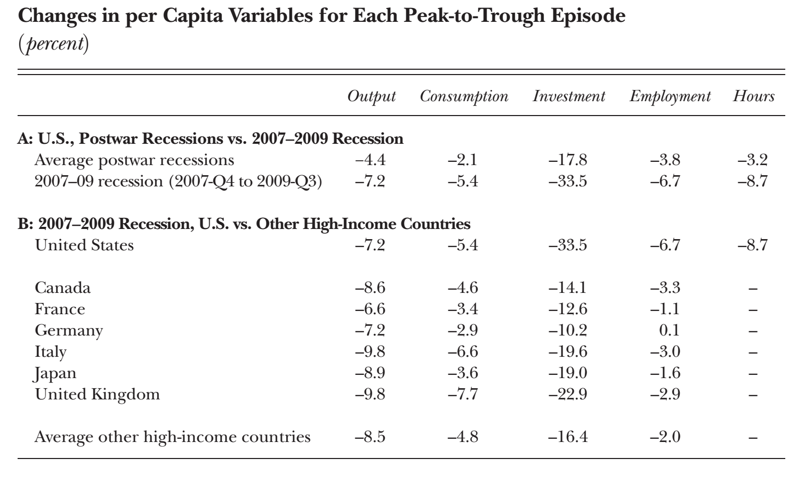
Notes:
Panel B of Table 1 compares the 2007–2009 recession between the Unitednel B of Table 1 compares the 2007–2009 recession between the United States and six other large high-income economies: Canada, France, Germany, Italy,ates and six other large high-income economies: Canada, France, Germany, Italy, Japan, and the United Kingdom. The average for these six economies is given inpan, and the United Kingdom. The average for these six economies is given in the bottom row. This comparison highlights the same striking features. Specifi bottom row. This comparison highlights the same striking features. Specif cally,ally, the decline in labor in the United States is much larger than in the other countries.e decline in labor in the United States is much larger than in the other countries. The average per capita employment decline (hours worked are not available fore average per capita employment decline (hours worked are not available for the other countries) in these countries is only 2 percent from the fourth quartere other countries) in these countries is only 2 percent from the fourth quarter of 2007 through the third quarter of 2009, compared to a 6.7 percent per-capita 2007 through the third quarter of 2009, compared to a 6.7 percent per-capita employment decline in the United States.ployment decline in the United States.

Slide 13
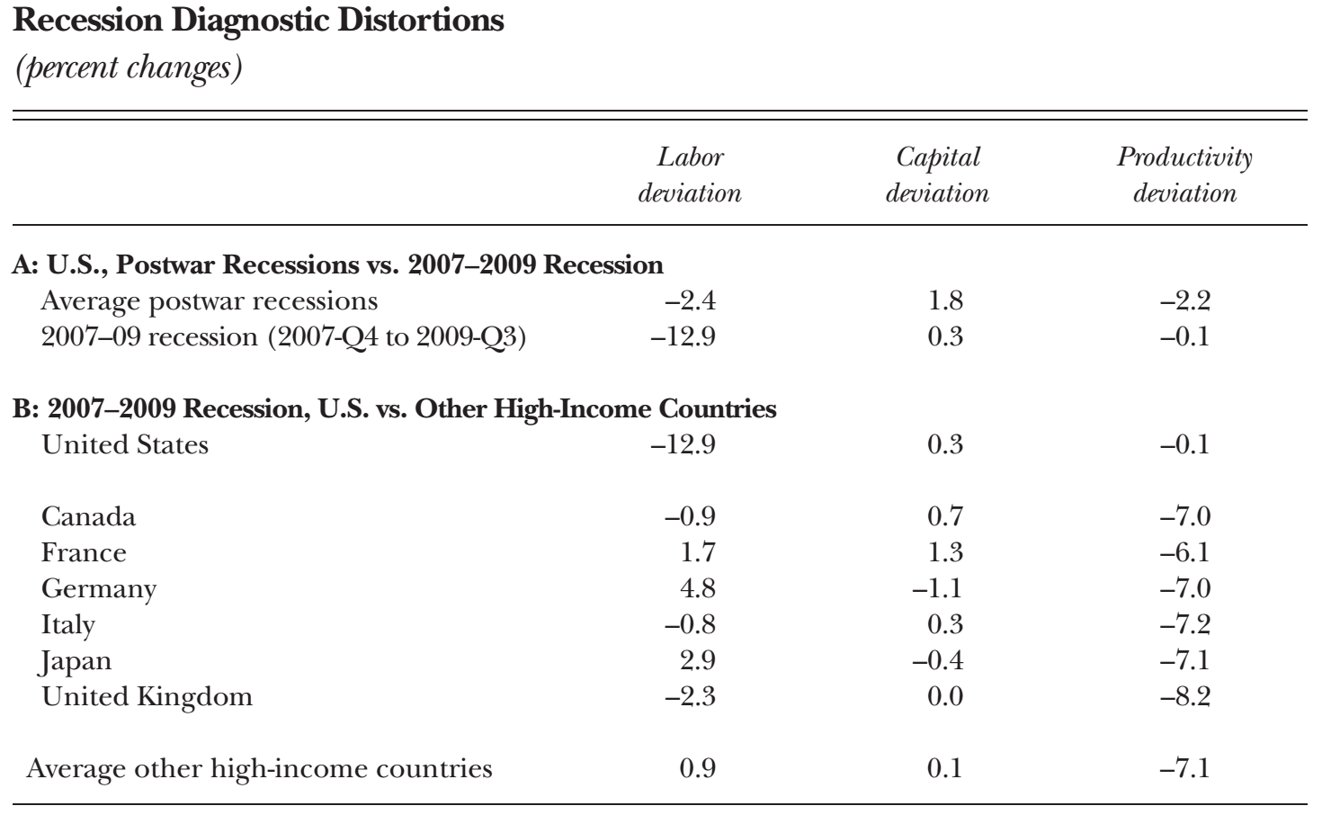
Notes:
The labor deviation is the percent difference between the marginal rate of substitution between consumption and leisure, and the marginal product of labor when actual data are plugged into that equation. The capital deviation is the percent difference between the intertemporal marginal rate of substitution between consumption and the marginal product of capital net of depreciation when actual data are plugged into that equation. The productivity deviation is the Solow residual.

Slide 14
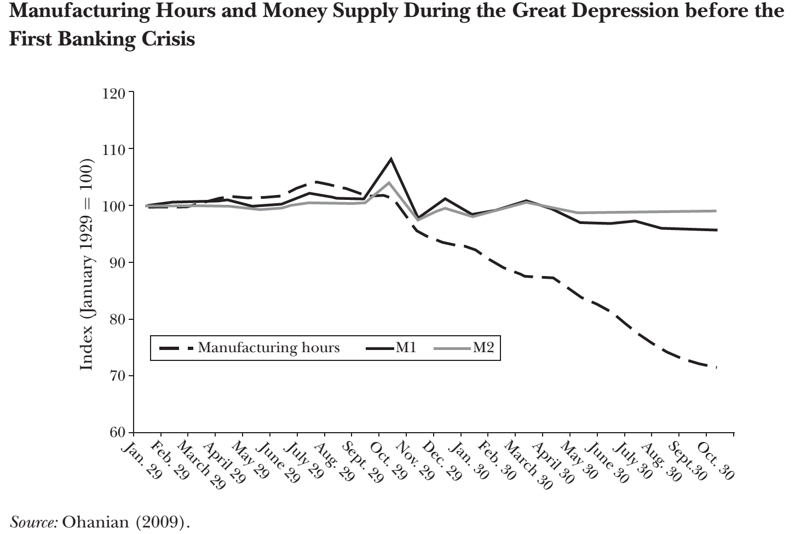
Two explanations of the crisis (1)
Financial – inefficient financial intermediaries – major contributor but not the main cause

Slide 15
Two explanations of the crisis (2)
Policy explanation:
The common argument here is that these policies distorted incentives through their deficient design.
US Mortgage programs
Troubled Asset Relief Program
American Recovery and Reinvestment Act

Slide 16
Conclusion of Ohanian

Slide 17
Macroeconomics after the Crisis: Time to Deal with the Pretense-of-Knowledge Syndrome Ricardo J. Caballero

Slide 18
Dynamic stochastic general equilibrium modeling (DSGE) is a method that explains economic phenomena, such as economic growth and business cycles, and the effects of economic policy, through econometric models based on applied general equilibrium theory and microeconomic principles.
“The model is an irresistible statements. The model is an irresistible snake-charmer ” - Caballero

Slide 19
The ultimate goal of macroeconomics is to explain and model the (simultaneous)e ultimate goal of macroeconomics is to explain and model the (simultaneous) aggregate outcomes that arise from the decisions made by multiple and heterogeneous economic agents interacting through complex relationships and markets.

Slide 20
Caballoro outlines two macroeconomics
Core – concentrates on the whole market and studies macroeconomic events (growth models, households design optimization).
Periphery - focused on specifics, by adding selected components to the general model (speculative bubbles, collateral constraints etc).
Notes:
nstead, core macroeconomics often has aimed not for a realistic anchor and astead, core macroeconomics often has aimed not for a realistic anchor and a simplifiplif cation of the rest, but for being only half-“goofy” on everything: preferencesation of the rest, but for being only half-“goofy” on everything: preferences and production functions that do not represent anyone but that could be foundd production functions that do not represent anyone but that could be found in an introductory microeconomics textbook, the same for markets, and so on. By an introductory microeconomics textbook, the same for markets, and so on. By now, there are a whole set of conventions and magic parameter values resultingw, there are a whole set of conventions and magic parameter values resulting in an artif an artif cial world that can be analyzed with the rigor of micro-theory but thatial world that can be analyzed with the rigor of micro-theory but that speaks of no particular real-world issue with any reliability.eaks of no particular real-world issue with any reliability

Slide 21
Integration?
There is a necessity to ingrate both
Challenges are present ( realism of periphery to abstraction of core)
Facing the economic complexity
Dominoes and Avalanches
Panics
Policy implications
Robustness
Notes:
Allen and Gale’s (2000) model of financial networks and the inherentlen and Gale’s (2000) model of financial networks and the inherent fragility of some of these structures provided an early and elegant example ofagility of some of these structures provided an early and elegant example of how linkages can cause substantial instability with respect to shocks differentw linkages can cause substantial instability with respect to shocks different from those the network was designed to handle.
n a complex environment, agents need to make decisions based on informa- a complex environment, agents need to make decisions based on information that is astonishingly limited relative to all the things that are going on and thaton that is astonishingly limited relative to all the things that are going on and that have the potential to percolate through the system. This degree of ignorance is notve the potential to percolate through the system. This degree of ignorance is not something agents with frontal lobes like to face. Anxiety is also part of the frontalmething agents with frontal lobes like to face. Anxiety is also part of the frontal lobe domain! Reactions that include anxiety and even panic are key ingredients forbe domain! Reactions that include anxiety and even panic are key ingredients for macroeconomic crises

Slide 22
Pretense of Knowledge

Slide 23
Questions?

