Slide 1
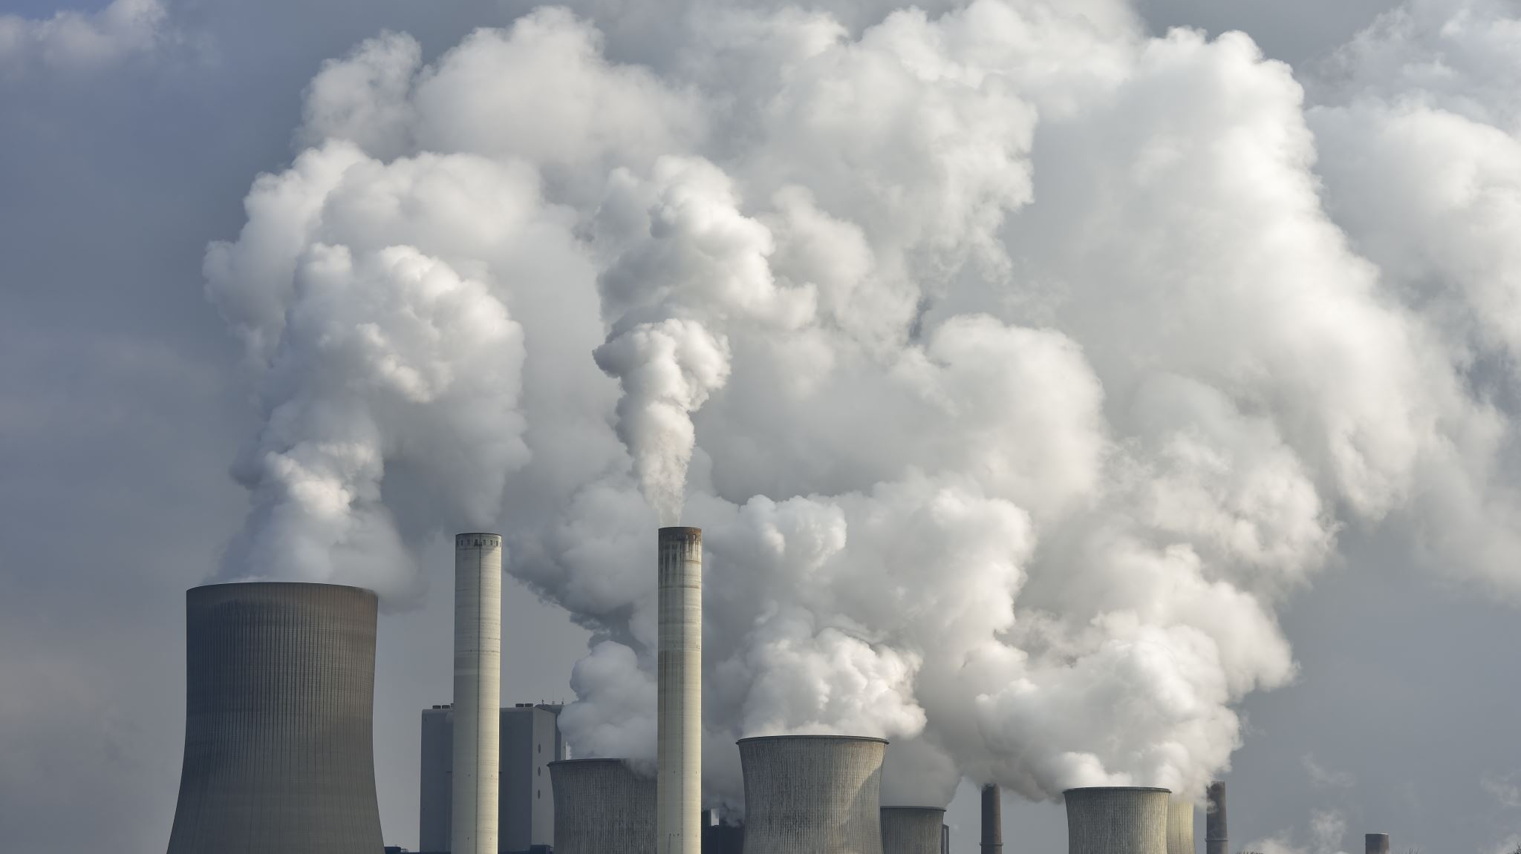
The social cost of carbon
30 September 2022

Slide 2
Social cost of carbon is an important part of climate change CBA
Social cost of carbon is an estimate of the harm caused by releasing more carbon dioxide into the atmosphere and increasing global warming.

Slide 3
https://www.youtube.com/watch?v=VXLzaRoxJK4

Slide 4
SCC in USA
Trump – $1-$7
Obama - $50
So how did the Trump administration conclude that global warming will be much less costly than the Obama administration assumed?

Slide 5
First, the Environmental Protection Agency focused solely on damages from climate change that would occur within the borders of the United States rather than across the entire globe.
Second, they used calculations that put less weight on the harm climate change could inflict on future generations.
Notes:
Trump officials contend that their carbon approach better reflects the way the government has traditionally done cost-benefit analyses.Critics argue that this approach is inappropriate for global, multigenerational problems like climate change, and that newer researchsuggests the social cost of carbon may be even higher than the Obama administration estimated, not much lower.
Ultimately, the courts could decide which view prevails. “This will be part of the legal challenges to these regulatory rollbacks,” saidRichard L. Revesz, an expert in environmental law at New York University. “The reasons for why the Trump administration picked thesenumbers for the social cost of carbon are going to be scrutinized.”

Slide 6
Tallying the costs of climate change
Predicting the costs of climate change is a maddeningly complex task
In 2009, the Obama administration brought 12 federal agencies together to hash out a best estimate of the social cost of carbon.
During Trump the E.P.A. under Scott Pruitt came up with its own “interim” estimate of the social cost of carbon.
Discount rate debate
Notes:
Critics counter that this approach overlooks two key points. First, many of those climate impacts in other countries could indirectly hurtthe United States, say, by roiling the global economy or by increasing the number of refugees. Second, climate change can only be solvedby all countries working together. If the United States refused to consider the impacts of its emissions on other countries, other countriescould respond in kind.
“The United States is only 14 percent of global emissions, which means that 86 percent of the damages we face will be caused by emissionsfrom other countries,” said Richard G. Newell, president of Resources for the Future, an environmental economics think tank. “If we tookthis domestic-only approach to its logical conclusion, that means other countries should not worry about their impacts on us.”

Slide 7
Integrated Assessment Models and the Social Cost of Carbon: A Review and Assessment of U.S. Experience by Gilbert E. Metcalf and James H. Stocky
Weyant (2017) argues that the uncertainty in IAMs is due more to the fundamental uncertainty in scientific and economic knowledge about key model features and inputs than to flaws in the models themselves.
Pindyck (2013) IAMs are “of little or no value for evaluating alternative climate change policies and estimating the SCC”

Slide 8
History of the Use of IAMS and the SCC In U.S. Climate Policy
Notes:
Nordhaus (2013b) defines IAMs as “approaches that integrate knowledge from two or more
domains into a single framework” (p. 1070). Nordhaus’s definition includes models that, by
themselves, do not generate estimates of the SCC(e.g., the Energy InformationAdministration’s
National Energy Modeling System [NEMS]). IAMs that can be used to estimate the SCC combine
amodel of the economy with amodel of the atmosphere and ocean (and possibly land) in
order to allow the researcher to track geophysical and economic variables of interest. An IAM
that is constructed to analyze climate changemust be able to track emissions, the concentration
ofGHGs in the atmosphere aswell as other carbon sinks (e.g., the ocean or forests), temperature
and other climate impacts arising from increased concentrations of GHGs in the atmosphere,
and the damages resulting from those climate impacts. For emissions resulting from human
activity, policy scenarios can be proposed to affect behavior, and thus emissions, along a number
of dimensions.

Slide 9
Current Uses of the SCC
SCC is currently used as an input into the official benefit–cost analyses of proposed U.S. regulations, as a component of legal challenges to government actions, and as a measure of the costs of climate change in the public discussion about climate policy.

Slide 10
IAMs: A Starting Point for Improving SCC Estimates or Fundamentally Flawed?
Criticisms of IAMs often focus on the uncertainties in key model components that drive the results in model runs (see, e.g., Pindyck 2013).
equilibrium climate sensitivity parameter,
damage functions,
treatment of catastrophic events,
the discount rate.
Notes:
Because equilibrium climate sensitivity is in the realm of geophysical climate science
Damage functions in early IAMs were derived from a top-down cross-sectional analysis of the relationship between the level of gross domestic product (GDP) and temperature;
While it is a much larger undertaking than a top-down approach, a bottom-up approach may provide a more believable identification of causal climate impacts. For example, Koop et al. (2014) used a combination of an
insurance company compilation of built property values on the U.S. East Coast, elevationmaps, and actual and simulated hurricane tracks to estimate the property damage cost of increased sea level rise and possibly stronger storms that track more over land.
Tipping points
Broadly speaking, there are two approaches to choosing the discount rate, a positive approach based on market rates and a normative approach based on valuing consumption across generations.
For example, implementing the Ramsey approach (the discount rate that emerges in an equilibrium growth model with endogenous savings) requires adopting a utility function, estimating the intertemporal elasticity of substitution, and estimating the uncertainty about future consumption growth over distant horizons.

Slide 11
Summary
The uncertainty concerning damage functions, climate catastrophes, and discounting in climate change models is likely to persist, which means that there will continue to be considerable variation in estimates of the SCC for the foreseeable future.
As ongoing research leads to amore precise quantification of uncertainty, IAMs will be better able to quantify and, we believe, narrow the range of uncertainty of the SCC as well as provide an increasingly solid scientific basis for the various steps in the calculation of the SCC.

Slide 12
Thank you! Questions?

