Slide 1
Chronology and periodization

Slide 2
Definitions
Chronology is simply the sequence of events ranging from first to last, or from beginning to end
Absolute and relative chronology
Periodization (A period of history is a specific time frame containing common characteristics)
Three-Age system

Slide 3
Timeline
2000 BC
1000 BC
0
1000 AD
2021
BC
=
BCE
AD
=
CE
BP = years ago (from 1950s)

Slide 4
Stone Age
Paleolithic:
LP (2,6 mya-300 kya), MP (300-45/40 kya) and UP (45-15/10 kya)
Mesolithic (15-10/8 kya)
Neolithic (10-7 kya)

Slide 5
Transitions and Historical periods
Copper Age (5th millennium BC)
Bronze Age (3-2 millennium BC)
For Central Asia (EBA 3200-2400 BC, MBA 2500-1900 BC, LBA 1900/1400-1400/1000 BC)
Iron Age (since 1000 BC)

Slide 6
Geochronology
Pleistocene (2.588 mya)
glacial and interglacial periods, faunal stages
Last Glacial Maximum (LGM) 29-19 kya
Holocene (11 700)

Slide 7
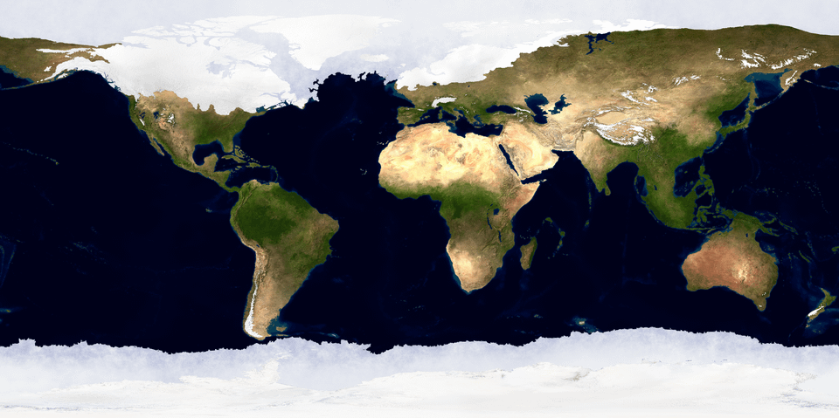

Slide 8
`

Slide 9
Why Ice Ages?
Last million years Ice ages came every 100 kya
Sun is a main source of energy (sunlight is stable)
Earth’ axis is slowly rotates in space with a period of 27 kya
Angle of its inclinations varies with periodicity of 41 kya
Earth’ orbit from changed within every 100 kya
Eccentricity and stochastic resonance

Slide 10
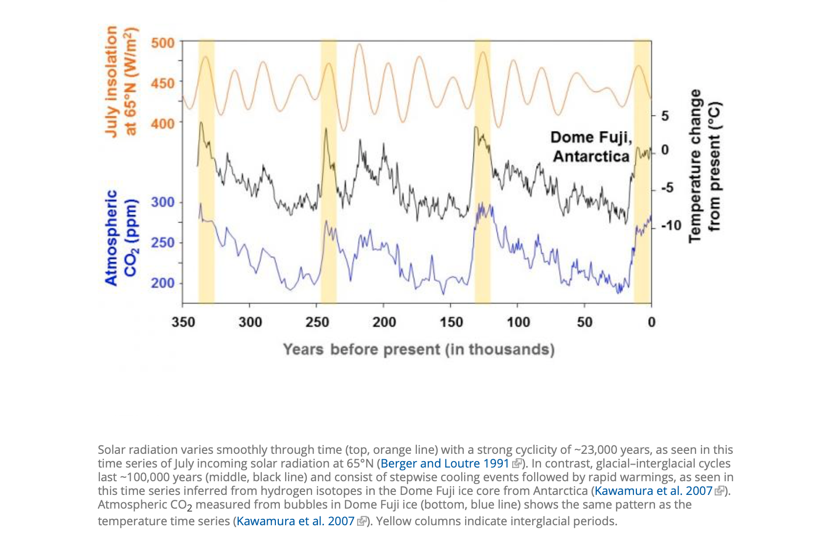

Slide 11
Foraminera
Single-celled marine plankton
More than 4000 extinct species
Plantic forams (upper waters) and benthic forams (seafloor or ocean sediments)
At least from Cambrian era (>500 million years ago)

Slide 12
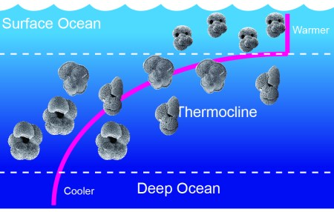

Slide 13
OIS or MIS
Marine isotope stages / Oxygen isotope stages
Alternating warm and cool periods (even and odd numbers)
More than 100 MIS up to 6 million years
The ratio of the stable oxygen isotopes, 18O and 16O
Higher O18 in the cooler periods
Calcite shells of small sea organisms (foraminera etc.)

Slide 14
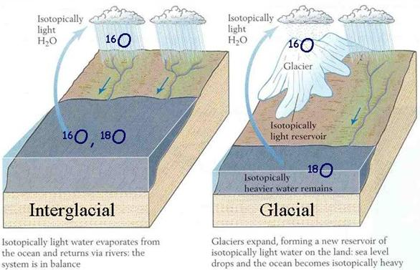
Biostratigraphy
Less C in atmosphere the cooler period / more 18O in ocean
More C in atmosphere the warmer period / less 18O in ocean

Slide 15
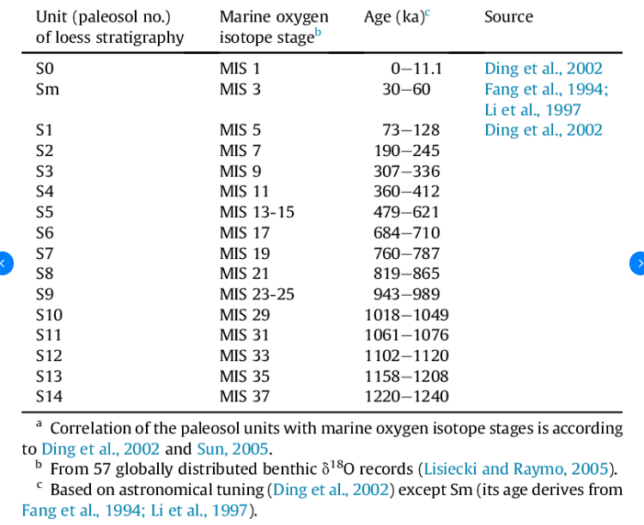

Slide 16
The earth magnetic field events
Matuyama, Brunhes, Gauss, Gilbert
Magnetization of volcanic rocks
781 000 y.a. last change of magnetic field
Marker of the beginning of middle Pleistocene
Dated by 40Ar/39Ar dating techniques

Slide 18
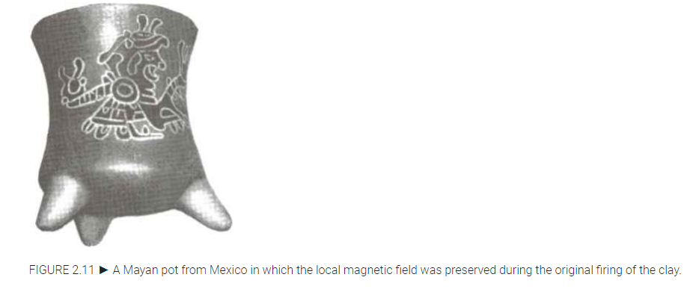
Paleomagnetic barcode

