Slide 1
HOW MUCH DOES REDUCING INEQUALITY MATTER FOR GLOBAL POVERTY?
Aidaralieva Aiana

Slide 2
Introduction
Over the past two and a half decades, global extreme poverty has decreased rapidly. Since 1990, the share of the world population living below the extreme poverty line of $1.90 per day has fallen from 35.6% in 1990 to 10.0% in 2015 (World Bank, 2018a). Against this backdrop, international development actors, bilateral development agencies and countries themselves have united around a goal of ‘ending’ extreme poverty by 2030.

Slide 3
4 distinct contributions:
Use micro data for 119 countries and grouped data for an additional 45 countries, allowing for an unprecedented data coverage of 97% of the world’s population.
Model the impact of distributional changes on future trajectories of global poverty by changing countries’ Gini index. The Gini index is arguably the most frequently used measure of inequality, and it makes for an intuitive way of modeling distributional changes which has direct policy relevance and conceptual simplicity.
Since there are infinitely many ways in which a change in Gini indices can occur, they use different growth incidence curves to capture how inequality reductions may occur in an intuitive manner.
Addressing the criticism that economic growth in national accounts is increasingly disconnected from income and consumption as observed in surveys (Ravallion, 2003; Deaton, 2005; Pinkovskiy & Sala-i-Martin, 2016), they utilize a novel machinelearning algorithm to estimate the share of economic growth passed through to income or consumption observed in surveys.

Slide 4
Their simulations suggest that the global poverty rate will remain around 6.5% in 2030 if growth is distribution-neutral and follows IMF forecasts.
They simulate all changes in Gini indices at the national level, not globally. A pro-poor distributional change as simulated in this paper implies a fall in within-country inequality, but can be expected to have a more 3 muted effect on global inequality, for which between-country differences matter greatly.

Slide 5
Inequality scenarios
With the growth rates and passthrough rates in place, it was considered five different scenarios for changes in the Gini index; that it changes by -2%, -1%, 0%, 1% and 2% per year.
Utilizing the World Bank’s Global Shared Prosperity Database (World Bank, 2018b), it was can looked at 259 spells with a comparable welfare aggregate and surveys that lie about 5 years apart. The histogram of annualized percentage changes in the Gini index from these 259 spellsis plotted in Figure 1.

Slide 6
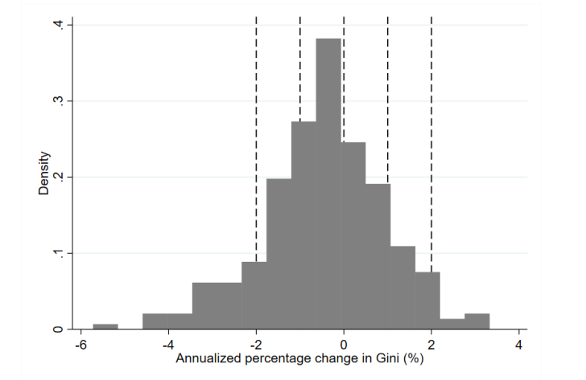
Figure 1: Observed annualized changes in the Gini compared with changes used in simulations
Note: Histogram of empirically observed annualized changes in the Gini using the spells from the surveys in World Bank (2018b).

Slide 7
Estimating global poverty
Armed with growth rates, passthrough rates, and changes in the Gini index, using the linear or convex growth incidence curve, authors can project the welfare distribution in each country towards 2030. To project the distribution, it was used the povsim simulation tool (Lakner et al. 2014).
In order to derive global poverty rates, a few more pieces are needed.
First, they need consumer price indices (CPI) and purchasing power parity (PPP) exchange rates to convert the national welfare aggregates into constant USD that have been adjusted for international price differences.
Second, they need population data to aggregate poverty estimates across regions and globally.
Finally, to arrive at regional and global poverty rates, they also need estimates for the 3% of the world for which we have no distributional data.

Slide 8
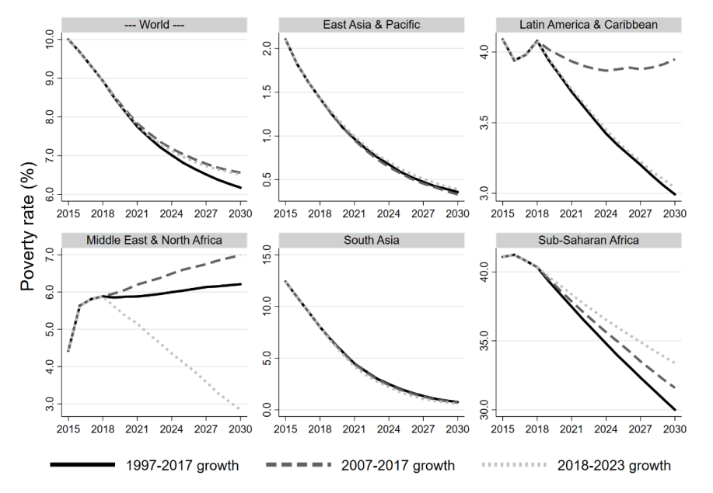
Figure 2: Global and regional distribution-neutral poverty projections to 2030
Impacts on Poverty: Global and Regional Trajectories to 2030
Note: Projected global and regional poverty rates measured at $1.90/day in 2011 PPPs assuming distribution-neutrality under three different growth scenarios: countries follow their growth patterns of (1) the past 10 years, (2) the past 20 years, or (3) the growth projections from the WEO.

Slide 9
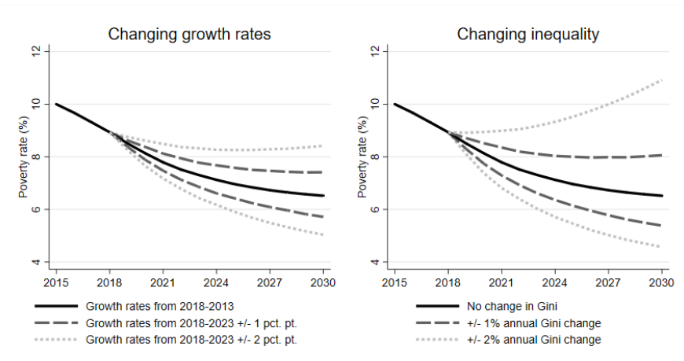
Figure 3: Simulations of global poverty under different growth and Gini scenarios
Note: Projected global poverty rate measured at $1.90/day in 2011 PPPs assuming that countries (1) exceed or fall behind the growth projections from the WEO by 1 or 2 pp annually (left panel), or (2) follow the WEO projections exactly but reduce/increase their Gini index by 1 or 2% annually (right panel).

Slide 10
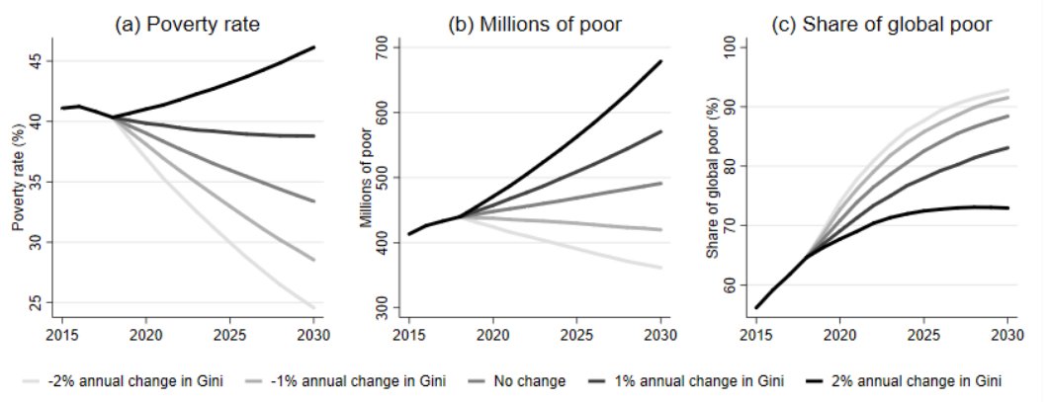
Figure 4: Poverty Projections in Sub-Saharan Africa
Note: Projected poverty rates in Sub-Saharan Africa measured at $1.90/day in 2011 PPPs assuming that countries follow the growth projections from the WEO under five different scenarios about how inequality will change in each country.

Slide 11
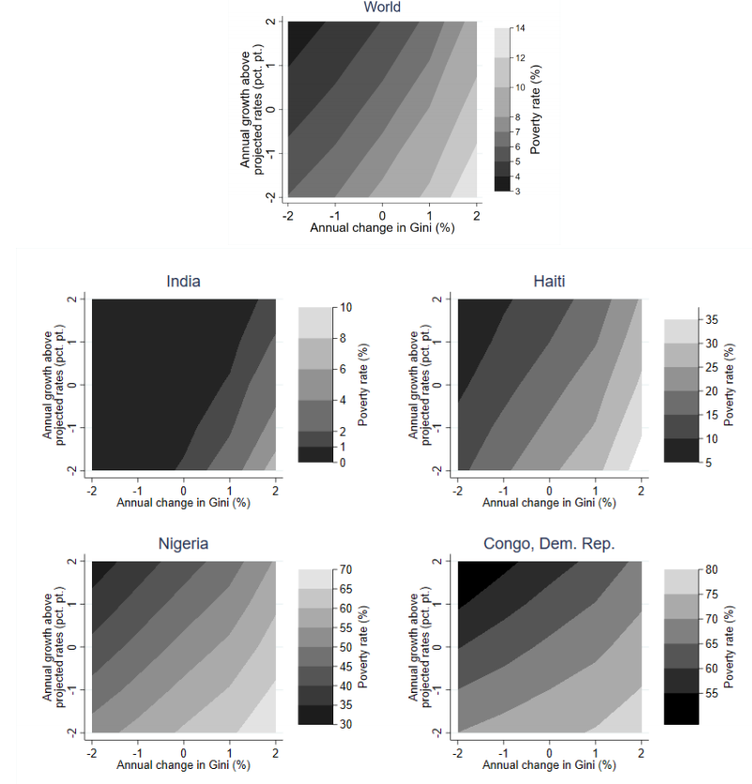
Figure 5: Global and country-specific iso-poverty curves, 2030
Note: The figure shows different combinations of changes in the Gini index and exceeding/falling behind growth forecasts that results in the same poverty rate globally and for four selected countries. The flatter the curves, the more growth matters relative to reducing inequality.

Slide 12
Conclusion
Using a global database covering 97% of the world’s population, this paper shows that under assumptions of distribution-neutral growth, the World Bank’s goal of achieving less than 3% extreme poverty by 2030, as well as the United Nations’ Sustainable Development Goal of complete eradication of poverty, will be very difficult to reach by 2030.
The poverty impact of more inclusive growth defined in this way is different across countries and depends on the initial level of poverty, as well as the shape of the distribution, the precise growth incidence curve used and the growth rate.
While many of the findings are intuitive, one of the contributions of the paper is to quantify these effects using plausible distributional changes.

