Slide 1
Gender, Family and Kinship Course

Slide 2
Content
Relationships between Gender, Family, and Kinship
What is their role in Anthropology?
Conclusion

Slide 3
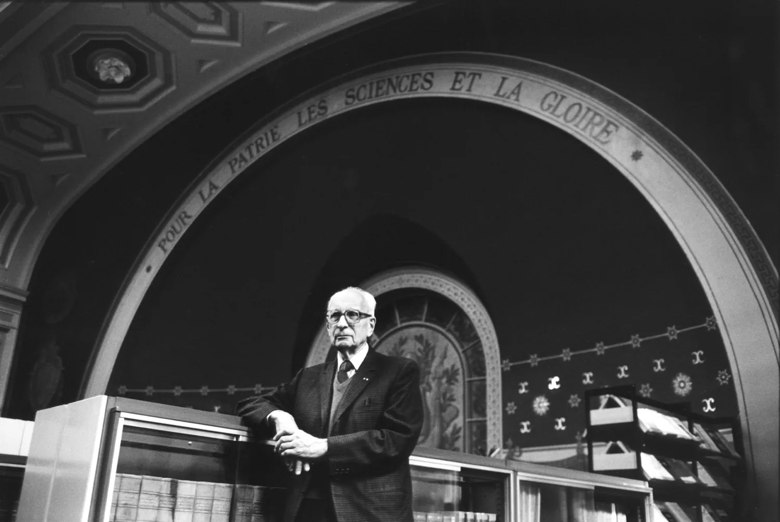
Alliance theory and Incest taboo by French anthropologist Claude Levi Strauss (1908 – 2009)
"The Elementary Structures of Kinship.” (1949)
Primary important institutions since the formation of a human society
Add a main point

Slide 4
“Gender refers to the socially constructed characteristics of women and men, such as norms, roles, and relationships of and between groups of women and men. It varies from society to society and can be changed.” WHO
Sex
Gender
“Sex refers to a set of biological attributes in humans and animals. It is primarily associated with physical and physiological features, including chromosomes, gene expression, hormone levels and function, and reproductive/sexual anatomy.”

Slide 5
Write examples of differences b/n sex and gender

Slide 6
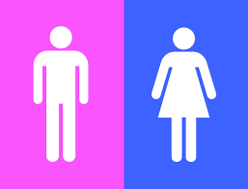
Within the world, the cultural norm is to classify people as male or female – this is called the gender binary. Many individuals have a gender identity that does not fit within this binary and use the umbrella term non-binary.
Gender binary
Non-binary

Slide 7
Family
A group of one or more parents and their children living together as a unit.
Family (from Latin: familia) is a group of people related either by consanguinity (by recognized birth) or affinity (by marriage or other relationship).
Nuclear and extended family

Slide 8
Write an original statement or inspiring quote about Family.

Slide 9
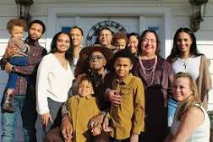
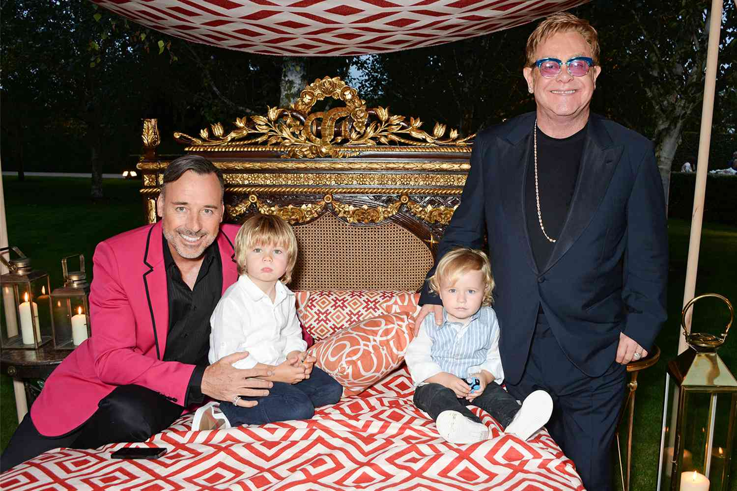
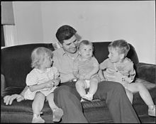
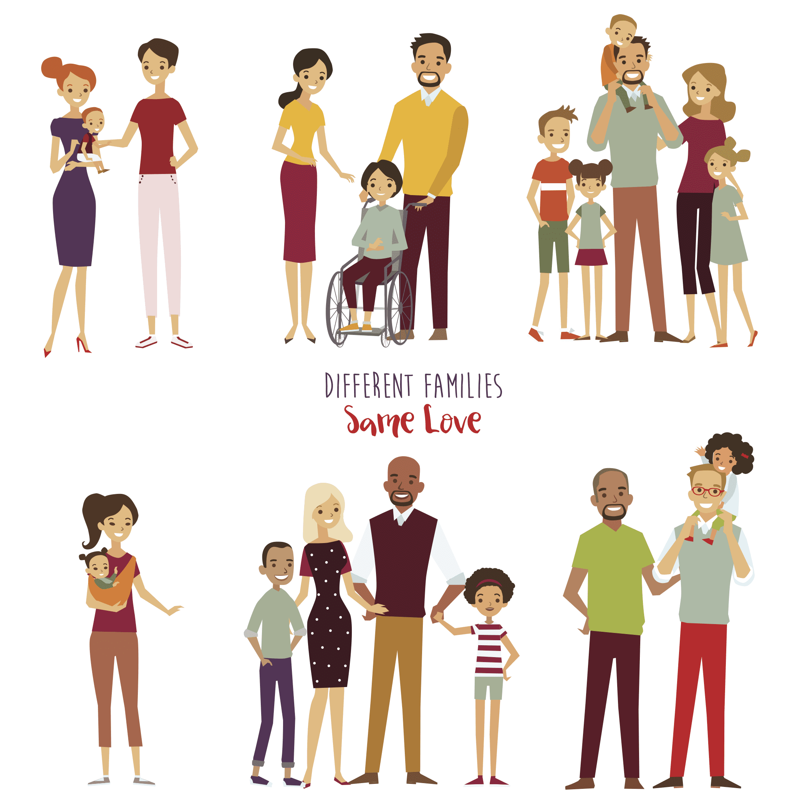
Non/Traditional family
Multigenerational family/extended family
American Family in the 1940s
Blended family
Gay family
e

Slide 10
Kinship refers to the relationships between persons based on descent or marriage.
The study of kinship is the study of a human’s relations with the web of people related to him through blood and marriage – mating, gestation, parenthood, socialization, and siblingship.
Kinship

Slide 11
6
Classification of kinship systems in the world:
There are
Eskimo, Hawaiian, Sudanese, Omaha, Crow, and Iroquois systems

Slide 12
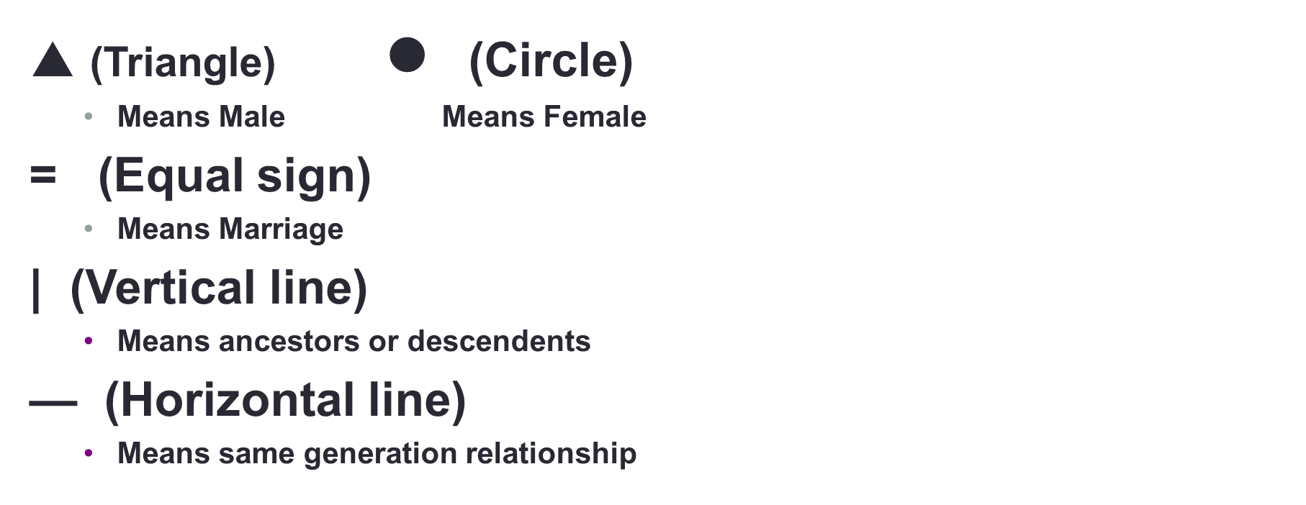

Slide 13
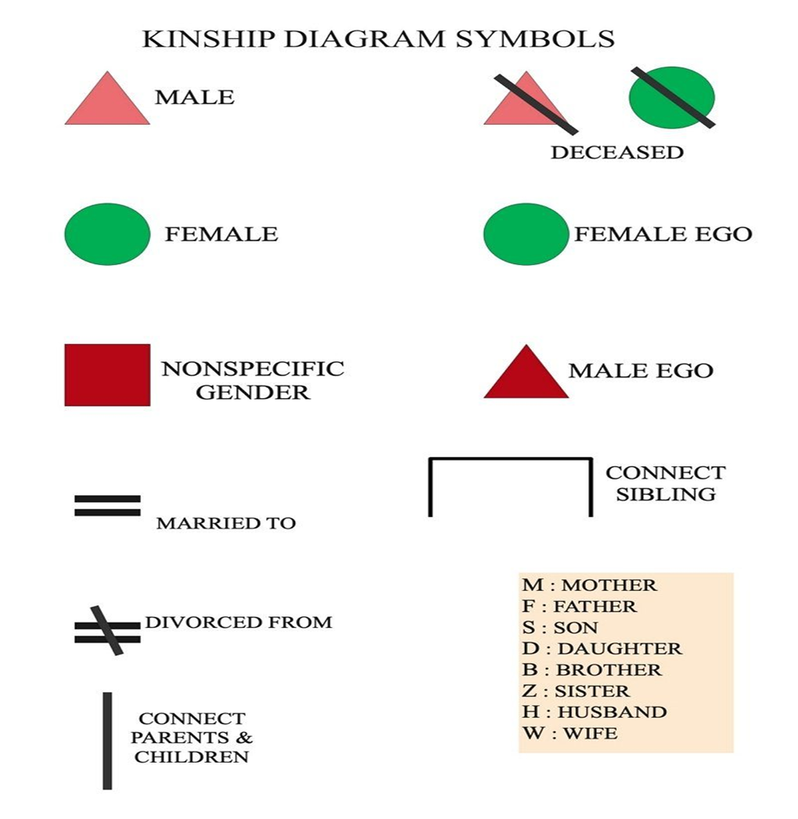

Slide 14
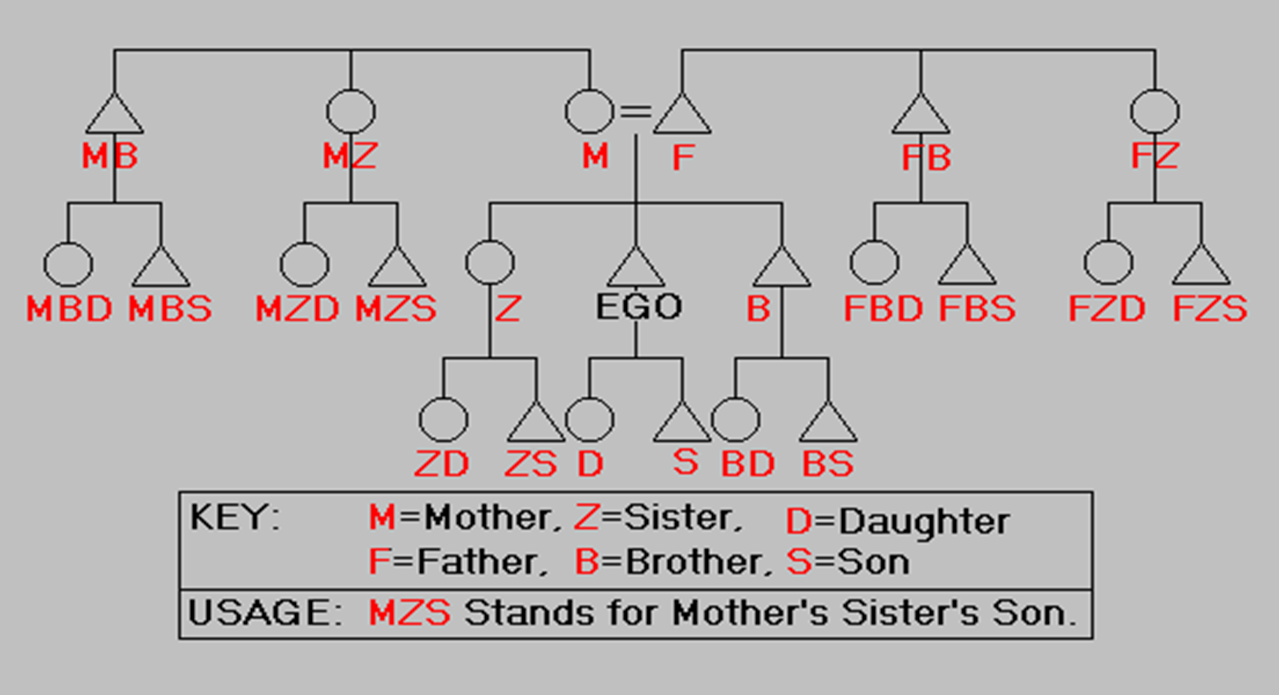

Slide 15
Gender, family, and kinship are primary and fundamental institutions in society.
Through these institutions, a human can identify his social role and position.
Lévi-Strauss Claude. (1971). Elementary Structures of Kinship. Beacon Press, Ch.1.
Stone L. (2010). Kinship and Evolutionary Theory. Kin Recognition in Kinship and Gender, Westview Press, Introduction.
Conclusion
And homework

