Slide 1
Shadow Economy
Kyrgyzstan

Slide 2
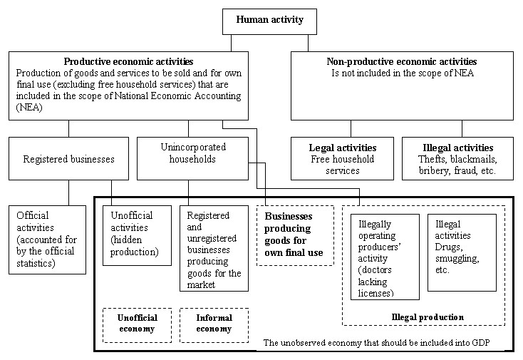
What is the shadow economy according to National Statistical Committee of KG?

Slide 3
Causes of the shadow economy in Kyrgyzstan
Objective reasons:
fast and cardinal nature of reforms in the economic and public spheres
imperfection of legal and regulatory framework
“Weakness” of the executive power and , in particular, of fiscal authorities
absence of necessary work experience in transition, as government agencies and economic entities. The important factor is a rapid growth in the number of small enterprises, especially in the field of trade and services. The collapse of other industries forces many people seek additional sources of income.
Subjective reasons:
a high level of corruption power
insufficient actions to combat organized crime

Slide 4
Causes of the shadow economy in Bishkek
high taxes- this fact is one of the reasons for the high level of corruption in the country.
growing internal migration from rural to urban areas: about 90 percent of migrants (both formal and informal) from rural areas are of working age. But they do not have enough money or opportunity to get a loan to start their own business. The education they have is mostly general in nature and is not actual in Bishkek. The technical skills necessary to get a job in a city are usually absent for rural residents.

Slide 5
Consequences of shadow economy
It erodes the tax and social security bases of the country to the point where a vicious circle can develop of further increase in the budget deficit or tax rates leading to further growth in the shadow economy and a weakening of the country’s social fabric
It creates unfair market conditions in that a growing SE attracts workers away from the official labour market and creates unfair competition for official firms
it distorts official indicators (e.g. unemployment, labour force, income, GDP, consumption, etc.) resulting in policies, including those to do with poverty reduction, that may be ineffective and even counterproductive.

Slide 6
Methodologies to estimate SE:
Direct Method
Surveys;
Samples;
Tax audits;
Questionnaires

Slide 7
Methodologies to estimate SE:
Direct Method
Deficiencies:
1) The problem is that the results depend directly on the questions asked by the survey, and few surveys are alike. As a result, it is very difficult to use the same parameters to measure and compare the informal economy in different countries.
2) Usually, what ends up happening is that the definition that is used has to be very simple and contain only one parameter. For example, the informal sector may be defined as those people who do not have the right to a pension when they retire. Clearly, this definition excludes several important elements that would describe the informal economy differently.
3)what is used is a direct questionnaire, people are not usually willing to admit that they are not reporting taxes or that they are engaging in fraudulent behavior, either because they feel afraid of getting caught or because they feel ashamed since they know this is a moral issue. This makes it difficult to estimate the extent of undeclared work.

Slide 8
Methodologies to estimate SE: Indirect methods
Income-expenditures discrepancy;
Labor force;
Transaction;
Electricity consumption

Slide 9
Methodologies to estimate SE: Indirect methods
Discrepancy between the National Expenditure and Income Statistics
In theory, the income measure of GDP and the expenditure measure should be equal to each other. However, informal activities can show up in the expenditure measurement but not in the income measurement. This is because the income side is measured through the value added of registered firms (the formal economy), while on the expenditure side there is some self-reporting. Thus, the difference between these two measures is an indicator of the size of the informal economy.
Deficiency-The problem with this estimate is that statisticians would like to make the difference between the two as small as possible; so, using the initial measure rather than the published measure would be ideal. Moreover, there are differences due to sampling and statistical errors

Slide 10
Methodologies to estimate SE: Indirect methods
•Discrepancy between Official and Actual Labor Force
Assuming that the total labor force participation is constant, all else being the same, then any decrease in the labor force participation in the official economy can be seen as an indicator of an increase in the activity in the informal economy
Deficiency-The problem with this method is that changes in labor force participation can be due to other causes. It could also be the case that people work in both the informal and formal economy; so, this is not a very good estimator.

Slide 11
Methodologies to estimate SE: Indirect methods
•The Transactions Approach
In 1979, economist Edgar Feige developed this approach based on the quantitative theory of money MV = pT, where M is money, V is velocity, p is prices and T is total transactions. The main assumption is that the relationship of the volume of transactions and official gross national product (GNP) is constant over time. Using the value of total transactions (pT) as an estimate of nominal GNP, he calculated the informal economy as the difference between nominal GNP and the official GNP.
Deficiency-Several issues arise with this approach. He had to assume there is a base year when there was no informal economy. Then, the assumption that the ratio of transactions to official GNP is constant over time was quite strong. Additionally, obtaining accurate estimates of the total number of transactions was difficult.

Slide 12
Methodologies to estimate SE: Indirect methods
•The Physical Input (Electricity Consumption) Method
Electricity consumption is the only best indicator of total economic activities.
Changes in electricity consumption reflect the changes in total economic activities:
(ΔEC/EC0)/(ΔTEA/TEA0) = const.
Changes in electricity consumption that are not attributed to changes in observed part of GDP reflect the changes in unobserved economy:
ΔTEA - ΔObserved part of GDP = ΔUnobserved part of GDP
Notes:
This method assumes that electricity consumption is the best physical indicator of both formal and informal economic activity. By using electricity as a proxy for the overall economic activity and then subtracting from it the official estimates of GDP, we get an indicator of informal economic activity. The difference between the growth of electricity consumption and official GDP is then attributed to the growth of the informal economy.

Slide 13
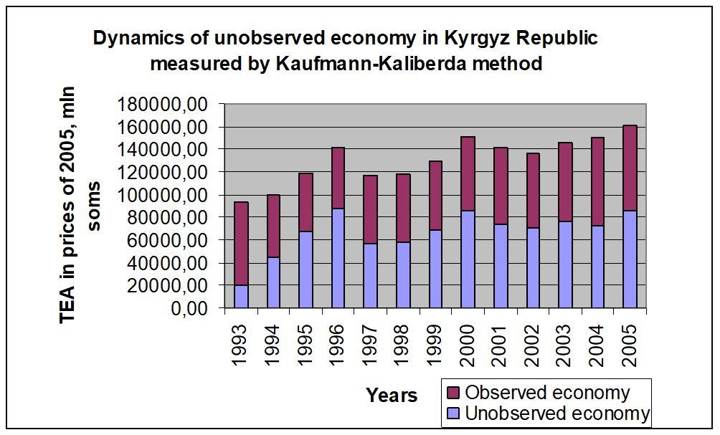
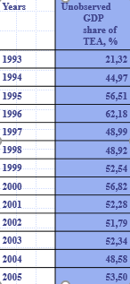
Methodologies to estimate SE in Kyrgyzstan
•The Physical Input (Electricity Consumption) Method -Kaliberda-Kaufmann methodology

Slide 14
Methodologies to estimate SE: Indirect methods
•The Physical Input (Electricity Consumption) Method
Deficiency-The critiques to this approach rely on the fact that not all informal activities require a considerable amount of electricity, or, if they do, other energy sources such as gas, oil and coal could be used. Also, the use of electricity has become more and more efficient in both types of economies. Finally, there may be differences in the elasticity of electricity/GDP across countries or changes over time.

Slide 15
Statistics Committee of the CIS (Commonwealth of Independent States) produced a special review on the condition of accounts of the unobserved economy in CIS countries for the end period of the 1990’s. According to that review, the stake of unobserved economy estimated, based on the production indicators in the Kyrgyz Republic, constituted to 32% within the country’s GDP, and this was including the indicator of the agricultural production from people’s personal subsidiary farms. While excluding the agricultural production indicator, the same would constitute to 13,11 %.
Principal theoretical approaches for defining unobserved economy are agreed on an international level and have found its use in the methodological guidance of making up the System of National Accounts (СНС-93) developed in partnership with the UN, IMF, World Bank and European Societies Commission. Though, these approaches can not resolve all the problems, because each country might have its own cases of shadow economy. The System of National Accounts gives a definition of illegal and hidden production that is necessary to take into account when forming up accounts.
Statisticians make changes to GDP on shadow economy to make it more consistent.

Slide 16
Assessment of the elements of shadow economy based on production method
In parts of production, the data corrections on shadow economy are made towards industrial production indicators, construction, transport, trade, market consumption services including financial services. Data corrections can be also made.
Industry (informal activity)- based on special sample surveys. All products manufactured by individuals are tracked (easy, food, printing, woodworking, etc.industry)
Construction (informal activity) -from customer surveys construction volumes, re-equipment of buildings (office shops, space,cafes) are determined. The construction of houses by individuals are not included in shadow economy- only capital repairs provided by firms are included
Agriculture-not included in SE, but changes are made based on natural indicators.
Trade (informal activity)- According to the results of market surveys and budget investigation of population. Tarde (hidden activity)-One-time accounting data with the usage of price indices
Transportation (informal activity)-special investigations on the volume of shippings, mean productivity of cars and etc.
Households (informal activity)- income from rents (survey data “Poverty Monitoring”, Tax Inspection, calculations)

Slide 17
Assessment of the elements of shadow economy based on consumption method
The gross domestic product using the method of expenditures is the sum of expenditures for usage (personal, government, non-profit organizations and etc), gross fixed capital formation, changes in inventories, net acquisition of valuables and net export of good and services.
In terms of expenditures, major changes are made to indicators of household expenditures for final consumption, because this value is calculated on the basis of trade indicators and fully linked to production indicators. This also include informal consumption of own production.
For indicator of fixed capital, changes are due to the construction of private houses. Hidden part include understatement of the cost of housing.
For exports- values are used that are provided by customs committee in an official manner.

Slide 18
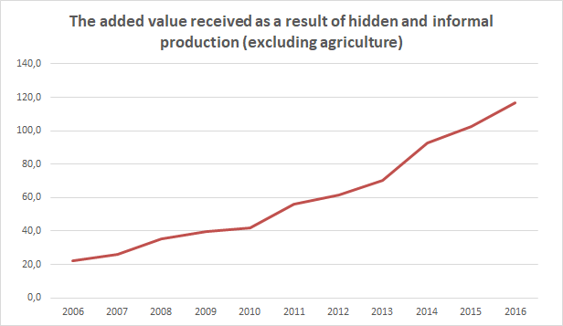

Slide 19
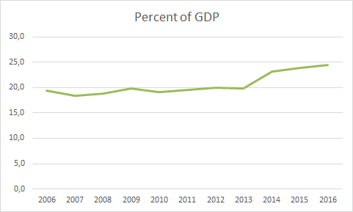

Slide 20
What is the role of Government of Kyrgyzstan?
The shadow economy has a negative impact on the development of the country's economy and therefore, the government should fight it.
However, even statistical bodies of the republic are conducting substantial work to collect objective quantitative information on the size, structure and dynamics of the shadow economy, obtaining such information is a big statistical and organizational problem. In this connection, the problem of statistical evaluation of the shadow economy in the republic has not been finally resolved.
Internal migration remains as a problem because of high unemployment in the rural areas.
As for taxes, if tax rates will decrease, tax revenues may even increase. This can happen for two reasons. Firstly, due to the reduction of taxes, and secondly, if we develop and implement a new system of tax collection. But the creation of a new tax collection system will require active institutional reforms.

