Slide 1
Comparative long-run Development: history matters
Azamat Usubaliev
AUCA

Slide 2
Going back in time
ALMOST ALL the developing countries of today were once colonies of European powers.
Exceptions: Afghanistan, Ethiopia, Turkey, Libya, Thailand and China
Does the past misfortune have something to do with today’s underdevelopment (poverty and inequality in particular)?

Slide 3
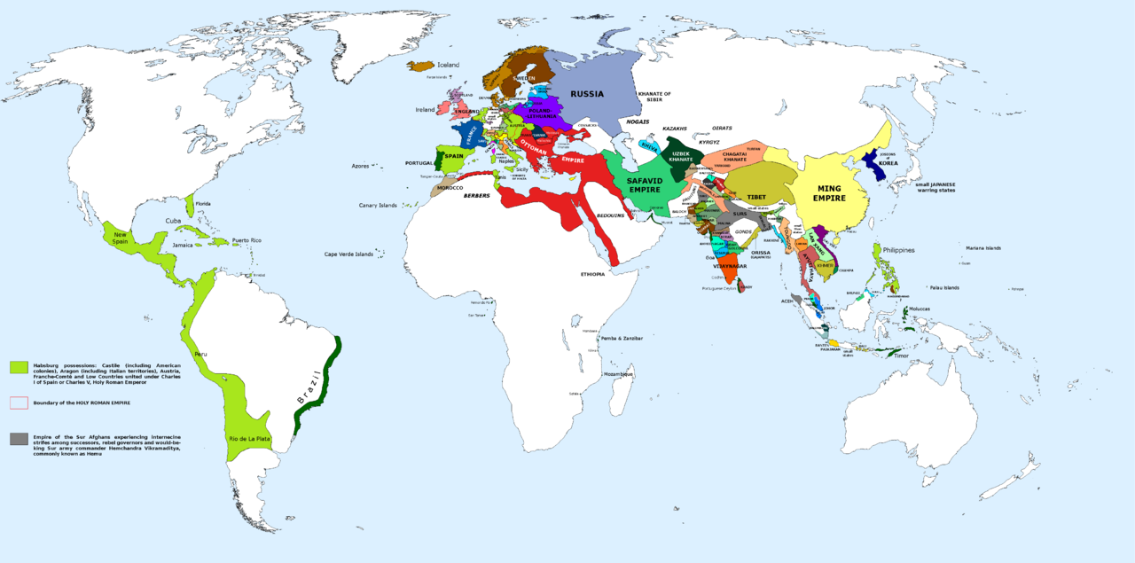
Before 1500
Today’s economists have estimated that around 1500, India, China, Ottoman Empire (Turkey), Aztec civilization (Mexico), Inca Empire (West Coast South America) were among the richest in the world.
Source: https://commons.wikimedia.org/wiki/File:1555-56_CE_World_Map.PNG

Slide 4
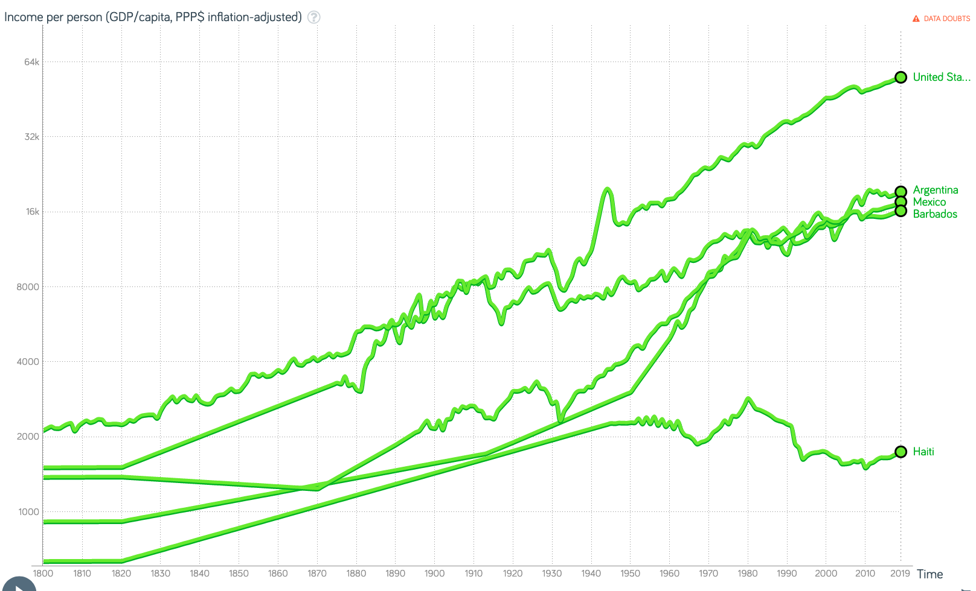
Many of today’s poor countries were rich once
Around 1700 Barbados and Haiti were richest countries in the American continent. Barbados had per capita income 50% higher than that of US.
Mexico’s per capita GDP was 89% of US per capita GDP in 1700, but fell to 28% in 1997.
Argentina’s GDP was same as that of US in 1800, but fell to 35% of the US per capita GDP in 1997
Source: www.worldbank.org software used: www.gapminder.org

Slide 5
1500: Watershed moment in history
Until 1500, the trans-Atlantic route was not yet discovered by the Europeans and the existence of the American continent was unknown to the Europeans.
Trades were isolated, localised and only a short stretch of sea route for trade was in use across Asia.
Europeans had very little role in it. The Arabs were a big player in oceanic trade.

Slide 6
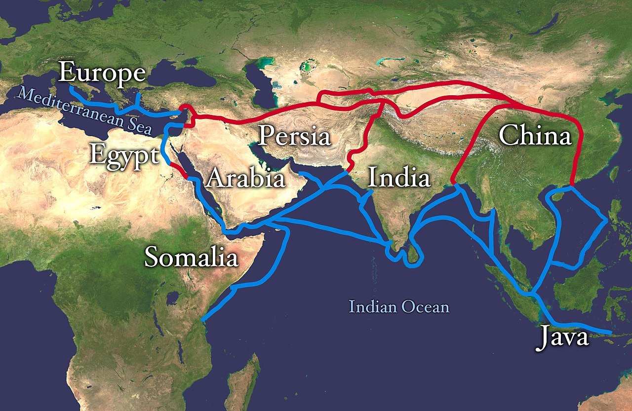
Silk road
But trade between Asia and parts of Africa did exist for centuries – via both land (Silk route) and sea

Slide 7
Important sea voyages that led remarkable changes to world trade
Spain and Portugal were two important pioneers in exploring new sea routes.
Columbus goes to ‘America’ (well, it was Haiti): 1492 [Spain]
Vasco da Gama reaches India: 1498 [ Portugal]
Portugal take the lead: Explore more of South America (1513), find out the (secretive) Spice Islands of Banda Sea, Indonesia (1512)

Slide 8
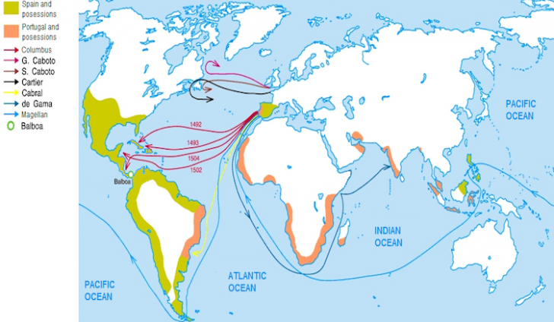
Discovery of the Americas
Source: https://www.worldatlas.com/articles/what-was-the-age-of-exploration-or-the-age-of-discovery.html

Slide 9
Colonisation (Spain and Portugal)
Spain: 1492 (Haiti) – Central America (1530-s), Peru (1532), Cuba, Bolivia, Colombia, Southern USA (Florida particularly) [1492 – 1832]
Portugal: Technically from 1415 (Ceuta island) to 1999 (the island of Macau). But their biggest occupation was Brazil (1532-1822), among notable occupations were Mozambique, Angola, Guinea-Bissau, Goa and Bombay (India)

Slide 10
Colonisation (French)
French: Canada (1605), Southern USA (1699), Haiti (1664), Senegal (1624, 1854), Tunisia, Algeria (1830), Syria and Lebanon (1860) Cambodia (1863), Vietnam (1884)
Notably, although France was to first abolish monarchy (1789-1792) in Europe, its overseas colonial aggression continued and prospered well into the next century.

Slide 11
Colonisation (Dutch and the British)
Dutch: (1581- ) Indonesia (1600 onward), Sri Lanka (1658), Mauritius (1638), part of South Africa (1652), Ghana, Surinam etc.
Britain: USA (1606 - 1776), Canada, Australia, India (1757-1947), South Africa and 52 Commonwealth countries [St. Kitts (1624) – Hong Kong (handed back to China in 1997)]
Most of the British Africa got independence by 1968, Zimbabwe in 1980
Both Britain and Netherlands started off with mercantile interests and then expanded into territorial interests.

Slide 12
British empire 1921

Slide 13
Mercantile colonialism
The early phase of colonialism was driven by strong mercantile interests – trade in spices, tobacco, sugar, silk, tea, opium (added later)
Later on (after industrial revolution) this was extended to raw materials for industries [ ex: cotton, indigo, rubber] and minerals
And then with substantial progress in colonisation trade expanded to slavery in the Americas.

Slide 14
The story of nutmeg
Portuguese were the first among the Europeans to discover the secret origin of nutmeg in 1512.
Nutmegs grew in abundance in Indonesia (Maluku islands, Banda)
Nutmeg was one of the most expensive tradable object at that time (more expensive than gold).
But the Arabs maintained monopoly in the spice trade, especially nutmeg and peppers, and they kept the knowledge of its source secret.

Slide 15
The story of nutmeg
The Dutch actually got substantial control of the spice islands around 1600.
Britain followed and they fought a bloody battle with the Dutch in 1624 over the control of several islands.
Eventually, in 1667 a settlement was reached in which the British gave up their claim in Indonesia in exchange for two islands in America – Manhattan and New Amsterdam, which was later renamed New York.

Slide 16
The story of nutmeg
The British then search for a suitable country to grow nutmeg and they found Kerala from where their interest grew for India, and
Eventually they colonised the whole country some 50/60 years later by taking advantage of various opportunities

Slide 17
Colonisation
Colonisation was an international architecture of exploitation for mercantile, industrial and political interests.
It required special legislations and treaties between the ruling country and the ‘ruled’ countries, and among the ‘ruled’ countries.
Colonisation was also competitive – there were battles and treaties among European powers over centuries for control of colonies

Slide 18
Coercion and drastic institutional changes
Forcible contracts to produce commercial crops that had very limited or no value, such as opium, tea and indigo in India, nutmegs in Indonesia, rubber in Malaysia, tobacco in Southern USA.
Eventually with complete political control taxation, trade, currency of trade and laws were changed to favour the colonial rulers.
India: Two major changes played havoc: tax was changed from cash to kind, land was made a private and tradable property.

Slide 19
Indentured labour and slavery
There were two forms of indentured labour: Contract labour and slavery
Long-term contract labour, a much later phenomenon than slavery: Mostly from Asia (India and China)
1.3 million Indians (1838-1918) were moved to Africa and the Caribbean, and another 250,000 to Malaysia (rubber plantation)
330,000 Chinese (1852-1907) were moved to South America and Caribbean

Slide 20
Indentured labour and slavery
Slavery is an extreme form of control of labour with intergenerational servitude
A human being was owned, sold and forced to work as per the will of the owner.
Rule of the Womb: A new born would fall into the possession of the mother’s owner.
Some indigenous population in South America were enslaved, but most slaves were brought from Africa.

Slide 21
Slavery
All European powers made abundant use of it as soon as the Transatlantic route was discovered from 1500 onward for 370 years
Between 1500 and 1866, an estimated total of 13 million people transported as slaves from Western Africa to the Caribbean islands and the Americas (but also to Egypt and Libya, and some to Europe).
Another 1.5 million people died in transit.

Slide 22
Slavery
Over 300 years about 14.5 million Africans were enslaved
Share of the European powers in slave trade:
Portugal: 45%
Britain: 20%
Spain: 12%
France: 10%
Netherlands: 5%
The Caribbean islands became a major hub of slave trade

Slide 23
Number of slaves received (1500-1866)
Barbados: 291, 235 (85% were shipped to continental Spanish America)
Jamaica: 448,044 (15-20% shipped to Colombia, Mexico, Panama, Venezuela)
Haiti: 691,522
Cuba: 861,241
Cape Verde: 93,433
Brazil: 4.8 million (also traded many slaves to Uruguay and Argentina)
USA: 380,384
Argentina: 63,014

Slide 24
End of slavery
Slave trade ended through legislation in home (i.e. ruling country) country between 1808-1835 [ US and UK 1808 were the first abolish slave trade]
But the end of slavery legislation was passed long after between 1834 and 1888.
UK: 1834
France: 1848
USA: 1865
Spain: 1886

Slide 25
Effect of slavery
Very long term damages:
Through broken/dysfunctional families
No physical resource and human capital to transfer to the next generation
Slavery facilitating institutions created in colonies and the slave sourcing countries are continuing to have long term effects on poverty and inequality, as studies show.

Slide 26
Effect of slavery
Studies show the following
Source country: Lack of ‘trust’ among people on society and on government
Destination country study
US: Share of slaves in total population in 1860 have strong effects on the education gap between the Black and the White population in 1940.
The 1940 education gap continues to affect the education gap prevailing in 2000

Slide 27
Different factors affect the process of long run development
Two main lines of argument:
Geography (Simple and Sophisticated views)
Climate, Disease, access to sea etc
Institution
Political, cultural, economic (in particular property right)

Slide 28
Simple geography view
Toynbee (1934): Countries that are abundantly blessed or extremely deprived, are unlikely to develop. Moderately endowed countries challenge the mankind and that is where progress is most likely to take place.
Sach’s view on Malaria: About 700,000 people die from Malaria and 90% of them are in Africa. Diseases like Malaria (and others) affects health, education and reduce productivity by a significant margin.

Slide 29
Sophisticated geography view (or temperate drift hypothesis)
Jeffrey Sachs: Production technology in tropical countries lagged behind the temperate area technology at least in agriculture and health. In addition, there are geopolitical power imbalances and wide gaps in public health provision. Result is a wider income gap between the two regions.
This explains Sachs’ initiatives of millennium villages in Africa → focus on eradication of malaria and developing the right technology

Slide 30
Long run comparative development
Historical and Institutional approach to development

Slide 31
Institutional view of development
A range of institutions play a crucial role in shaping our destiny, and their effects are felt through centuries.
Two sets of institutions are crucial:
Political institutions that redistribute resources, and make education widely available
Private property rights to secure and encourage investment (an argument due to Douglas North)
Institutions in developing countries have been shaped by their colonial past.

Slide 32
Acemoglu, Johnson and Robinson’s research on colonialism (2001, AER):
Regressed 1995 per capita GDP of 64 countries on their index of current institutions (protection against expropriation based on 1985-1995) and found the relation positive and significant.
But current institutions can be endogenous → low GDP leads to poor institutions
So the authors used ‘the soldiers mortality rate’ of the colonial times (1604-1900) as an instrument for current institutions. The relation between GDP and institutions is positive and significant.

Slide 33
Soldier (disease) mortality rate
Malaria and yellow fever were the two biggest killer of European soldiers/settlers.
Soldier mortality rates in British colonies (1700-1900) per 1000 soldiers:
Indian soldiers in India: 11 (Bengal) 13 (Madras)
British soldiers in Britain: 15
British soldiers in India: 70 (Bengal) 170 (Madras)

Slide 34
Acemoglu, Johnson and Robinson’s research on colonialism:
European empires created extractive institutions in those colonies where mortality rate was high and where they did not want to settle (example India, Africa etc.) → “Steal fast and get out”
and created progressive institutions where they could settle (ex: US, Australia) → Settle and create home like environment
Even hundred of years later, these institutions still persist or mutate into more regressive institutions.

Slide 35
Acemoglu-Johnson –Robinson: Reversal of institutions
Institutional reversal: Colonial powers invested in those countries that were poor, and extracted from those that were rich.
We have said earlier, around 1500, Mughal India and Aztecs and Incas in the Americas were more prosperous than Europe.

Slide 36
Acemoglu-Johnson –Robinson: Reversal of institutions
Countries that had progressive institutions in 16th and 17th century and thus were rich that time were forced to accept extractive institutions (like slavery, by strengthening the role of the elite as rent-providers etc.)
These countries had resources/wealth that could be extracted easily without needing to create wealth through progressive institutions.

Slide 37
Acemoglu-Johnson –Robinson: Reversal of institutions
Countries that were less populated and less developed that time (like USA) were given progressive institutions, which reversed their existing ‘unproductive’ institutions.
There was also an issue of ‘virgin’/unsettled/sparsely settled countries.
This reversal of global income distribution largely took place around the late 18th century which then caused a long term reversal of global income distribution.

Slide 38
Debate: Geography vs Institutions
Pro-geography: William Easterly argued that the slavery as an institution thrived under specific geographical conditions that historically were less populated and were suitable for plantation crops (sugar, tobacco, coffee, banana etc.). Thus, geography determined institutions
Institutionalists: True, geography facilitated slavery, but slavery emerged with huge time lags in the Southern US and in South America despite very similar geography, because of the absence of institutions

Slide 39
Debate: Geography vs Institutions
Pro-geography: Access to the trans-Atlantic sea route was the main factor behind the rise of Europe and its global dominance from 1500 onward.
Pro-institutions (Acemoglu et al.): Dominance of Europe occurred during the late 17th to early 18th century with industrial revolution.
Access to Atlantic per se did not ensure the rise of Europe.
(Cntd..)

Slide 40
Debate: Geography vs Institutions
Pro-institutions (Acemoglu et al.):
But the political institutions that emerged afterwards, favouring mercantile policies favouring trade and investment, were the key.
UK and Netherlands flourished because of non-absolutist monarchies, but Spain and Portugal faltered due to absolutist monarchies.
For UK pro-investment policies eventually helped industrial revolution.

Slide 41
Further arguments based on biogeography
If one goes back at the early stage of civilisation, around 11000BC, we see that all continents were inhabited by humans.
Thus, Africa, Eurasia and Americas were in similar conditions that were ideal to make transition from hunter gatherer societies to agriculture.
Yet, Eurasia was first to do so around 8500 BC. Then the East-ward migration took Agricultural knowledge to Iran and Indus valley (today India-Pakistan) around 7000 BC.
In contrast, agriculture started in China around 7500 BC, in Africa 4000 BC, in Mexico around 3500 BC, in the Eastern US around 2500 BC.
The climate, vast expanse of East-West spread of Eurasia made this early start possible.

Slide 42
Criticism of the institutional view
The institution-based argument ignores some complexities and is at times simplistic.
Britain made land a private property in India. This led to a breakdown of historical community based insurance institutions→ private greed overwhelmed collective cooperation
British introduction of tax-in-cash replacing the tax-in-kind policy in India (19th Century) led to commercialisation of agriculture, but also forced farmers to switch from food crops to cash crops, and to be exposed to market risk.

Slide 43
Long run causes of comparative development
Economists see this as a complex process of geography, history (i.e. colonisation) and institutions, all interlinked.
Broadly speaking, geography (land-locked/coastal, tropical/temperate, mineral rich/poor etc.) was an early (two centuries ago) determinant of resource/income inequality and pre-colonial domestic institutions.
These institutions and local conditions determined the type of colonial regime they would face [ extractive or progressive]

Slide 44
Long run comparative development
The colonial regime (Progressive or Extractive) created a new set of institutions and a new order of inequality.
These factors, in combination with other factors, such as human capital, public goods etc. have created today’s level of income and human development

Slide 45
Readings
1. Todaro & Smith: Chs 1 and 2
2. Sokoloff, K.L. and Engerman, S.L. (2000) "History lessons: Institutions, factor endowments and paths of development in the New World", Journal of Economic Perspectives, Vol. 14, No. 3 (Summer 2000), pp. 217-232
3. Engerman, S. (2012) Institutional change, Journal of Comparative Economics, 40, 596-603
4. Soares, R. R., Assunção, J. J., Goulart, T. F. (2012), A note on slavery and the roots of inequality, Journal of Comparative Economics, 40, 565-580
5. Bertochchi, G. A., Dimico, A. (2012) The racial gap in education and the legacy of slavery, Journal of Comparative Economics, 40, 581-595

