Slide 1
Archaeological theories

Slide 2
Archaeological theory refers to the various intellectual frameworks through which archaeologists interpret archaeological data.

Slide 3
Definition of Theory
Ways of explanation
Why we do archaeology
Issues of interpretation
Theory and method
Why we selected this site
How we dig it

Slide 4
Why theory is relevant to archaeological practice
We need to justify what we do
We need to evaluate one interpretation of the past against another, to decide which is stronger (e.g. lay lines)
We must be explicit in what we do as archaeologists
We do not ‘need’ theory, we all use theory whether we like it or not

Slide 5
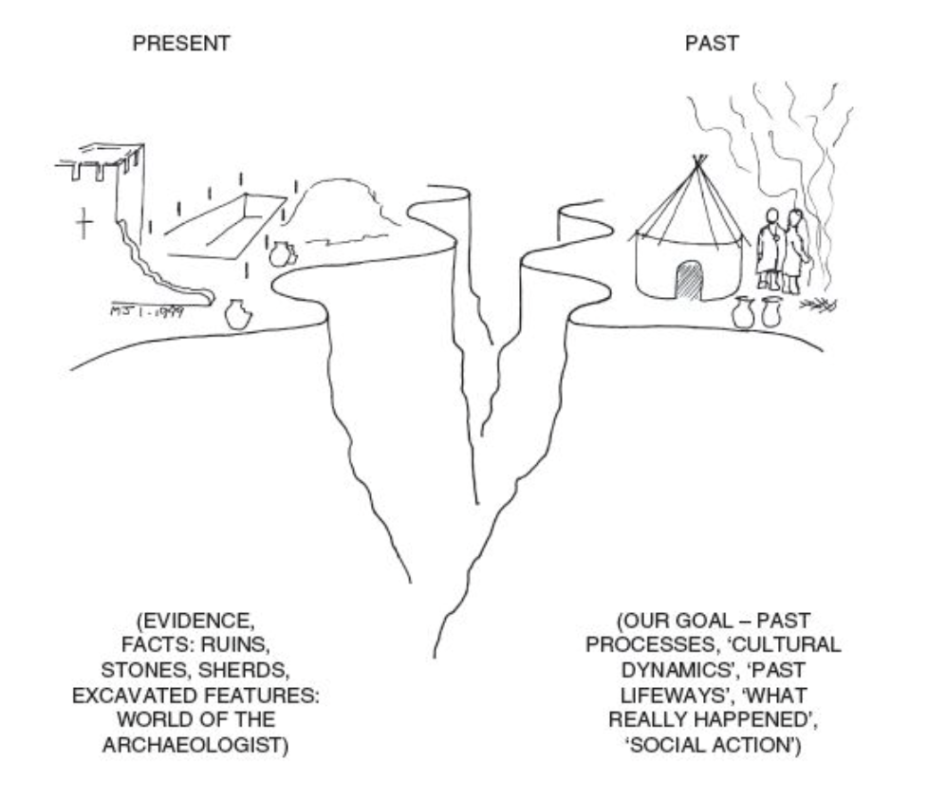

Slide 6
Material Culture
Meaning
Active, not passive
Constructed
Symbolic

Slide 7
Normative approach
depends on two assumptions: first, that artefacts are expressions of cultural norms, ideas in people’s heads, and second, that those norms define what ‘culture’ is”

Slide 8
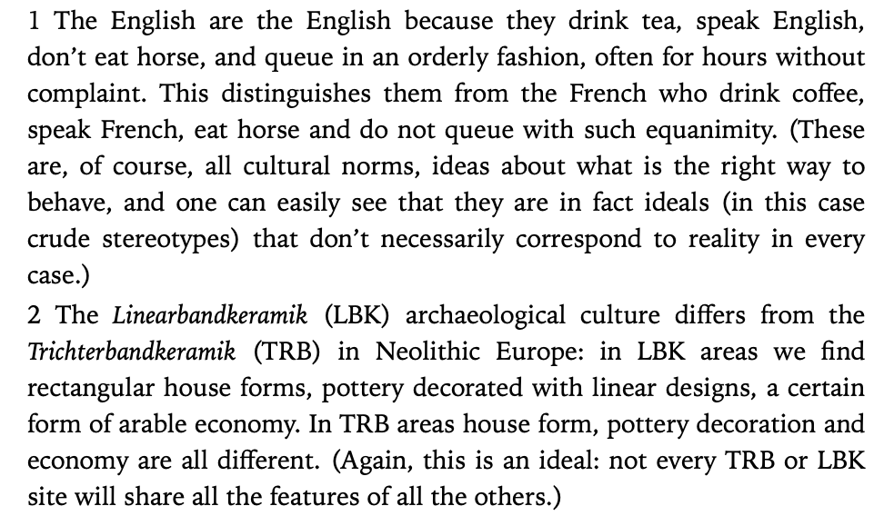

Slide 9
Consequences
1) “it leads to a tendency to particularize what archaeologists say about the past rather than generalize. ”
2) “ is that cultures tend to be viewed as unchanging.” any changes come from outside
More and more data, and less ideas about past

Slide 10
Culture History
is an archaeological theory that emphasizes defining historical societies into distinct ethnic and cultural groupings according to their material culture.
Distinct historical cultures (particularism)
Diffusion and migration (outside change)
Descriptive
Inductive reasoning

Slide 11
“Lewis Binford called the culture-historical view of change ‘an aquatic view of culture’ (Binford 1964, 204”

Slide 12
Analogy
Is a process of reasoning that assumes that if objects have some similar attributes, they will share other similarities as well.
Based on technology, style, function of cultures

Slide 13
In archaeology
Direct historical analogy (simple principle of working from known to unknown)
Functionalist approach to analogy (using ethnographic data)

Slide 14
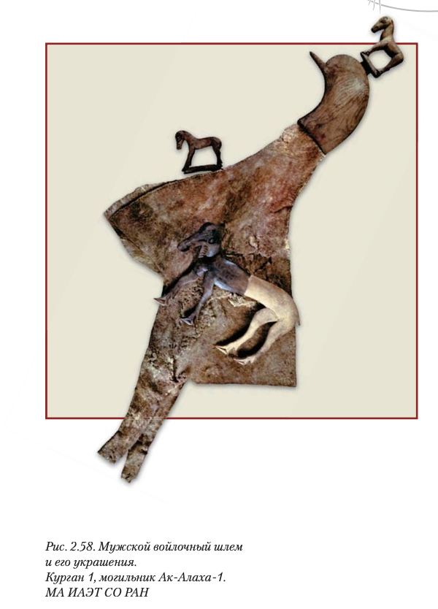
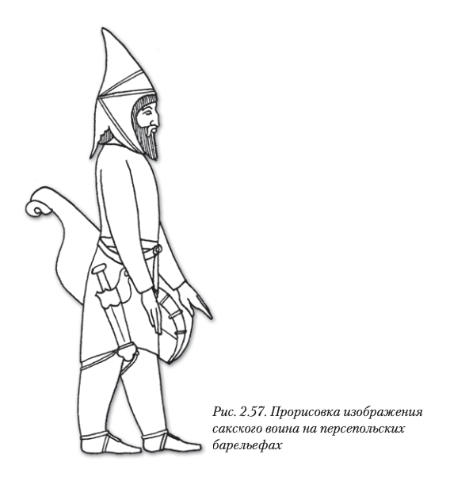

Slide 15
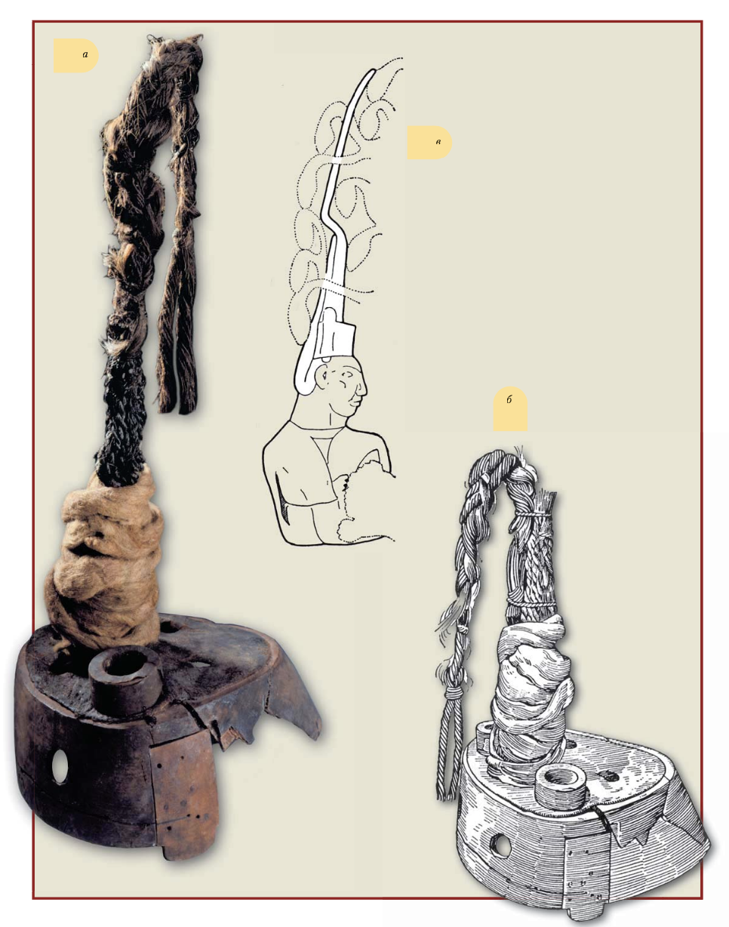
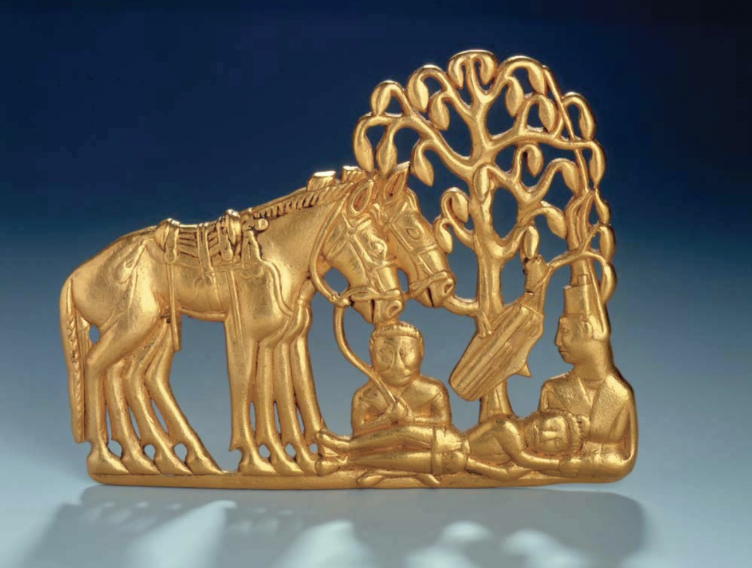

Slide 16
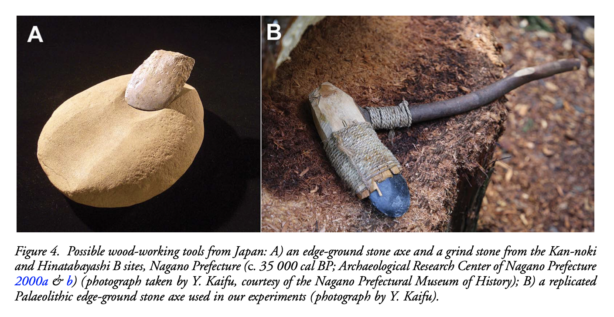
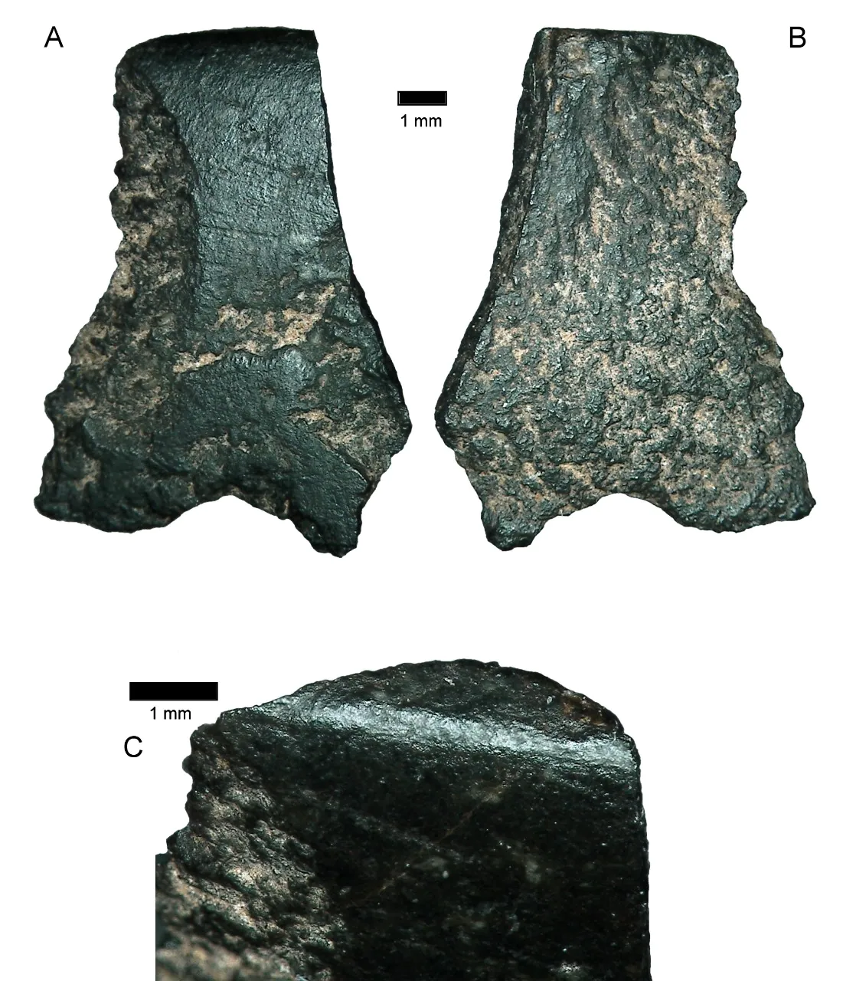
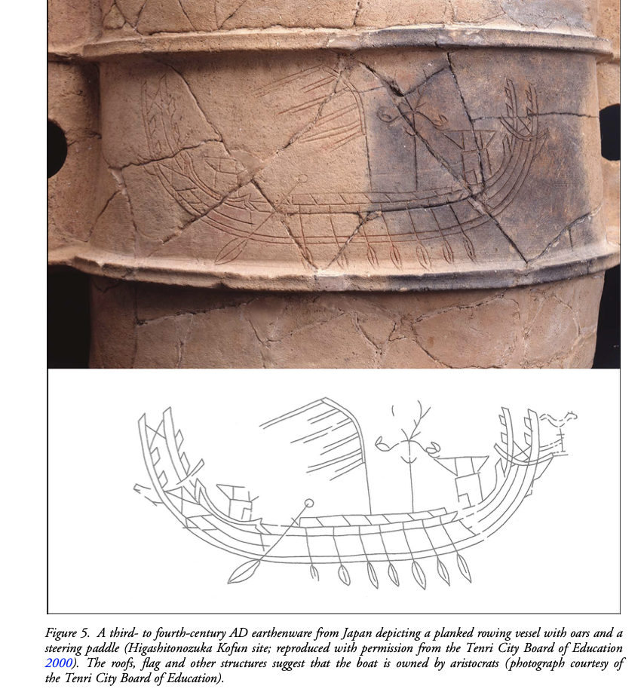
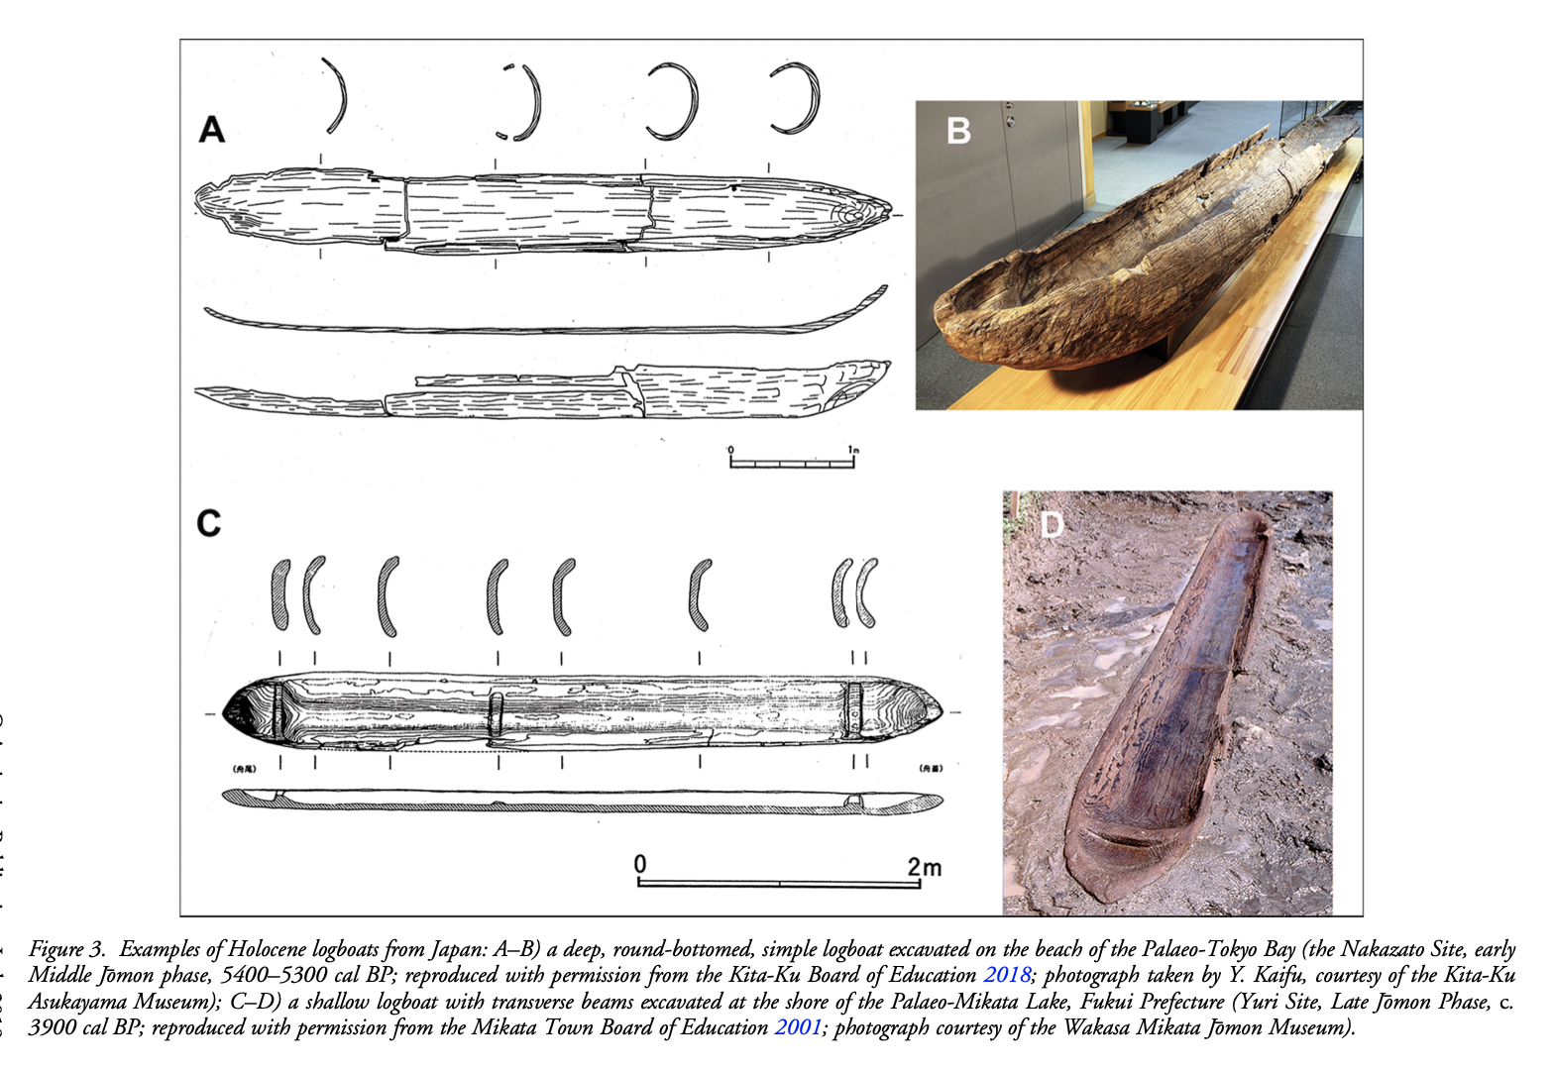
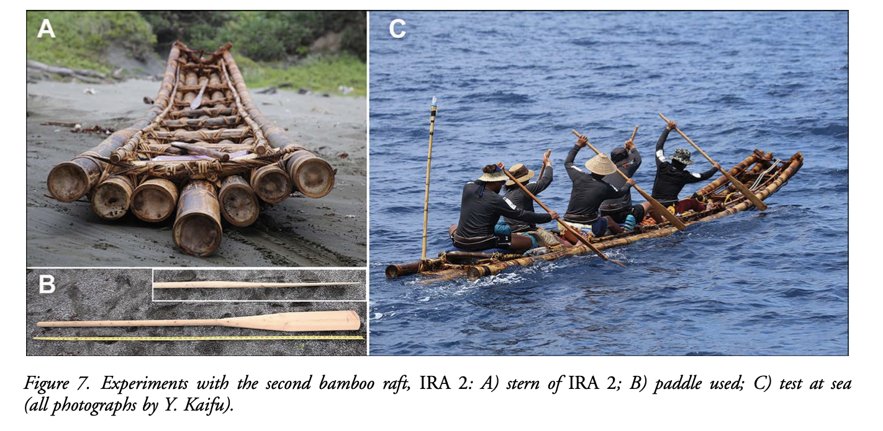
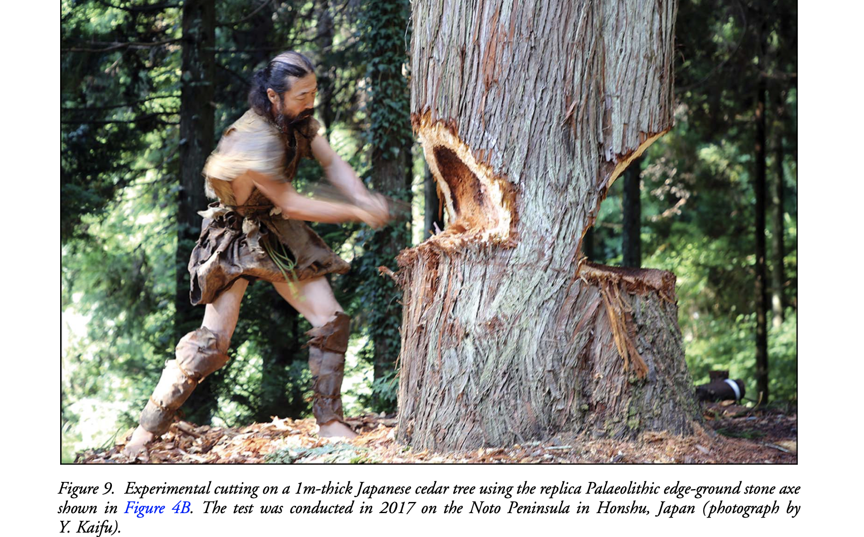

Slide 17
Archaeological analogy
Is based on guesswork that because an artifact is used in a specific way today, it was used in that way millennia early.
Past is dead and knowable only through the present
Accurate knowledge of the past is essential to understanding the present

Slide 18
New Archaeology or Processual Archaeology
is a theoretical movement rooted in the 1960s–1970s
The new archaeologists argued that archaeology should focus on explanation (as defined by logical positivism) as opposed to explication.
Cultural evolution
Systems theory
Deductive reasoning

Slide 19
?
“we must to be more scientific and more anthropological”

Slide 20
NA: Key points
1) cultural evolution
2) systems thinking (generalization and optimism)
3) cultural ecology and modelling of subsistence economy
4) scientific approach
5) culture process (why? than when?)
6) to be more explicit about biases (problem oriented research)
7) understanding of the variability

Slide 21
Culture history vs culture process
“In this view, traditional history simply described a set of more or less random political events such as battles and births and deaths of monarchs without ever really explaining anything. By substituting process for history, the long-term trends or processes beneath the surface of such events became the important objects of study”

Slide 22
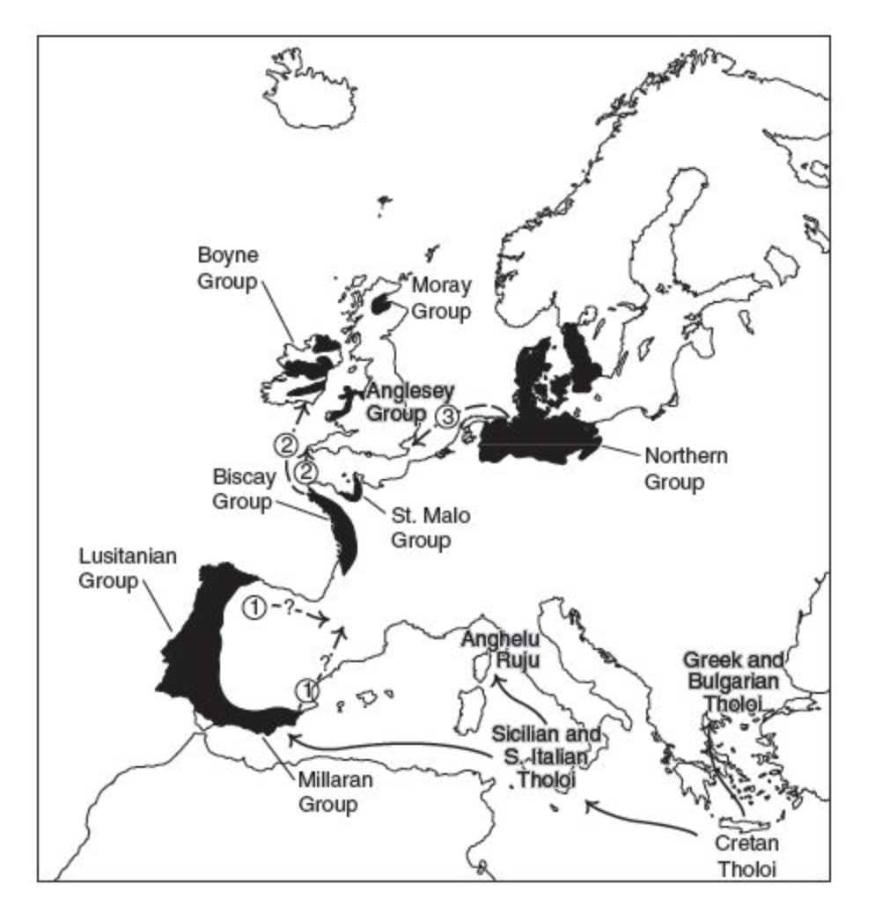
Case study: Megaliths
Dating, typology and diffusion (Mediterranean origin like Maltese temples)

Slide 23
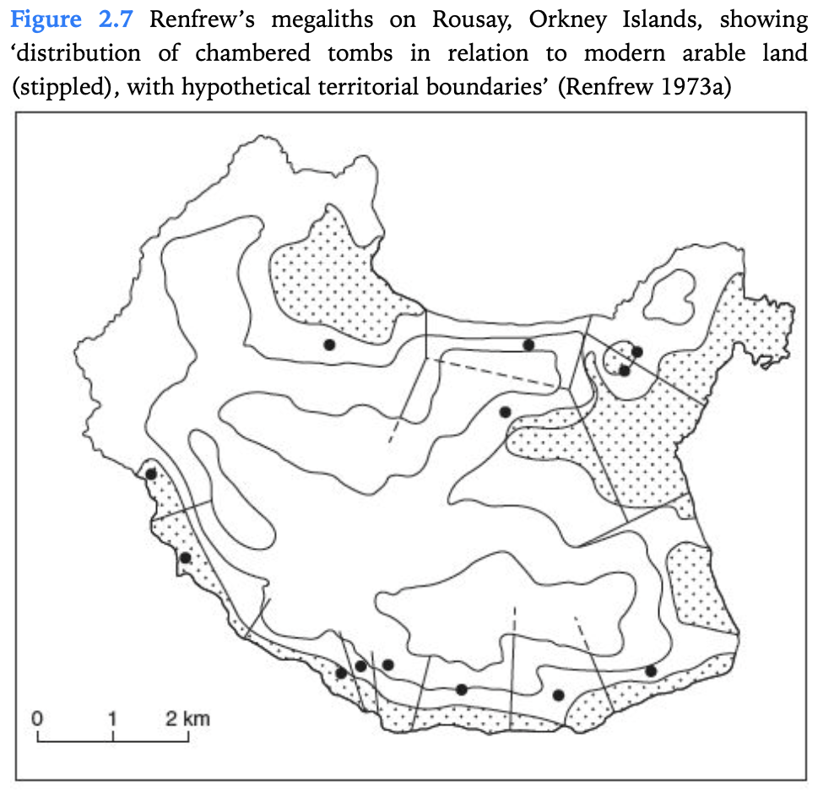
NA approach
Dating revealed older origin
C. Renfrew suggested that they might be territorial markers of particular groups, by reference to the ancestors buried within them

Slide 24
Study the past by using the present
Middle range theory
Ethnoarchaeology
Experimental archaeology

Slide 25
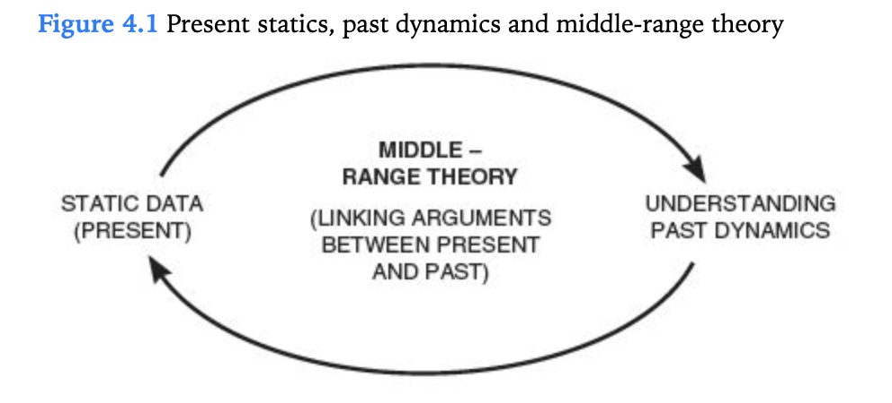

Slide 26
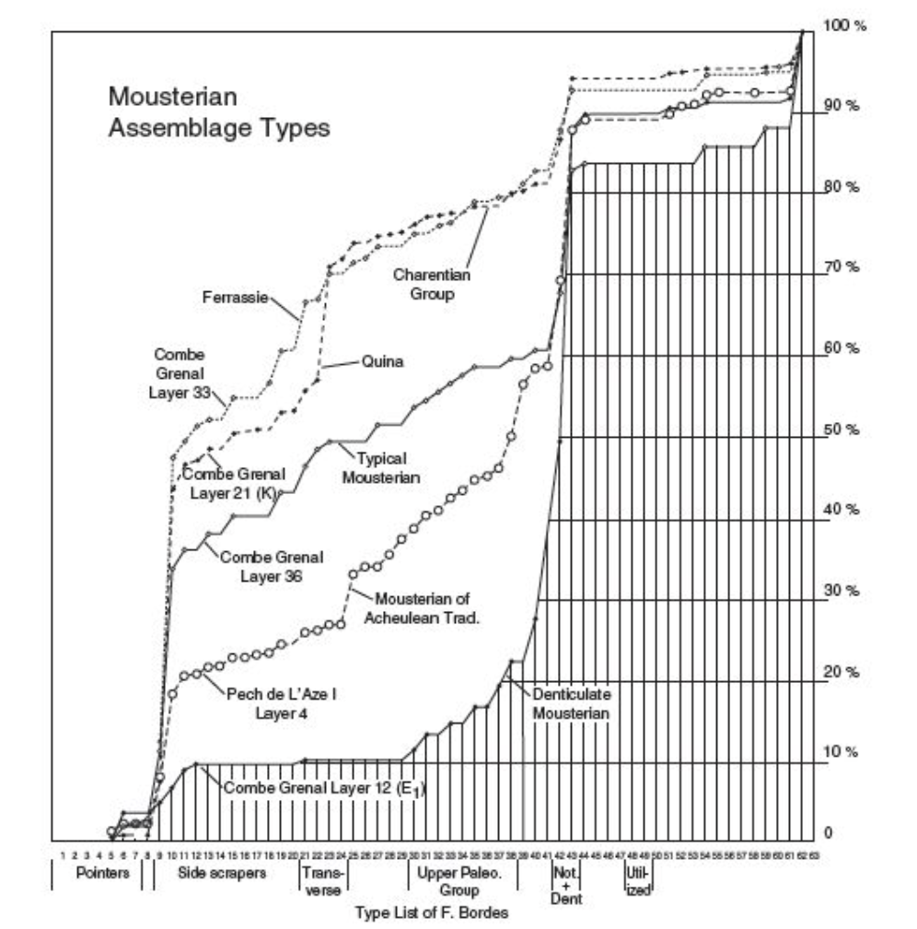

Slide 27
Two opinions
Different stone tool assemblages = different cultural groups (F. Bordes)
Collection of tools – ‘tool-kits’ withing adaptation (L. Binford)

Slide 28
Middle range theory
Three fundamental assumptions:
1. The archaeological record is a static contemporary phenomenon
2. The content of archaeological record is a result long-dead human interaction and subsequent mechanical forces and formation processes.
3. Relationships between static, material properties and long-extinct dynamic properties of the past

Slide 29
Examples
Preparation of grain for human consumption
Ageing of animals
Differentiation of kill sites and residential sites

Slide 30
Ethnoarchaeology
Is the study of living societies to aid in the understanding and interpreting of the archaeological record.
Deals with dynamic processes in the modern world
Structure and Symbols

Slide 31
Experimental archaeology
Controlled experiments with the dynamics of material culture can be a fruitful source of data to test middle-range theory
Criteria:
1. the materials used in experiment must be those available locally to the prehistoric society
2. the methods must conform with the society’s technological abilities

Slide 32
Cultural systems
Adapted to external environment
Elements of culture more or less observable
Cultural systems can be compratively observed and generalised
Elements of cultural system are interdependent (trade, subsistance, ritual, social system etc.)
Different elements of cultural systems are linked one to another and explained by function
Archaeologists can examine the links between subsystems in terms of correlation rather than simple causes.

Slide 33
Culture and process
Culture (F. Boas)
Culture as a set of ideas (normative view)
Culture as a system
Thinking in the context of cultural systems is a functionalism
External ”kick” (K. Flannery)
“view of cultural systems as purely or primarily adaptive to an external environment, and as monolithic entities that are characterized by harmony and homeostasis”

Slide 34
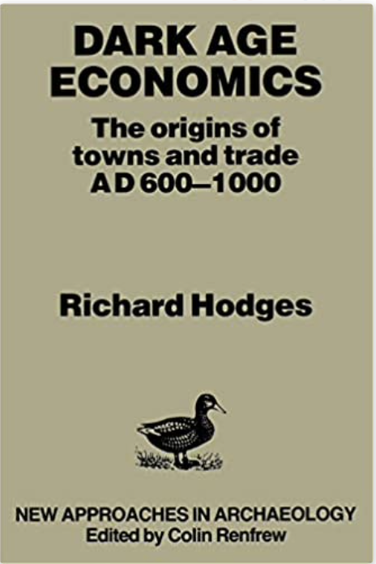
Prossesual interpretation of the rise of towns, trade and social complexity in post-Roman northwest Europe
Planning of towns reflect the central control and royal origin

Slide 35
Critique
Critical theory (J. Habermas)
“systems theory is an ideology of control”
Inside and outside views of culture (M. Harris)
Conflicts and competition (not external kick)
Marxist view of political economy
World systems theory (core and periphery)
Theory of chaos

Slide 36
Post-Processual Archaeology
is a movement in archaeological theory that emphasizes the subjectivity of archaeological interpretations. Within the post-processualist movement, a wide variety of theoretical viewpoints have been embraced, including structuralism and Neo-Marxism.
Subjectivism
Interpretation
Materialism and idealism
Structuralism
Human agency and individual

Slide 37
Key statements
1) rejection of positivist view of science and the theory/data split. The data are always theory-laden
2) interpretation is always hermeneutic (study of meaning)
3) rejection the opposition between material and ideal
4) need to look at thought and values in the past
5) the individual is active (A. Giddens)
6) need to look at context
7) interpreting the past is always political act

Slide 38
Structural Archaeology
Theoretical approach to the analysis of archaeological material based on structuralism, stressing the idea that human actions are guided by beliefs and symbolic concepts that are themselves underpinned by ways of thinking about the world.
Structure as a code = Particular meanings
Rules of thinking expressed in material culture

Slide 39
Culture as a language (F. de Saussure)
“language is composed of hidden rules ”
Culture is fundamentally expressive, a system of hidden cognitive meanings
Not meaning, but understanding and experience

Slide 40
Examples
Rock Art
Medieval houses in England

Slide 41
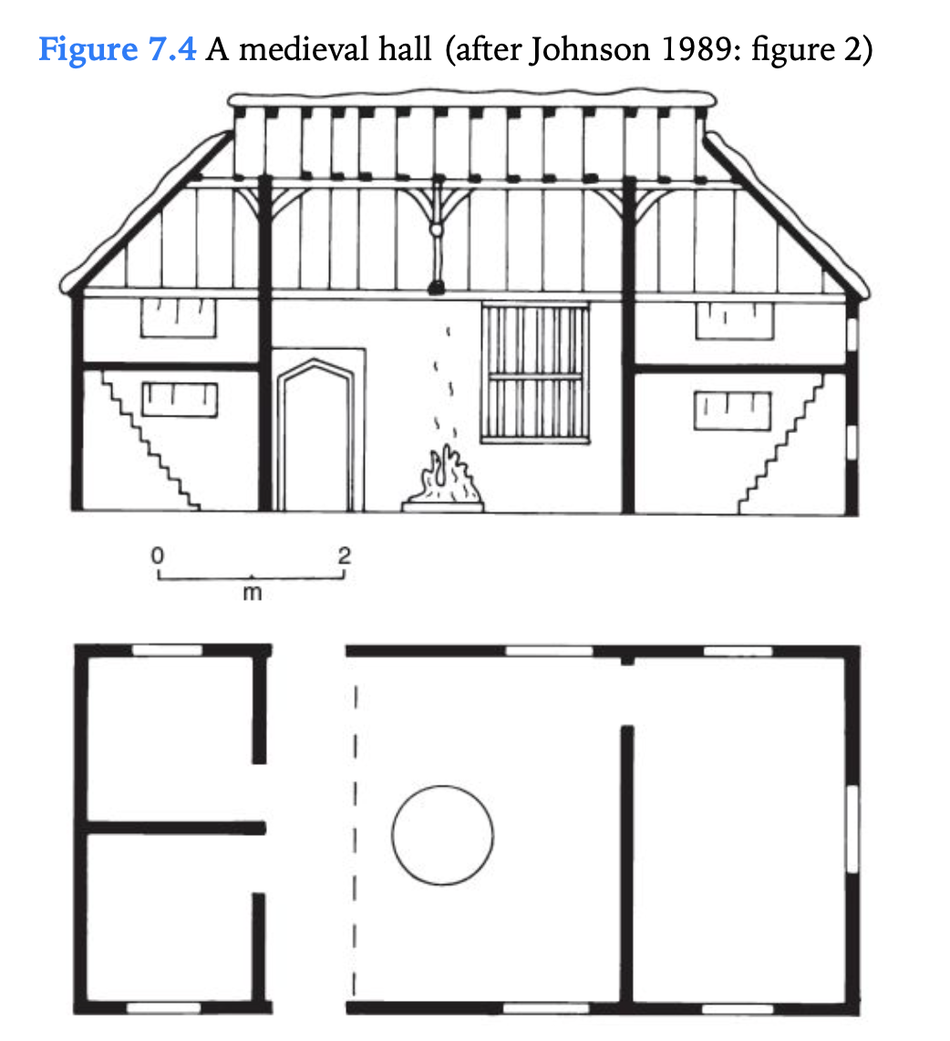

Slide 42
Phenomenology
How we might explore the meaning through archaeological evidence?
One of the methods is phenomenology
“It involves a description of things as they are experienced in the world by a human subject”
Subject-object relations
Study of landscape and sites in the landscape (e.g. Tash-Rabat part of the Silk Road)

Slide 43
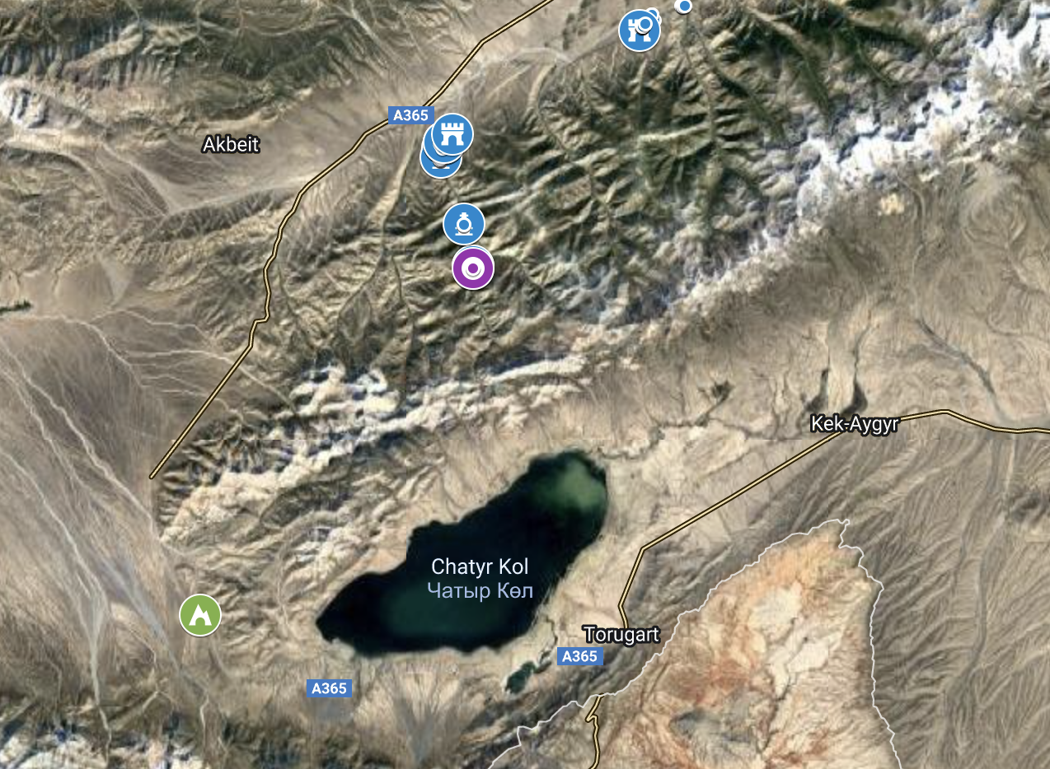

Slide 44
Marxist acrhaeology
Is a materialist philosophy
“it is not the consciousness of men that determines their being, but on the contrary, their social being that determines their consciousness ”
“ Each different mode of production results in a different kind of class antagonism”
Dialectical model of social process or culture change
Academic discourse is also political

Slide 45
Cognitive Archaeology
The study of prehistoric ideology: the ideals, values, and beliefs that constitute a society's worldview.
Cognitive maps
Human behavior in the past
Rituals/Traditions

Slide 46
Gender Archaeology
is a method of studying past societies through their material culture by closely examining the social construction of gender identities and relations.
Man/Women/Children
Power and authority
Age/Social Status/

Slide 47
Male bias in archaeology
Androcentrism
Use of language
Ethnographic studies
History of archaeology itself
Feminist Archaeology
Archaeologies of Gender
Archaeologies of Identity (masculinity, childhood, sexuality, race and ethnicity, disability, etc.)

Slide 48
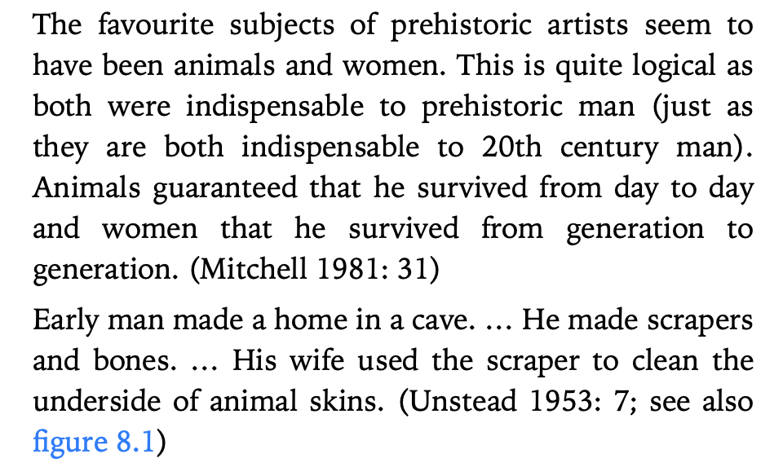

Slide 49
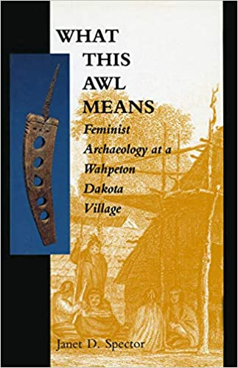
She breaks three academic rules of writing:
1) telling how she came to archaeology and to the site
2) focus on tiny little artefact
3) story about that artefact

Slide 50
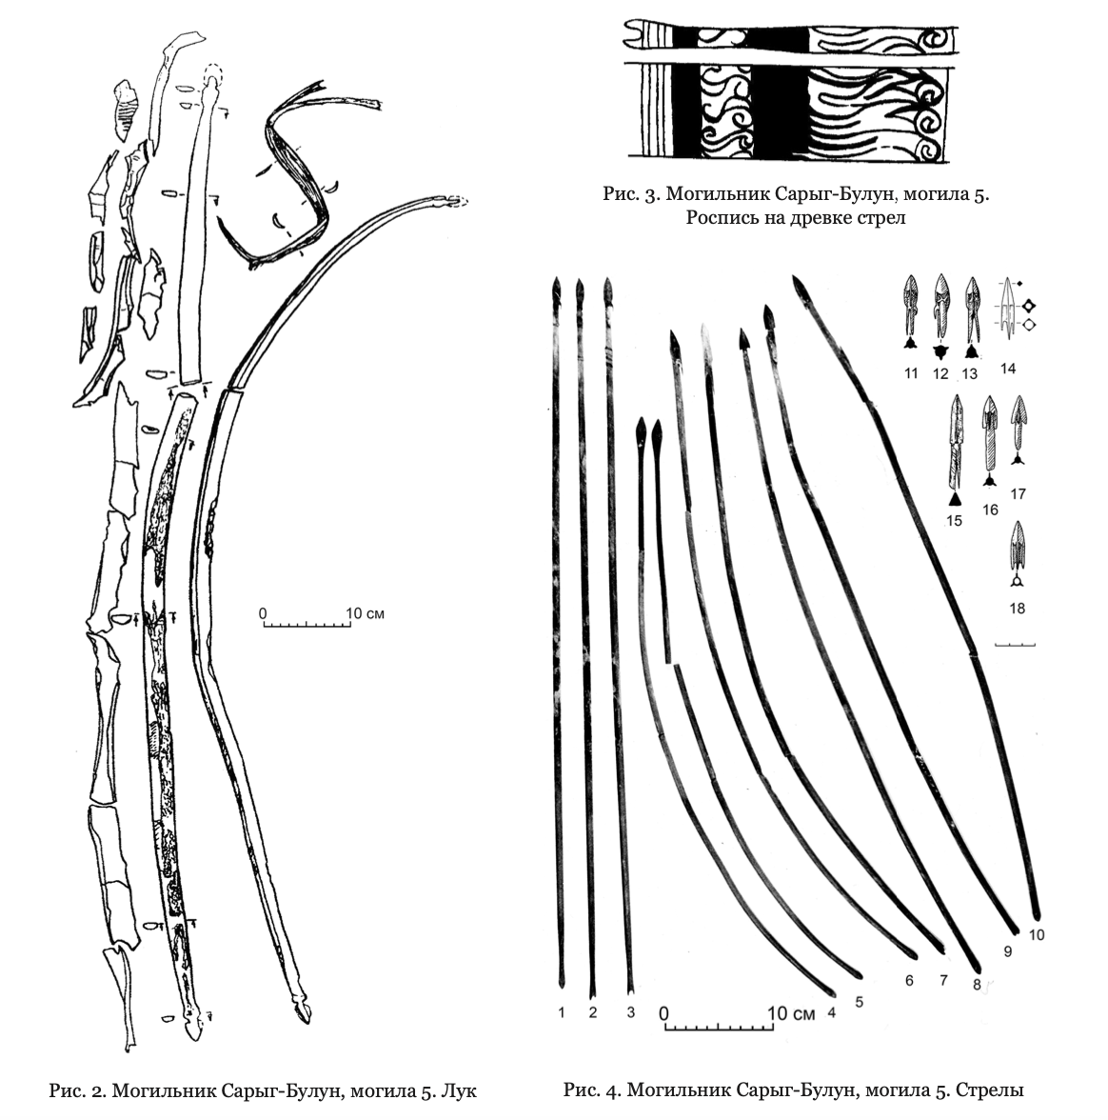
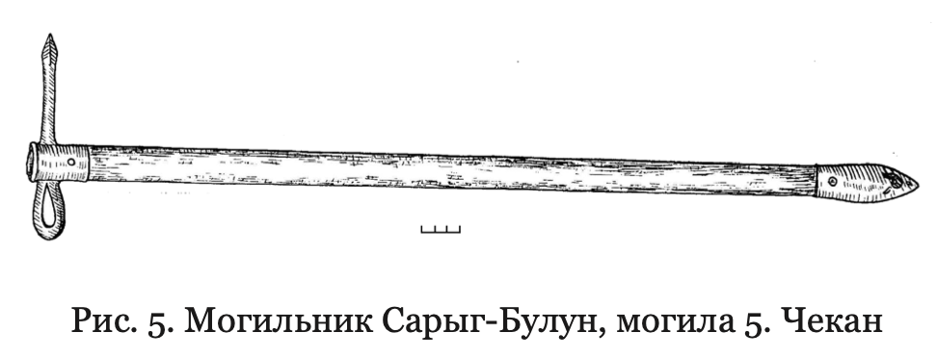
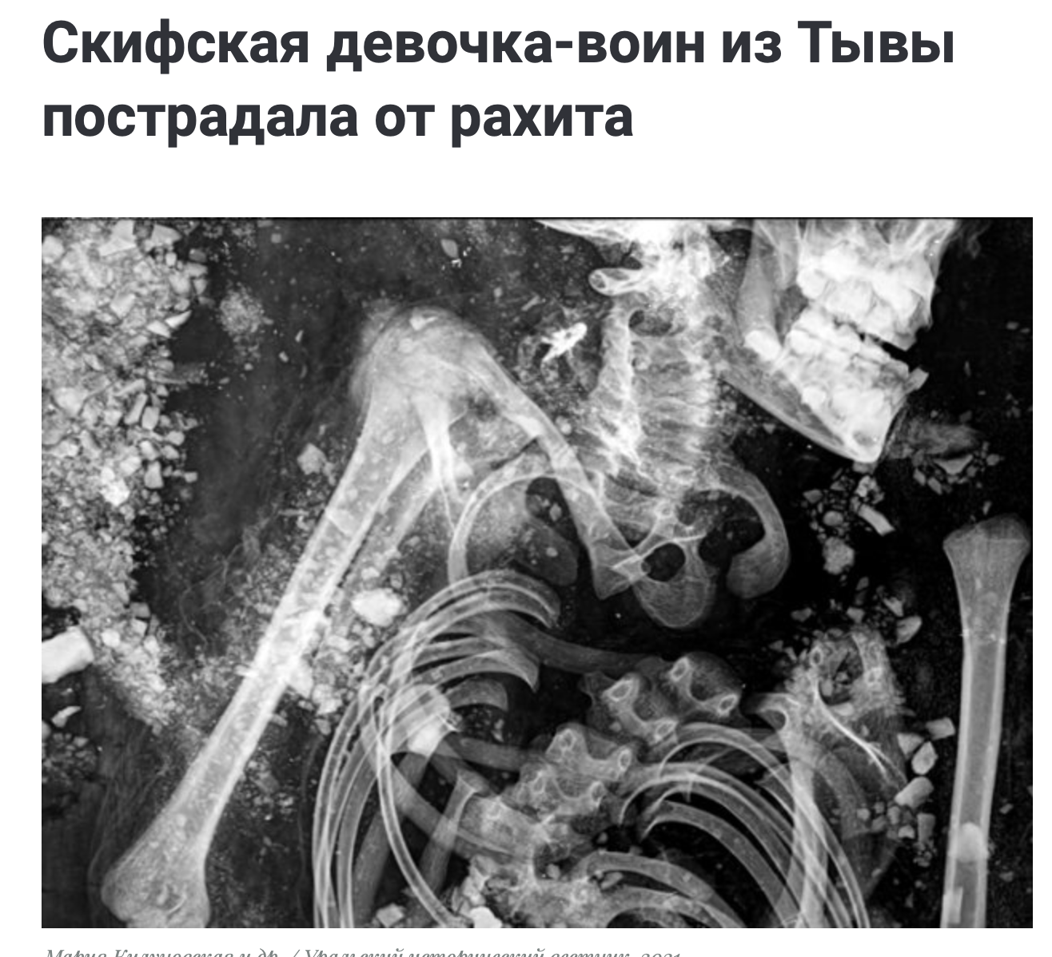

Slide 51
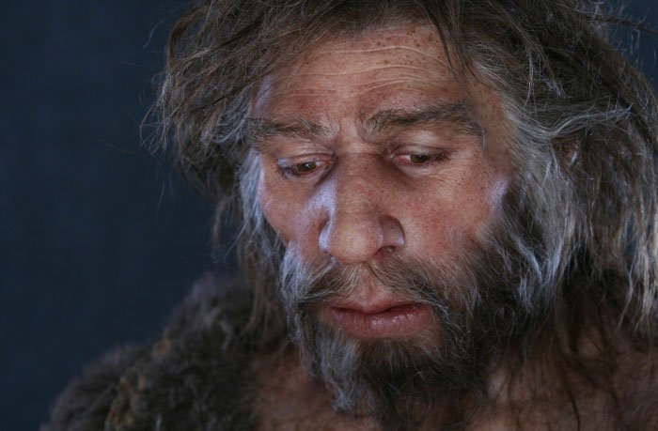
Neanderthal from Shanidar I

Slide 52
Archaeologies of Identity
Focused on construction of social identities
Masculinity
Childhood
Race
Sexuality
Disability

Slide 53
Examples
From medieval castles to palaces
To be man = ability and training to fight
Shift to to an unfortified Renaissance architecture
To be a man = a new ‘self-fashioning’, with ideas of civility, literacy and familiarity with the works of Classical literature, and of ‘courtly’ behavior

Slide 54
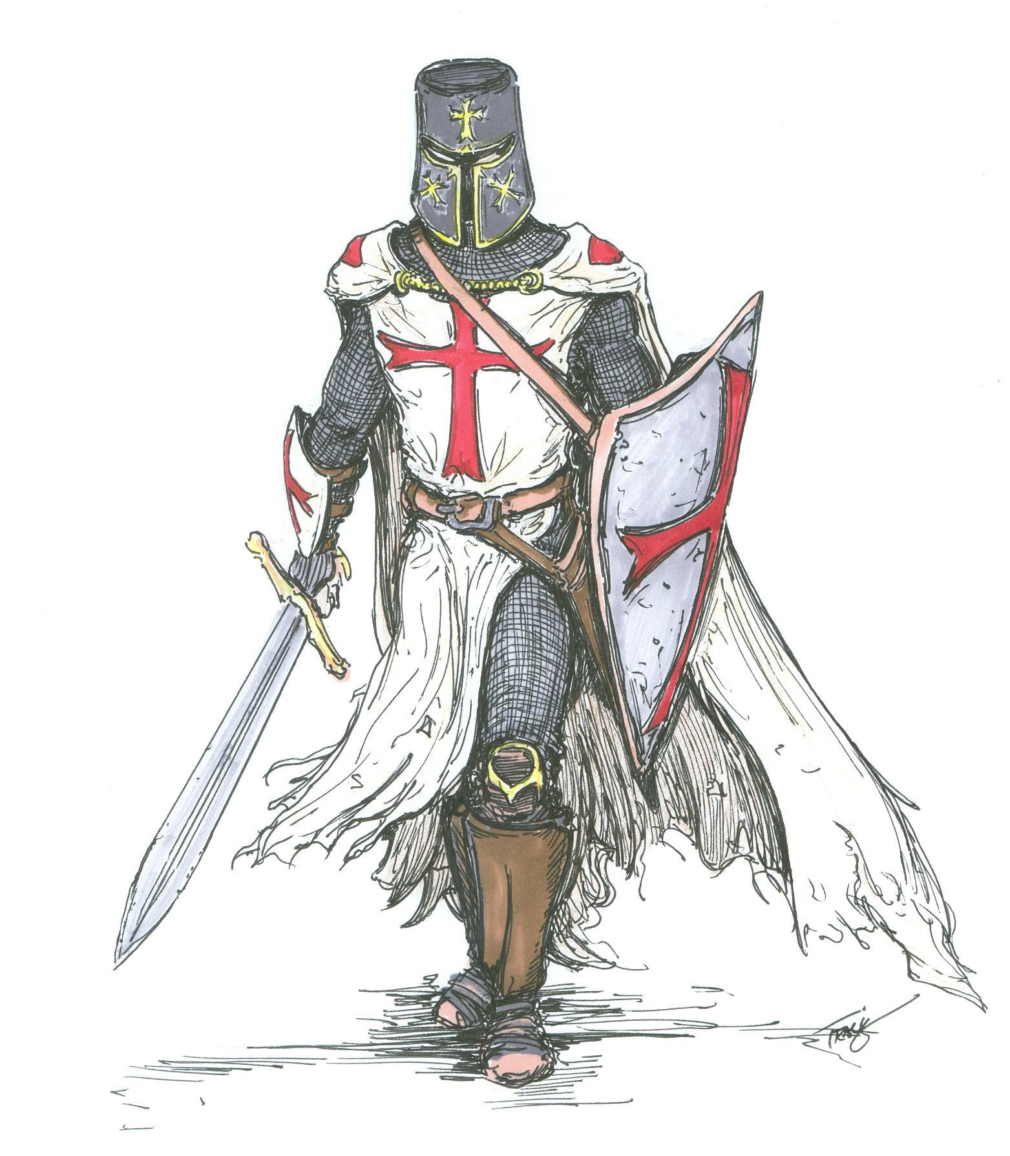
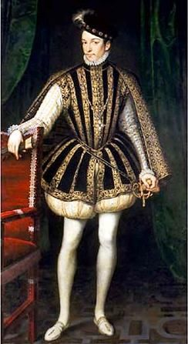

Slide 55
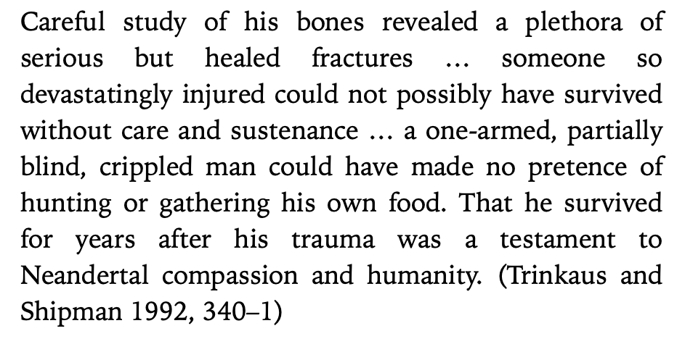

Slide 56
Performativity
‘Performativity’ is a centrally important idea in understanding identities
By Judith Butler
Performance occur in material settings
Structure and define ‘who you are’
Often take place through the body
“performativity applies just as much to contemporary practice as it does to interpretations of the past”

Slide 57
Indigenous archaeology
is a form of archaeology where indigenous peoples are involved in the care of, excavation and analysis of the cultural and bodily remains of peoples they consider their ancestors. It has been largely developed as a sub-discipline of archaeology since the late twentieth century, in response to some of the historical inequities in the practice, which developed largely as Europeans and Americans studying ancient cultures other than their own.

Slide 58
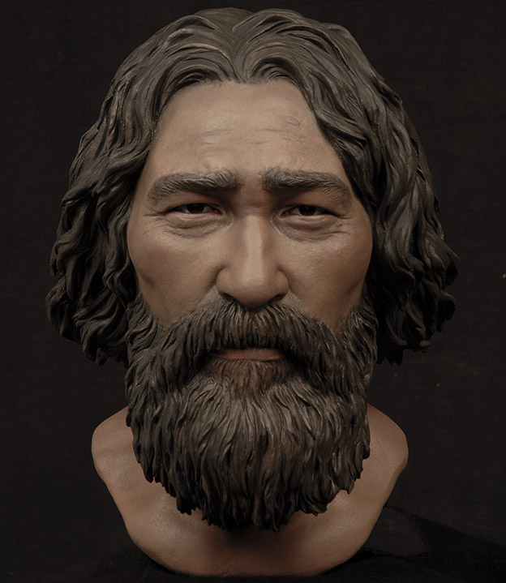
Kennewick Man

Slide 59
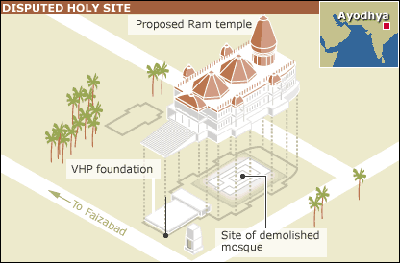
Ayodhya site

Slide 60
