Slide 1
Economics of Family and Kinship: Household, Residence
Outline
Family structures and kinship dynamics
Types of household
Types of residence
Conclusion

Slide 2
What kind of families do you know?
And how do they relate to the household and residence?

Slide 3
Seven types of family
Nuclear families: children "living with two parents who are married to one another and are each biological or adoptive parents to all children in the family,"
Single-parent families: children living with a single adult of either gender,
Unmarried biological or adoptive families: children living with two unmarried parents who are each biological/adoptive parents to all the family's children,
Blended families: children living with one biological/adoptive parent and that parent's spouse,
Cohabiting families: children living with one biological/adoptive parent and that parent's unmarried cohabiting partner,
Extended families: children living with one or two parents, and at least one related, non-parent adult (age 18+) such as a grandparent or adult sibling, or
"Other" families: children living with adults who are not their biological or adoptive parents.

Slide 4
The case of the US

Slide 5
Forms of households
Single-person household, one person living alone
A single-parent household, an adult living with offspring
Nuclear household, a married couple or not with or without children
Extended household includes more than one family: patrilinieal extended household and matrilinieal extended household
Collateral extended household includes sisters or brothers
Complex household means multiple wives or multiple husbands

Slide 6
Households
Basic residential units that implement:
Economic production
Consumption
Inheritance
Child rearing
Shelter in terms of migration is the source of extending families (case of KG)

Slide 7
Household income
Household income is a measure of the combined incomes of all people sharing a particular household or place of residence.
It includes every form of income:
salaries and wages,
retirement income,
Stipend,
Ill-benefits,
Pensions,
Investments.
Average household income can be used as an indicator of the monetary well-being of a country's citizens. Mean or median net household income, after taxes and mandatory contributions, is good indicator of the standard of living.

Slide 8
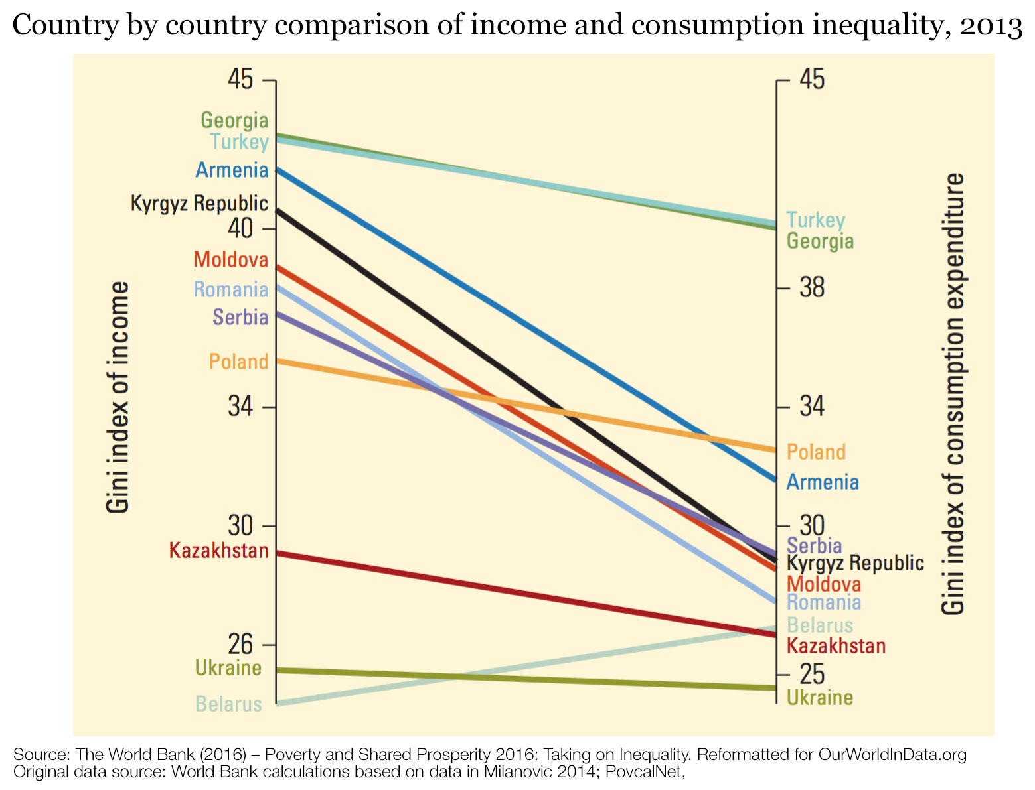
What is the global economic inequality???.

Slide 9
Household income in Central Asia

Slide 10
The causes of malnutrition and unsatisfactory households in KG

Slide 11
Living cost in KG of 2021
Cost of living | One person | Family of 4
💰 Total with rent | $430 | $1200
🛋️ Without rent | $232 | $844
🏨 Rent & Utilities | $198 | $357
🍽️ Food | $167 | $439
🚐 Transport | $18 | $49.3
💳 Monthly salary after tax | $241
💸 GDP per capita | $1174
😃 Human freedom index | 6.62
❤️ Life expectancy 71.6 Basket of food | 71.6 $59/5000som

Slide 12
Causes of malnutrition
Increased Poverty
The rise in food prices leads to an increased number of people living in poverty. For example, if food prices rise by 5 percent, the poverty rate rises by 3.5 percent.
. As families get poorer and larger, their diet becomes less healthy.
The increased cost of living
Our reporters have investigated the trends in consumer prices since 2011 on items like food, petrol, and transport. Families in regions have to buy 15% more expensive products than they were six years ago. Rising poverty, family size, and food prices mean families can’t feed their children.
The lifetime price of malnutrition
UNICEF, in its report, says that malnutrition keeps people from reaching their full potential. Malnourished children underperform in school, limiting their future job opportunities. Malnourished adults are less able to work, contribute to local economies, and provide care for their families. This perpetuates a cycle of poverty and economic stagnation.

Slide 13
Family household organization
Polygamous households - potential conflict among spouses of the individual to whom they are married.
"Islamization is going on, as one can see. It's changing not only the role of women in our society but the whole institution of the family. Family relations are changing," Sezim NGO repr. says.
Reasons for family and therefore, household changes
1. Islamization
2. Socio-economic hardship
3. Migration

Slide 14
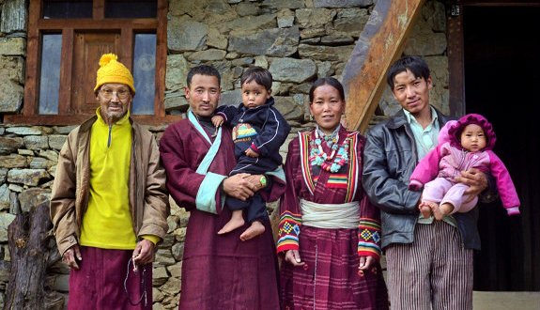
Polyandrous families
Polyandrous families - older husbands often dominate the younger ones.
“Compared to monogamous husbands and wives, polygynous husbands and wives are less cooperative, one with another, and co-wives are least cooperative, one with another. The husbands' and wives' behavior in a corresponding series of inter-household games indicates that these differences cannot be attributed to selecting less cooperative people into polygyny. Finally, behavior in polygynous households is more reciprocal and less apparently altruistic”.
Abigail Barr “Cooperation in Polygynous Households” in AMERICAN ECONOMIC JOURNAL: APPLIED ECONOMICS VOL. 11, NO. 2, APRIL 2019 (pp. 266-83)

Slide 15
Cultural and traditional forms of economy of family and kinship
Bride wealth is a gift from the husband’s kin to the wife’s, which stabilizes the marriage by acting as an insurance against divorce.
Dowry, much less common than bride wealth, correlates with low status for women.
Fertility is often considered essential to the stability of a marriage.
https://www.youtube.com/watch?v=k4Vqo6GgkmI

Slide 16
Economics of marriage
In about 75 percent of the societies known to anthropology,28 one or more explicit economic transactions take place before or after marriage.

Slide 17
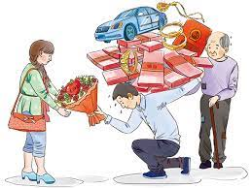
Bride-price/Bride-wealth
Bride price refers to a situation where the groom alone, or with his family, makes a wedding payment to the bride's family in the form of livestock, money, commodities, or other valuables

Slide 18
Bride service
The next most common type of economic transaction at marriage— occurring in about 19 percent of the societies with economic transactions—requires the groom to provide bride service

Slide 19
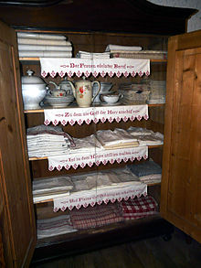
Dowry
A dowry is a transfer of parental property, gifts or money at the marriage of a daughter.
Dowry, much less common than bride wealth, correlates with low or high status for bride and her parents.
Fertility is often considered essential to the stability of a marriage.
Indirect dowry occurs in about 12 percent of societies in which marriage involves an economic transaction.

Slide 20
Conclusion
Marriage, family, and household are interrelated aspects of human life.
A household can differ accordingly to the type of family.
Marriage transaction includes such different payments as bride-price, dowery, indirect dowry and ctr.

Slide 21
Reference
Malinowski, B. The Argonauts of the Western Pacific, L.1922. Ch.Kula.
Enrlich, A.“Power, Control and the Mother-in-Law Problem: Face-Offs in the American Nuclear Family”, An Anthropological Reader, edited by Robert Parkin and Linda Stone, Malden&Oxford: Blackwell, 2004, pp.175-185
Read more http://www.odecanet.org/living-beyond-your-means-how-kyrgyzstans-baby-boom-produced-a-generation-of-sick-children

