Slide 1
Energy resource management
Instructor: Aikerim Motukeeva
Class 3-4: Oil Market Development

Slide 2
Oil Supply chain
https://www.youtube.com/watch?v=8W8SW98-sXQ

Slide 3
Exploration
Geographical studies (aerial and satellite photography)
Geophysical surveys (gravitational / magnetic filed change)
Seismic surveys
Exploratory drilling
Cost: cost of surveys and studies + cost of drilling (with the possibility of finding dry holes) + cost of rentals.

Slide 4
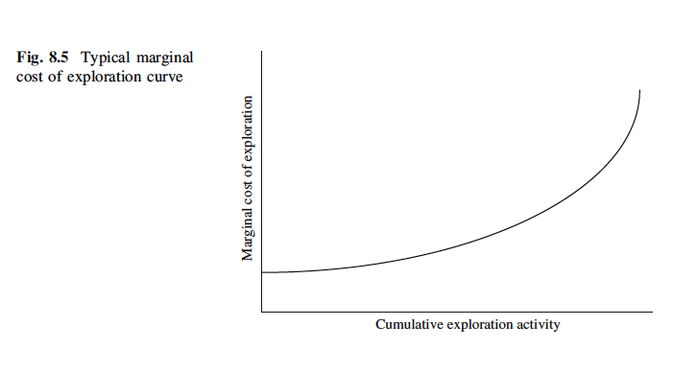
MC curve at the exploration stage

Slide 5
Exploration Risks
Contractual
(arises due to the possibility of changing the terms of the contract after the discovery is made )
Commercial
(geological conditions, smaller size of the reserve than initially estimated, poor quality of the output, unfavorable market situation)

Slide 6
Development Stage: Investment Decision
Cost-Benefit Analysis:
Environmental compliance requirements
Relocation of settlements (if any)
Geological conditions
Development schedule
Additional drilling and test requirements
Local infrastructure availability for transporting the output

Slide 7
Development Cost Example: Prudhoe Bay (Alaska)
Permafrost temperatures
and geographical remoteness
Increase transportation costs

Slide 8
Development Cost Example: North Sea
Violent winds and waves of the North Sea increase the costs of production

Slide 9
HOW DID OIL MARKET DEVELOP?
Industry structure development
Corporate dimension
Global economy
Governments policy (legal aspect)
Military conflict

Slide 10
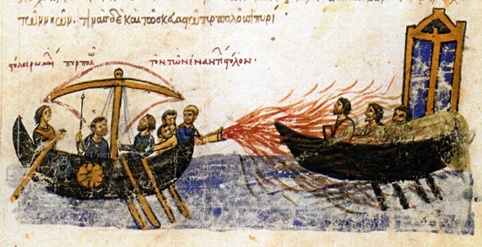
Oil in ancient times
Roman Empire - medicine (stop bleeding, relieve toothache, stop fever)
Babylon – building walls
Troy – military purpose (burn ships)

Slide 11
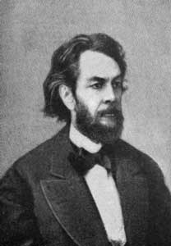
Pennsylvania Boom
1854 - George Bissel established Pennsylvania Rock Oil Company
– use of oil in lighting.
Economic background – population and demand for lighting increased (whale oil was scarcer)

Slide 12
Pennsylvania Boom
1859 – first oil drilled in the city of Titusville (Pennsylvania)
Refined into kerosene (productivity increased)
Oil rush (price of land soared from 4$ to 2mln$)
1862 – 3 mln barrels produced. Price slumped from 10$/b to 10 cents/barrel
“The rule of capture” – pump as much as you can until the oil field is drained by someone else (waste/damage)

Slide 13
Titusville oil rush

Slide 14
Pennsylvania Boom
1870 - trade of oil:
Spot sale (immediate delivery and payment)
Regular sale (within 10 days)
Futures sale (certain Q for certain P at certain point in time) – speculation
➔
Chaotic disorganized market

Slide 15
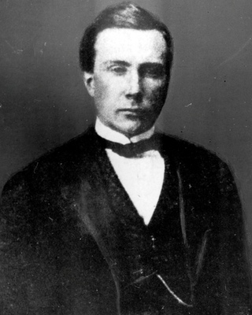
Standard oil
1865 – John D. Rockefeller - Integrated supply chain (own tank cars, warehouses)
Economies of scale (refined in big Q, got rebates on transportation by train)
Drawbacks (forced railroads to pay Standard oil 25 cents on every 1$ shipped by competitors)
Economic background (civil war ended, economic growth)

Slide 16
Standard oil: Domestic Market
1872 – P slumped. Standard bought competitors who went bankrupt
Predatory pricing
By 1879 – Standard controlled 90% of US refining (pipeline system, transportation)
1885 – Standard started producing oil (1/4th of US oil production) – vertically integrated company.
Standard Oil controlled P on oil.

Slide 17
Standard Oil: Corporate Wars
D for oil in Europe increased
1870 – 80’s kerosene exports – 50% of US oil output (90% of exports by Standard Oil) but competition arose
1873 – Nobel family went into refining in Baku. Adopted integrated structure of the company. By 1884 – 10.8 mln barrels.
Standard was ousted from Russia, but Nobels had only Russian domestic market (distance, winters, weak D). Needed transportation

Slide 18
Nobel oil production site in Baku

Slide 19
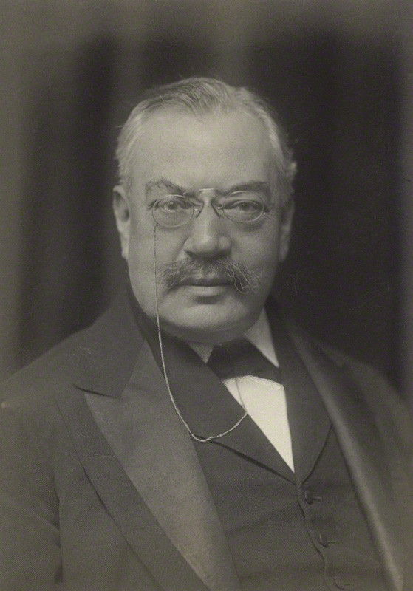
Oil corporate wars
1883 – Paris Rothschilds financed railroad Baku-Batum (Bnito company)
Standard dominated European market, Nobels had Russian market ➔ Rothschilds went East
Samuel Marcus – merchant contracted by Rothschilds shipped oil through Suez Canal to Shanghai, Singapore, Japan.

Slide 21
Oil corporate wars
1890 – Royal Dutch produced oil in Sumatra (Dutch East Indies)
Royal Dutch + Shell = 50% of Russian/Eastern exports
1907 – merged into Royal Dutch/Shell Group
➔
Standard in US, Europe
Nobels in Russia
Royal Dutch/Shell in the East
Oil wars (P cuts, sabotage, slander)

Slide 22
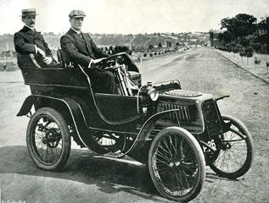
Oil corporate wars (US market)
1877 – Thomas Edison invented light bulb
D for oil decreased BUT ➔
Internal combustion engine
“The man who owns a motorcar gets for himself, besides the joys of touring, the adulation of the walking crowd, and…is a god to women”

Slide 23
Oil corporate wars (US market)
1900 – 8000 automobiles; 1912 – 902 000 automobiles
Oil was refined into gasoline now. D grew
Production grew out of Pennsylvania
1901 – Spindletop oil field in Texas
1905 – Glenn Pool field in Oklahoma
New companies reduced Standard refining capacity to 61% in 1911

Slide 24
US oil producing states

Slide 25
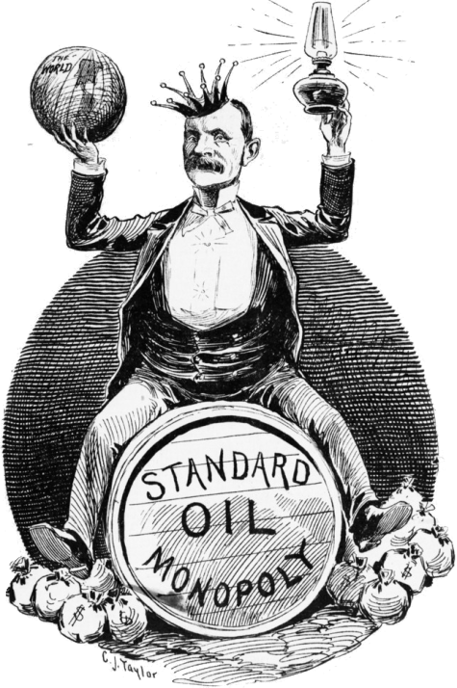
Oil corporate wars (US market)
1906 Theodor Roosevelt’s administration brought suit vs Standard Oil (under 1890 Sherman Antitrust Act)
1911 Standard was divided in 34 companies
By 1911 – Standard had 60% of refining, 50% of tank cars, 4/5% of kerosene exported
➔ Standard Oil of New Jersey (Exxon), Standard Oil of New York (Mobil), Standard Oil of California (Chevron), Standard Oil of Ohio (Sohio), Standard Oil of Indiana (Amoco), Continental Oil (Conoco), Atlantic (Sun)
Did it hurt Standard Oil shareholders?

Slide 26
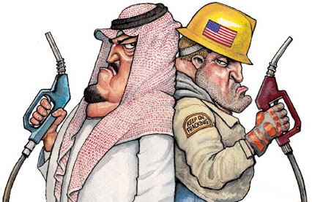
OIL & GEOPOLITICS

Slide 27
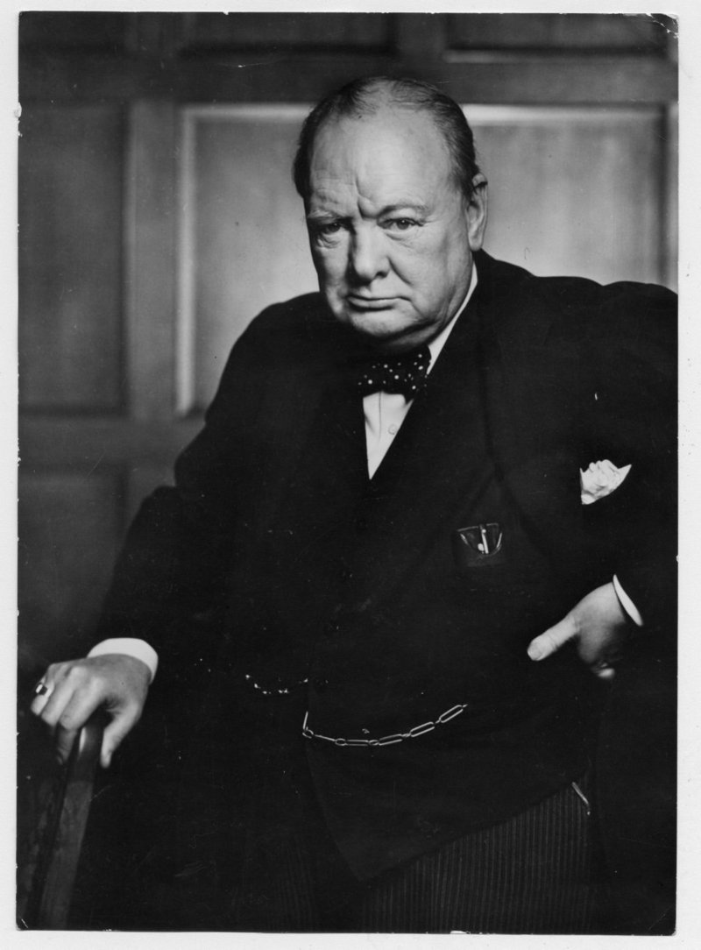
Oil in geopolitics
1911 – Churchill converted British fleet from coal (21 knots) to oil (25 knots) – faster, easier to refuel
British oil national policy: government bought 51% shares in Anglo-Persian, contracted Royal Dutch/Shell

Slide 28
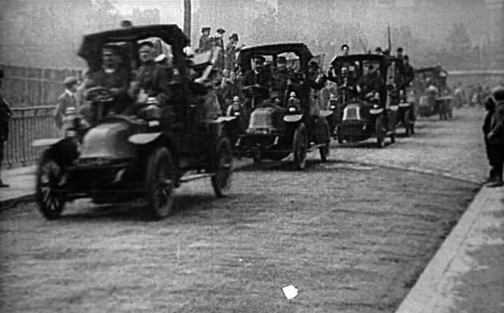
Oil in geopolitics: WWI
WWI – first mechanized war (internal combustion engine changed every dimension of war – sea, ground, air)

Slide 29
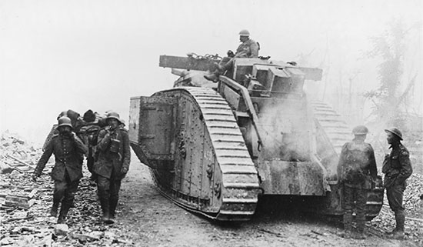
Oil in geopolitics: WWI
Allies relied on motorcars for mobility, while Germans relied on railroads

Slide 30
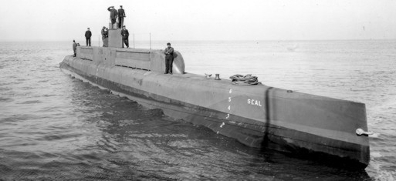
Oil in geopolitics: WWI
May 31, 1916 British fleet (oil) pushed the German fleet (coal) off the North Sea

Slide 31
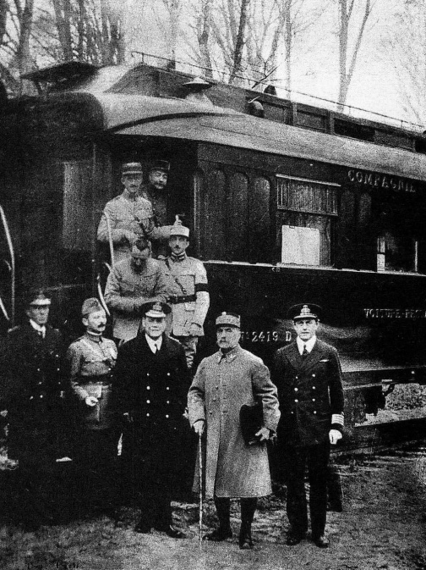
Oil in geopolitics: WWI
80% of oil demand of Allies – satisfied by the US, while oil S to Germany was blocked.
11 November 2018 – Compiegne Armistice.

Slide 32
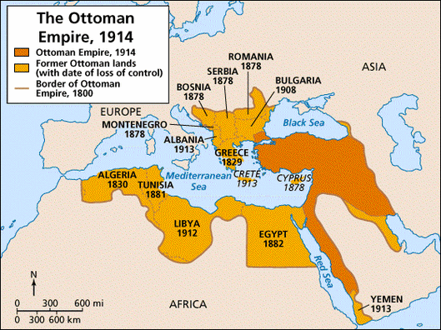
Oil and the aftermath of the WWI
Shift in traditional balance of power and new significance of oil (strategic) ➔ rivalry over the remains of the Turkish empire (esp. Mesopotamia)

Slide 33
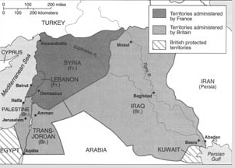
Oil and the aftermath of the WWI: Middle East
1920 – San Remo Agreement (Mesopotamia – British mandate under League of Nations. France gets 25% instead of Deutsche Bank in the Turkish Petroleum Company and 25% of Mesopotamian oil)
1924 – French establish CFP (Compagnie Francaise des Petroles)
Uk and France divide Iraq

Slide 34
Oil and the aftermath of the WWI: Middle East
But US companies also join in Iraqi oil partition.
1928 – Agreement 23.75% of oil each to Royal Dutch/Shell, Anglo-Persian, CFP, Near East Development Company (US consortium) ➔
The Red Line Agreement (self-denying clause – to drill on particular territory within Turkish Petroleum Company)
Renamed into Iraq Petroleum Company

Slide 36
COMPANIES VS GOVERNMENTS

Slide 37
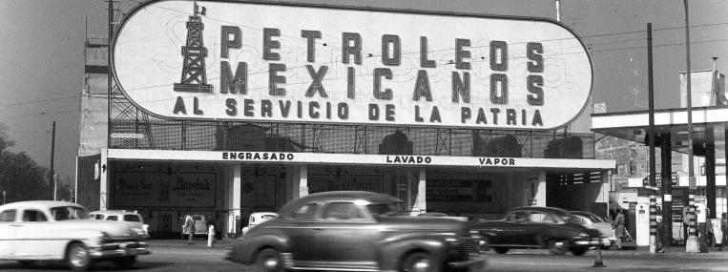
Companies vs Governments: Mexico (rise of nationalism)
Pan American Petroleum Company (US), Mexican Eagle (UK). 1921 – Mexico 2nd largest producer (191 mln b/y).
1911 – revolution
1917 – constitution (oil belongs to the nation). Production fell
1938 – Nationalization without compensation
Pemex state-owned company

Slide 38
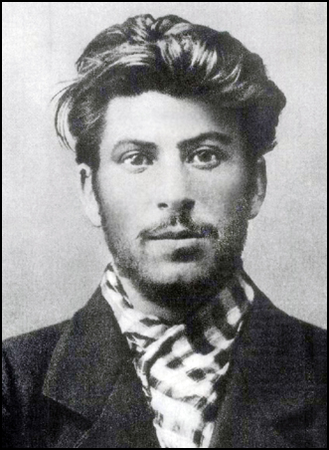
Companies vs Governments: Russia
1917 – revolution (civil war)
1920 – Bolsheviks nationalized Baku oil fields. Nobels lost oil production
1922 – United front vs Soviet nationalization (Royal Dutch/Shell, Standard of New Jersey, Nobels) BUT
1923 – Russia re-enters global oil market (United front waged price wars ➔ useless)

Slide 39
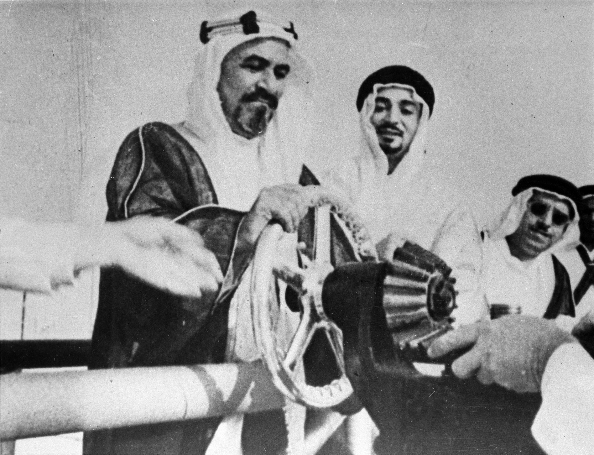
Companies vs Governments: Arabian Concessions
On the contrary - foreigners welcomed concessions
Kuwait – Sheikh Ahmad
1934 – 75 year concession to Kuwait Oil Company (Gulf and Anglo-Persian)
179,000 $ up front, 36,000$ / annually, 94,000$/year if oil found
1938 – first oil

Slide 40
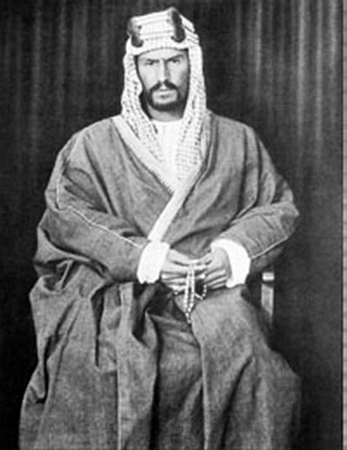
Companies vs Governments: Arabian Concessions
1933 – King Ibn Saud gave Socal concession for 60 years (175,000$ up front, royalties, loans).
BUT during WW2 – wells plugged and cemented.

Slide 41
Conclusion: Interwar Period
New significance of oil after WWI
Rivalries in the Middle East (colonial-type division)
1920-30’s – oil glut of global overproduction
New relationship between companies and governments (nationalism in Mexico and Russia vs welcoming attitude in Arab countries)

Slide 42
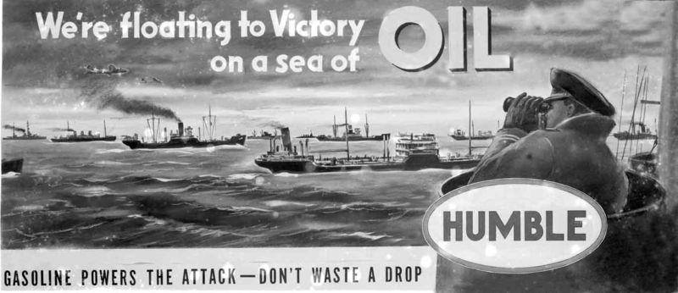
WW2

Slide 43
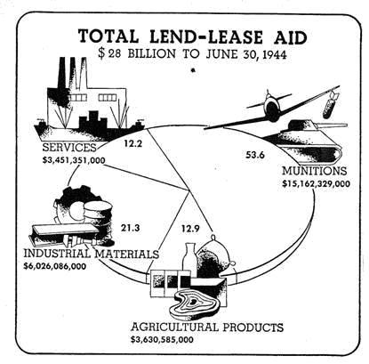
WWII oil supplies of Allies
March 1941 – Lend Lease program (till September 1945)
Shipment to USSR - 2,670,371 tons of petroleum products (gasoline and oil)

Slide 45
Oil on the European Front
Germans chasing oil:
Attack on USSR (Baku)
Rommel in North Africa

Slide 46
Oil on the Pacific
Japanese chasing oil:
Dutch East Indies
Pearl Harbor
Cut Supplies (kamikaze)

Slide 47
WWII oil supplies of Allies
WWII US production: 3.7 mln b/d in 1940, 4.7 mln b/d in 1945 (30%⬆)
WWII fuel consumption = 100 x WWI
90% of Allies’ oil – produced by the US

Slide 48
POST-WAR OIL ORDER

Slide 49
Post-war oil order: Middle East
Middle East - no oil production during WWII
1940 – ME = 5% of world oil production (US=63%). Oil wells plugged.
1943 – US granted Land Lease to Ibn Saud
Aramco (Arabian American Oil Company = Socal + Texaco)

Slide 50
FDR and Ibn Saud

Slide 51
Post-war oil order: Middle East
US 1945 – 20 mln cars; 1950 – 40 mln cars (explosion of oil D)
1948 – US oil imports > exports
New focus – ME. 3 big oil deals
1) Saudi Arabia
Aramco (Socal+Texaco+Jersey & Socony)
2) Kuwait (LTC with Royal Dutch/Shell to distribute in Europe)
3) Iran (LTC with Jersey & Socony for oil distribution in Europe)

Slide 52
Post-war oil order: Europe
Focus shifted from the US to the ME. Oil would flow to Europe.
But can Europe afford this oil? WWII – Europe in ruins
1946 –recession, inflation, unemployment
1947 – Marshall Plan – 13 bn$ (20% of aid to purchase oil from the ME; substitution for coal – cheaper, not unionized)
How to transport?
1950 – Tapline (Saudi Arabia – Lebanon – Europe)

Slide 53
Tapline

Slide 54
Post-war oil order: Governments vs companies
1940-50’s renegotiation over rents
Economic side: unjust profit division
Ex: 1940: P= 2.50$/b, cost = 85 cents/b, profit = 1.65$/b (goes to the company)
Political side (nationalism vs entrepreneurship)
Governments became more assertive ➔

Slide 55
Post-war oil order: Governments vs companies
1) Venezuela (Standard Oil of New Jersey; Royal Dutch/Shell):
Oil = 90% of export value
1943 - New government ➔new agreement on the “50/50 principle” (government’s royalties+taxes = company’s net profits)
1948 – government take ⬆6-fold (60% of government income)

Slide 56
Post-war oil order: Governments vs companies
2) Independents in the Neutral Zone (Saudi Arabia & Kuwait)
1947 - Amir of Kuwait gave concession to Aminoil (US independent) - 7.5 mln$ cash, 15% profits, 33 cents/b royalty
1948 – Ibn Saud gives concession to Getty Oil (US independent) – 9.5 mln$ cash, 1 mln$/year, 55 cents/b royalty.
Compared to: Aramco 33 cents/b; Anglo-Iranian 16 cents/b; IPC 16 cents/b; Kuwait Oil Company 15 cents/b ➔
Raised expectations of Arab governments

Slide 57
The Neutral Zone

Slide 58
Governments vs companies: 50/50
1950 – New agreement with Saudi Arabia (50/50, + foreign tax credit) 78 mln$
1952 – same conditions for Kuwait, Iraq
Why US government agreed?

Slide 59
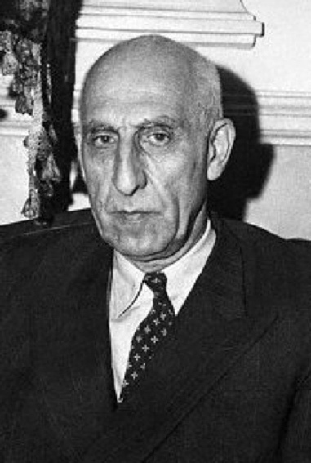
Oil ownership issue: Iranian oil
1941 –Iran – 3rd largest oil producer (40% of ME production)
Anglo-Iranian: profit = 250 mln pounds, government take = 90 mln pounds (paid more in taxes to GB than in royalties to Iran)
April 1951 – Mohammed Mossadegh nationalizes AIOC

Slide 60
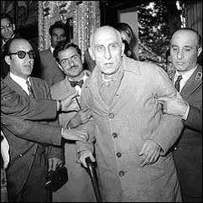
Iranian oil
1952 – Iranian production drops = 20,000 b/d (1950 = 666,000)
Financial trouble (oil = 2/3 of forex, 50% of budget revenue)
August 1953 - Operation Ajax (CIA + MI6). Shah reinstated

Slide 61
Iranian oil
1954 - Consortium (Anglo-Iranian 40%, Jersey 7%, Socony 7%, Texaco 7%, Socal 7%, Gulf 7%, US independents – 5%, Shell 14%, CFP 6%)
! By the agreement: Iran owns the oil, companies – contract agents who buy oil from Iran,

Slide 62
Conclusion
After WWII oil center shifted from the US to the ME
US Marshall plan helped Europe shift from coal to oil
1940-50’s - governments renegotiated oil production agreements (50/50; foreign tax credit)
New psychological perception of oil ownership by governments (AIOC nationalization)

Slide 63
1950’s-1960’s

Slide 64
1950-60’s
Oil market growth
 | 1948 | 1972
Global oil production | 8.7 mln b/d | 42 mln b/d
US oil production | 5.5 mln b/d (64% of global output) | 9.5 mln b/d (22%)
ME oil production | 1 mln b/d | 18 mln b/d
Global proven oil reserves | 62 bn b | 534 bn b

Slide 65
Oil production trend

Slide 66
1950’s: Elephants
New oil fields:
1956 – oil in Algeria.
1956 – oil in Nigeria (Shell+BP)
1957 – Libya gave out 47 concessions. By 1961 – 10 big fields (high quality sweet; close to Europe)

Slide 68
End of 50/50
Post-war order basis:
Great deals of 1940’s
50/50 agreement between Government and Companies
7 sisters in ME: Standard Oil of New Jersey (Exxon), Socony (Mobil), Socal (Chevron), Texaco, Gulf, Royal Dutch/Shell, BP (Anglo-Iranian)

Slide 69
End of 50/50
1957 – ENI (Italy) partnership with Iran: ENI (25% of profits) vs Government (75%)
1958 – St Oil of Indiana deal with Iran: Company (25%), Government (75%)
1960 – Arabian Oil Company (Japan). Company (43% of profits) vs Saudi Government (57% + 10% of shares). Kuwait – same conditions ➔
50/50 principle crumbles

Slide 70
Change in the international oil industry
New players: ⬆D; technology; communication; travel; bargaining of independent companies
 | Before 1957 | After 1957
Oil market players | Only big oil companies | Hundreds new entrants
Profitability | ROR = 20% | ROR = 11%

Slide 71
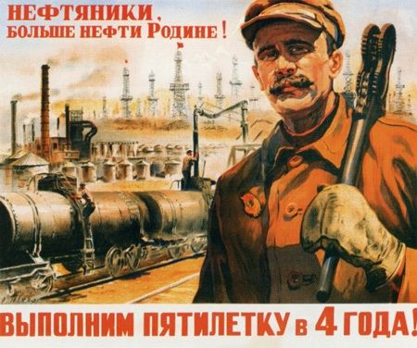
Oil market prices
1955-1960 – new oil fields in the USSR (Volga Urals).
2nd largest producer (3/5 of ME production).
Aggressive marketing: barter deals, P cuts (50% of ME oil P)

Slide 72
OPEC ESTABLISHMENT

Slide 73
1950’s – competition⬆ (P cutting: post price vs market price).
Governments took royalties from the post price. Companies absorbed costs ➔
August 1960 – companies posted P⬇ 7% without consultation with G
14 September, 1960 – OPEC established in Baghdad (Saudi Arabia, Venezuela, Kuwait, Iraq, Iran + Qatar = 80% of world crude oil exports) ➔ system of production regulation

Slide 74
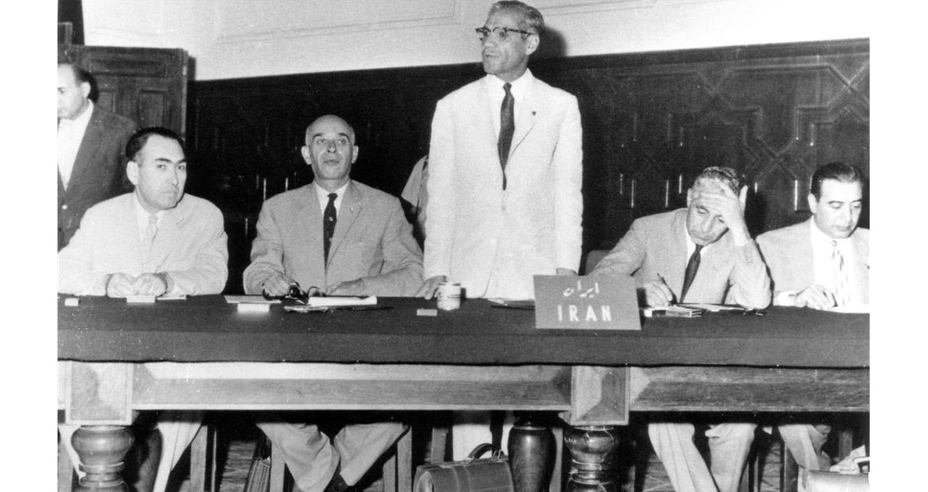
OPEC
OPEC aims achieved:
Consultations with Governments before changing posted P
Not cut P again
Why so little achieved?

Slide 75
OPEC
Legal and economic dependence on foreign companies (concessionary contracts + marketing networks)
Competition among ME countries (market share)
Political rivalries:
Saudi Arabia vs Egypt
Iran vs Saudi Arabia (Shia vs Sunni; Persians vs Arabs). 1957 – 1970: Iran production ⬆387%, Saudi Arabia production ⬆258%

Slide 76
OPEC Pricing
How can OPEC determine prices?
What does it depend on?

Slide 77
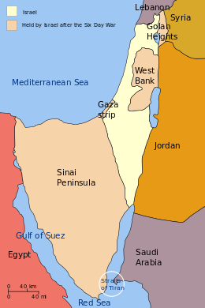
Six-Day War: Oil Weapon
June 6-10, 1967 Six-Day War
Israel seized control of the Gaza Strip and the Sinai Peninsula (from Egypt), the West Bank and East Jerusalem (from Jordan), and the Golan Heights (from Syria)➔
Oil embargo (6 June – 1 September): Saudi Arabia, Kuwait, Iraq, Libya, Algeria banned shipments to US, UK, West Germany➔
6 mln b/d lost to the market

Slide 78
Six-Day War 1967
OECD system of rerouting from non-Arab countries (Venezuela ⬆400,000 b/d, Iran ⬆200,00 b/d, Indonesia) + US shut-in capacity
September 1967 – embargo ended
Result: lost oil revenues for the Arabs, oil weapon failed (supplies were redistributed). Gulf countries increased production to higher than pre-war levels ➔
Illusion of security of supply

Slide 79
World economy
Low oil prices
1949 – 1972: energy consumption⬆ 3 times, oil ⬆D 5.5 times
Economic growth, income growth (car ownership; power generation; petrochemical industry) ➔
Improved refining; supertankers
 | 1949 | 1972 | Increase
US C | 5.8 mln b/d | 16.4 mln b/d | x3
European C | 970,000 b/d | 14.1 mln b/d | x15
Japanese C | 32,000 b/d | 4.4 mln b/d | x137

Slide 80
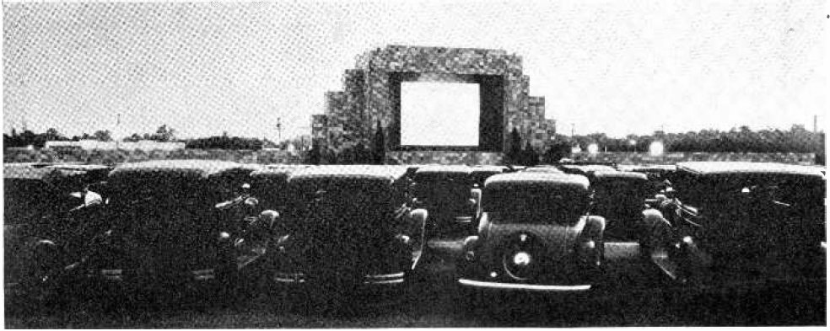
American dream

Slide 81
World economy
Shift from coal to oil (cheaper, available, not unionized)
Japan: 1960 annual growth – 11%, oil D growth – 18%
- Automobile industry revolution: 69,000 cars in 1955 to 4.1 mln on 1968
 | 1950 | 1970
Europe | Coal = 75% Oil = 25% | Coal = 22% Oil = 60%
Japan | Coal = 50% Oil = 7% | Coal = 20% Oil = 70%

Slide 82
German and Japanese economic miracles

Slide 83
1972: End of S Glut
By 1972 D caught up with S
Global D⬆ from 19 mln b/d (1960) to 44 mln b/d (1972)
US: 1957-1965 4 mln b/d of surplus capacity. 1970 – 1 mln b/d
1971: US peak output (11.3 mln b/d) ➔import quota lifted
1973: US imported 6 mln b/d (36% of oil C) ➔
US no longer the security margin for Europe
+ Prudhoe Bay and North Sea oil unavailable

Slide 84
Prudhoe Bay

Slide 85
North Sea drilling

Slide 86
Resource Nationalism
1969 – Muammar Qaddafi military coup in Libya. Demands ⬆20% in royalties
1970 – Shah of Iran demands 55% of profits. Followed by others
1971 – Tehran Agreement between United Front (major companies) and Arab countries + Iran (government take = min 55%; P⬆ 35 cents/b; in return – 5 year stability)
1971 – Tripoli Agreement (United Front & Libya, Venezuela) P⬆ 90 cents/b

Slide 87
Resource Nationalism
New point of contention: legal ownership
Concession = colonialism ➔
Participation
Algeria took 51% of shares
Libya took 51%
1972 Participation Agreement (Gulf states): 25% participation share, will ⬆ to 51% by 1983
➔
Oil exporters obtained leverage over P (negotiated between G and C)

Slide 88
Conclusions
1950-1960’s:
S>D (new oil fields; USSR). P⬇
main oil factors: US import quotas (1959); USSR resuming exports (1955); competition
OPEC’s role insignificant
Violation of 50/50 principle
Cheap oil fueled economic boom
Early 1970’s
Supply surplus ended by 1972 (US S peaked)
Nationalism on the rise (participation)

Slide 89
1973 Oil Crisis

Slide 90
1973 aftermath
1973 – first time when national governments obtained the monopoly on P setting
Oct 1973 – available Arab oil = 20.8 mln b/d; Dec 1973 = 15.8 mln b/d (panic)
Company S system: pro-rationing (still, oil loss during crisis: US – 18%, Japan – 17%, W. Europe – 16%)

Slide 92
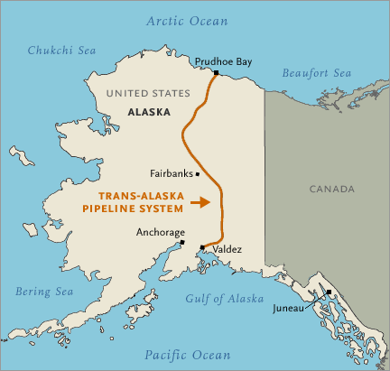
US
GDP drop 6% (1973-1975).
Unemployment – 9%
Trans-Alaskan pipeline
1975 fuel-efficiency standards (from 13 MPG to 27.5 MPG)
Strategic petroleum reserve

Slide 94
US growth and oil P

Slide 95
US inflation and oil P

Slide 96
US interest rate

Slide 97
UK: inflation

Slide 98
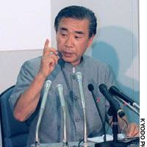
Japan
Oil = 77% of energy mix; ME: 44% of total oil S.
First recession since WWII
Trade
Debt

Slide 99
Japanese inflation

Slide 101
Japan’s debt

Slide 102
What were the consequences of the energy crisis?

Slide 103
1973 aftermath
IEA: negotiating platform; strategic reserves; research
New energy policy initiatives:
Conservation / fuel efficiency
Security of S (diversification in terms of suppliers and fuels)
Japan (nuclear; imports of coal/LNG; Pacific Rim suppliers, shift from energy-intensive to knowledge intensive industries)
France (nuclear, conservation – ban on ad campaigns, shift to coal)

Slide 104
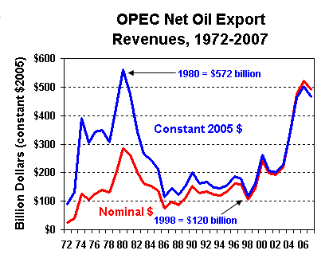
OPEC Golden Age
1974 – 1978 – OPEC’s golden age

Slide 105
Saudi Arabia

Slide 106
Saudi Arabia: infrastructure
1970’s – Annual growth = 10% (1980’s = 1.3%)

Slide 107
Saudi Arabia infrastructure
Rapid urban development

Slide 108
Companies vs Governments: Nationalization wave
Wave of nationalizations:
Iran in 1951
Iraq in 1972 (IPC)
Kuwait in 1975 (50 mln$ compensation to BP, Gulf)
Venezuela in 1976
Saudi Arabia (1974 took 60%, fully nationalized in 1980, compensation based on book value)

Slide 109
Companies vs Governments: Nationalization wave
1970’s Contractual agreements
Companies bought oil from governments (as middlemen). Ex: Exxon contract: will buy 900,000 b/d from Venezuela
Late 1970’s Governments went downstream:
1973 – 8% of OPEC oil sold directly on the market
1979 – 42% sold directly

Slide 110
Global market
Expectation of rising D and P
OPEC: 1973 = 65% of global production; 1978 = 62%
But supplies from new fields added:
Alaska 1978 – 1 mln b/d
Mexico 1980 – 1.9 mln b/d

Slide 111
Second Oil Crisis

Slide 112
Second oil crisis 1979: Iranian Revolution
Dec 1978 Shah fled; exports stopped ➔
Spot P ⬆20%
Oil crisis (panic)
Link between upstream and downstream severed (BP)
Build-up of inventories (companies/utilities/industries/motorists) Total shortage 5 mln b/d ➔ Spot market
Embargo vs Iranian oil (disrupted contracts)
OPEC took advantage to increase P

Slide 113
Second oil crisis 1979: dual market
Official (G sold oil to companies at official P – LTC). 1979: Saudi Arabia – 18$/b; rest – 28$/b
Spot market (speculation intensifying panic). 1979: P = 40 – 850$/b
1979 – OPEC sold oil mostly in spot market (at higher P)
March 1979: OPEC meeting (abandonment of official P, except Saudi Arabia). Buyers chasing scarce S

Slide 114
Gas lines
Inflation
Interest rate
Carter’s approval rating = 25%
But S/D imbalance couldn’t endure for long. High P spurred investments, which increased S and led to oil glut that persisted throughout 1980’s

Slide 115
Conclusion
1973 oil crisis led to recession in oil importing countries but benefited oil exporting ones
OPEC gained the monopoly over P setting throughout 1970’s
Nationalization wave resulted in severed supply chains and transformed oil industry structure (new significance of the spot market)
Tight market and panic sparked by Iranian revolution led to the second oil crisis
Unlike 1973, 1979 crisis did not reflect the real situation of the oil industry, it was a crisis of panic and information asymmetry

Slide 116
Oil Glut of 1980’s

Slide 117
1980’s
Strong S from new oil fields (North Sea, Alaska, Mexico, Angola, China, Malaysia) vs weak D due to recession and shift to alternatives, like coal, nuclear, renewables.
1978: oil = 53% of total energy market; 1985 = 43%
Energy efficiency ⬇C by 2mb/d in US (1973-1985: US – 25% more energy efficient and 32% more oil efficient; Japan – 31% and 51%)

Slide 118
1980’s: structure of the oil market
New dominance of the spot market (non-OPEC productions > OPEC and sold in spot market)
1970’s: spot market = 10% of int. traded oil; 1982 = 52% (oil companies as traders)
1983 – NYMEX introduced futures contracts (hedging) ➔ new players (fin. firms - speculators)
How NYMEX works?

Slide 119
1980’s: structure of the oil market
Low oil P:
Mergers (Shell + Belridge; Texaco + Getty oil; Chevron + Gulf for 13.2 bn$).
10 mb/d global excess capacity

Slide 120
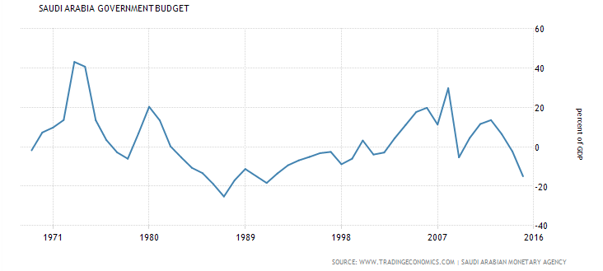
1980’s: OPEC
1986: ⬇revenues Saudi Arabia ⬇11%; Kuwait ⬇4%; Libya ⬇40%; Iran ⬇42%; Algeria ⬇45%

Slide 121
1980’s: structure of the oil market
Pricing:
Netback pricing (Saudi Arabia to retake market share)
No single pricing mechanism: netback deals, spot deals, barter deals ➔
Buyers’ market
Benefit to oil importing countries = 50 bn$

Slide 123
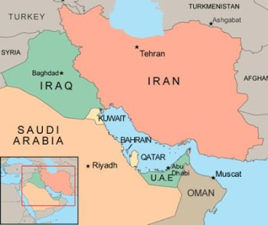
Oil in 1990’s: Gulf War
Aug 1990 – Feb 1991 (Coalition of 34 nations (US) vs Iraq’s annexation of Kuwait)

Slide 124
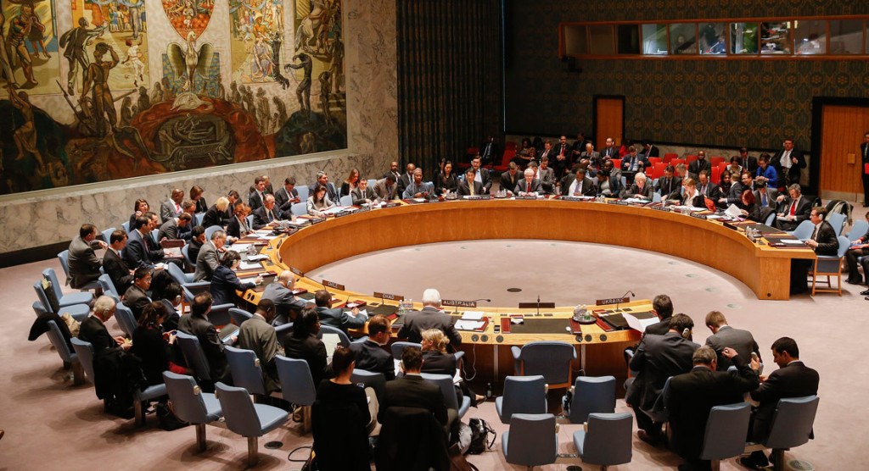
Gulf War
Coalition (fear of destabilized region; disrupted oil S for the precarious global economy)
UN resolutions 661; 665 – economic sanctions, naval blockade

Slide 125
Intentional oil spill to keep US naval ships away

Slide 126
Iraqi troops set fire 700 oil wells in Kuwait (10 months – 6 mb/d lost)

Slide 127
Oil Price (other OPEC compensated for lost oil)

Slide 128
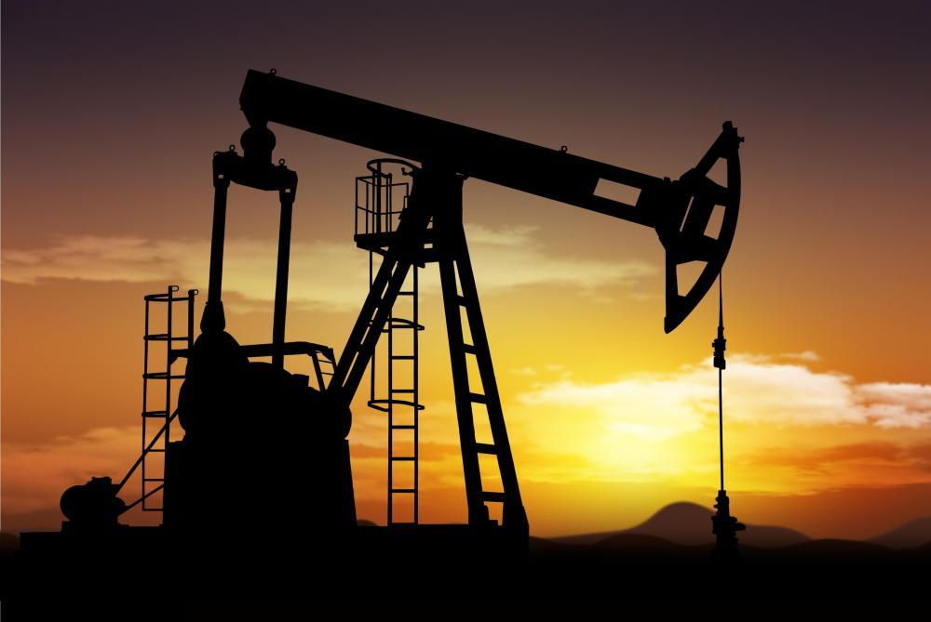
OIL IN 2000’s

Slide 130
Oil market in 2000’s (tight S)
2002 onwards – price increase due to aggregate oil disruption:
Venezuela 2002 – General strike to call Chavez on referendum (oil S⬇ from 3.1 mb/d to 200,000 b/d). Recovered only in 2003

Slide 131
Oil market in 2000’s (tight S)
2) Nigeria (8th OPEC)
Oil & gas = 40% of GDP
Population = 155 mln
250 ethnic groups
Muslim North vs Christian South
Oil produced in Niger Delta but local G got 13% of revenues
2003 Gang attacks on facilities (10% of oil production stolen); 2006 – ⬇40% of oil output

Slide 132
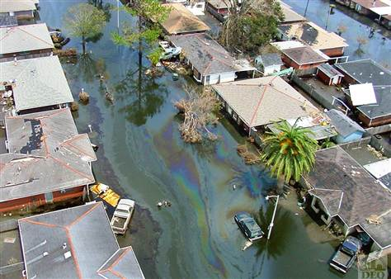
Oil market in 2000’s (tight S)
3) Hurricane Katrina 2005
155 platforms destroyed in the Gulf of Mexico; 535 pipeline segments damaged ➔
Decline of 29% of oil production and 30% of refining capacity
Electricity shut down (oil locked in storage tanks)➔
1.5 mb/d loss

Slide 134
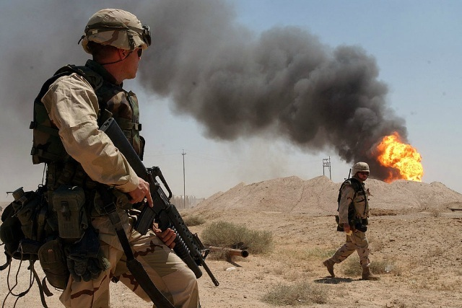
Oil market in 2000’s (tight S)
4) Iraq 2003
Oil facilities looted; pipeline blown up
1.6 mb/d loss (recovered only in 2009)

Slide 135
Iraq 2003

Slide 136
Oil market in 2000’s (strong D)
1980 – 2000 D⬆ 25%
2000 – 2010 D⬆ 12%
Not only developed but also emerging economies (2004-2008 China grew at 11% and imported 3,7 mb/d in 2007, India – 8%)
While S⬇:
Venezuela, Nigeria, Iraq
Saudi output⬇; investments in new oil fields ⬇(1997)

Slide 137
Oil consumption in China, 1980 - 2007

Slide 138
Global Financial Crisis

Slide 140
Financial Crisis 2008
Low r (recycling of petrodollars , investing into US treasuries, corporate bonds, asset market)
Cheap $ led to flight to commodities
Many players (banks, pension funds, hedge funds, sovereign wealth funds, individuals).
Expectations of ever strong D
Futures P translated into spot P
Electronic P got divorced from physical market

Slide 141
Financial Crisis 2008
July 2008 – peak P of 147.27 $/b
D⬇ (econ. crisis)
December 2008 – bottom P of 32$

Slide 143
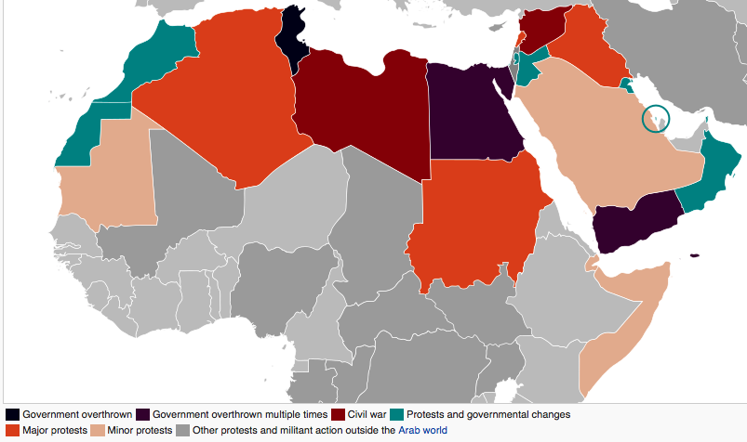
Arab Spring
February 2011
P rose to 95 $/b
June 2011 P = 114.83 $/b

Slide 144
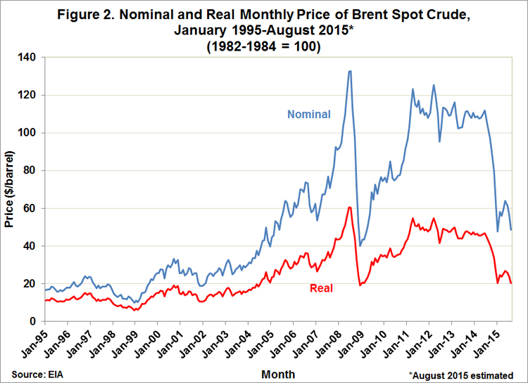
Oil price drop
2012 – Greek concern alleviated, cheaper $

Slide 145
What is the state of the current oil industry?

Slide 146
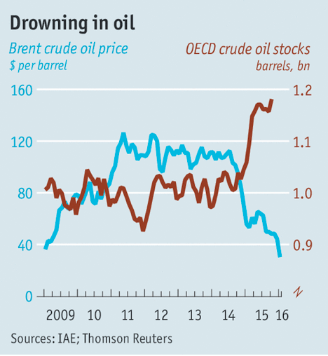
Current oil markets: 2015
Global Supply = 96.3 million b/d
Global Demand = 94.8 million b/d
Oversupply = 1.5 million b/d
P = 33.56$/barrel

Slide 147
Current oil markets
US stocks of crude oil – 1.3 billion barrels (record).
OPEC abandoned quotas (2015 December meeting – prisoner’s dilemma, +Russia/US).
US lifted ban on oil exports (December 2015) .
Iran – 3-4 million b/d (potential output), 500 000 - immediate.
Demand is expected to decrease (China, Europe, Middle East – new gasoline prices)

Slide 148
Discussion
Are low oil prices good/bad for global economy?
New economy of oil:
Globalization
Financialization (S&P 500, Dow Jones)

Slide 149
China
Less D (EU – recession (oil drags CPI lower); ME – recession)
Global markets fell 7% since 1 January 2016 (China concern – regulatory efficiency, lower demand, industrial overcapacity – 1.8 mln lay offs – 15%).

Slide 150
Chinese industrial overcapacity

Slide 154
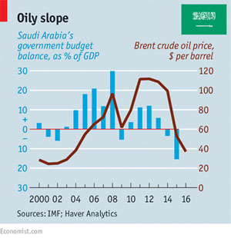
Saudi Arabia
Budget deficit – 15% of GDP (90% revenue - from oil)
IPO of Aramco (most valuable oil company) – 10.2 million b/d (more than the whole US), low cost producer.
Reforms - price increase on water, electricity (AC), gasoline (50%), 5%VAT

Slide 156
Brazil
2015 – GDP ⬇2%
December 2015 – Fitch downgraded to junk status
Dilma Rousseff impeached

Slide 157
Venezuela
Rampant inflation (141%)
Economic state of emergency, GDP shrank by 7%
Government deficit – 24% of GDP
Civil unrest

Slide 158
Russia
10% cut in public spending
74 roubles / $
GDP shrank 4%, inflation – 13%
Budget deficit rises by 1% for every 5% drop in oil prices
Real wages fell by 9% in 2015
2015 – 2 million people fell into poverty
Retail sales dropped 13%
Remittances to Central Asia decreased by 44% in Tajikistan, 50% in Uzbekistan, 30% in Kyrgyzstan

Slide 159
Russia’s real wages fall 9%

