Slide 1
Changing rituals in Iron Age

Slide 2
Early Iron Age
Still grave pits, however almost all of them with burial mounds (kurgans!)
Variety of on ground structures
Richness of grave goods (especially in elite burials)
Variety of body position and orientation , but mostly in sleeping position
Horse burials
Materiality of commemorative practices

Slide 3
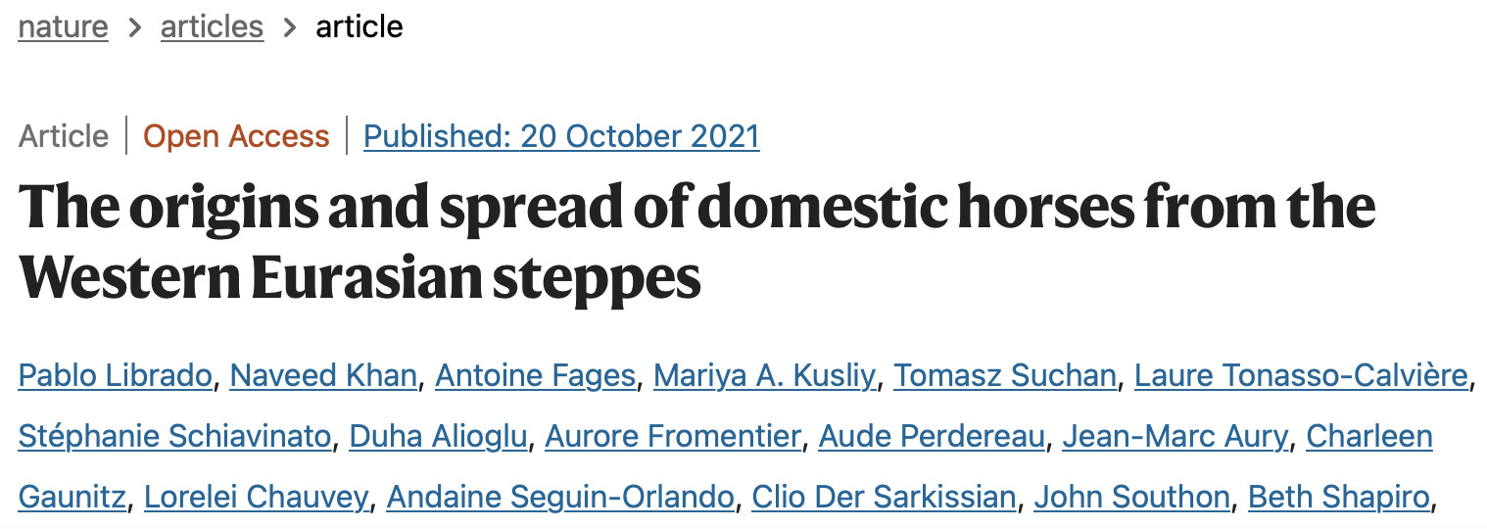
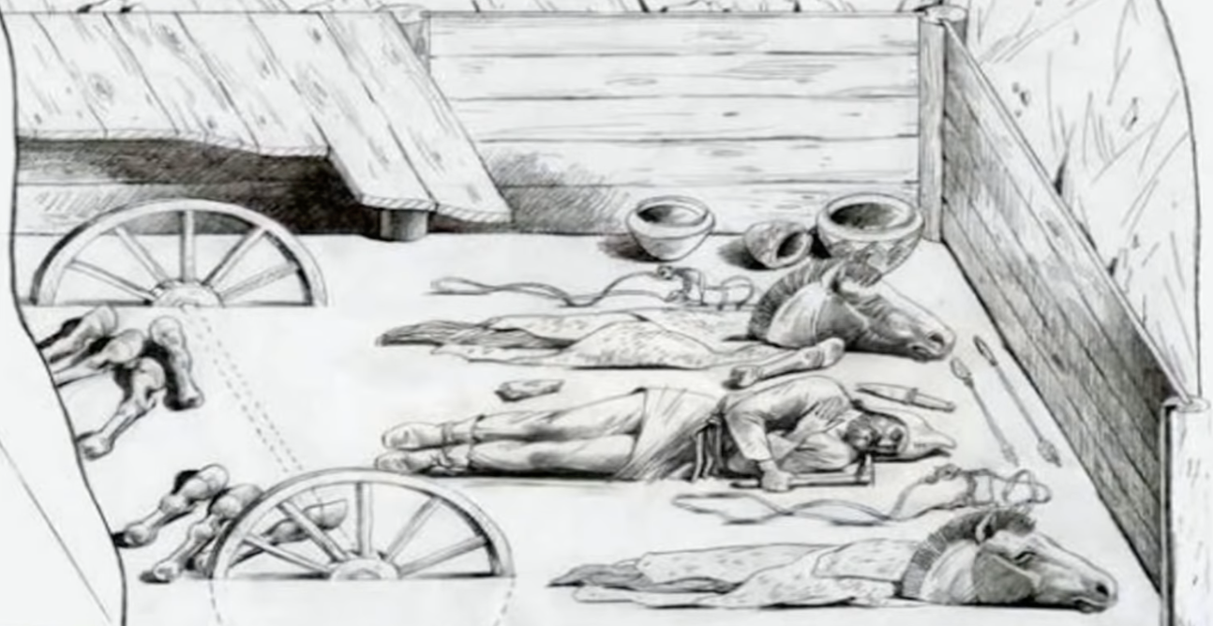
Meaning of the horse
Sintashta, country of towns
2100-1800 BC
Sacrifice of horses
First chariots

Slide 4
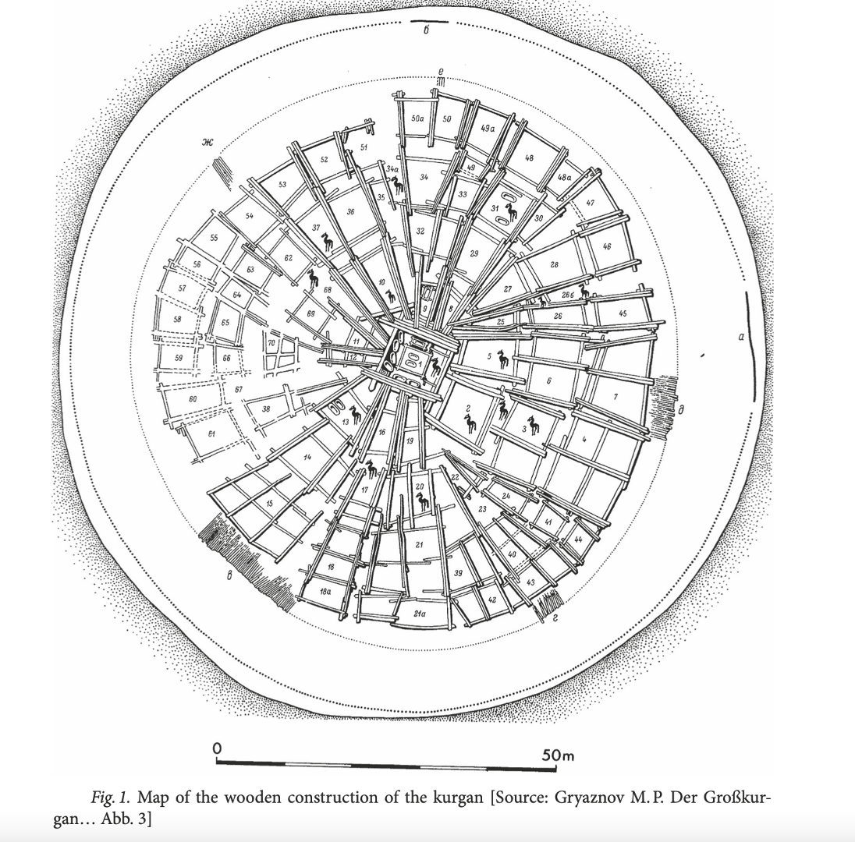
Arzhan
9 BC
Earliest bronze bites

Slide 5
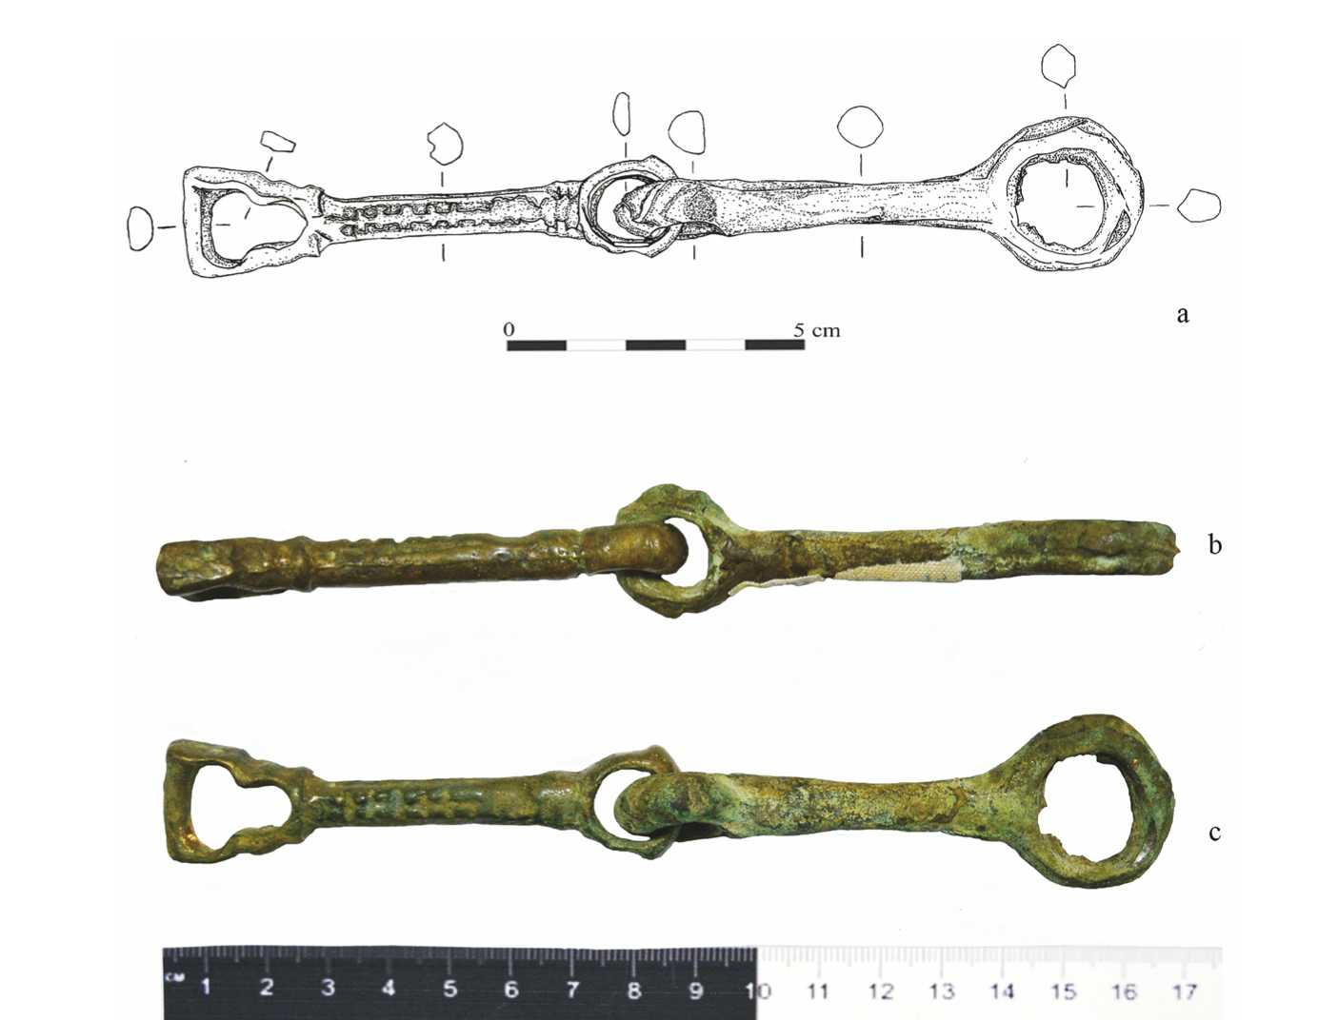
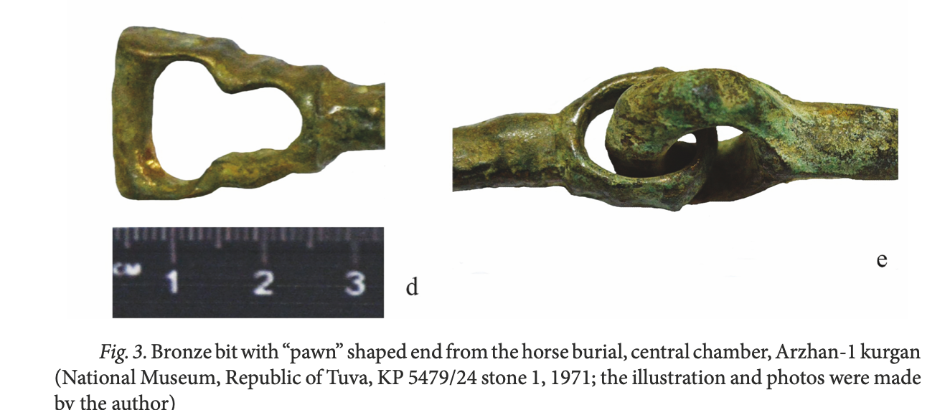

Slide 6
Khereksurs

Slide 7
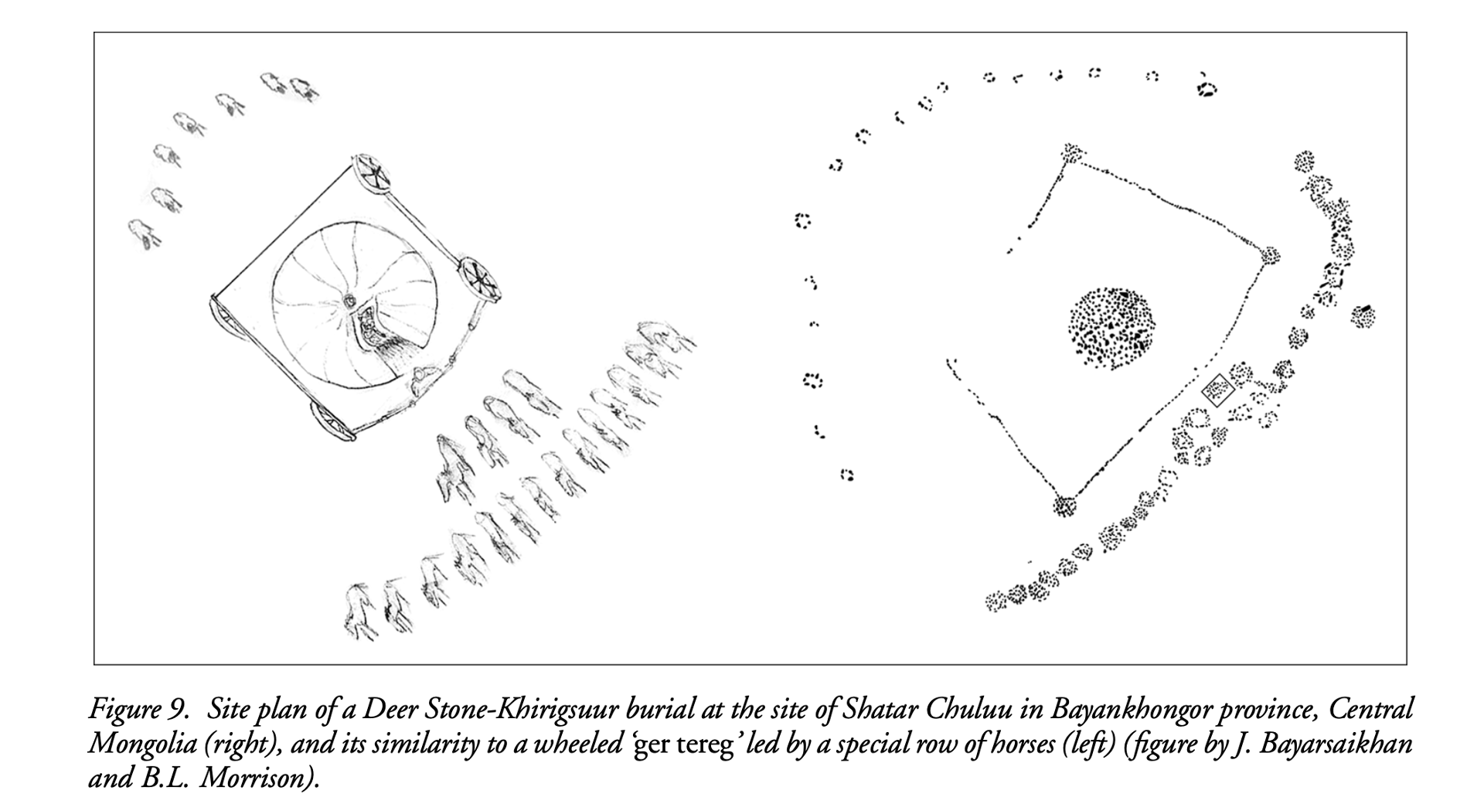
Ё

Slide 10
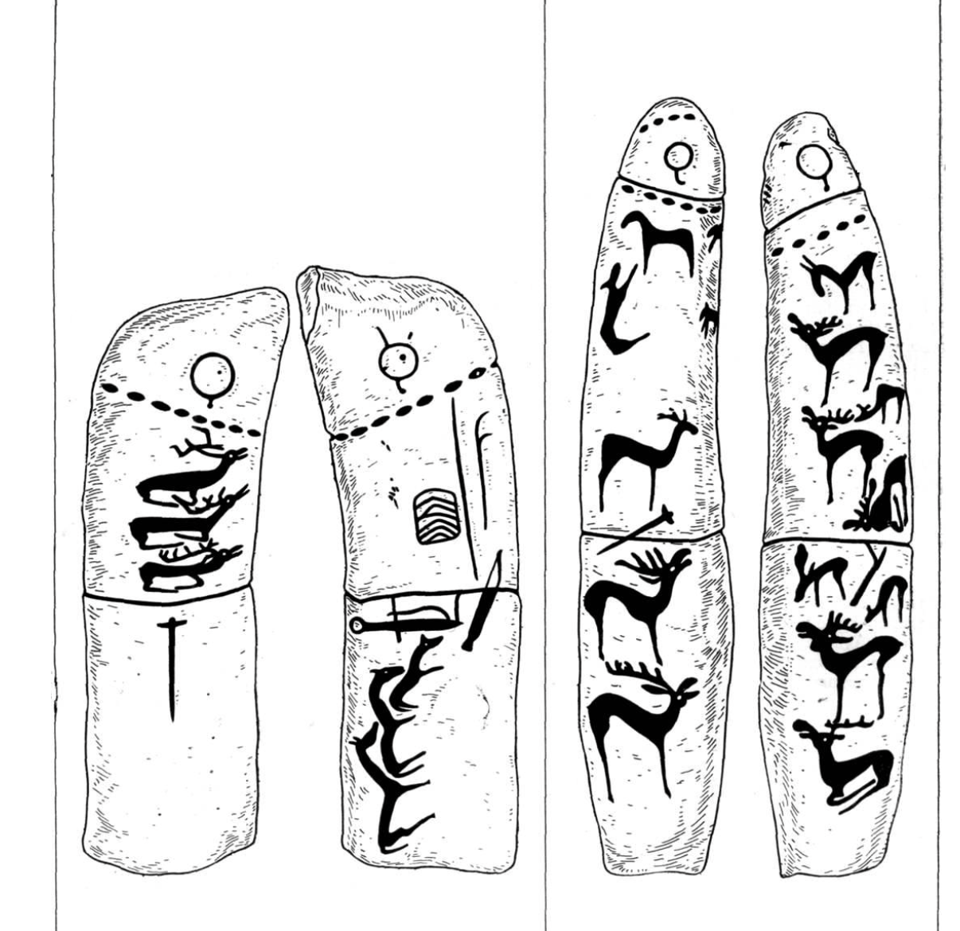
Deer Stones

Slide 11
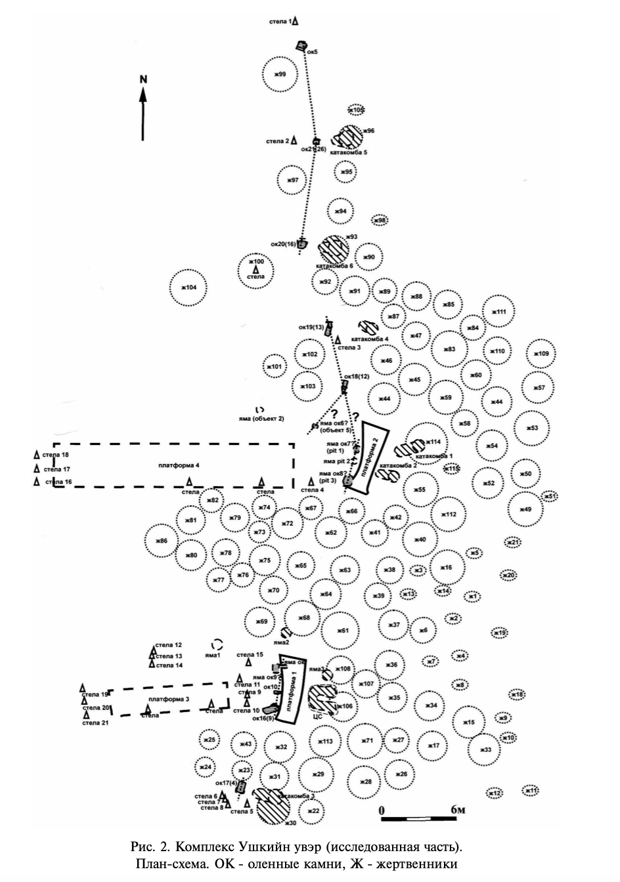
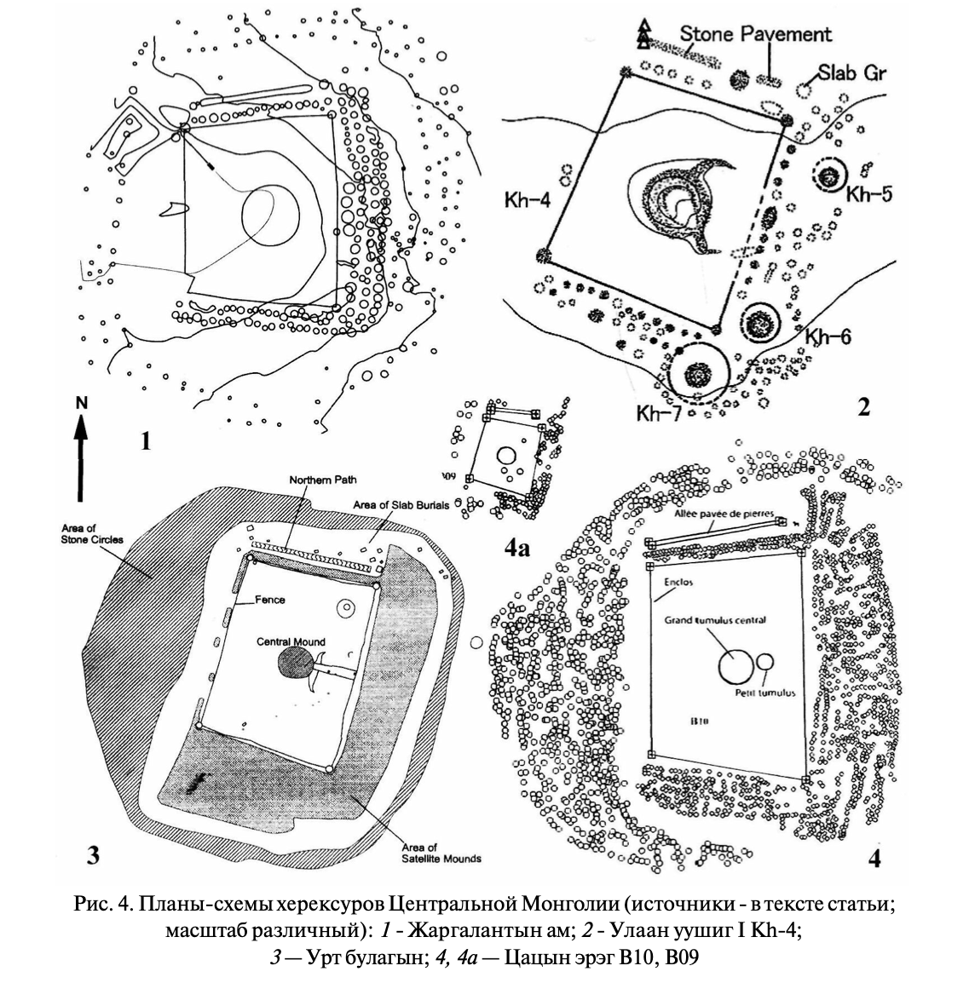

Slide 12
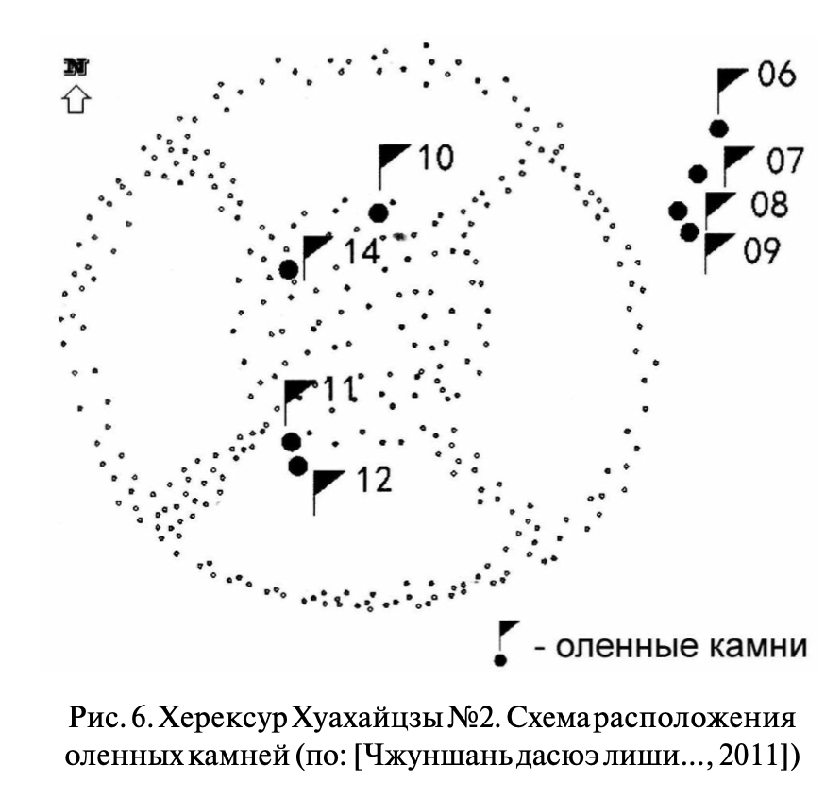
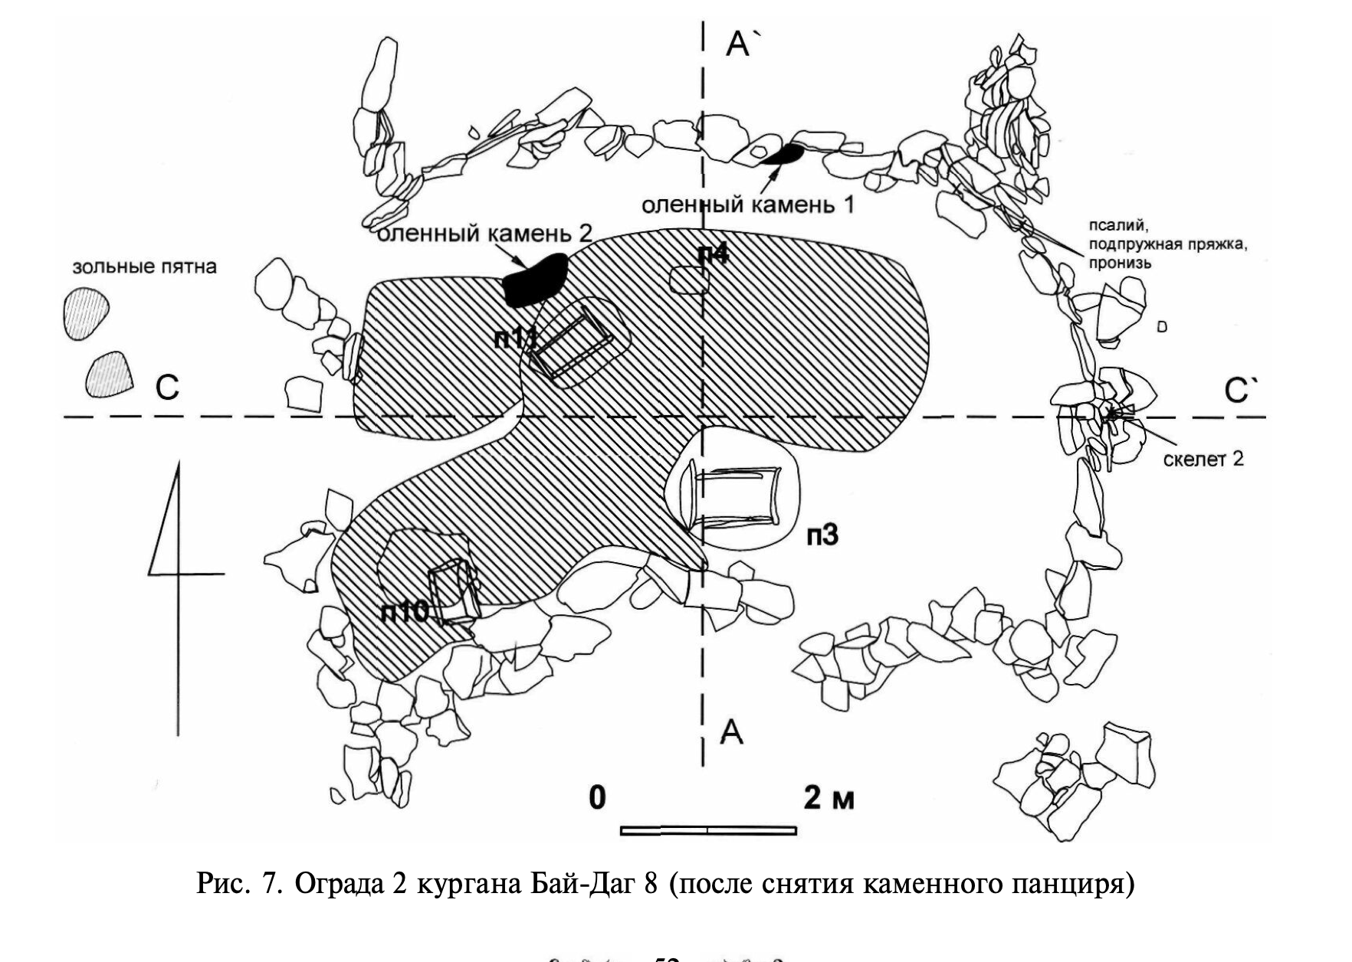

Slide 13
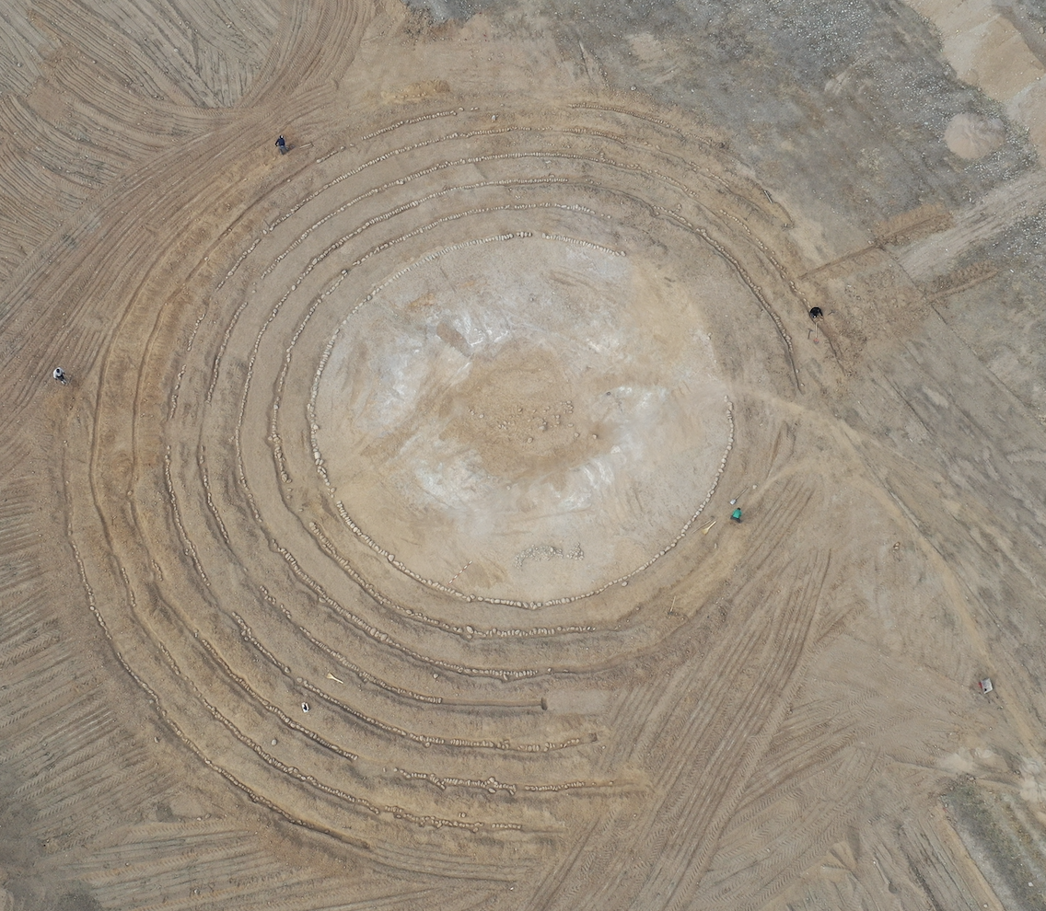
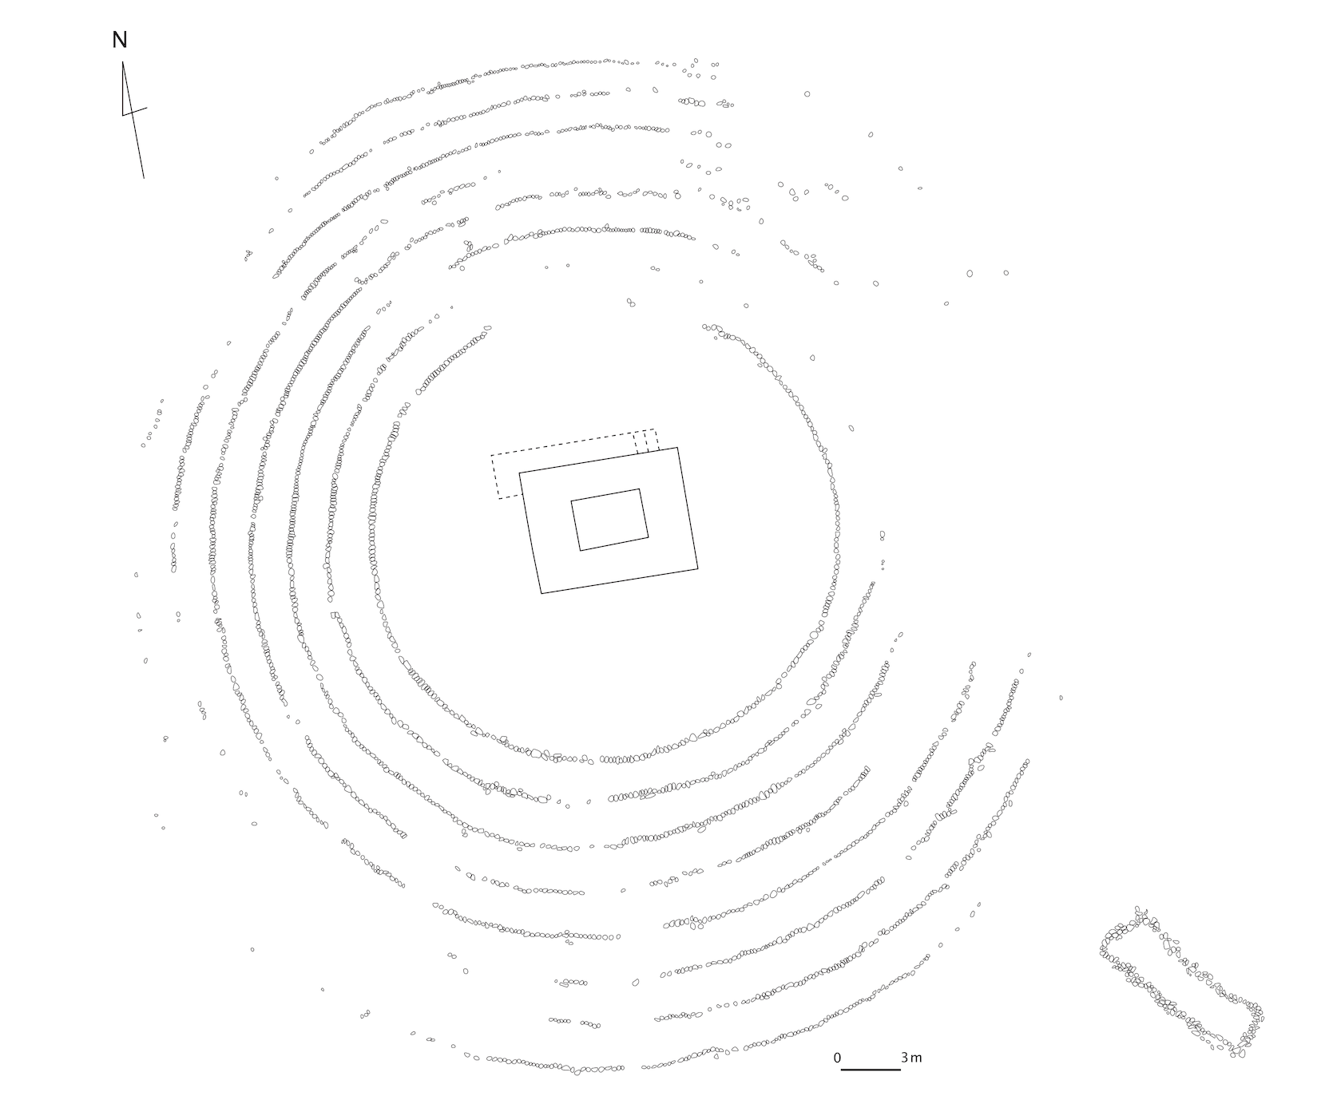

Slide 14
Conclusive remarks
Economic and social changes causes change in mortuary practices
Elite differentiation here and after
Horse as sacrifice and conductor
Сommemoration as practical communication
Mythological and genealogical perception of the past

